Slide 1
Red Cross Donor Data Analysis
1
1
2
Data Acquisition
Data Preparation
Exploratory Data Analysis
Data Visualization
Machine Learning Models and Evaluation
3
4
5

Slide 2
Data Acquisition
Red Cross Donor data were obtained in CSV format

Slide 3
Data Preparation
Total number of records = 34508
Missing value percentage:
Feature | Missing value percentage %
ZIPCODE | 0.263707
MARITAL_STATUS | 71.195085
GENDER | 1.428654
WEALTH_RATING | 92.149646
DEGREE_LEVEL | 77.958734
PREF_ADDRESS_TYPE | 11.716124
BIRTH_DATE | 61.406051

Slide 4
Data Preparation
Missing values treatment:
MARITAL_STATUS, WEALTH_RATING, DEGREE_LEVEL, BIRTH_DATE have more than 20% missing data. Those were not considered as features and were removed.
Missing values for GENDER and PREF_ADDRESS_TYPE are replaced by their modes.
Feature | Missing value percentage % | Missing value Treatment
ZIPCODE | 0.263707 | Noise Variable
MARITAL_STATUS | 71.195085 | Ignored
GENDER | 1.428654 | Replaced with the mode, ‘FEMALE’
WEALTH_RATING | 92.149646 | Ignored
DEGREE_LEVEL | 77.958734 | Ignored
PREF_ADDRESS_TYPE | 11.716124 | Replaced with the mode, ‘HOME’
BIRTH_DATE | 61.406051 | Ignored

Slide 5
Exploratory Data Analysis
The Features (i.e., variables) are segregated into five Categories namely:
Dependent variable(Y): This is the DONOR_IND which is to be predicted
Noise Variables: Variables which would not have a significant impact on the value of the DONOR_IND
Independent Variables: Variables which were considered to have an impact on the DONOR_IND
Redundant Variables: Variables whose information is already contained in the sample data for another variable
Feeder Variable: The variables which feed the predictor

Slide 6
Exploratory Data Analysis (contd..)
Noise Variables
ID
ZIPCODE
Independent Variables
AGE | Donor_years
GENDER | PrevFYGiving
ALUMNUS_IND | PrevFY1Giving
PARENT_IND | PrevFY2Giving
HAS_INVOLVEMENT_IND | PrevFY3Giving
PREF_ADDRESS_TYPE | PrevFY4Giving
EMAIL_PRESENT_IND | CurrFYGiving
Redundant variables were not found.
TotalGiving was the only feeder variable found in the dataset.

Slide 7
Feature Engineering
Feature scaling for continuous variables: Min-Max Scaling was performed for the continuous variables.
Encoding for categorical variables: Categorical variables were encoded using One-Hot encoding.
New feature, Consecutive_G, was created by summing up PrevFYGiving, PrevFY1Giving, PrevFY2Giving, PrevFY3Giving, PrevFY4Giving, and CurrFYGiving by considering visualizations.
Outliers were calculated using the percentile method.
Anomalies were found using the PyCaret Anomaly detection.

Slide 8
Data Visualization
Data visuals are created using Tableau where charts are plotted using the independent variable (dimensions) against the dependent variable (DONOR_IND).
These charts help us in getting a preliminary idea about the relationship between the independent variables (dimensions) to the dependent variable (DONOR_IND).

Slide 9
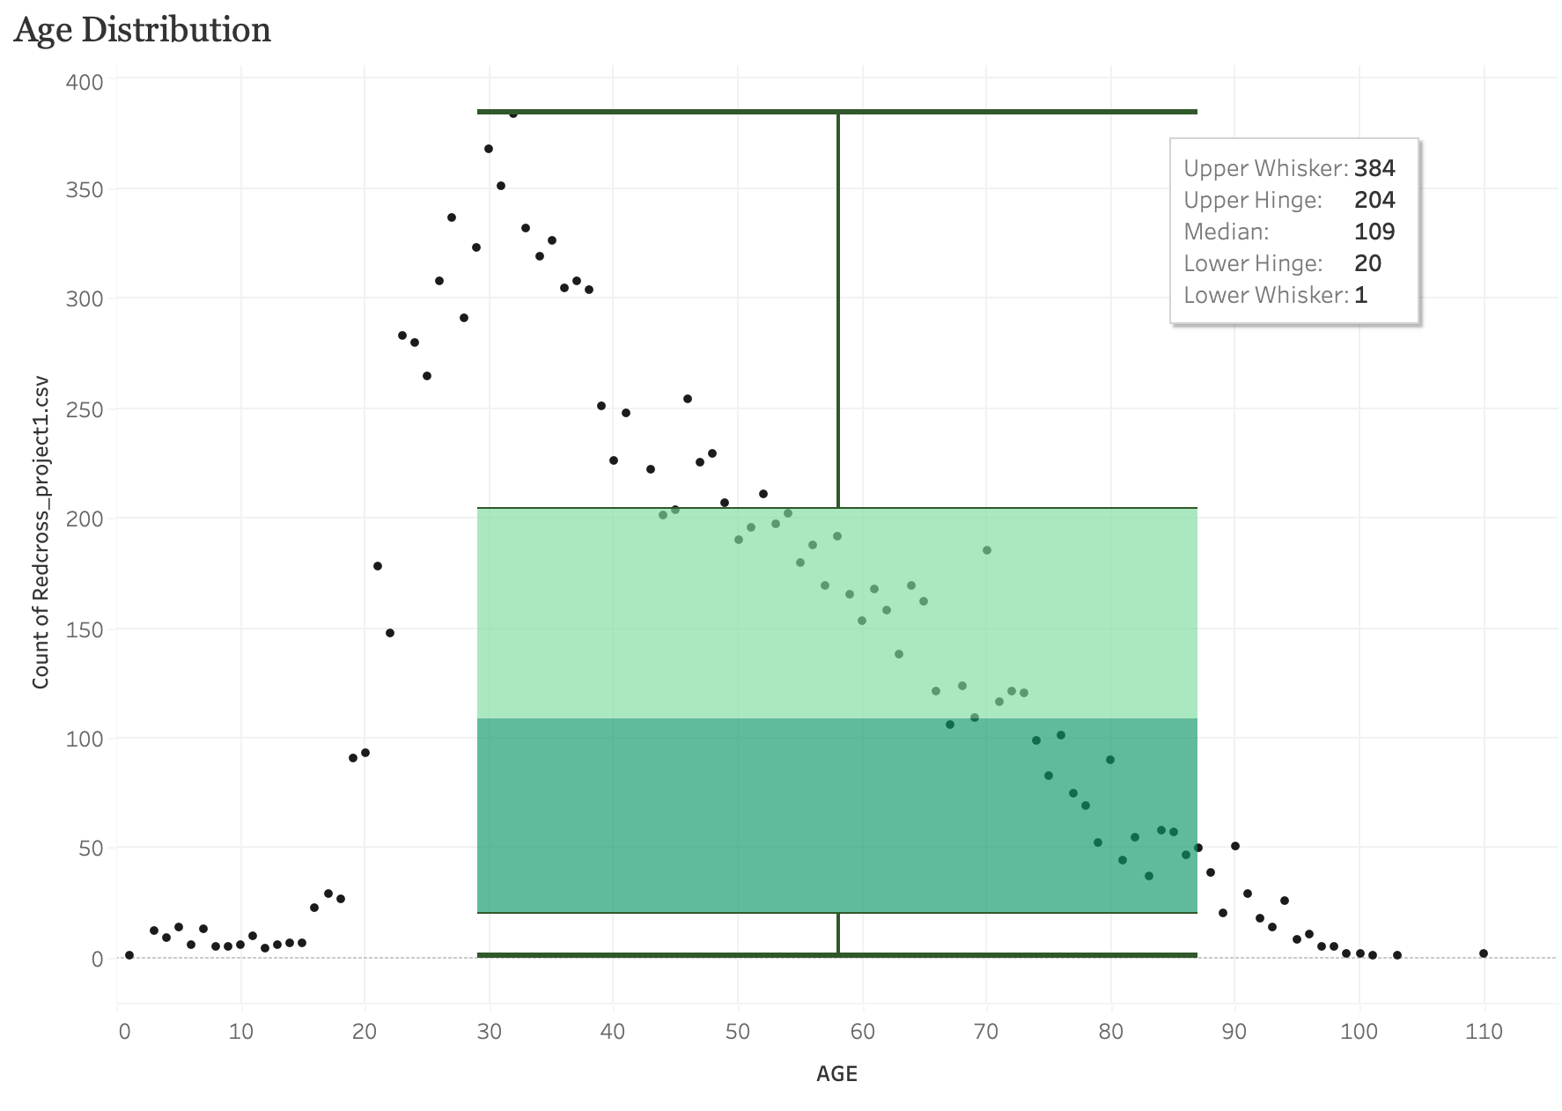
Data Visualization (contd..)
Right-Skewed distribution was observed in age-count plot.
Therefore, the 'quantile'
transformation method was applied in the PyCaret set up in analysis process.

Slide 10
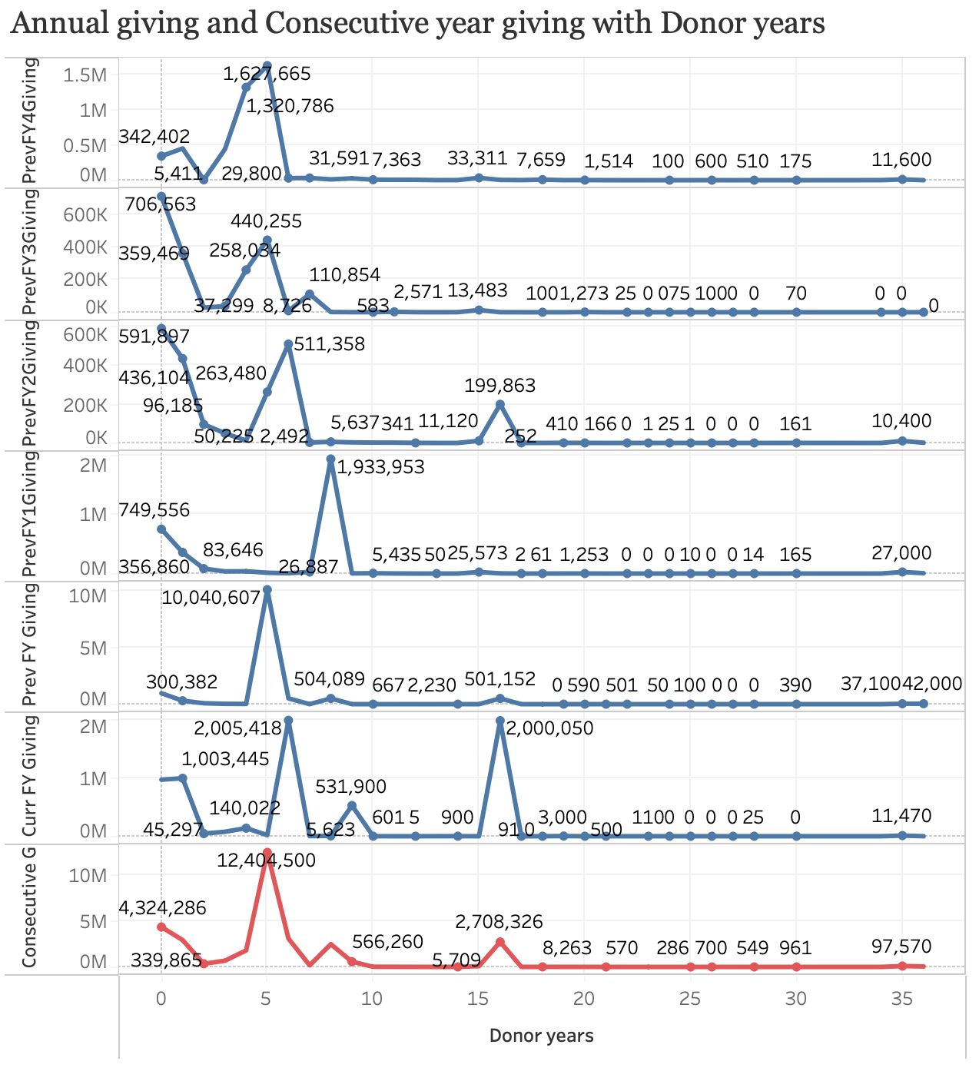
Data Visualization (contd..)
Rather than using year-wise giving, use of Consecutive year giving for 6 years were effective since trend is the same with Donor Years.
Consecutive year giving shows the greatest Chi_Squared value to DONOR_IND (see slide 14)

Slide 11
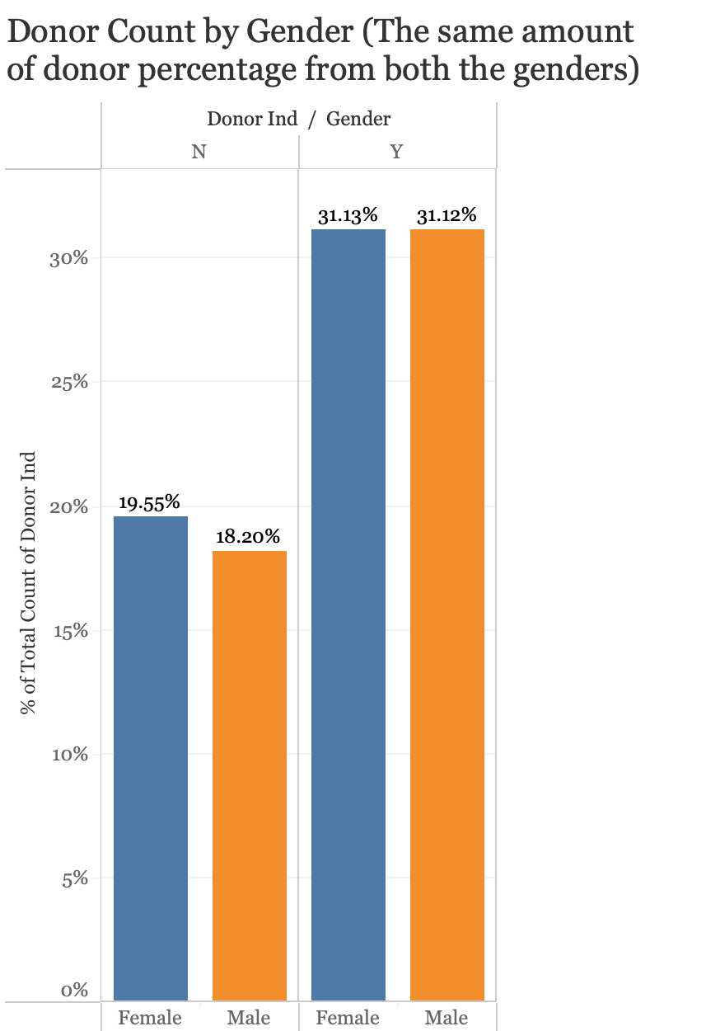
Data Visualization (contd..)
Donor percentage is the same for both Male and Female.
Hence, GENDER is not considered as a feature.

Slide 12
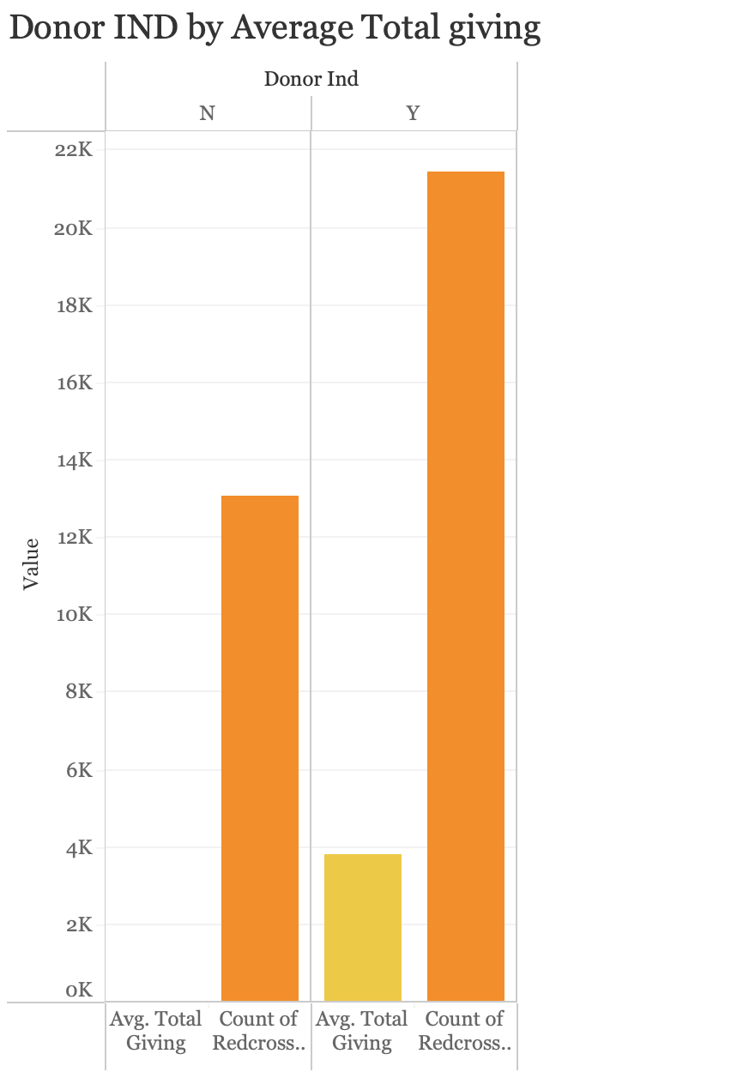
Data Visualization (contd..)
Constituent is a donor if and only if there’s a Total giving for the constituent.
Therefore, ‘TotalGiving’ is a feeder variable.
Hence, ‘TotalGiving’ is ignored.

Slide 13
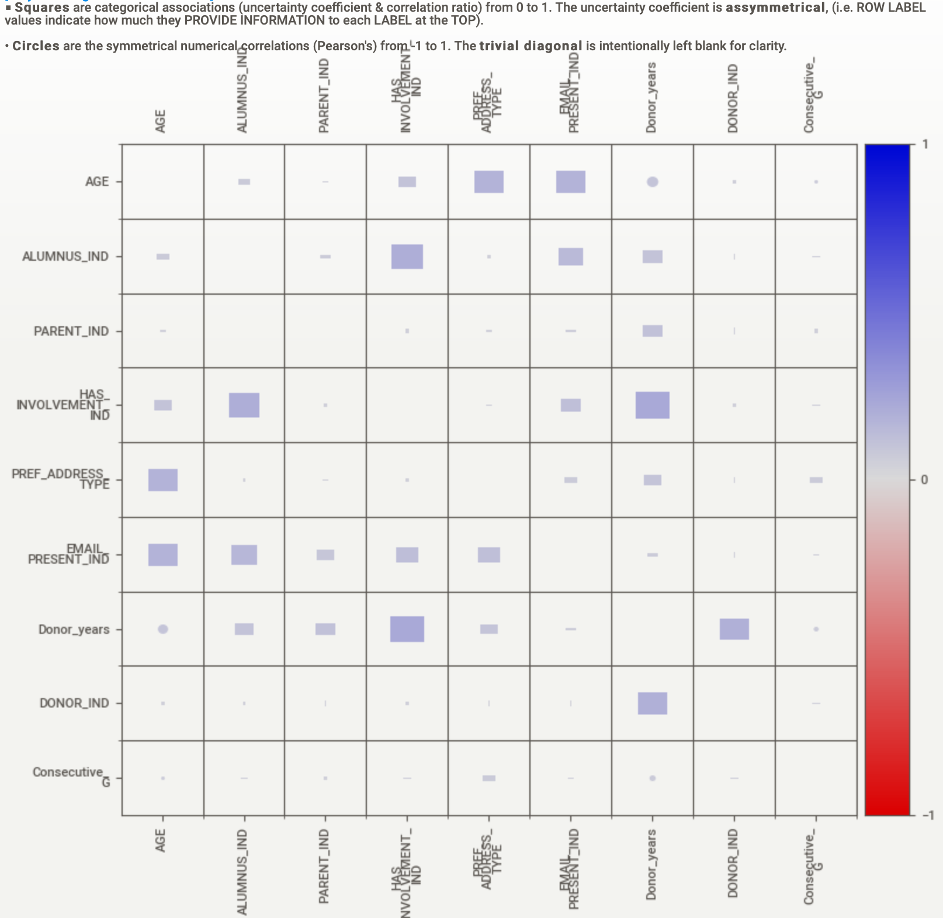
Data Visualization (contd..)
Blue: Positive Correlation
Red: Negative Correlation
Sweet Viz heat map only shows weak categorical association.

Slide 14
Donor Chi-Squared Test Analysis
The Chi-Squared Test Analysis was performed in Azure ML which provided the list of features which impact the DONOR_IND and the test values indicated the severity of the relationship between DONOR_IND and the features.
Top 5 features impacting the DONOR_IND
1. Consecutive_G
2. Donor_years
3. HAS_INVOLVEMENT_IND
4. AGE
5. PREF_ADDRESS_TYPE
Top 8 features impacting DONOR_IND
Independent Variable | Chi-Squared Test Value
Consecutive_G | 9223.26
Donor_years | 676.238
HAS_INVOLVEMENT_IND | 46.74
AGE | 25.69
PREF_ADDRESS_TYPE | 12.26
Independent Variable | Chi-Squared Test Value
ALUMNUS_IND | 9.15
PARENT_IND | 3.24
EMAIL_PRESENT_IND | 1.11

Slide 15
Machine Learning Models and Evaluation
Algorithm | ML-Model | Accuracy % | Recall | Precision | F1 | AUC
Azure-ML | Two-Class Boosted Decision Tree Classifier | 0.68 | 0.51 | 0.96 | 0.67 | 0.75
PyCaret | Ada Boost Classifier | 0.68 | 0.47 | 0.98 | 0.64 | 0.73
H2O | GBM_1_AutoML_ | 0.60 | 0.99 | 0.60 | 0.75 | 0.73
Tableau link:
https://public.tableau.com/app/profile/darshika.keerthisinghe/viz/RedCrossDonorAnalysis/Story1?publish=yes

Slide 16
Questions?

