Slide 1

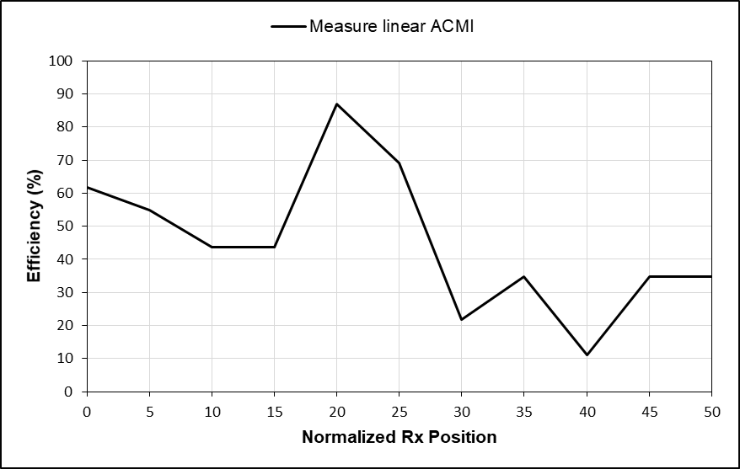
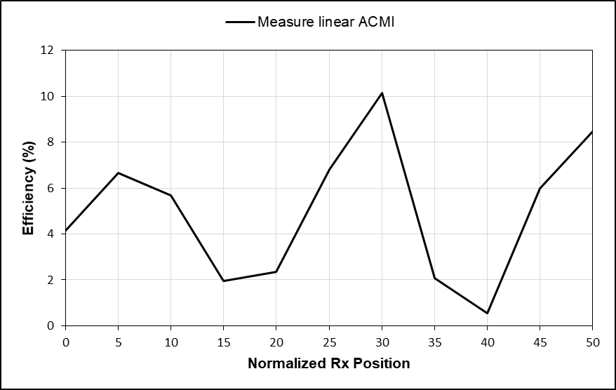
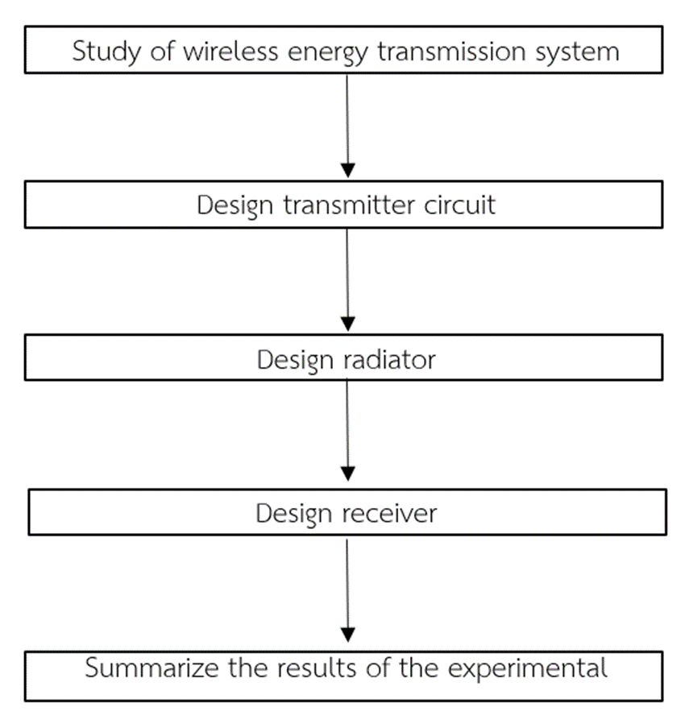
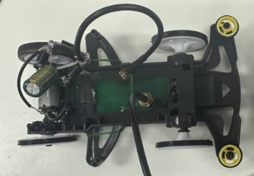
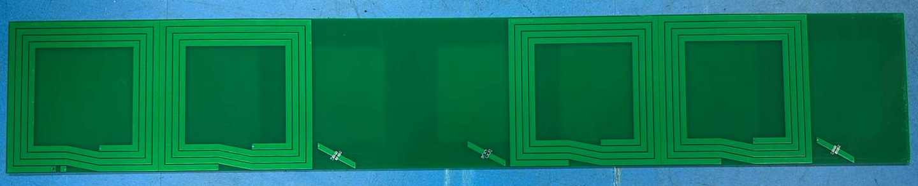
Demonstration of resonant wireless power Transfer using Toy racing Cars and Tracks
Department of Engineering, Faculty of engineering, Kasetsart University
Tanit Wisessri,Chatpisut Promsatarporn and Asst.Prof. Denchai Worasawate
Introduction
For EV charging, wireless power transfer (WPT) technology has been used. Through electromagnetic coupling, the WPT system may transport power from the transmitting side to the receiving side. As a result, when the EVs are close to the WPT facilities, the batteries can be charged without physical touch. When compared to traditional charging methods, WPT provides advantages to drivers such as safety, convenience, and ease of use. However, the stationary WPT system has yet to tackle two intrinsic problems: a longer charging time than typical fuel-filling time and a lower mileage than engine-powered vehicles.
The dynamic wireless power transfer (DWPT) system is a promising solution to the concerns raised above. DWPT allows the EV to be powered constantly while in motion by the transmitter installed beneath the roadway. It is possible to charge and consume energy at the same time. As a result, the driving range of EVs can be greatly enhanced. Meanwhile, the battery capacity, as well as the cost and weight, might be reduced.
Related Theories
Wireless Power Transfer
WPT is a technology that allows electrical power to be transferred wirelessly between two devices without the need for wires or physical contact. There are two main types of WPT: Dynamic WPT (DWPT) and Static WPT (SWPT). DWPT transfers power while the transmitter and receiver are in motion, while SWPT transfers power while the transmitter and receiver are stationary. This technology has various applications, including charging mobile devices, electric vehicles, and medical implants, among others.
2.Alternately Coupled Magneto inductive
The Alternately Coupled Magneto Inductive (ACMI) coil arrangement is a new approach to implement Dynamic Wireless Power Transfer (DWPT) that aims to achieve nulls-free power transfer. Conventional DWPT using Magneto Inductive Waveguides (MIWs) is known to suffer from power transfer nulls caused by standing waves, which result from changing phases during propagation and reflection. These nulls can be overcome with minimal increase in complexity and cost by utilizing the characteristic of oppositely propagating waves with the same magnitude becoming out-of-phase and resulting in power cancellation, using the ACMI arrangement.
5.2 Connect transmitter circuit, radiator, and receiver with load to measure efficiency.
The power of input is approximately 7.2 Watt and the output of power by using resister 100 Ω to measure voltage. At the nominal height of 2 cm, the measured efficiency (η) at 13.56 MHz versus the normalized Rx positions are given in Fig.3.
FIGURE 3 Efficiency for no load
The process of the project
FIGURE 4 Efficiency with 100 ohms resistor
Summary
ACMI is a practical and efficient technology for Dynamic Wireless Power Transfer (DWPT), which uses magnetic-inductive coupling to transfer energy through an electrical path. It has higher energy transfer accuracy than other wireless energy transfer technologies and can transfer up to 80 percent of energy before loading. Although there is a range where energy transfer is only 10 percent, it can still transfer energy without any power loss or nulls. ACMI was tested by providing energy to a load and making a car run on a track, with the motor adjusted to use less power. The technology is small, easy to install, and has the potential to be a useful tool for wireless energy transfer.
The results of the experimental
Work piece
Problem and Obstacle
1. Some software is outdated, and it can be challenging to find information to study.
2. It is complicated to order PCB production.
3. Shipping of some devices may experience delays
4. We ordered the wrong size of hardware that is needed for our use.
FIGURE 1 Work piece of Rx coil and receiver circuit
Suggestion
1. Select software that is readily accessible and regularly updated.
2. Select device for measurement that have dual-source architecture, which enables fast and accurate measurement of 2-port devices without requiring any switching. This makes it ideal for high-throughput testing of complex components such as filters and amplifiers.
References
A Comparative Study of the Efficiency of Dynamic Wireless Power Transfer with Resonant Frequency, http://digital_collect.lib.buu.ac.th/project/b00257293.pdf [Retrievedon December 2022].
Developing a dynamic wireless power transfer system that supplies electricity to the car while driving, https://bit.ly/3uXdXni [Retrieved on December 2022].
C. Rakluea, A. Worapishet, S. Chaimool, Y. Zhao and P. Akkaraekthalin, "True Nulls-Free Magnetoinductive Waveguides Using Alternate Coupling Polarities for Batteryless Dynamic Wireless Power Transfer Applications," in IEEE Transactions on Power Electronics, vol. 37, no. 8, pp. 8835-8854, Aug. 2022, doi: 10.1109/TPEL.2022.3145579.
FIGURE 2 Work piece of Tx coil
5.1 Connect transmitter circuit, radiator, and receiver without load to measure efficiency.
We measure output from amplifier, and we get approximately 1 watt or 29.9dBm. Then, we measure output from receiver coil. The measured efficiency (η) at 13.56 MHz versus the normalized Rx positions are given in Fig.3.

