Slide 1
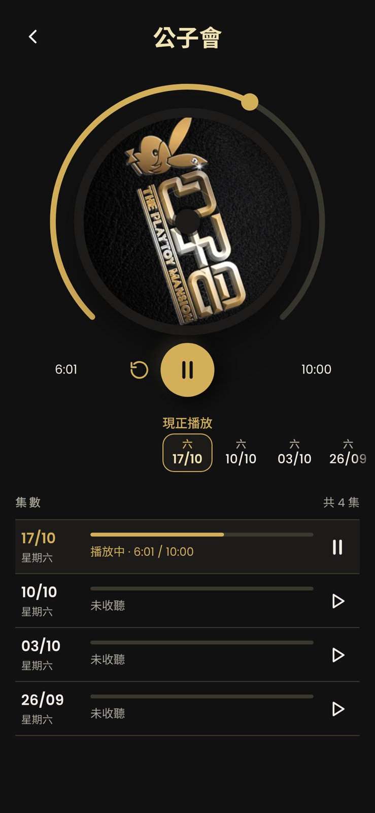
PORTFOLIO PROJECT · v1.2.3
903 Player
A one-thumb commuter player for a Hong Kong radio archive.
THE PROBLEM
The station's web archive needs a hunt for each day's link and two hands to operate, which is painful on a crowded commute. It has no API and blocks cloud IPs.
THE SOLUTION
A personal-use PWA that discovers recordings on-device, then plays them in a one-handed vinyl-style player with auto-resume.
Personal-use PWA · built in 3 active days

Slide 2
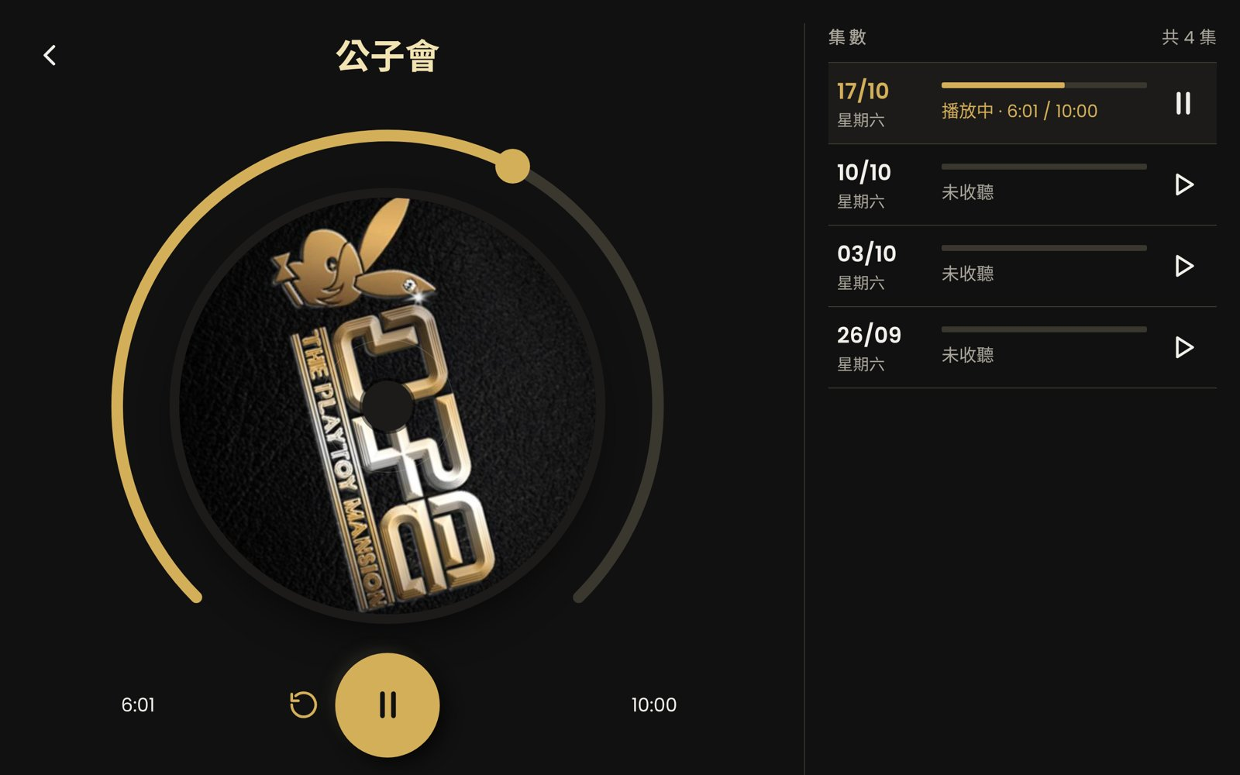
Key features
On-device discovery
Vinyl player
Probes 14 days of audio URLs with metadata-only audio. No backend.
Spinning disc, drag-to-seek arc ring, ±30 / ±60s controls.
Smart date strip
Auto-resume
Lists only days with recordings; ticks episodes heard 95%+.
Remembers progress per episode and picks up where you left off.
Lock-screen control
Today's shows
Media Session support for lock screen and headphones.
HK-time schedule with a swipeable card stack and 'New' badges.
Adaptive layouts
Installable PWA
Phone, landscape two-column, 1.3x desktop and 1.5x iPad scaling.
Device splash screens, auto-update and iOS safe-area fixes.
3
427
82
13
680
active dev days
commits
merged PRs
Claude Code sessions
unit tests

