Slide 1
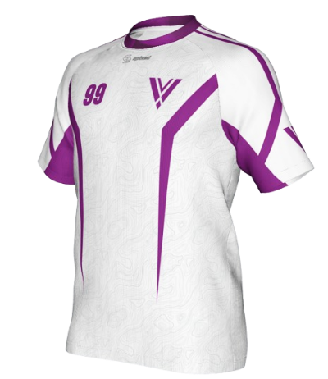


Slide 2
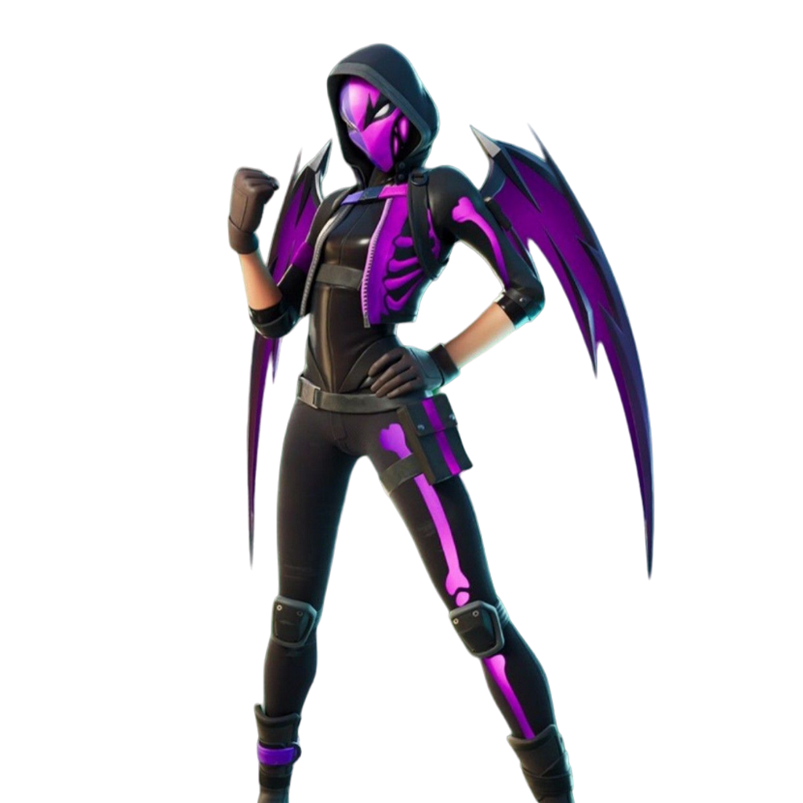



VAYNE
VAYNE
VAYNE
CUP
CUP
CUP

