Slide 1
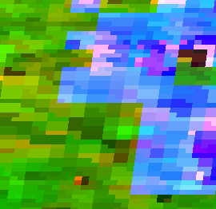
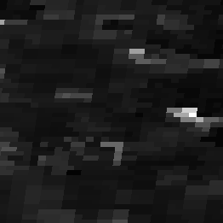
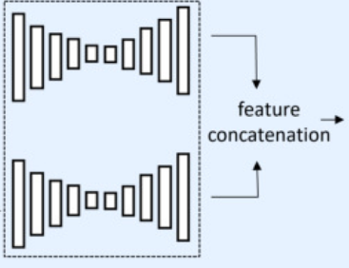
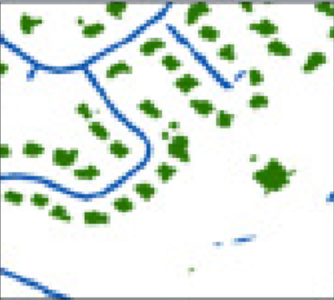
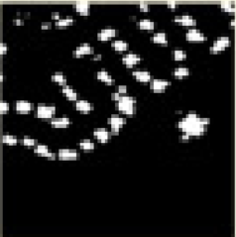
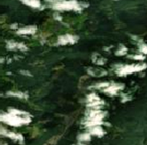
Framework v1.0
Details of VHR data:
Channels: 3. (RGB)
Size: 200×200. (For now, the size is 2×2 km^2. Downsample VHR image resolution to 10 m)
pre_modis
8×8×2
Direct Concatenation
8×8×4
Upsample
200×200×4
post_modis
200×200×1
8×8×2
Siamese CNN
no share weights
Siamese CNN
Details of modis data:
Channels: 2. (According to Tellman et al. 2021, two bands were used to generate flood map: band 7 and the ratio of band 1 to band 2. Here we only consider the images of Terra.)
Size: 8×8. (For now, the size is 2×2 km^2 (modis resolution: 0.25 km))
200×200×1
CNN
pre_vhr
pre_modis
post_modis

Slide 2
Framework v1.1 for Spacenet8 test
Details of VHR data:
Channels: 3. (RGB)
pre_modis
Direct Concatenation
Upsample
post_modis
Siamese CNN
no share weights
Details of modis data:
Channels: 2. (According to Tellman et al. 2021, two bands were used to generate flood map: band 7 and the ratio of band 1 to band 2. Here we only consider the images of Terra.)
pre_vhr
Details of this test
Just keep the data from Spacenet8
What we do is to download MODIS and train a new Siamese CNN

