Slide 1
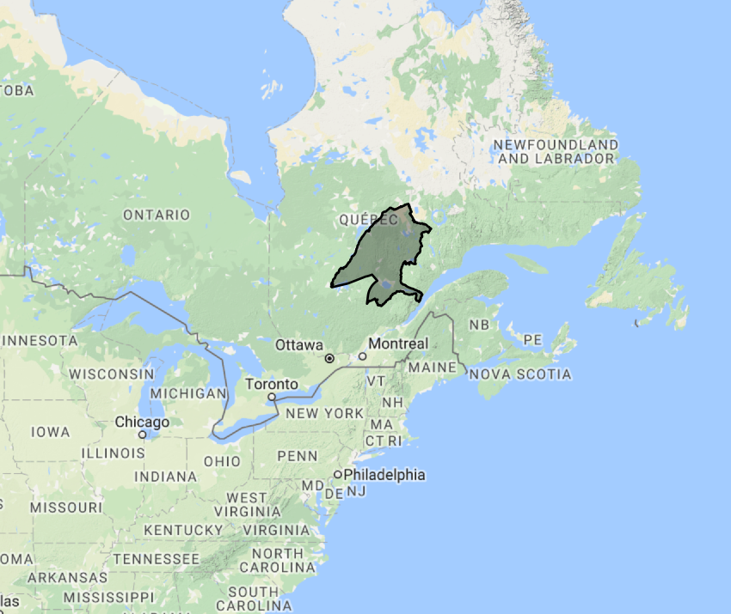
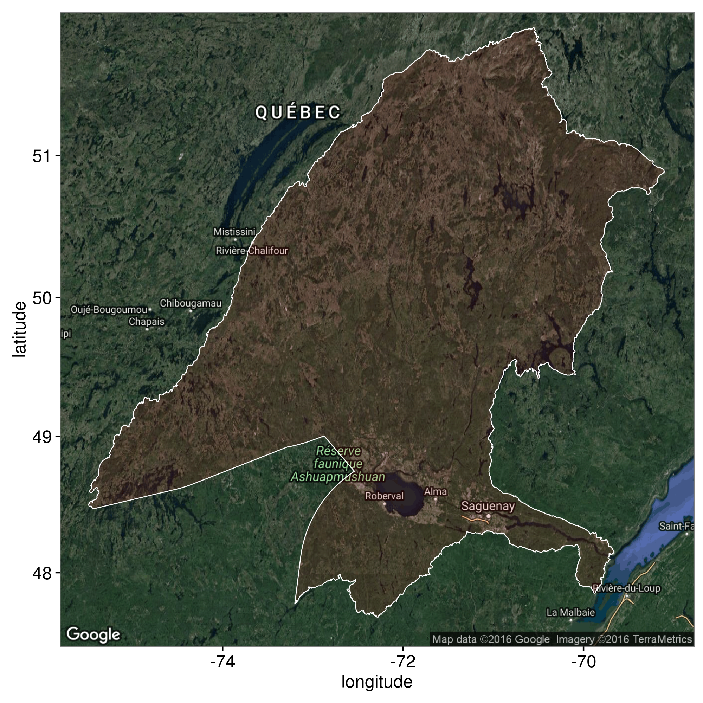

Slide 2
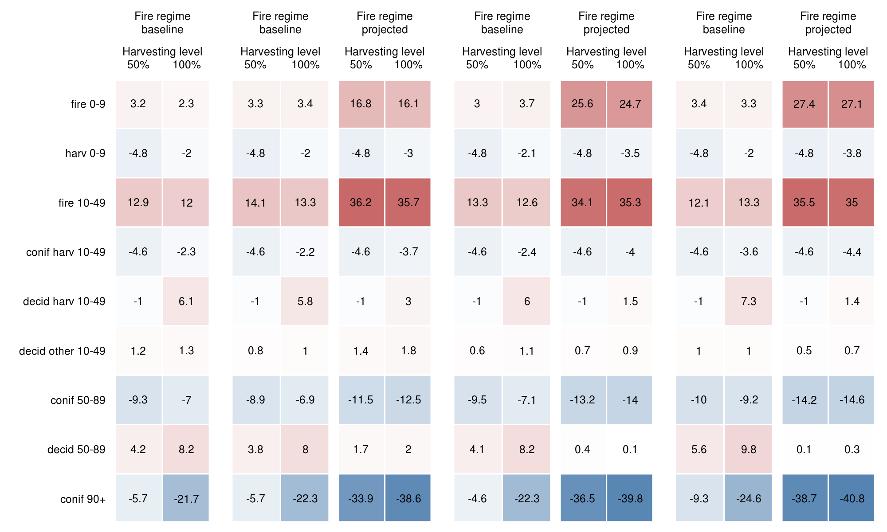
Baseline
RCP 2.6
RCP 4.5
RCP 8.5

Slide 3


CBFA - Caribou habitat projections – 2100
Description of simulation ensemble
Projected climate
Factor | Levels | Number of levels
Climate change scenario | RCP 2.6, RCP 4.5, RCP 8.5 | 3
Fire regime | baseline, projected¹ | 2
Harvesting level | 50%, 100% | 2
¹ Fire regimes projections are associated with the climate change scenario being simulated, i.e. with the appropriate RCP. Total of 12 treatments with projected climate
Baseline climate
Factor | Levels | Number of levels
Climate change scenario | baseline | 1
Fire regime | baseline | 1
Harvesting level | 50%, 100% | 2
Total of 2 treatments with projected climate
Each of the 14 treatments replicated 5 times
Total (expected): 70 simulations (3 simulations failed)
Total (final): 67 simulations

Slide 4
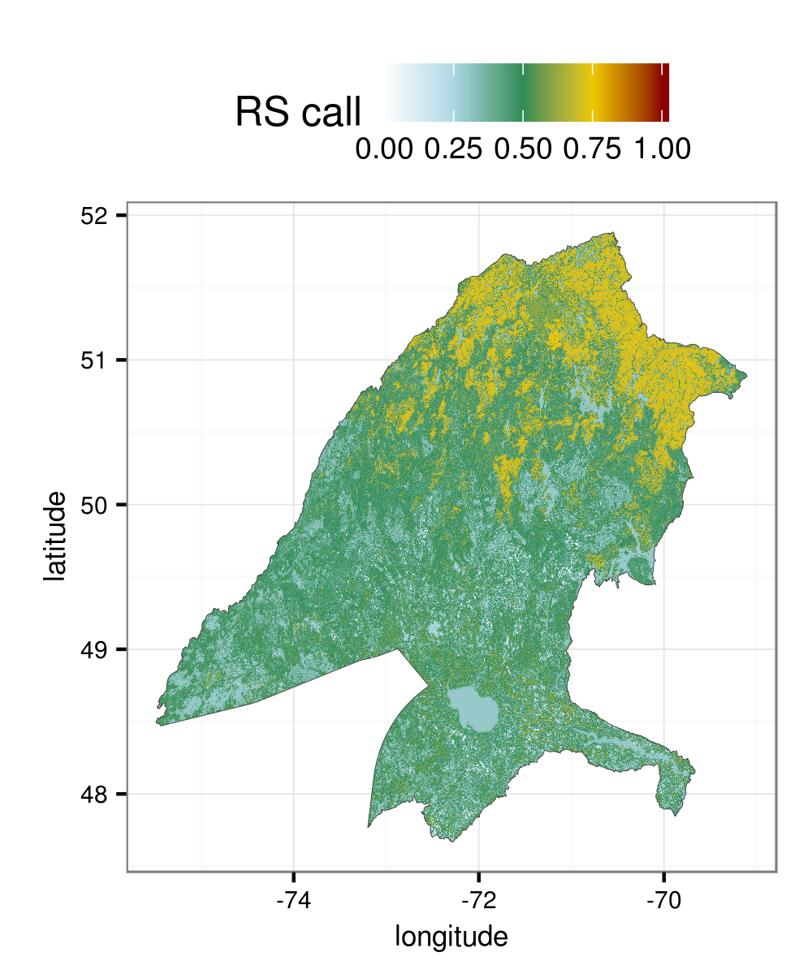
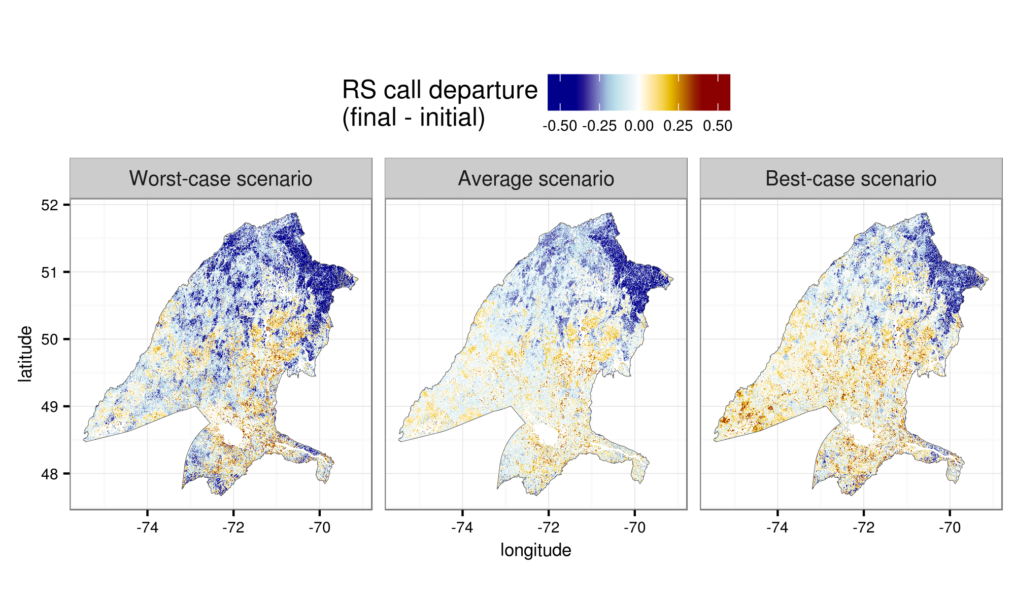
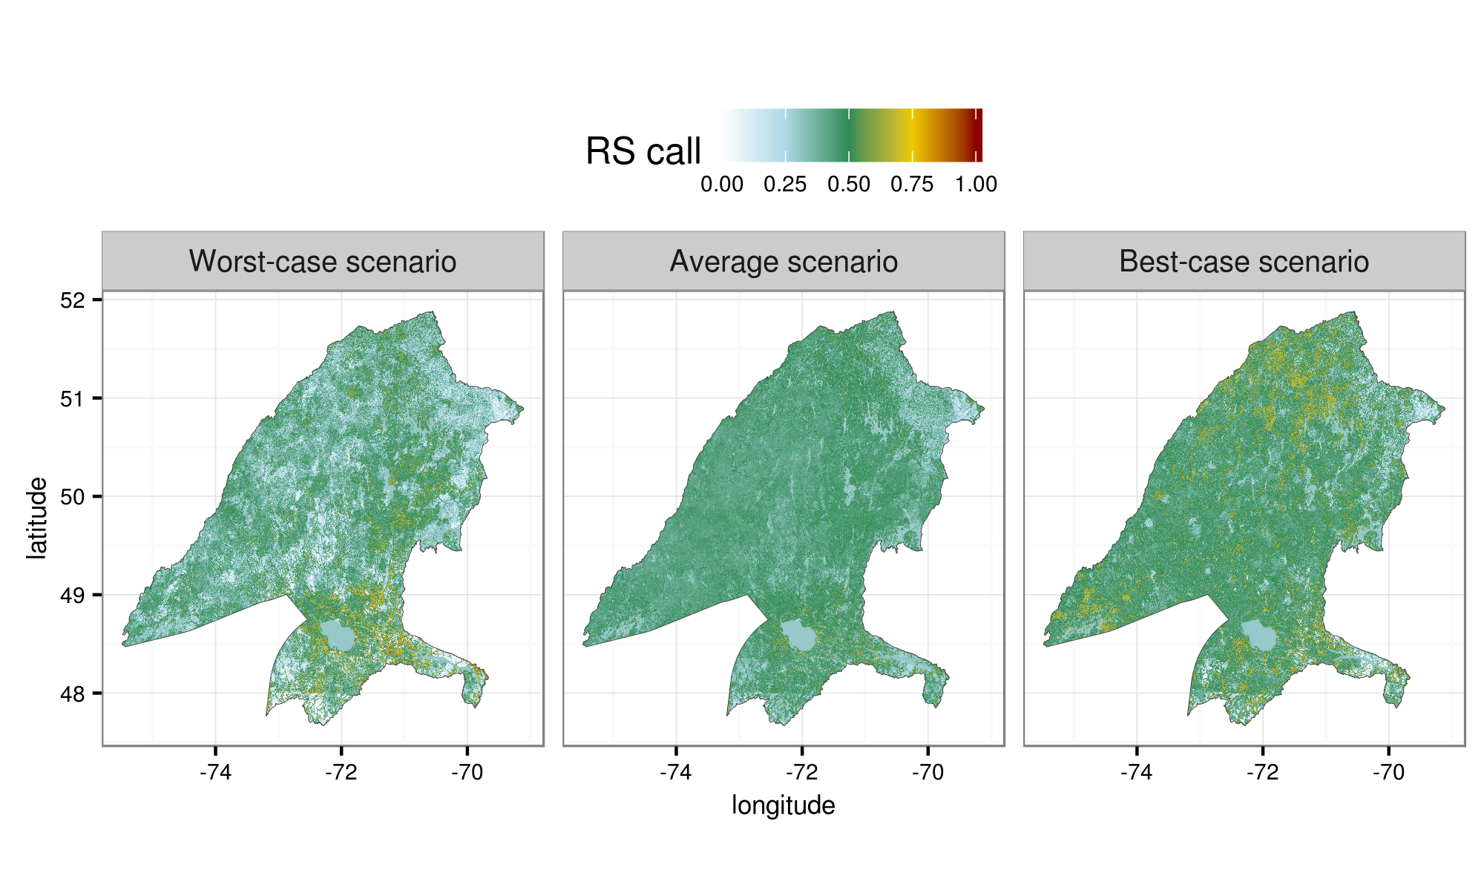
Initial conditions
Projections 2100

Slide 5
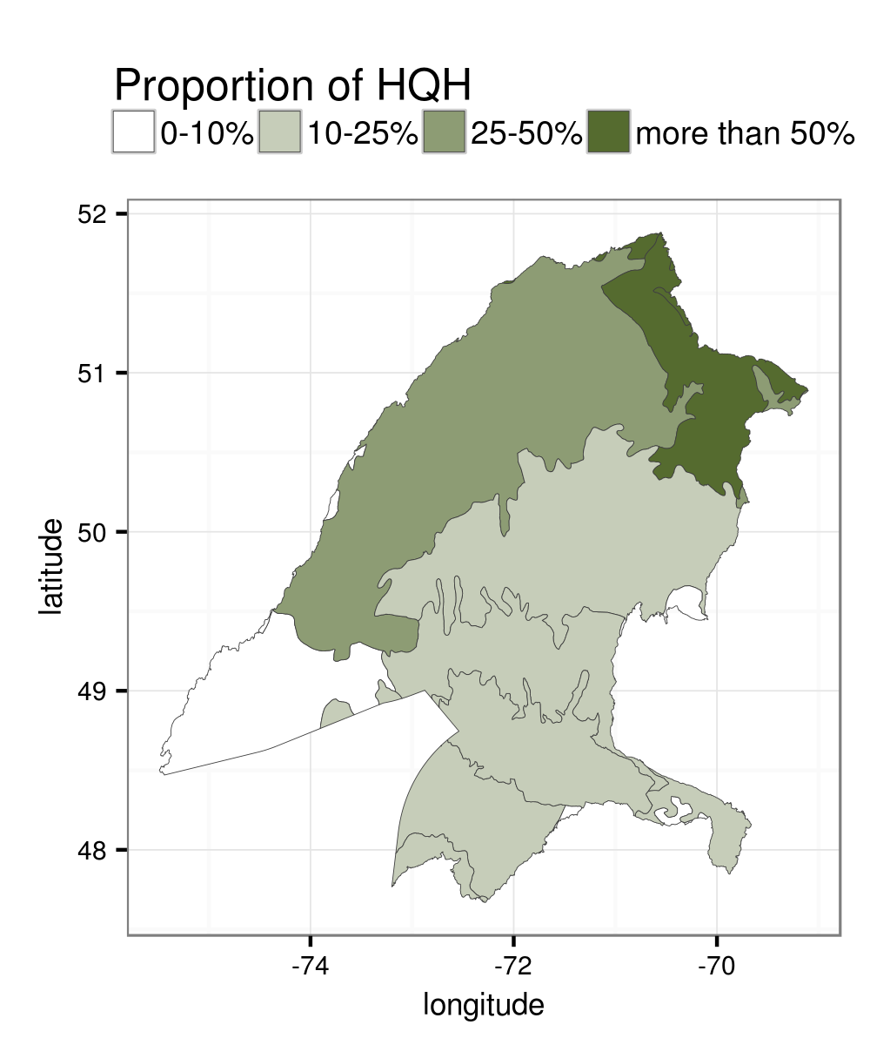
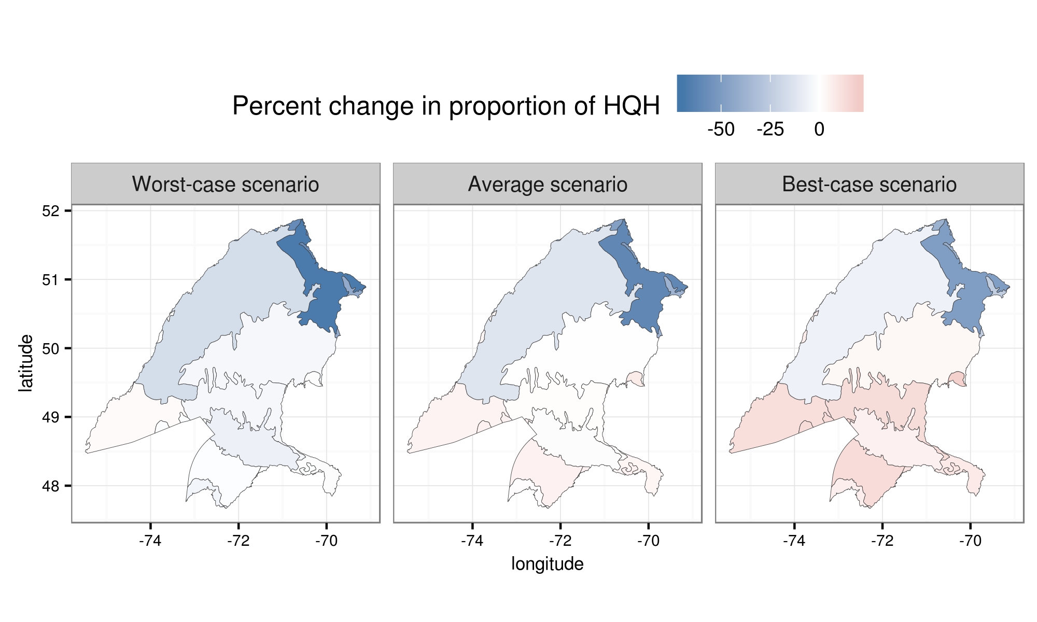
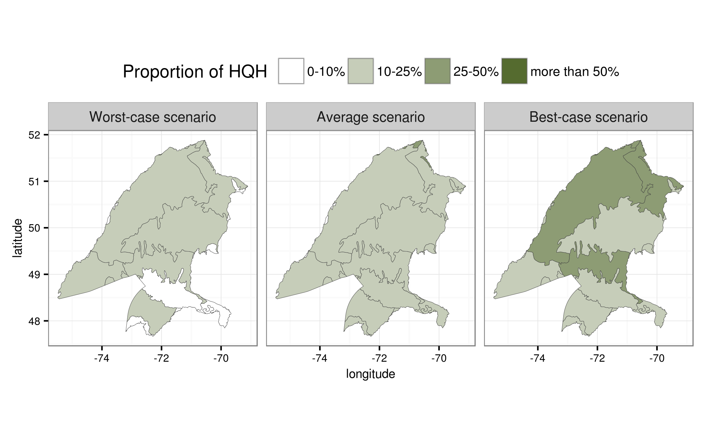
Initial conditions
Projections 2100

Slide 6
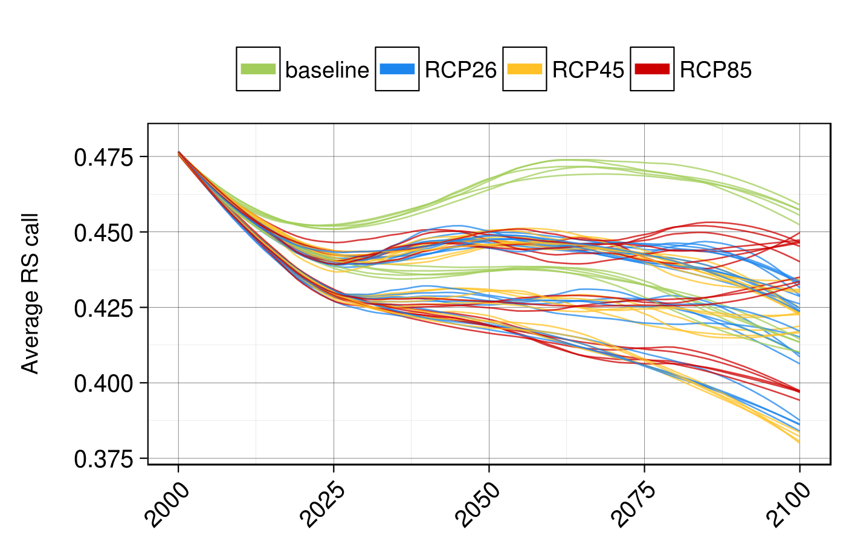
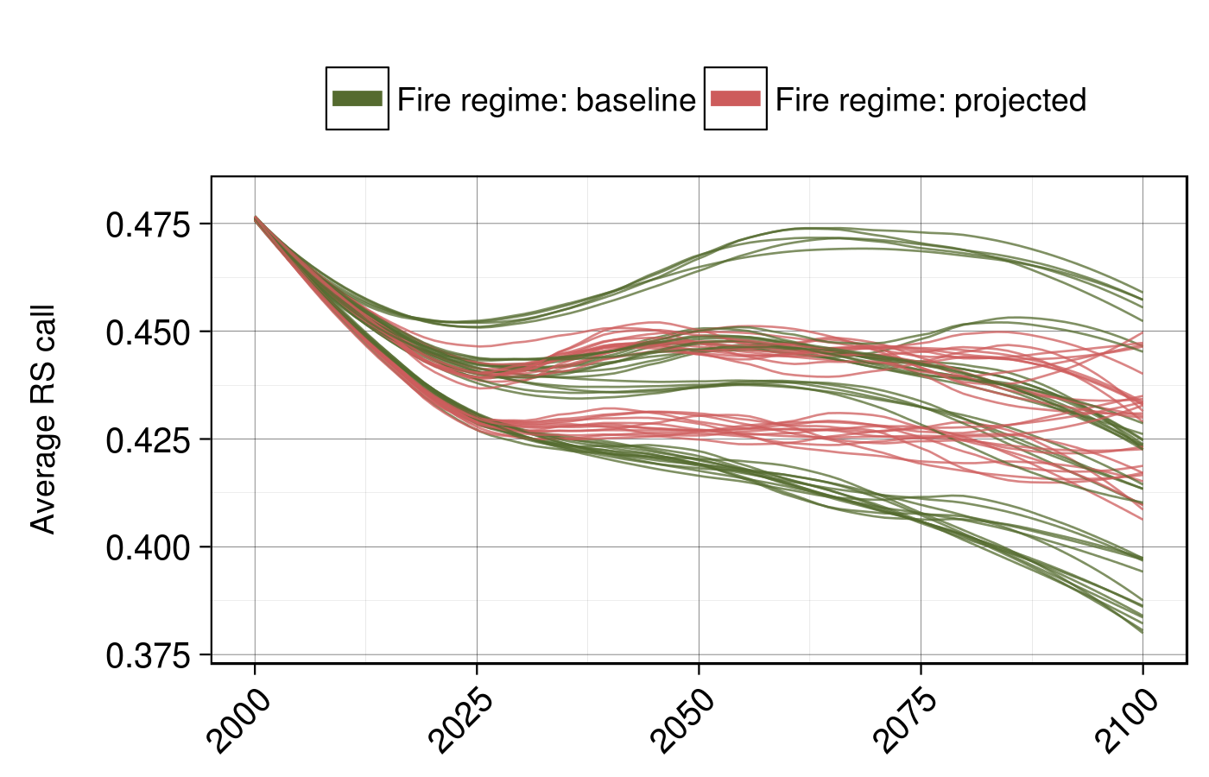
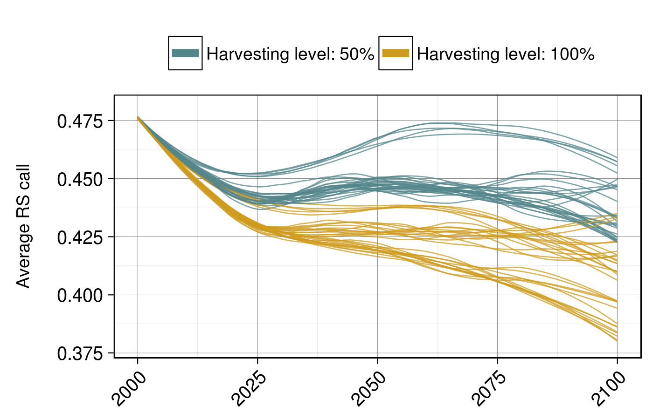
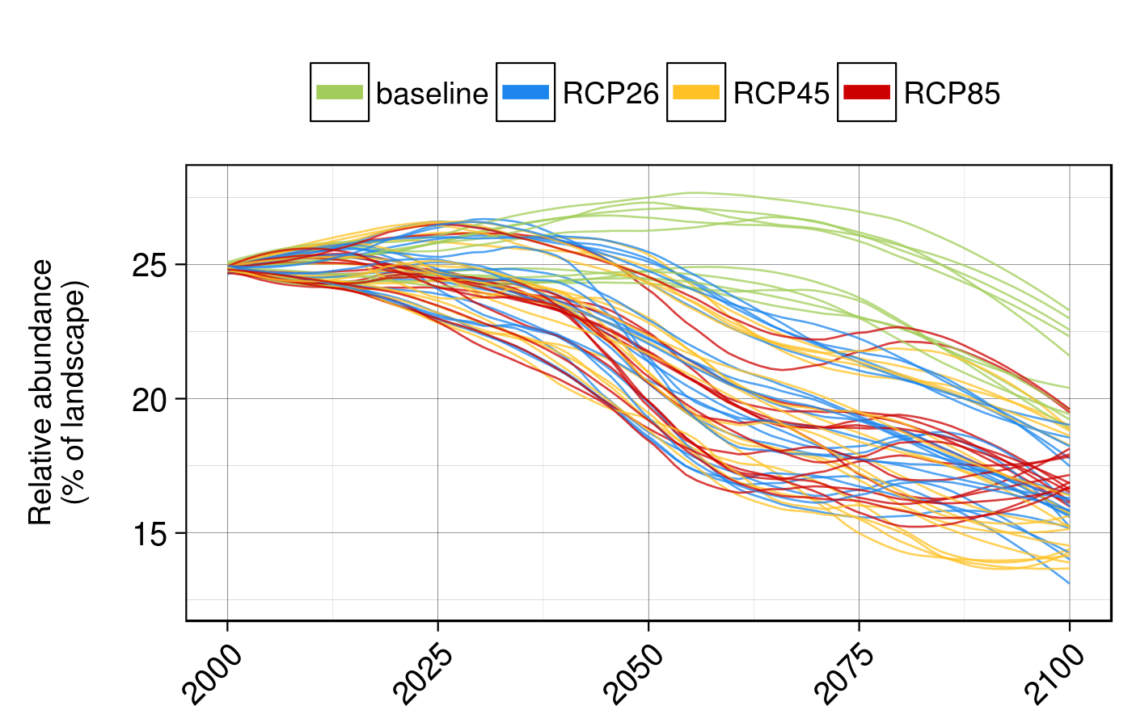
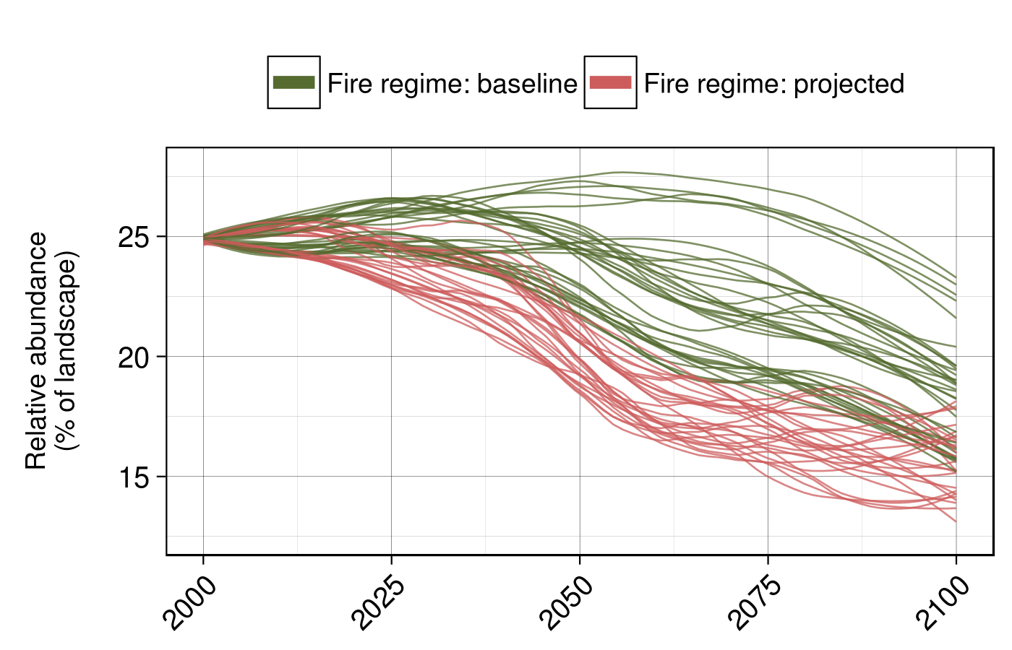
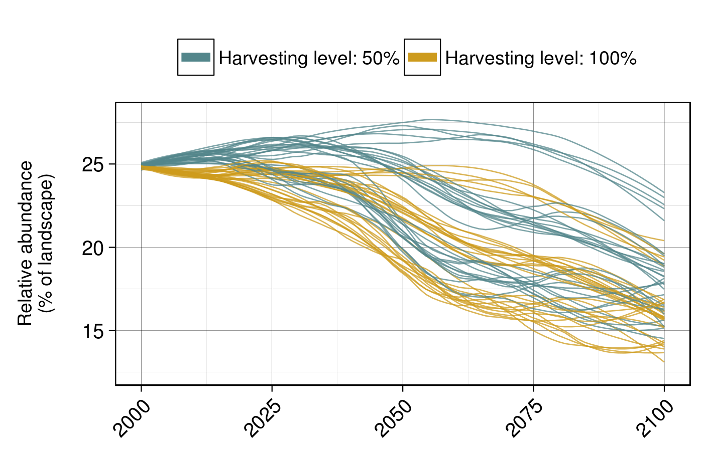
Average conditions
High quality habitats

Slide 7
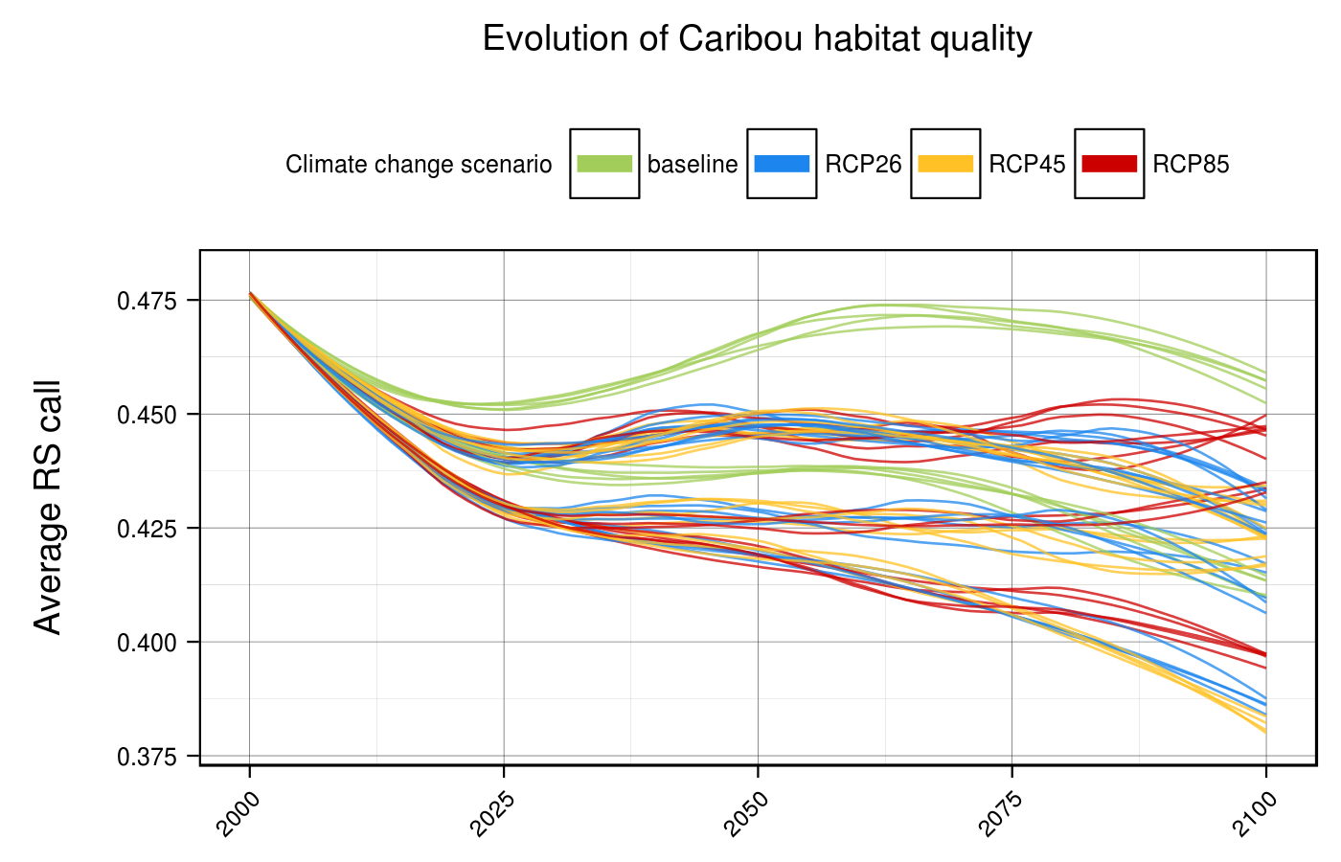
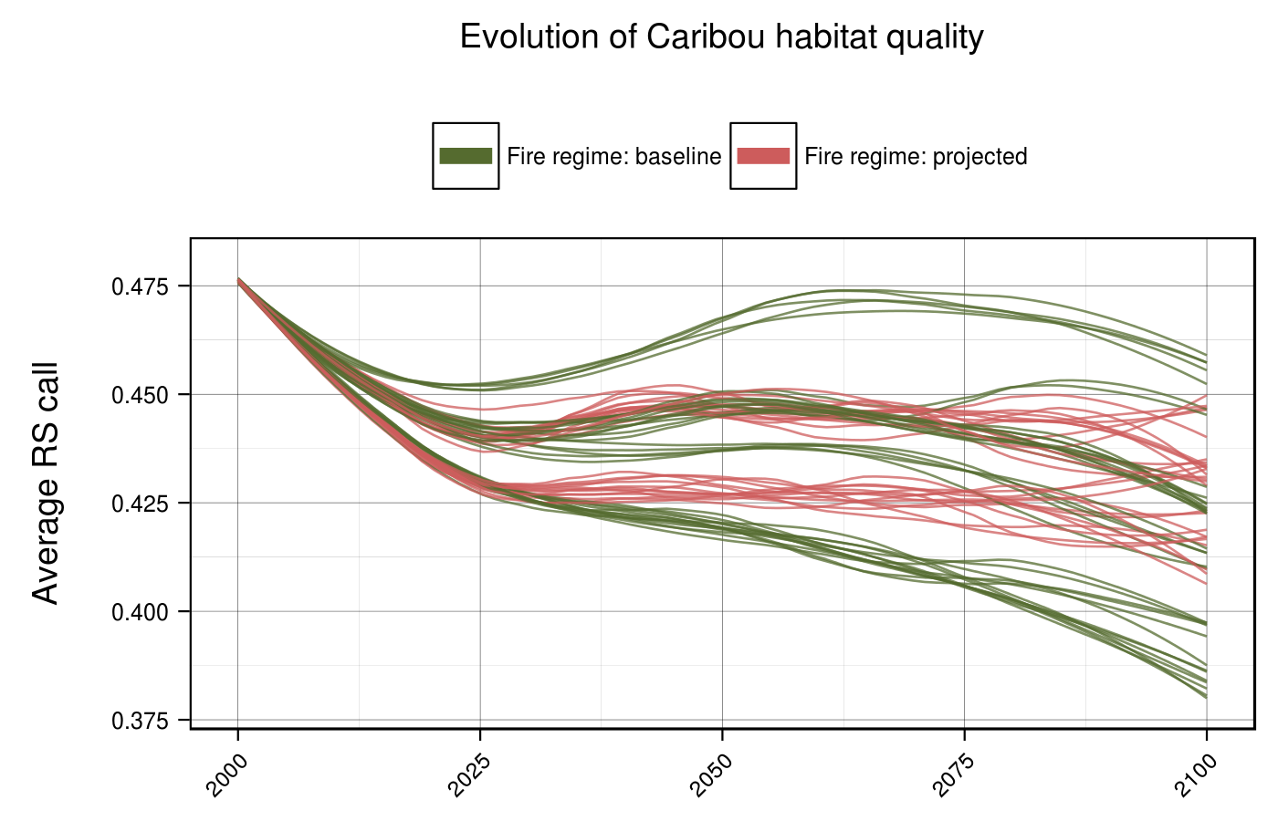
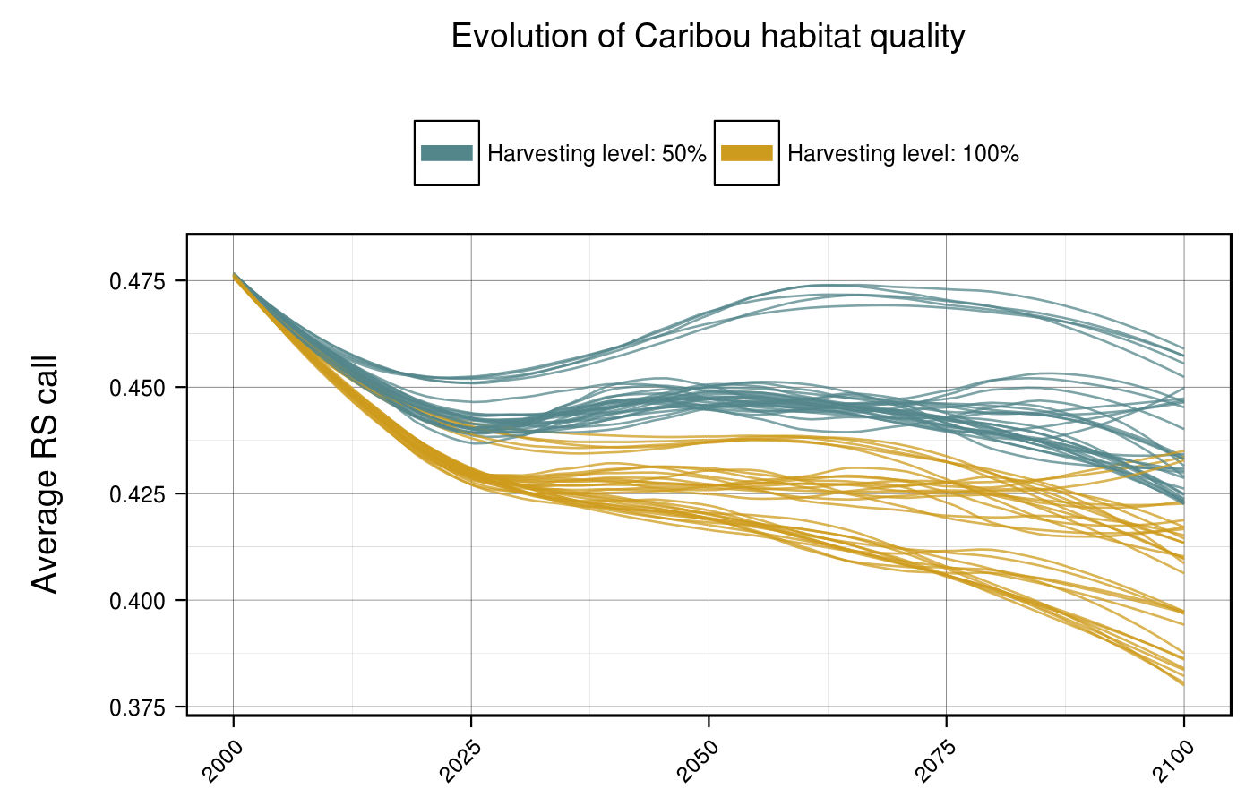



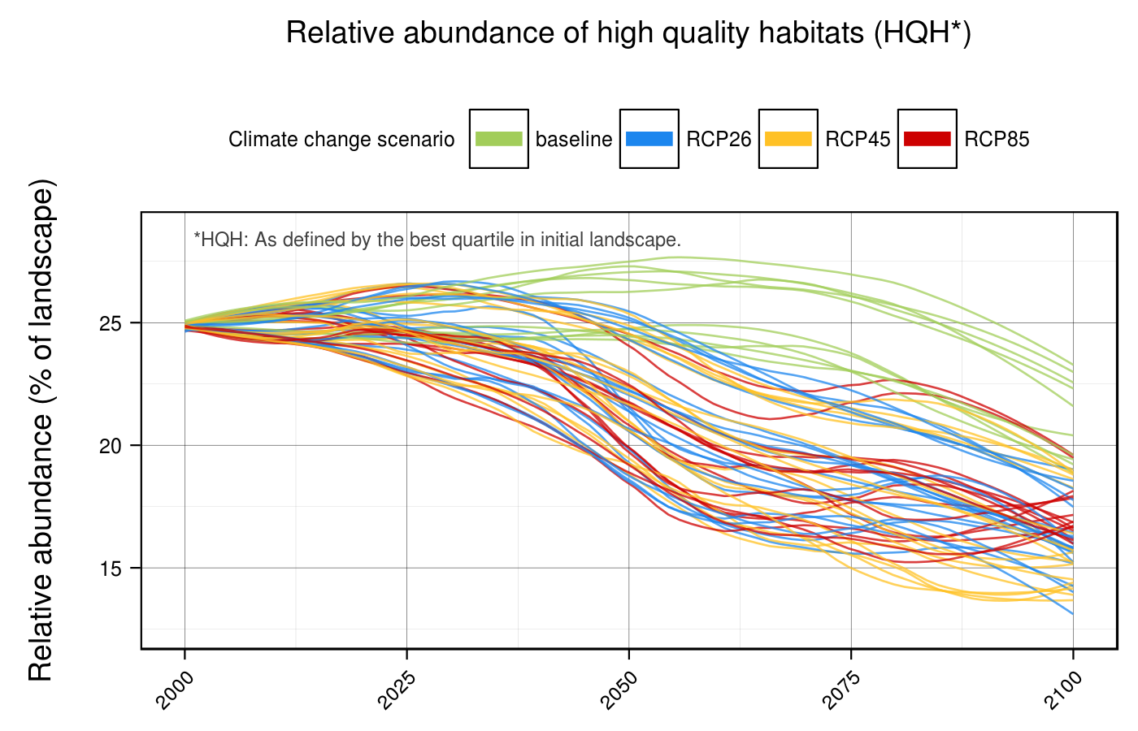
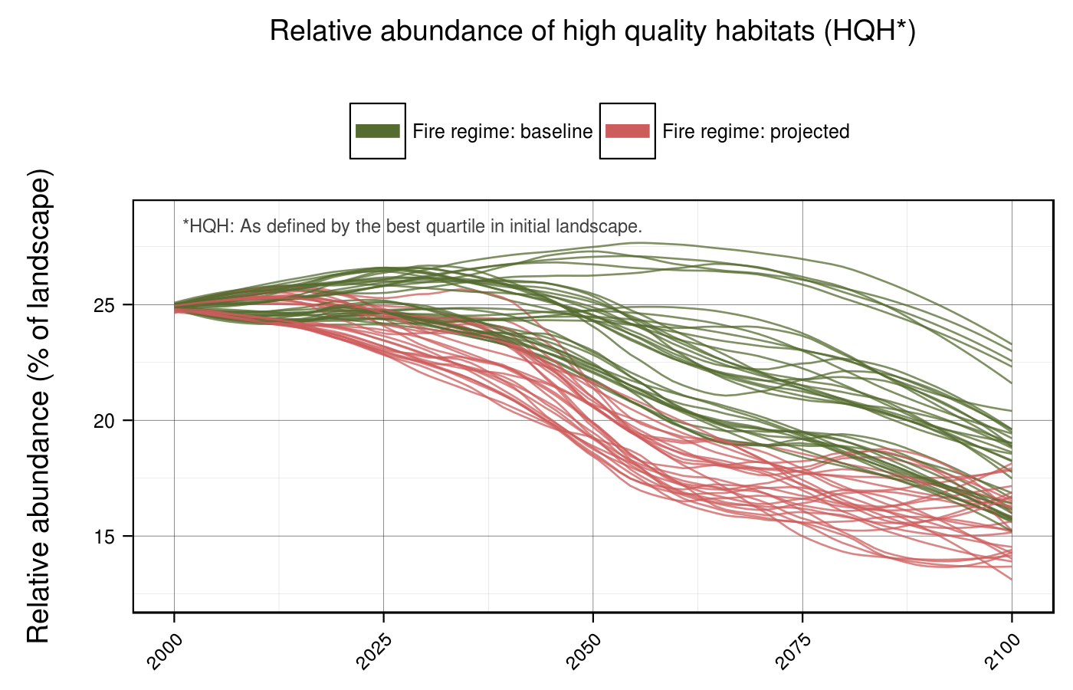
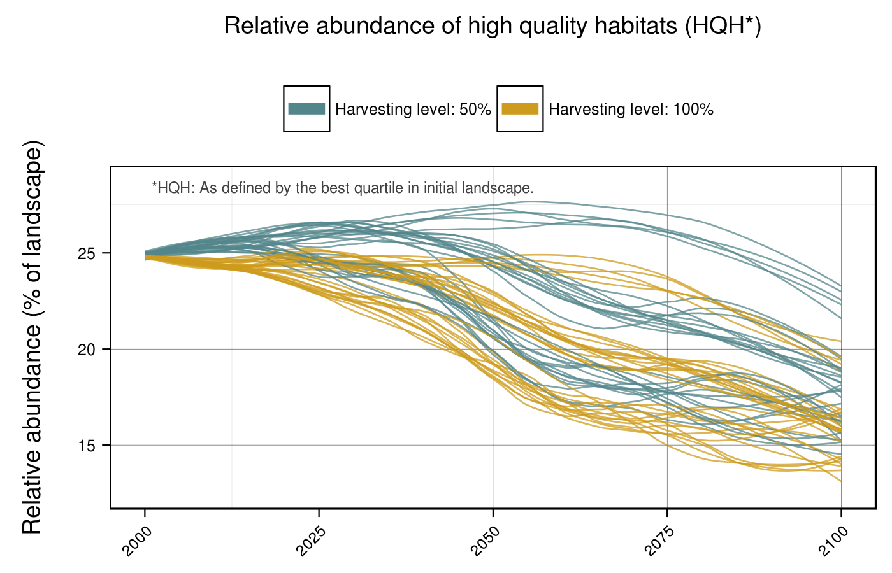
Evolution of caribou habitat from 2000 to 2100
A sensitivity assessment
Average conditions
High quality habitats

