Slide 1
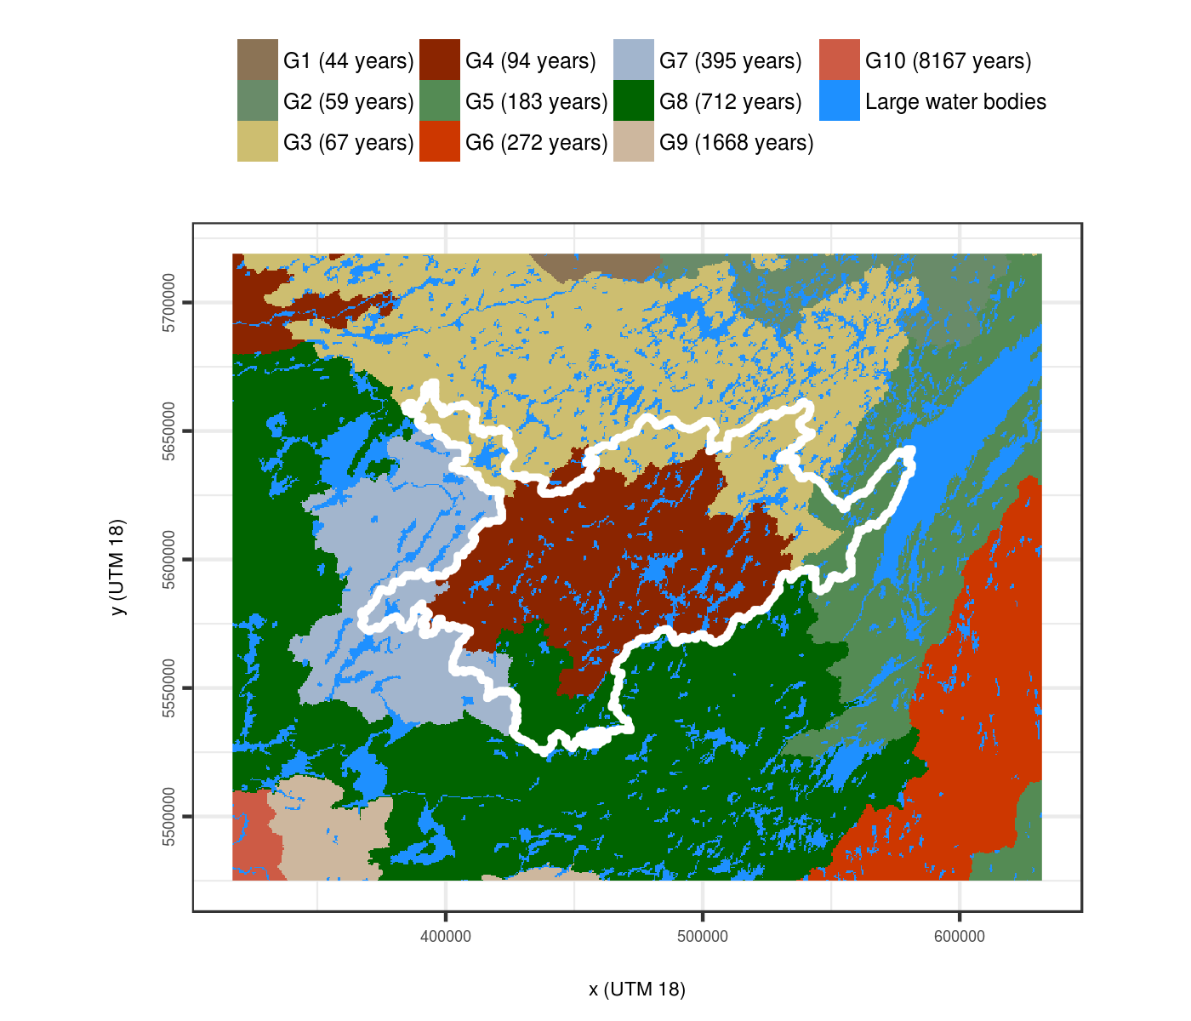
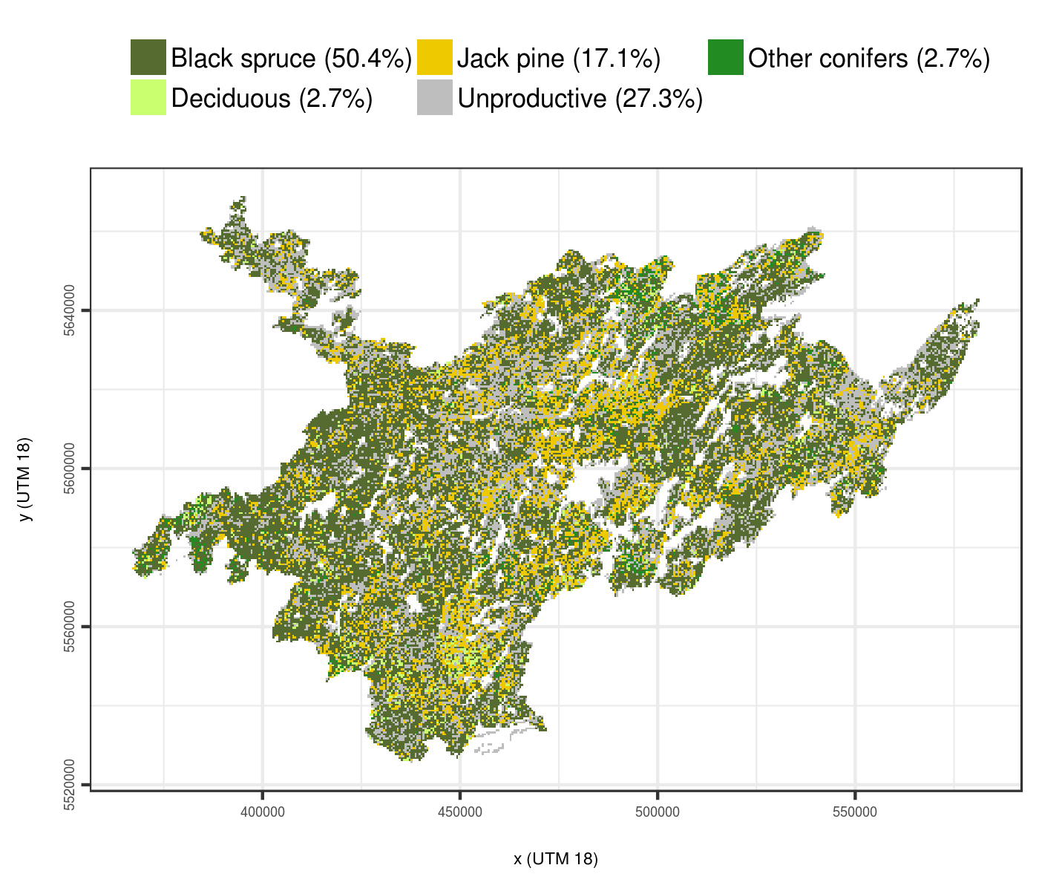
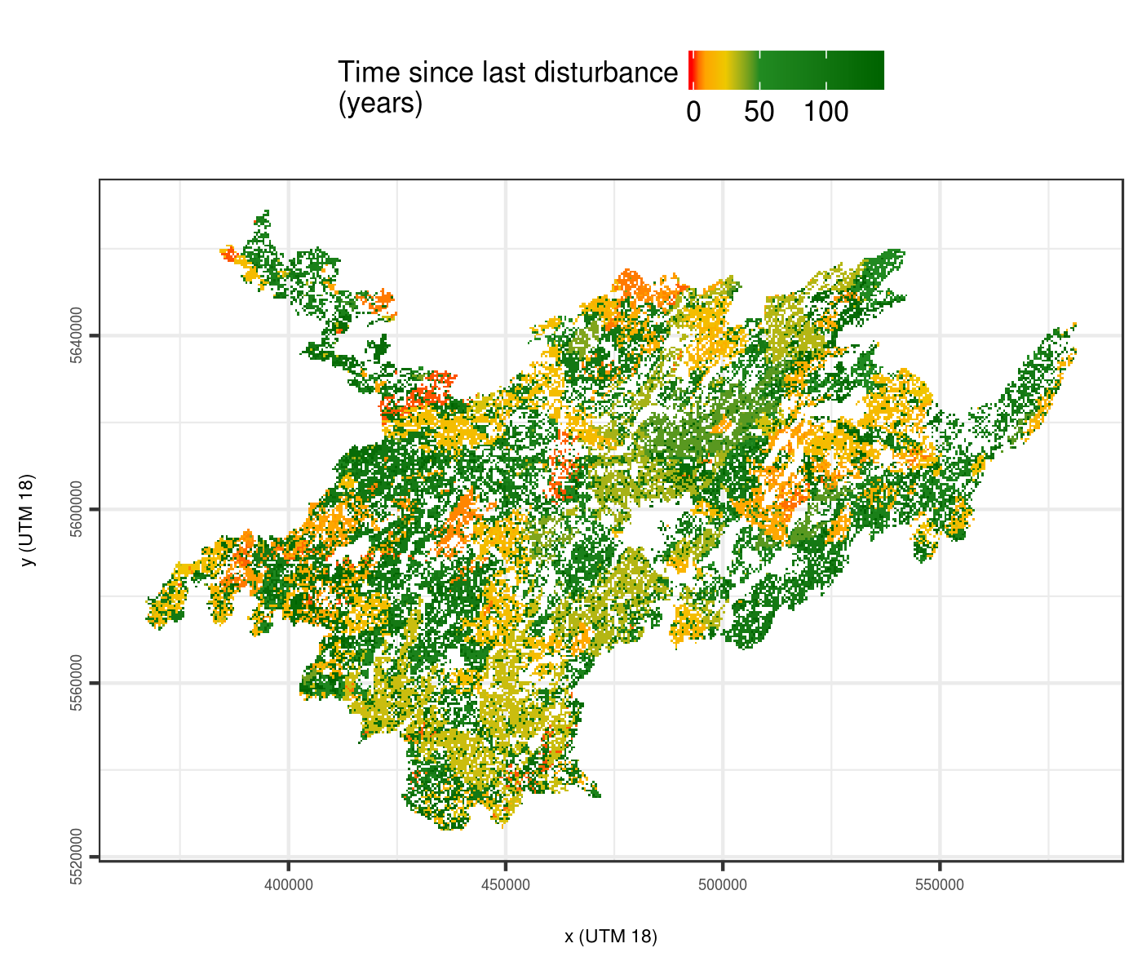
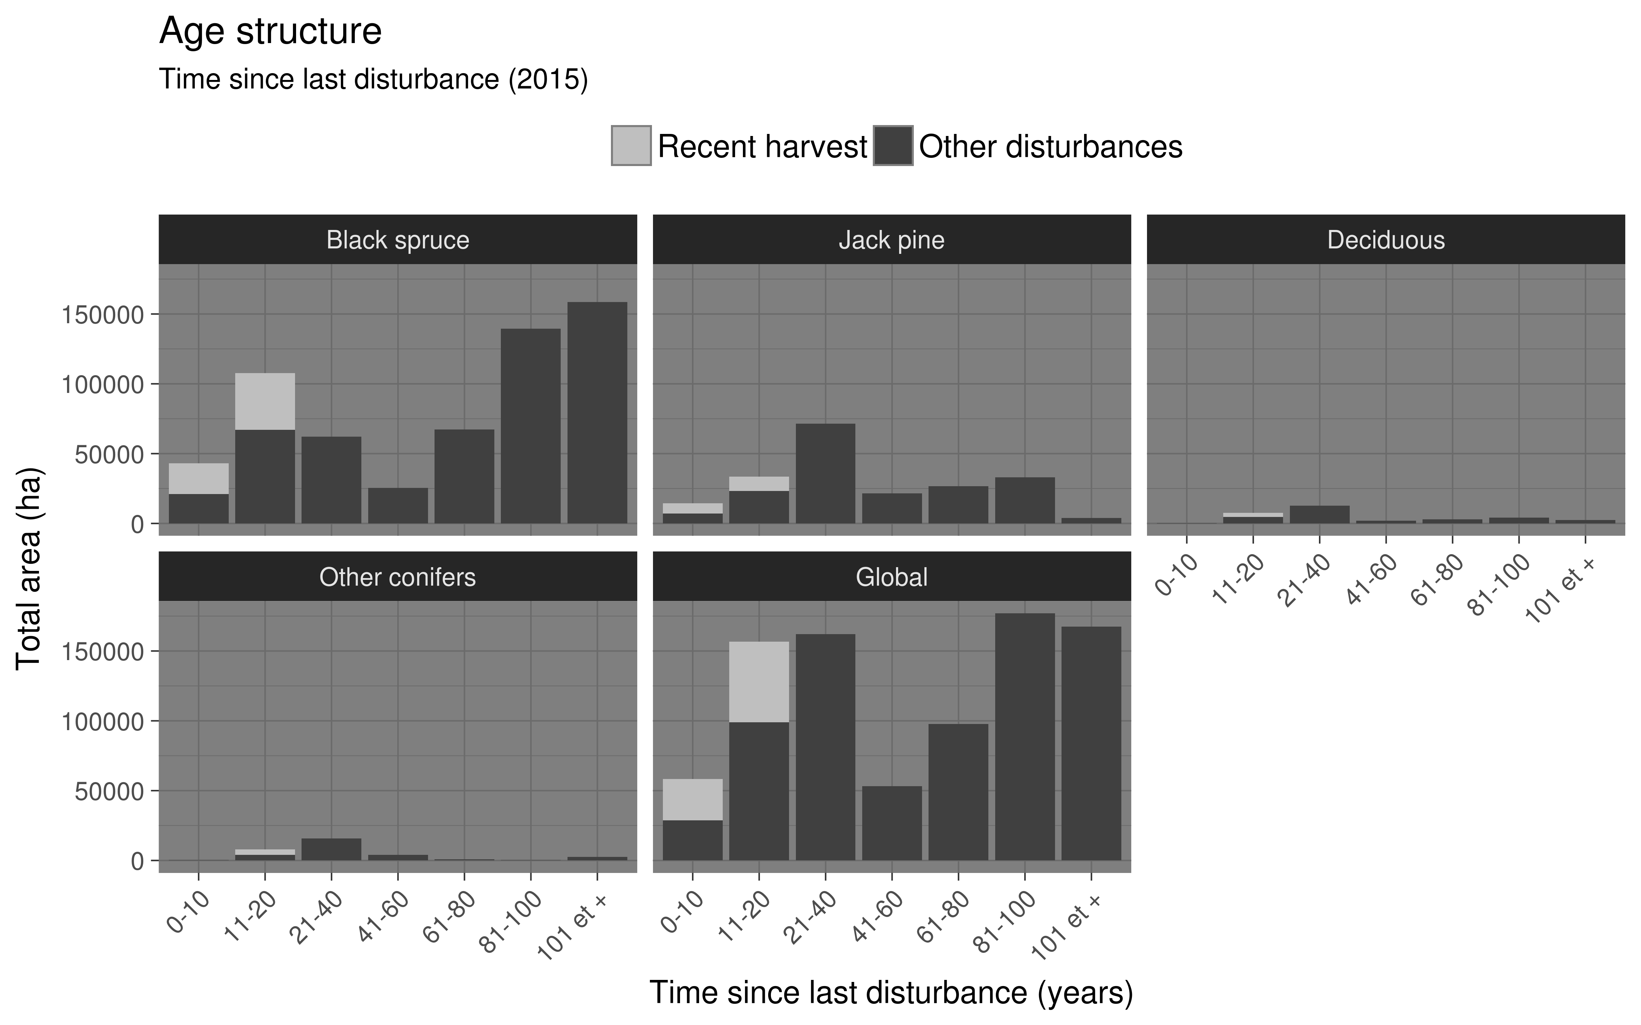
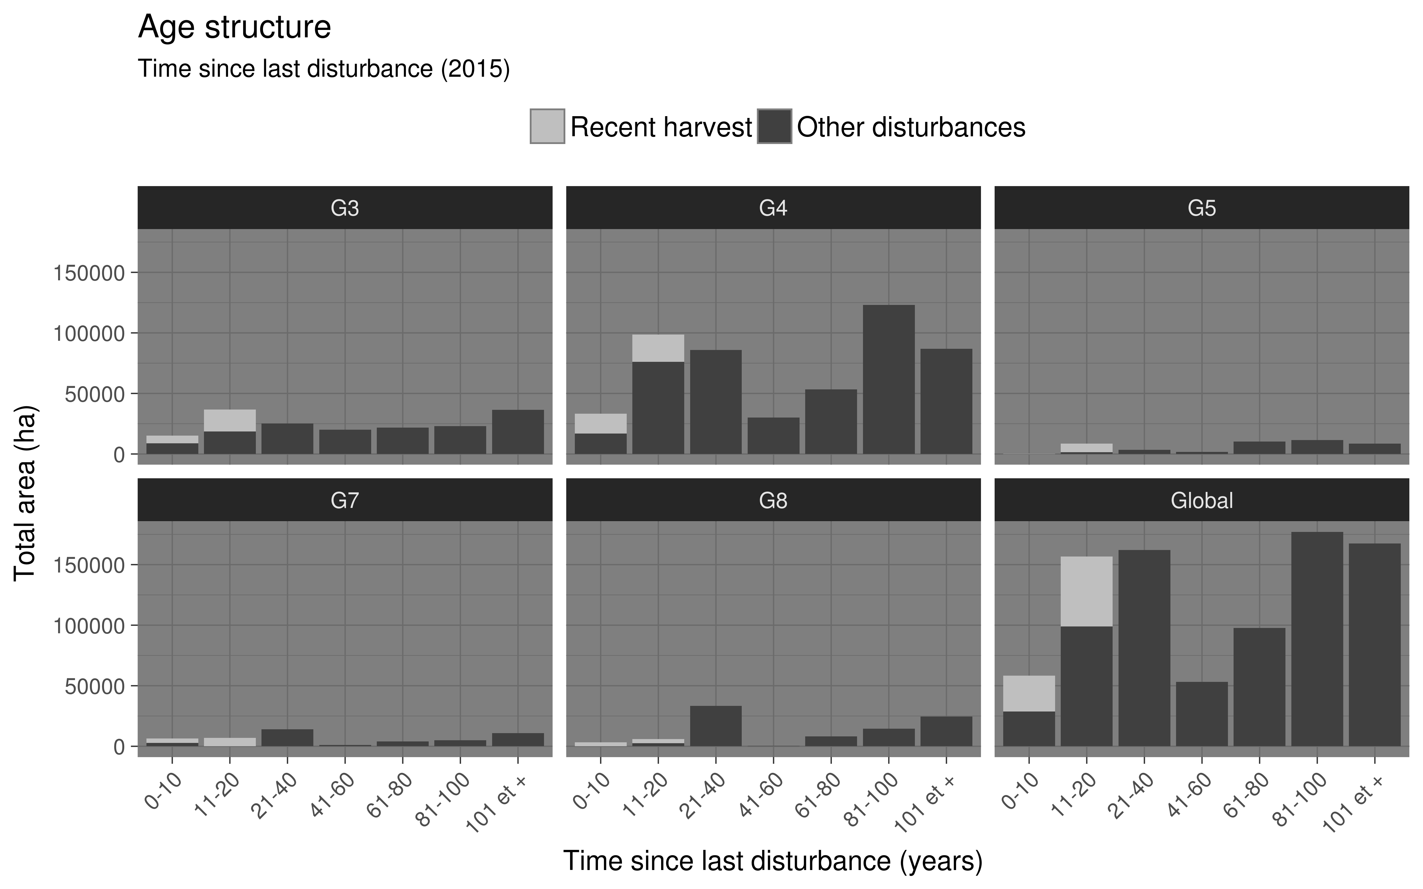
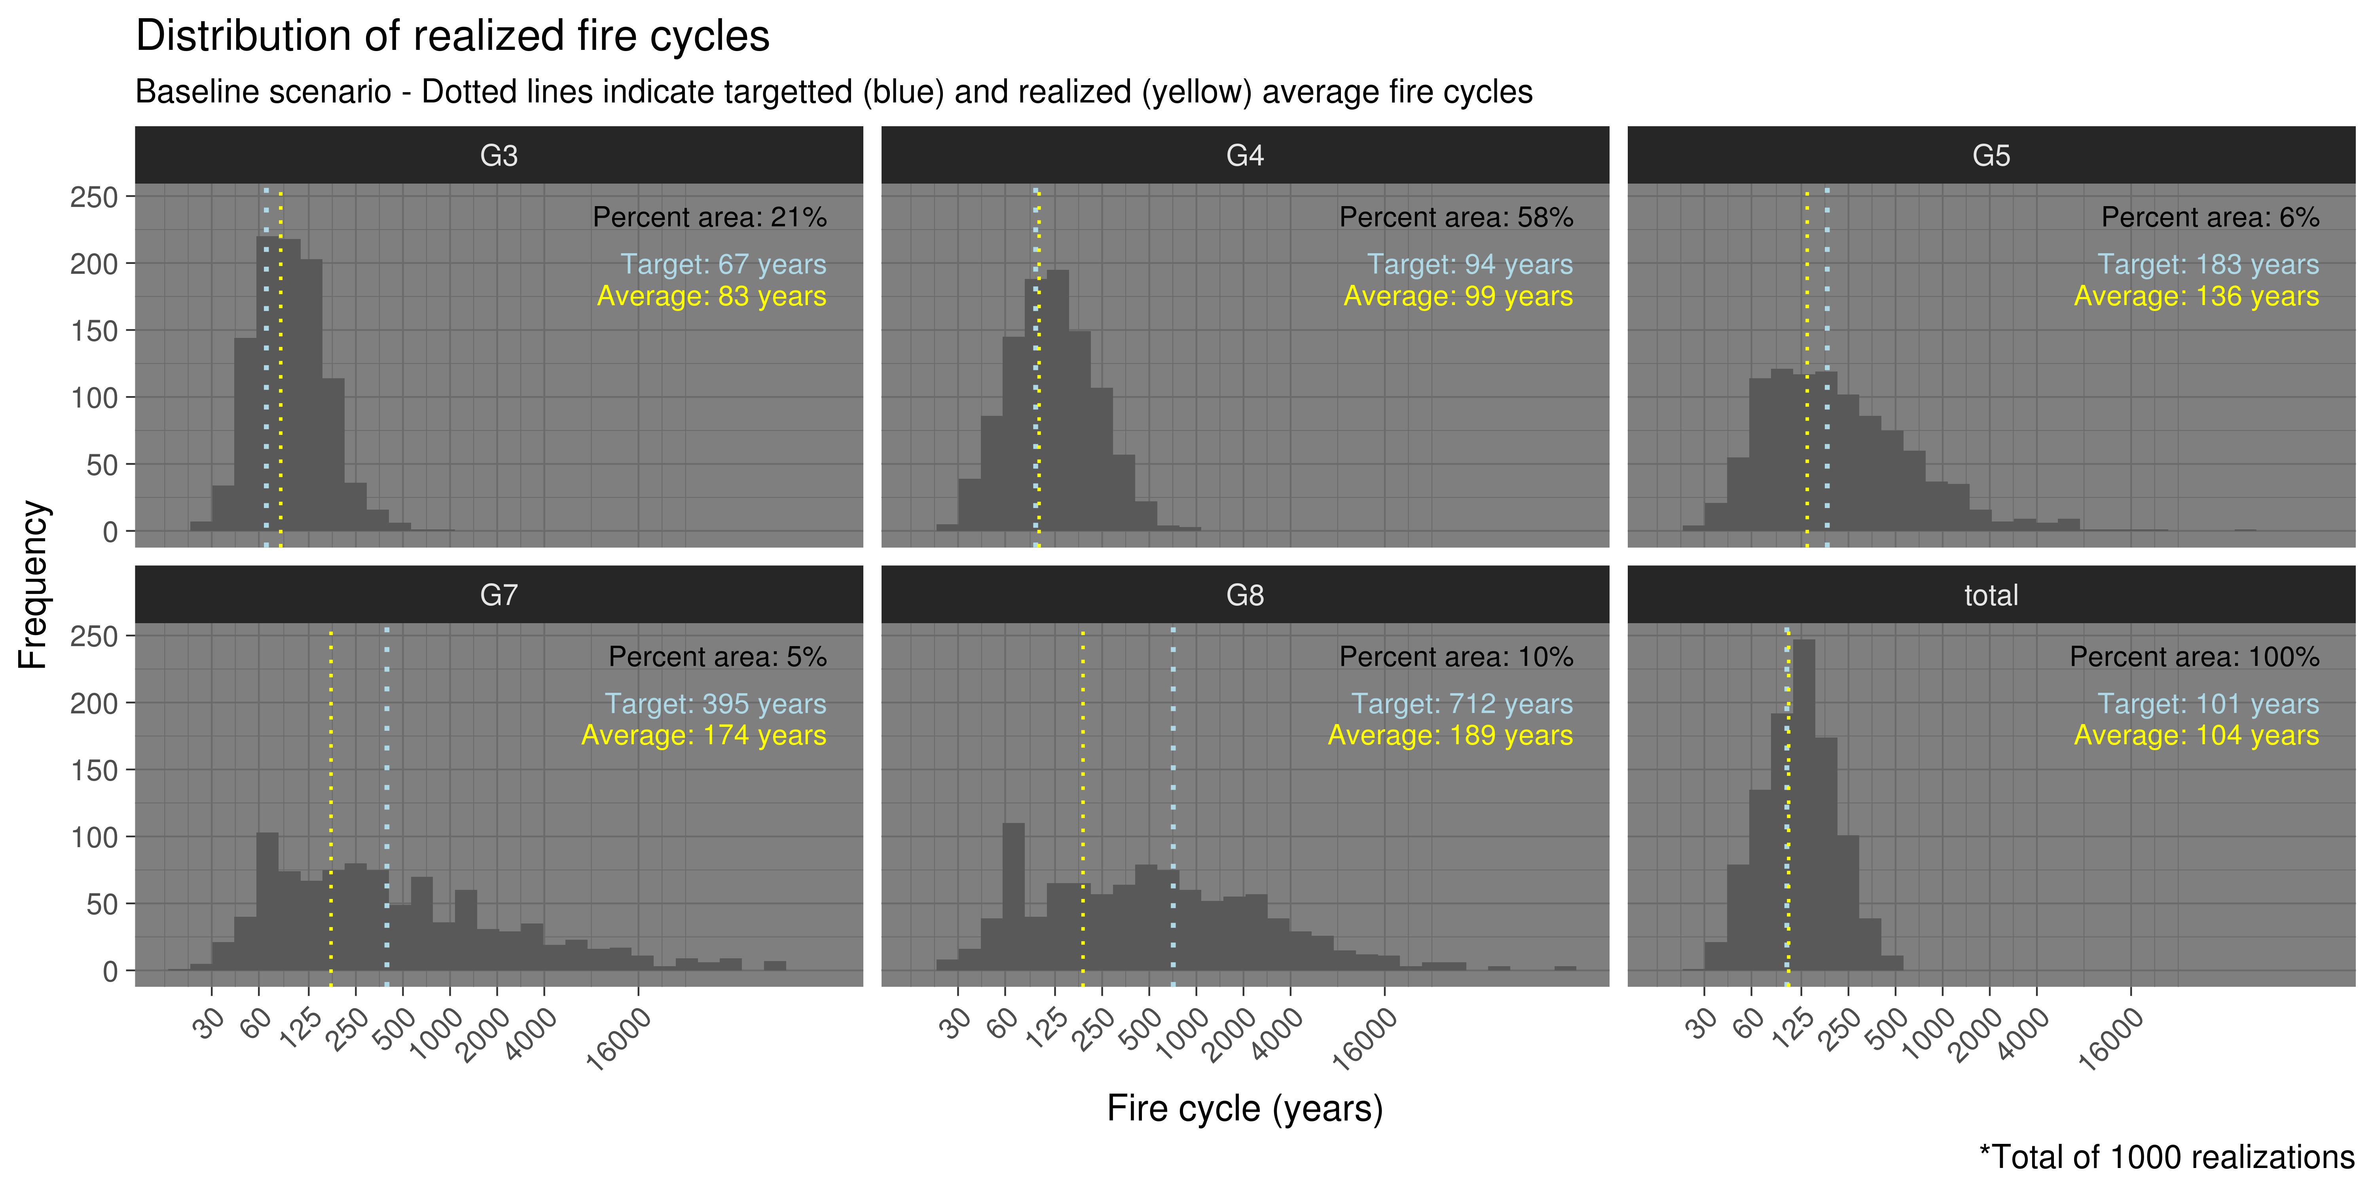
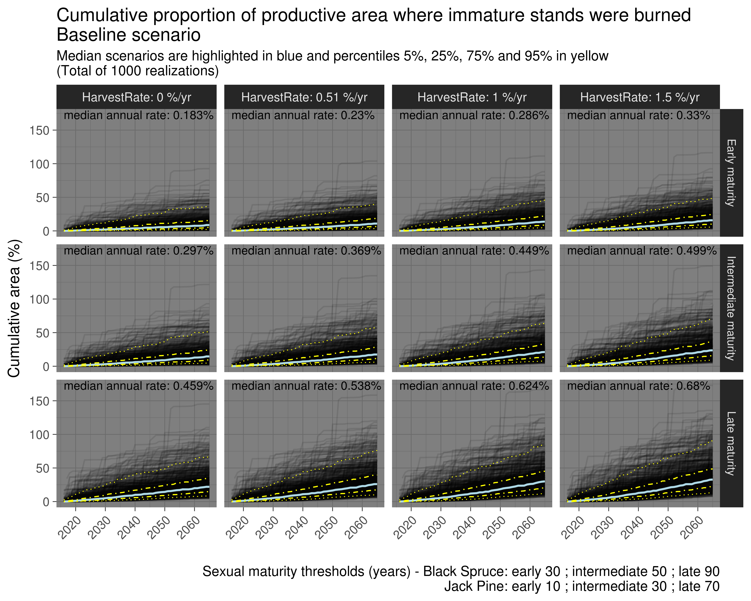
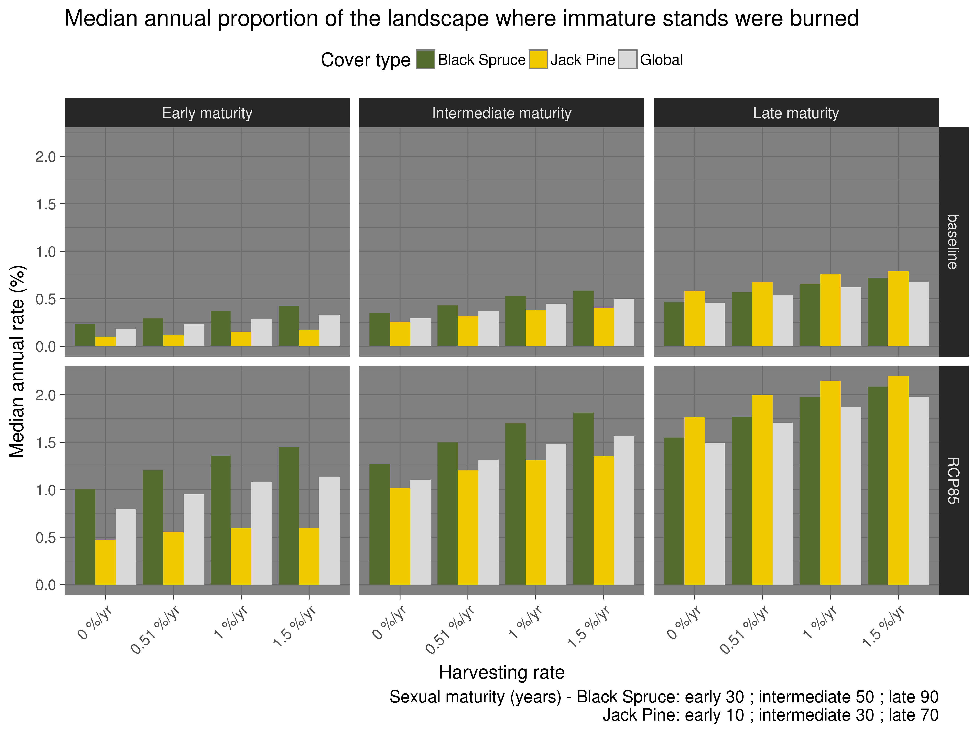
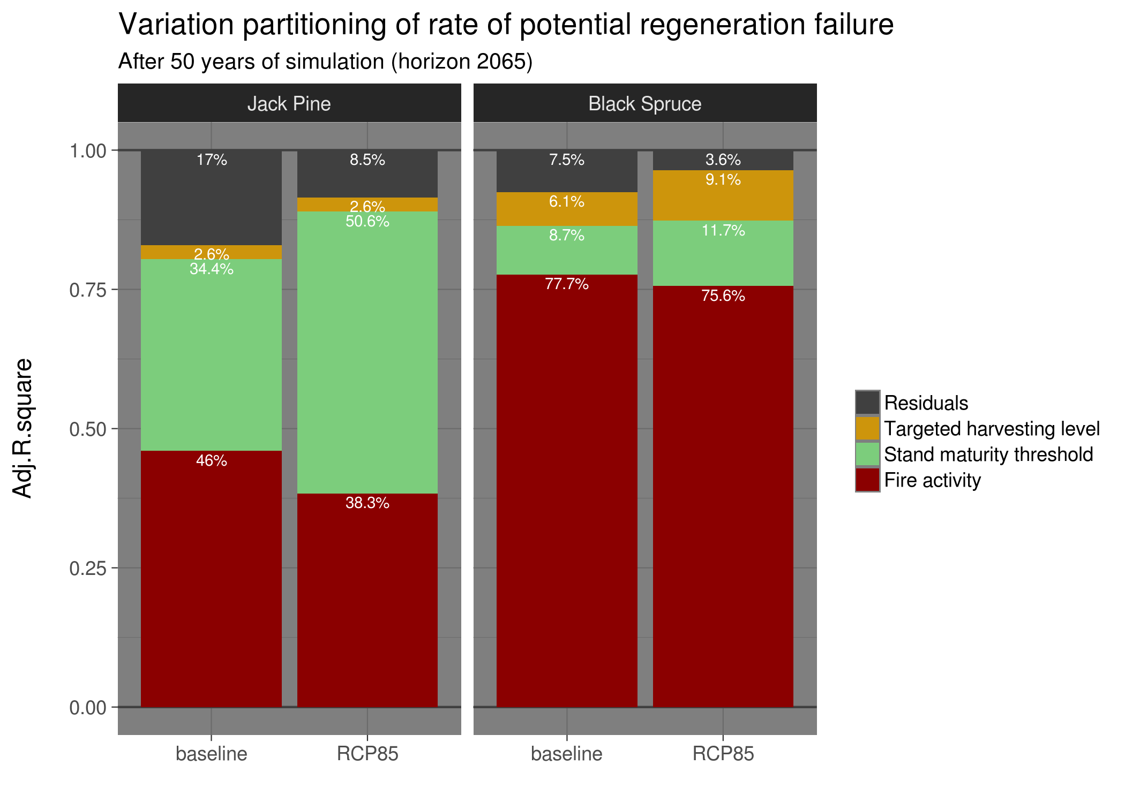
Landscape initiation
Legend
./gis/studyArea.*
./gis/fireZonesGauthier.*
./gis/canadlake_p.*
./initFireRegime.R
Prepare fire regime input files
./scripts/gdal_polygonizeR.R
Geoprocessing script
Simulation step
./initCoverType.R
Prepare cover type input files
Compute cover type summary statistics
Data processing step
./gis/forestInventory.*
** not available online
./initHarvest.R
Prepare initial harvesting history input file
Compute harvesting baseline statistics
Script to execute
Sourced function(s)
./initTsf.R
Prepare initial fire history input file
Compute initial age distribution
./{relativePath}/{inputFile}.*
./{relativePath}/{outputFile}.*
./data/studyArea.*
./data/coverTypes*.*
./data/fireZones*.*
./data/harvest.tif
./data/tsfInit*.*
Fire simulation
./simPilotFire.R
Provide parameters and experimental design for fire regime ensemble
Pilot fire simulations
./scripts/simFireFnc.R
Simulates a given fire regime
./scripts/fireSpreadFnc.R
Simulates a single fire event
Harvest simulation
./outputs/simFire_{cc_scenario}_{simID}.Rdata
** Multiple large files – not available online
./simPilotHarvest.R
Provide parameters and experimental design for harvesting treatments
Pilot harvest simulations
./scripts/simHarvestFnc.R
Simulates harvesting
./outputs/simHarvest_{cc_scenario}_{harvestTreatment}{simID}.Rdata
** Multiple large files – not available online
Compilation of simulation outputs
./outputCompilationFire.R
Time-consuming steps are conducted here for easier downstream analyses and visualization
Compilation of pre-fire stand attributes (age & cover type)
./compiledOutputs/outputCompiledFire.*
** Not available prior to publication
./outputCompilationHarvest.R
Time-consuming steps are conducted here for easier downstream analyses and visualization
Compilation of harvesting outputs
./compiledOutputs/outputCompiledHarvest.*
** Not available prior to publication
Extraction of results
./resultsRegenFailure.R
Compute occurrences of young stands being burned before maturity thresholds
Visualization of results
./resultsHarvest.R
Compute realized harvesting
Visualization of results
./resultsVarDecomp.R
Compute variation partitioning
Visualization of results
and more...

