Slide 1
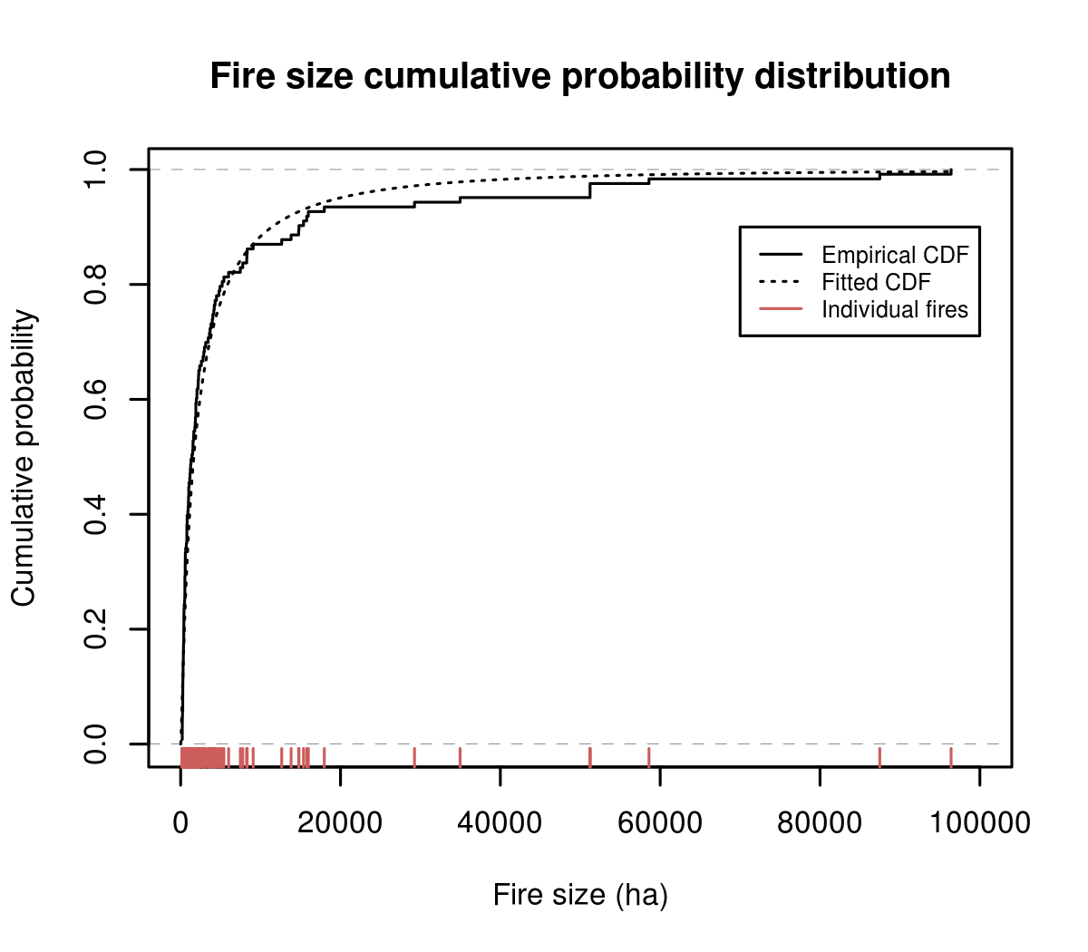
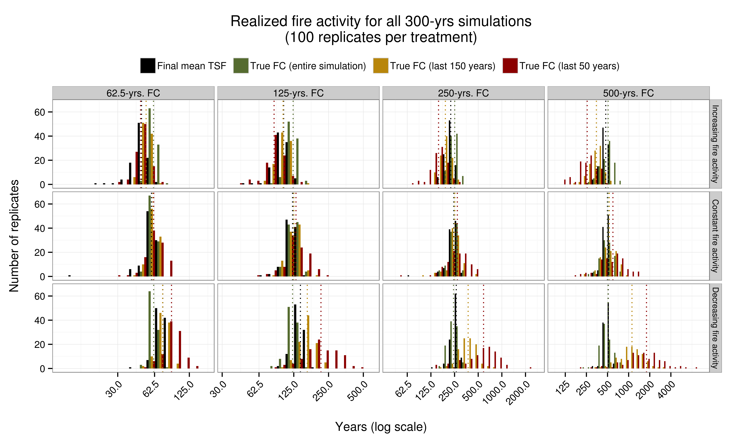
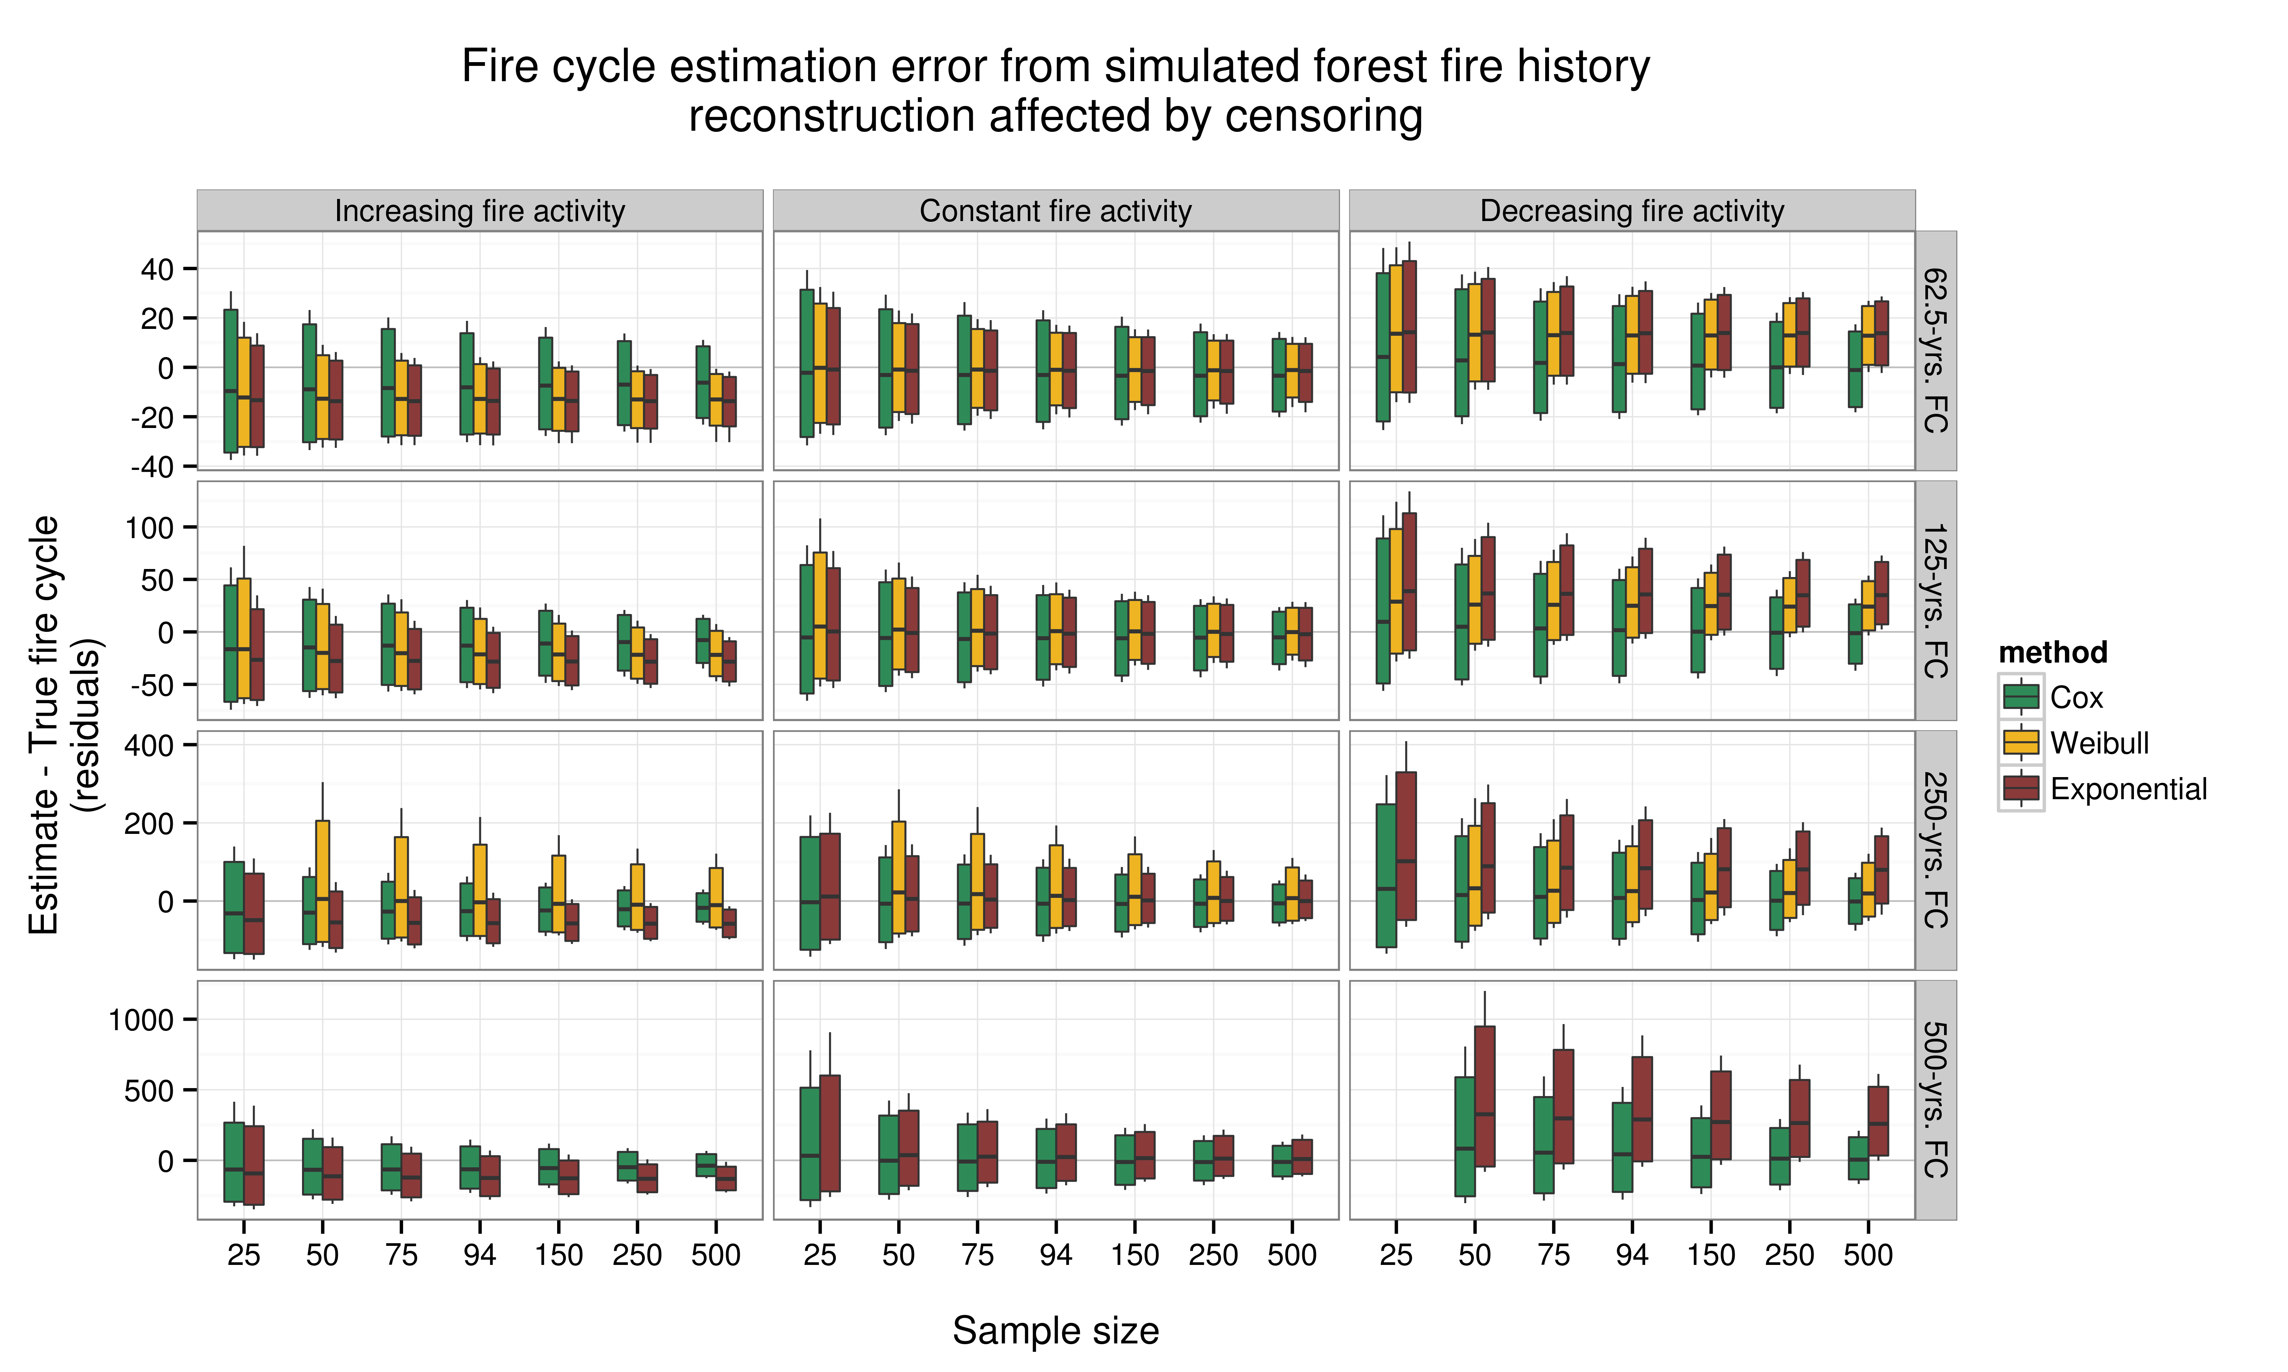
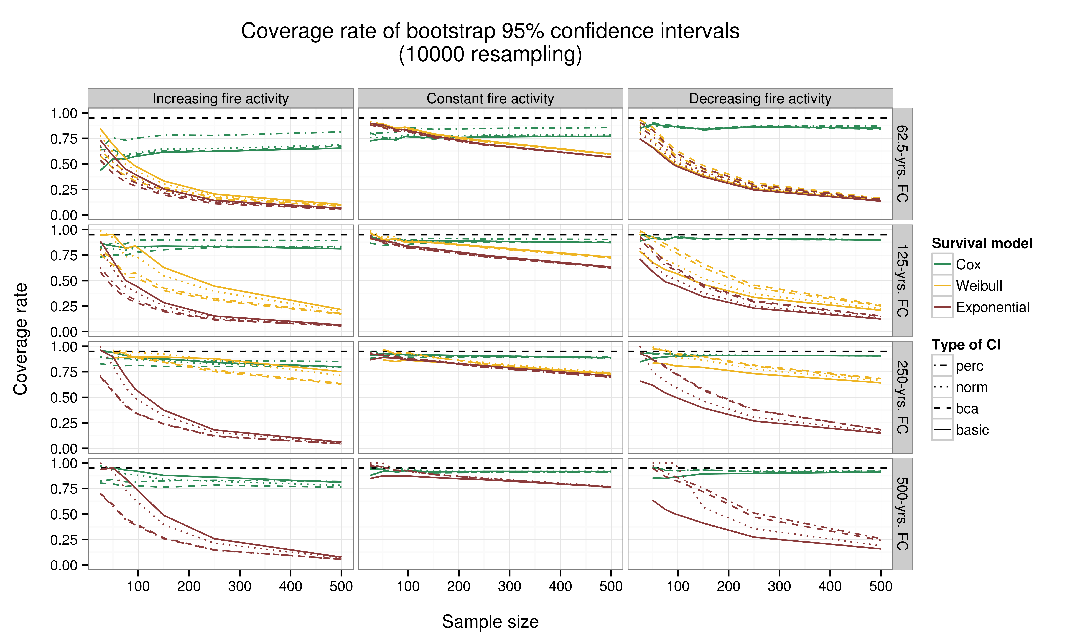
Landscape aging and burning
Legend
./data/fireObs.csv
./scripts/simFnc.R
Runs individual simulations
Outputs TSF maps and/or fire maps
Simulation step
./simPilot.R
Prepares simulation inputs
Deploys experimental design
Data processing step
./scripts/fireSpreadFnc.R
Runs a simple cellular automaton that simulates fire spread
Script to execute
Sourced function
./outputs/simOutput_{fireCycle1}_{correlation1}.RData
./outputs/simOutput_{fireCycle1}_{correlation2}.RData
./outputs/simOutput_{fireCycle1}_{correlation3}.RData
./outputs/simOutput_{fireCycle2}_{correlation1}.RData
./outputs/simOutput_{fireCycle2}_{correlation2}.RData
...
./{relativePath}/{inputFile}.csv
./{relativePath}/{outputFile}.Rdata
Simulation output compilation
./outputCompilation.R
./compiledOutputs/tsfFinal.RData
./compiledOutputs/simOutputCompiled.RData
Dendroecological processes and field sampling
./simFcEstimation.R
Simulates dendroecological sampling
Sampling effort, number of trials
Simulates censoring
Compute estimations of fire cycle for all simulation
./scripts/censFnc.R
Simulates loss of information (TSF) due to forest aging
./scripts/FcEstSurvFnc.R
Survival-based fire cycle estimation functions
./simFcCoverage.R
Simulates dendroecological sampling
Sampling effort, number of trials
Simulates censoring
Compute estimations and bootstrap confidence intervals for all simulations
./compiledOutputs/survivalEstimatesFullDF.RData
./compiledOutputs/survivalBootstrapFullDF.RData
Post-processing
./postProcessing1.R
Time-consuming steps are conducted here for easier downstream analyses and visualization.
Merging estimations data with true FC statistics for easier downstream analyses
Filtering out unwanted simulation results
./compiledOutputs/survivalEstimates.RData
./compiledOutputs/survivalBootstrap.RData
./postProcessing2.R
Producing figures and tables for final publications and supplementary material
and more...
Empirical fire size
distribution
Realized fire regimes
Analysis of residuals
Confidence interval
performances (coverage)

