Slide 1
elasticsearch
Deng liuyan

Slide 2
content
what is Elasticsearch
Elasticsearch plugins
Elasticsearch items
Elasticsearch、haystack、django配置使用

Slide 3
What is Elasticsearch?
Elasticsearch is an open-source search engine
Elasticsearch is written in Java
Built on top of Apache Lucene
A distributed real-time document store where every field is indexed and searchable
A distributed search engine with real-time analytics
Notes:
Lucene是java框架
分布式文档存储，将每一个字段都编入索引，使其能够被搜索
实时分析

Slide 4
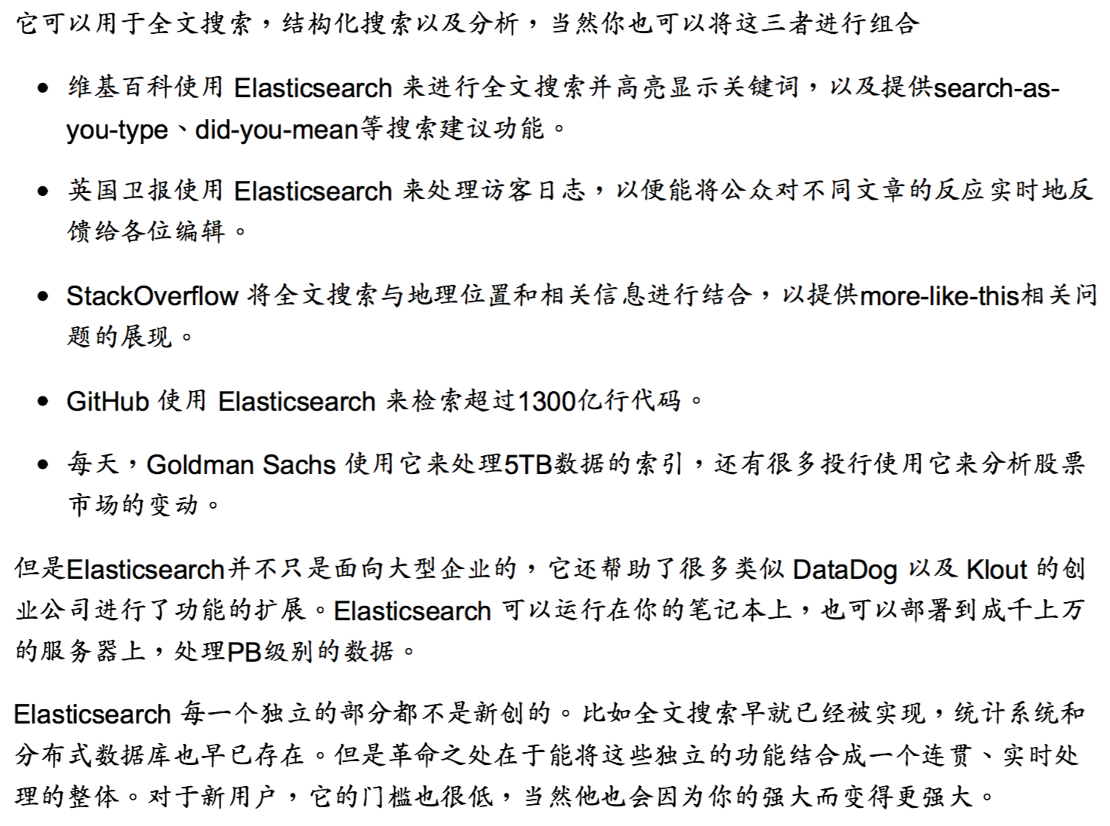

Slide 5
plugins
Marvel (plugin) is a monitoring tools
Sense is interactive console inside Marvel.
Elasticsearch-head is a document browser, http://10.80.121.35:9200/_plugin/head/

Slide 6
items
node: running instance of Elasticsearch
cluster: group of nodes with the same cluster name
elasticsearch = relational DB
indices = databases
types = tables
documents = rows

Slide 7
items
fields = columns
index (noun) = like a database in a traditional relational database
Index (verb) = to index a document is to store a document in an index (noun)
Inverted index = relational databases add an index, such as a B-tree index, to specific columns in order to improve the speed of data retrieval. Elasticsearch and Lucene use a structure called an inverted index for exactly the same purpose.

Slide 8
example
http://127.0.0.1:8090/api/v1.0/omimsearch/?q=%E8%BD%AF%E9%AA%A8&page%EF%BC%9D30&per=30

Slide 9
Django、elasticsearch、haystack
Haystack为Django提供了模块化的搜索。它的特点是统一的，熟悉的API，可以让你在不修改代码的情况下使用不同的搜索后端（比如 Solr, Elasticsearch, Whoosh, Xapian 等等）
Document of haystack:https://django-haystack.readthedocs.io/en/v1.2.7/searchqueryset_api.html#searchqueryset
Settings: http://nanvel.name/2013/07/django-haystack-example
Notes:
river做mysql与elastic search同步
elasticsearch.yml change cluster name and node name elasticsearch start 默认端口9200

Slide 10
Requirements
pip install django-haystack==2.6.0
pip install pyelasticsearch==1.4
pip install elasticsearch==1.9
brew install elasticsearch(不支持5.X版本)
# and launch:
elasticsearch -f -D es.config=/usr/local/Cellar/elasticsearch/0.90.2/config/elasticsearch.yml

Slide 11
参考
http://nanvel.name/2013/07/django-haystack-example
https://qbox.io/blog/elasticsearch-python-django-frontend-queries
http://www.sojson.com/blog/85.html
Elasticsearch官方文档
Haystack官方文档

