Slide 1

Continuous Integration after Hudson, CruiseControl, and Home Built

Slide 2
Jenkins
Branched from Hudson
Java based Continuous Build System
Runs in servlet container
  Glassfish, Tomcat
Supported by over 400 plugins
  SCM, Testing, Notifications, Reporting, Artifact Saving, Triggers, External Integration
Under development since 2005
http://jenkins-ci.org/
Notes:
Servlet：交互式浏览和修改数据，生成动态web页面

Slide 3

Jenkins for Continuous Integration
Jenkins – open source continuous integration server
Jenkins (http://jenkins-ci.org/) is
  Easy to install
  Easy to use
  Multi-technology
  Multi-platform
  Widely used
  Extensible
  Free

Slide 4
Improving Your Productivity
Continuous integration can help you go faster
  Detect build breaks sooner
  Report failing tests more clearly
  Make progress more visible
Notes:
log非常清晰，有自己的工作空间，每一次的构建都很清楚的列出来，通过一些组件可以将结果图形化展示等

Slide 5
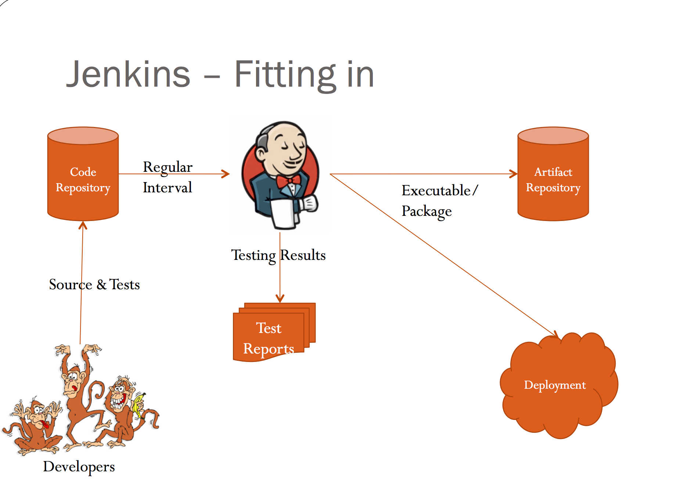
Notes:
整个开发环节，Jenkins作为持续集成工具，可以做到的角色。
程序员们

Slide 6
What can Jenkins do?
Generate test reports
Integrate with many different Version Control Systems
Push to various artifact repositories
Deploys directly to production or test environments
Notify stakeholders of build status
…and much more
Notes:
stakeholders ：相关人士们

Slide 7
How Jenkins works - Setup
When setting up a project in Jenkins, out of the box you have the following general options:
  Associating with a version control server
  Triggering builds
    Polling, Periodic, Building based on other projects
  Execution of shell scripts, bash scripts, Ant targets, and Maven
  targets
  Artifact archival
  Publish JUnit test results and Javadocs
  Email notifications
As stated earlier, plugins expand the functionality even further
Notes:
Jenkins的工作流程，配置

Slide 8
How Jenkins works - Building
Once a project is successfully created in Jenkins, all future builds are automatic
Building
Jenkins executes the build in an executer
  By default, Jenkins gives one executer per core on the build server
Jenkins also has the concept of slave build servers
  Useful for building on different architectures
  Distribution of load

Slide 9
How Jenkins works - Reporting
Jenkins comes with basic reporting features
  Keeping track of build status
    Last success and failure
    “Weather” – Build trend
These can be greatly enhanced with the use of pre-build plugins
  Unit test coverage
  Test result trending
  Findbugs, Checkstyle, PMD

Slide 10
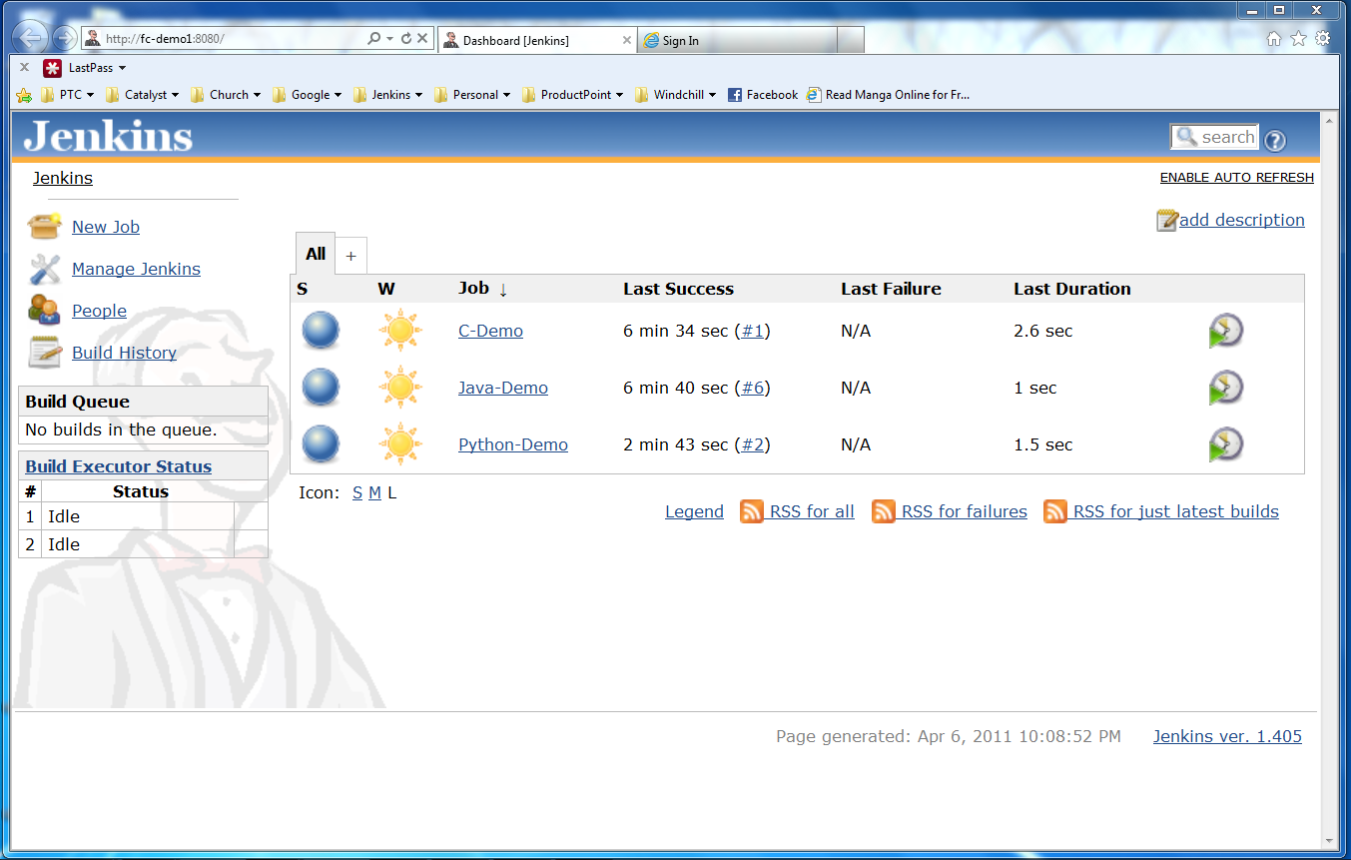
Jenkins User Interface
Actions
Nodes
Jobs

Slide 11
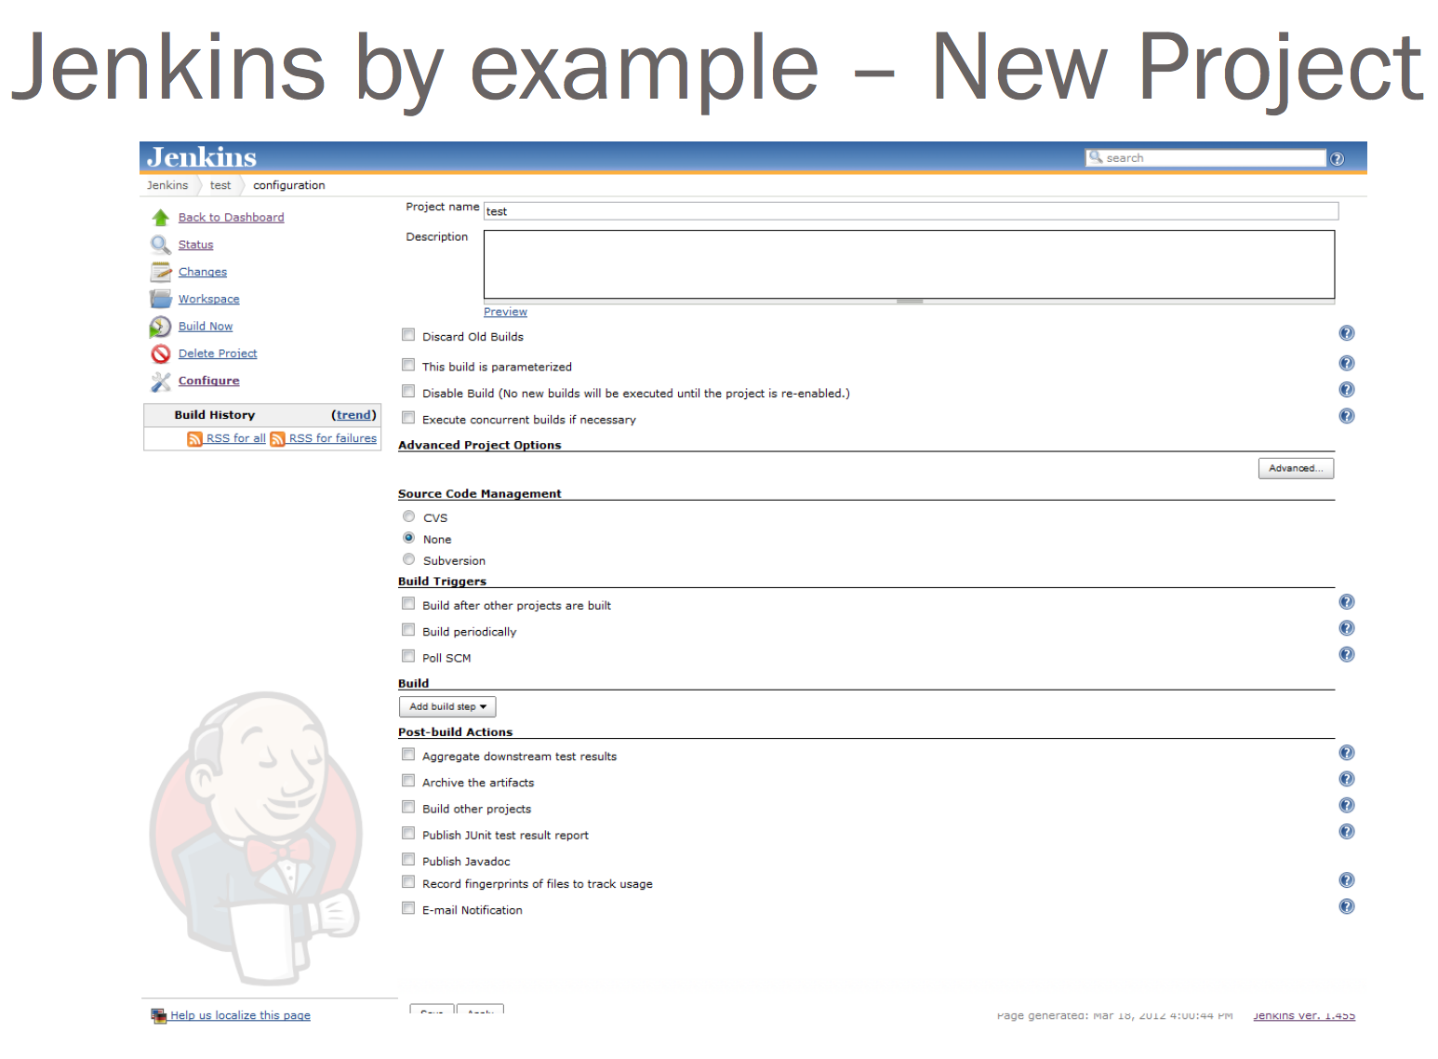
Notes:
点击configure时，你可以进行配置，基础配置比较少，如果你加入很多的组件，将会变得很灵活

Slide 12
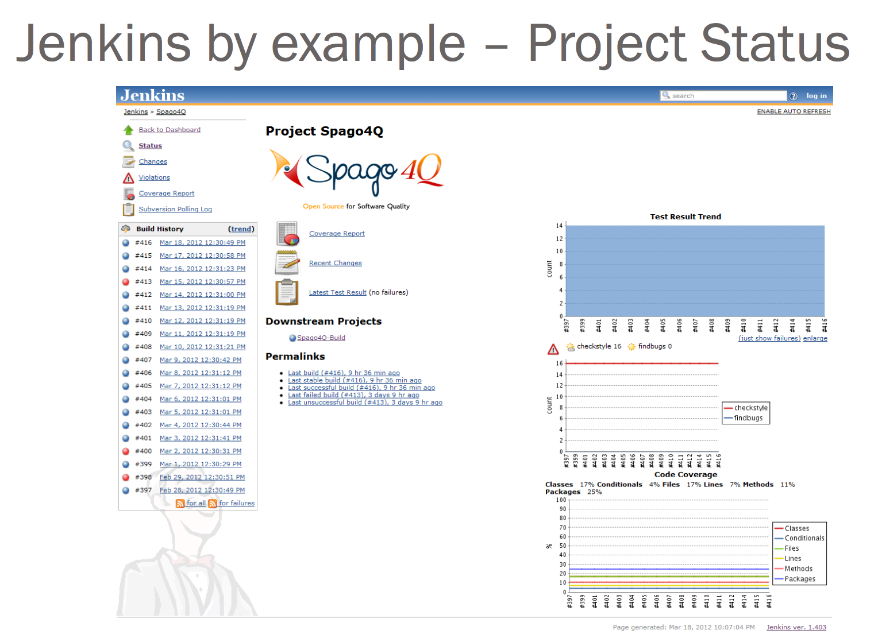

Slide 13
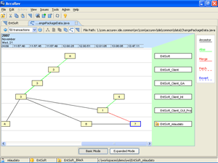

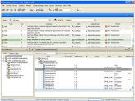




Jenkins Plugins - SCM
Version Control Systems
  Accurev
  Bazaar
  BitKeeper
  ClearCase
  Darcs
  Dimensions
  Git
  Harvest
  MKS Integrity
  PVCS
  StarTeam
  Subversion
  Team Foundation Server
  Visual SourceSafe

Slide 14
Jenkins Plugins – Build & Test
Build Tools
  Ant
  Maven
  MSBuild
  Cmake
  Gradle
  Grails
  Scons
  Groovy
Test Frameworks
  Junit
  Nunit
  MSTest
  Selenium
  Fitnesse

Slide 15
Jenkins Plugins – Analyzers
Static Analysis
  Checkstyle
  CodeScanner
  DRY
  Crap4j
  Findbugs
  PMD
  Fortify
  Sonar
  FXCop
Code Coverage
  Emma
  Cobertura
  Clover
  GCC/GCOV

Slide 16
Jenkins Plugins – Other Tools
Notification
  Twitter
  Campfire
  Google Calendar
  IM
  IRC
  Lava Lamp
  Sounds
  Speak
Authorization
  Active Directory
  LDAP
Virtual Machines
  Amazon EC2
  VMWare
  VirtualBox
  Xen
  Libvirt

Slide 17
Jenkins for Teams
Multi-configuration jobs
Multi-stage jobs
Swarms to dynamically contribute capacity
Languages
  Java
  C
  Python

