Slide 1
Jmeter
liuyan

Slide 2
Content
What is jmeter?
How to install jmeter?
Jmeter partner---blazemeter
How to work?
Jmeter report

Slide 3
What is jmeter?
The apache jmeter™ application is open source software, a 100% pure java application designed to load test functional behavior and measure performance.

Slide 4
What is jmeter?
Apache jmeter features include:
Ability to load and performance test many different applications/server/protocol types:
Web - HTTP, HTTPS (java, nodejs, PHP, ASP.Net, …)
Soap / rest webservices
Ftp
Database via JDBC
Ldap
Message-oriented middleware (MOM) via JMS
Mail - SMTP(S), POP3(S) and IMAP(S)
Native commands or shell scripts
Tcp
Java objects
Full featured test IDE that allows fast test plan recording (from browsers or native applications), building and debugging.
Command-line mode (non gui / headless mode) to load test from any java compatible os (linux, windows, mac osx, …)
A complete and ready to present dynamic html report

Slide 5
What is jmeter?
Easy correlation through ability to extract data from most popular response formats, HTML, JSON , XML or any textual format
Complete portability and 100% java purity.
Full multi-threading framework allows concurrent sampling by many threads and simultaneous sampling of different functions by separate thread groups.
Caching and offline analysis/replaying of test results.
Highly extensible core:
Pluggable samplers allow unlimited testing capabilities.
Scriptable samplers (jsr223-compatible languages like groovy and beanshell)
Several load statistics may be chosen with pluggable timers.
Data analysis and visualization plugins allow great extensibility as well as personalization.
Functions can be used to provide dynamic input to a test or provide data manipulation.
Easy continuous integration through 3rd party open source libraries for maven, graddle and jenkins

Slide 6
How to install jmeter?
OSX : Brew install jmeter --with-plugins
Window : Please find the solution yourself

Slide 7
Jmeter partner---blazemeter
Blazemeter was a company that existed from 2011 to 2016. Blazemeter provides load testing for software developers. they marketed a commercial, self-service load testing platform as a service (paas), which is compatible with open-source apache jmeter, the performance testing framework from the apache software foundation.
Recoding to export .Jmx file:
You can add it in chrome store after you have a google account.
You can use it to record youe action to create a jmeter test script
Export the file to jmx and open it in jmeter

Slide 8
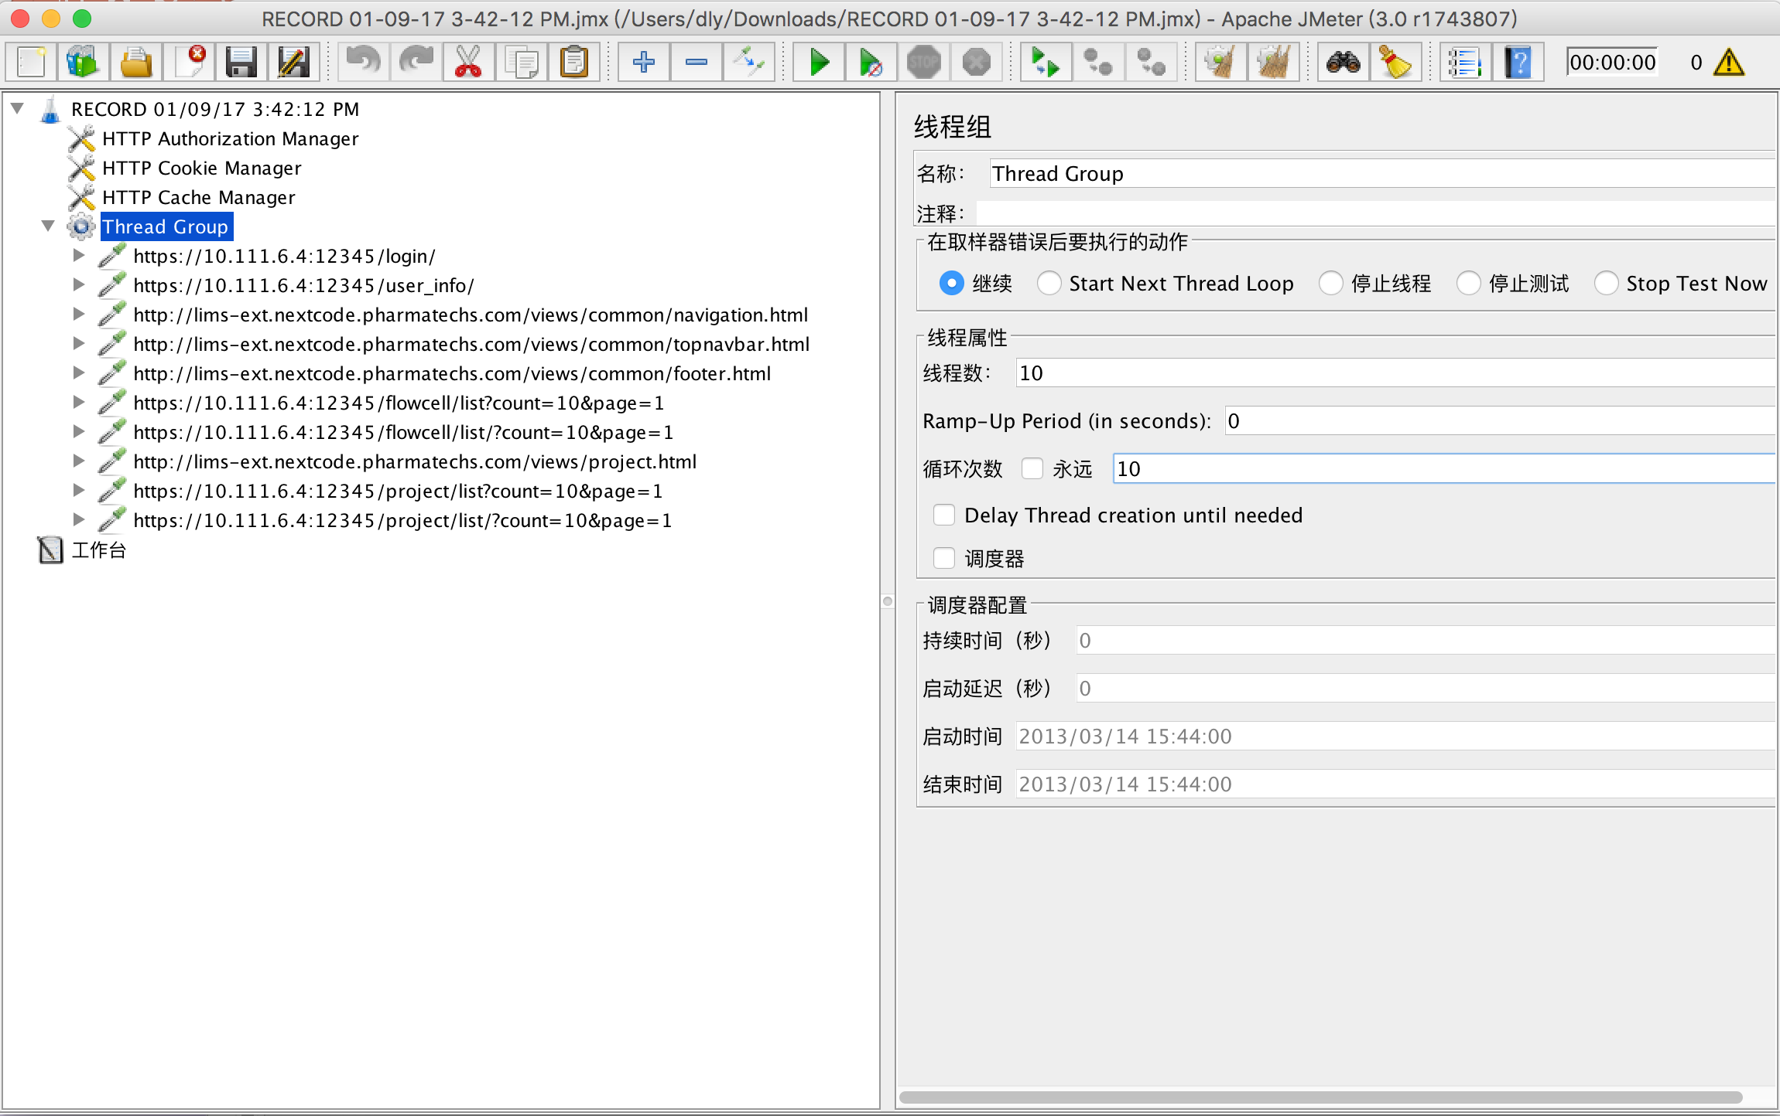
How to work?
Notes:
测试计划(Test Plan)是使用 JMeter 进行测试的起点，它是其它 JMeter 测试元件的容器。 线程组(Thread Group)代表一定数量的并发用户，它可以用来模拟并发用户发送请求。 取样器(sampler)定义实际的请求内容，被线程组包含，我们主要用HTTP请求。 监听器(Listener) 逻辑控制器(Logic Controller) 断言(Assertions) 配置元件(Config Element) 前置处理器(Pre Processors)和后置处理器(Post Processors) 定时器(Timer)

Slide 9
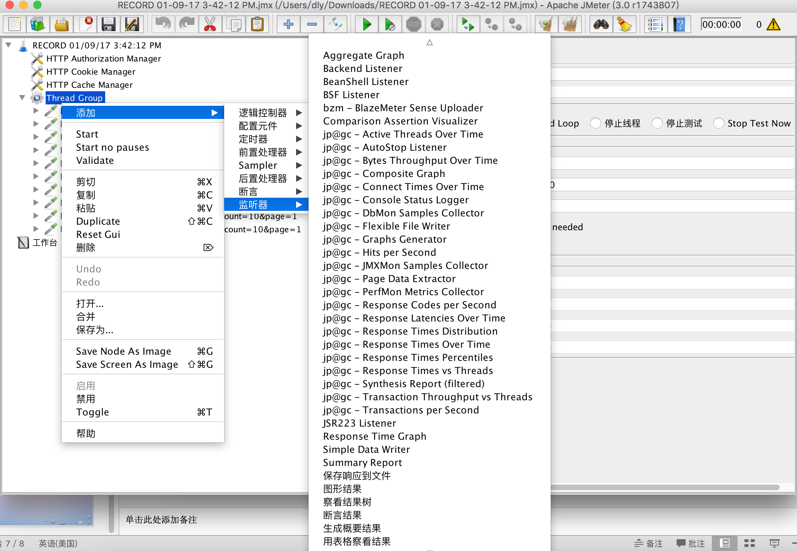
How to work?

Slide 10
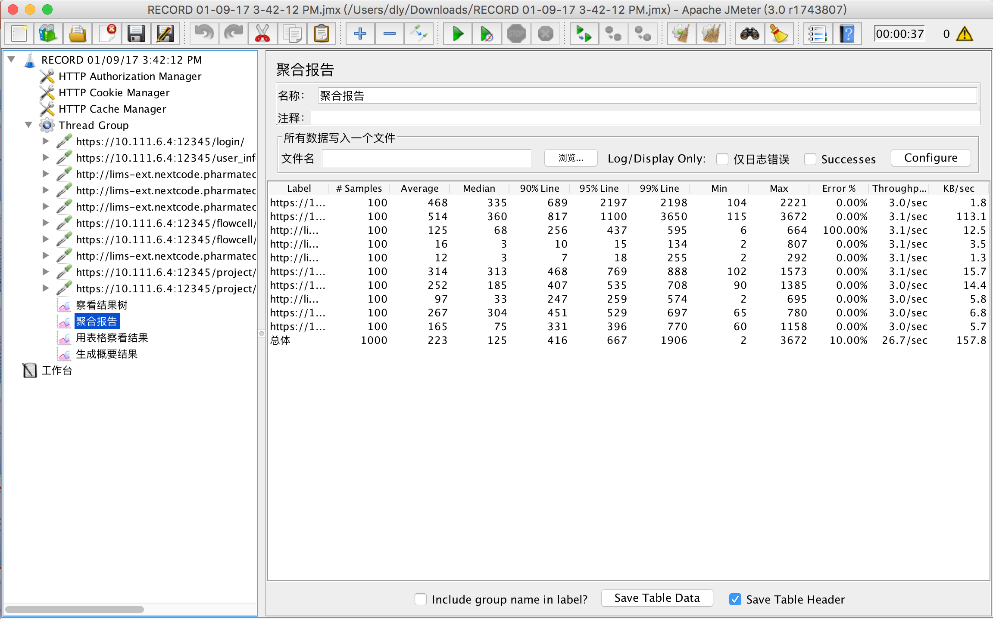
Notes:
Label：每个 JMeter 的 element （例如 HTTP Request ）都有一个 Name 属性，这里显示的就是 Name 属性的值 #Samples：表示你这次测试中一共发出了多少个请求，如果测试计划模拟10个用户，每个用户迭代10次，这里就会显示100 Average：平均响应时间 — 默认情况下是单个 Request 的平均响应时间，当使用了事务控制器时，也可以以事务为单位显示平均响应时间 Median：中位数，也就是 50 ％用户的响应时间 90% Line： 90 ％用户的响应时间 Min：最小响应时间 Max：最大响应时间 Error%：错误率，本次测试中出现错误的请求的数量 / 请求的总数 Throughput：吞吐量 —— 默认情况下表示每秒完成的请求数（ Request per Second ） KB/Sec：每秒从服务器端接收到的数据量

Slide 11
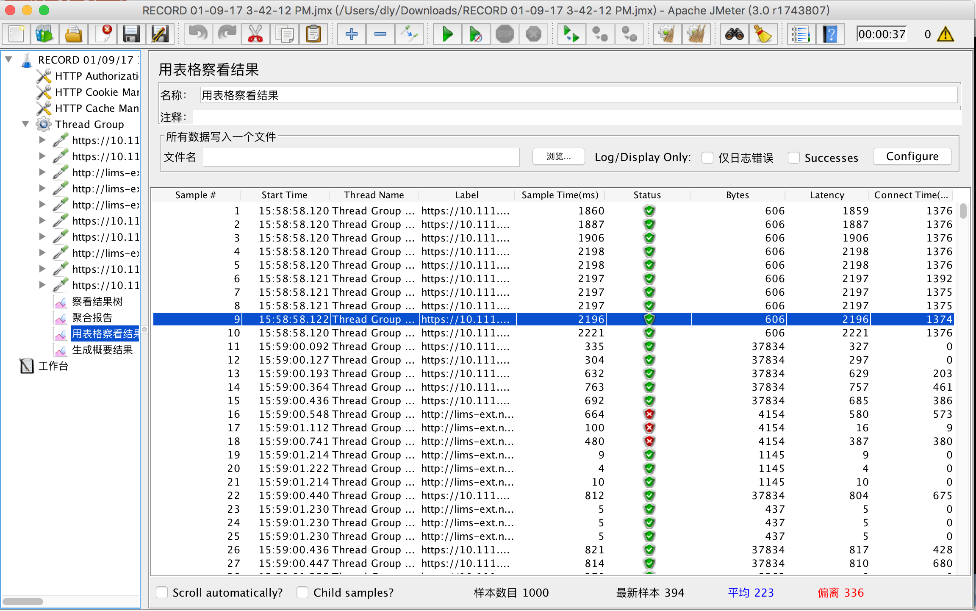
Notes:
查看结果树添加步骤：（右键点击每一个操作步骤 ---> “添加”---->“监听器”---->“用表格察看结果”）
样本数目：总共发送到服务器的请求数。
最新样本：代表时间的数字,是服务器响应最后一个请求的时间。
平均值：总运行时间除以发送到服务器的请求数。
偏离：服务器响应时间变化、离散程度测量值的大小，或者，换句话说，就是数据的分布。

Slide 12
Other usage link
Tests
jmeter fields translated

Slide 13
Thanks!

