Slide 1
Telecom Customer Churn Dashboard
Mini Project – Data Analysis using Microsoft Excel
Presented by: Dharani
B.E. Electrical and Electronics Engineering
1

Slide 2
Introduction
Customer churn refers to customers leaving or discontinuing a telecom service.
High churn can reduce customer base, revenue and long-term business growth.
Data analysis helps identify customer groups and service factors associated with churn.
This project uses Excel to analyze telecom customer data and build a dashboard.
2

Slide 3
Project Objectives
Measure the total number of churned customers and overall churn rate.
Identify contract, tenure, service and payment categories with higher churn.
Analyze customer characteristics such as gender, partner status and senior-citizen status.
Create KPIs, Pivot Tables, charts and slicers for interactive analysis.
Present the findings through a professional telecom churn dashboard.
3

Slide 4
Problem Statements – 1
1. How many customers have churned?
2. Which contract has more churn?
3. Which tenure group has more churn?
4. Which internet service has more churn?
5. Which payment method has more churn?
4

Slide 5
Problem Statements – 2
6. Do senior citizens churn more?
7. Does monthly charge affect churn?
8. Do customers with partners churn less?
9. Which gender has more churn?
10. Which services have more churn?
5

Slide 6
Dataset Overview
Dataset: Telecom Customer Churn
Total records: 7,043 customers
Customer attributes: CustomerID, gender, senior-citizen status and partner status
Service attributes: phone, internet and streaming services
Billing attributes: contract, payment method, monthly charges and total charges
Target variable: Churn (Yes / No)
6

Slide 7
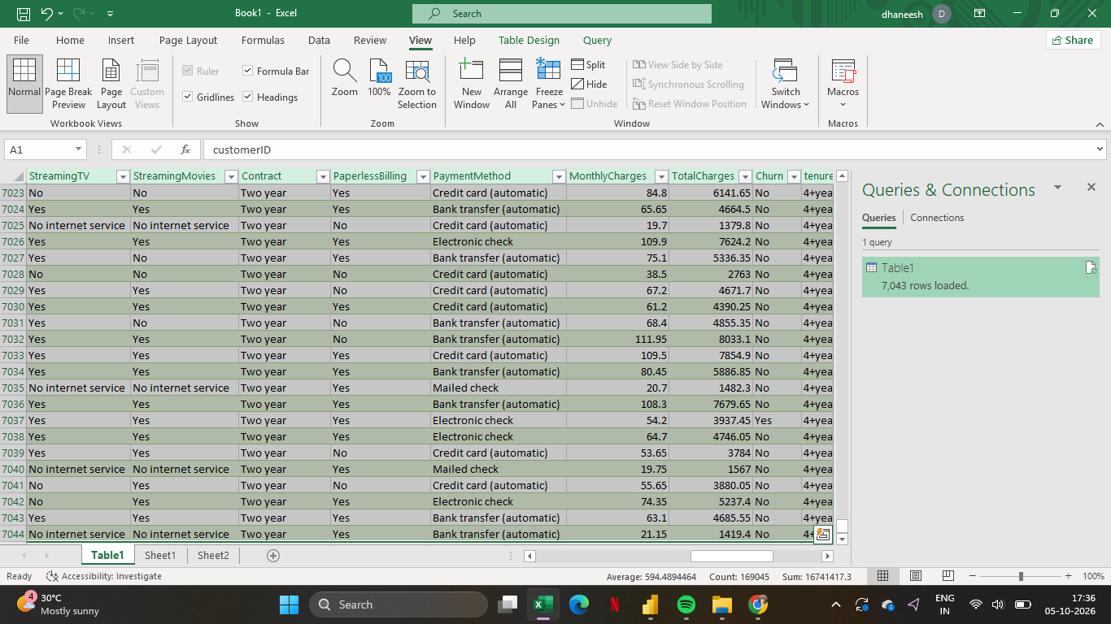
Raw Data Analysis
7

Slide 8
Data Preprocessing
Checked the dataset structure and column names.
Reviewed missing, blank and inconsistent values.
Checked and corrected data types for numerical and categorical fields.
Prepared the data as an Excel Table for analysis.
Created useful categories such as Tenure Groups and Senior Citizen classification.
8

Slide 9
Data Transformation & Preparation
Cleaned and organized the dataset for Pivot Table analysis.
Grouped tenure values into meaningful tenure categories.
Prepared categorical fields for churn comparison.
Used the cleaned table as the source for Pivot Tables and Pivot Charts.
The final prepared dataset contains 7,043 customer records.
9

Slide 10
Key Performance Indicators (KPIs)
Total Customers
7,043
Churned Customers
1,869
Churn Rate
26.54%
Avg. Monthly Charges
64.76
The dashboard KPIs provide a quick summary of the customer base and churn situation.
10

Slide 11
Charts – Churn & Contract Analysis
Chart 1: Overall Churn
Chart 2: Contract-wise Churn
11

Slide 12
Charts – Tenure & Internet Service
Chart 3: Tenure Group vs Churn
Chart 4: Internet Service vs Churn
12

Slide 13
Charts – Payment & Senior Citizens
Chart 5: Payment Method vs Churn
Chart 6: Senior Citizen vs Churn
13

Slide 14
Chart – Monthly Charges & Churn
Chart 7: Monthly Charges Category vs Churn
14

Slide 15
Chart – Partner & Churn
Chart 8: Partner vs Churn
15

Slide 16
Chart – Gender & Churn
Chart 9: Gender vs Churn
16

Slide 17
Chart – Services & Churn
Chart 10: Service-wise Churn
17

Slide 18
Slicers – Interactive Analysis
Gender
Senior Citizen
Contract
Internet Service
Payment Method
Partner
Tenure Group
Insert screenshot of your slicers here
18

Slide 19
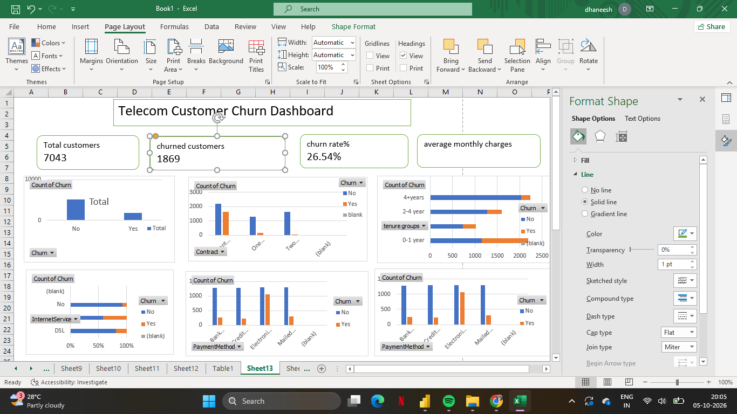
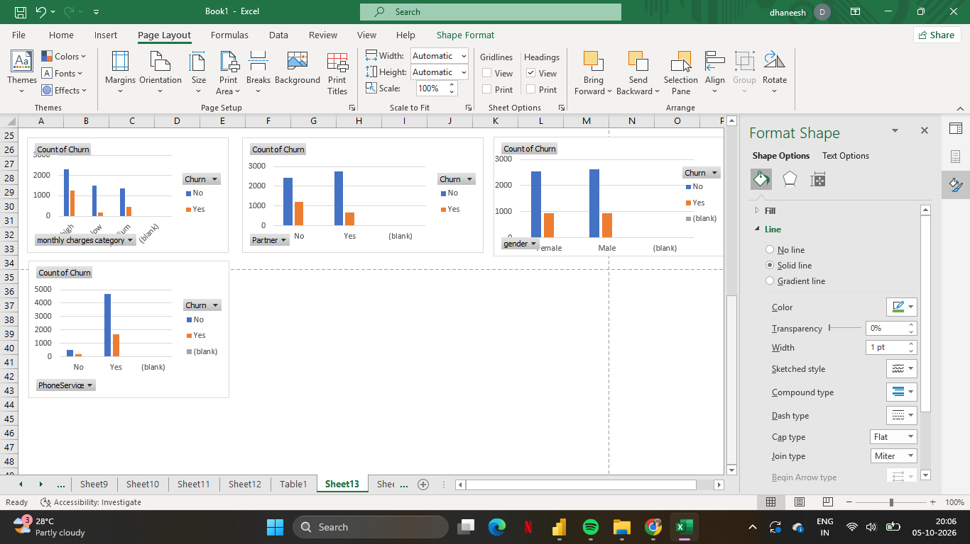
Final Dashboard
19

Slide 20
Conclusion
The telecom dataset contains 7,043 customers, of which 1,869 customers have churned.
The overall churn rate is 26.54%, showing a significant level of customer loss.
The analysis compares churn across contract, tenure, services, payment method and customer characteristics.
KPIs, Pivot Charts and slicers make the analysis easier to understand and explore.
The dashboard can help identify high-churn customer segments and support data-driven retention decisions.
20

