Slide 1
Datathon 2025
Dylan Day
Natalie Schwartz

Slide 2
Agenda
Overview
Data ETL
Data Exploration
Model Selection
Model Deployment
Results

Slide 3

Overview
FutureBright Insurance is seeking a predictive model to estimate expected auto claim losses and improve customer risk segmentation.
Using historical exposure and claims data, we build and compare several modeling approaches such as XGBoost, transformer-based TabPFN, and composite frequency–severity models which are supported by rigorous variable reduction and model tuning.
The presentation covers the full workflow from data exploration to model evaluation and business interpretation.

Slide 4
Data Extract, Transform, Load
In the ETL stage, the policy-level and claim-level datasets were loaded, cleaned, and merged to create a modeling and inference dataset.
Model and Inference data extracted and visualized to identify potential issues.
‘veh_value’ and ‘credit_score’ are capped at their 99th percentile for stability.
Data is loaded into memory for further exploration.

Slide 5
Data Exploration
Loaded and prepared modeling and inference datasets.
Analyzed target distributions and applied a 99th percentile severity cap to control extreme values.
Generated diagnostic plots to understand heavy-tailed loss behavior.
Assessed predictor stability using a consistency check across modeling and inference data.
Ran predictiveness checks to evaluate how each predictor relates to frequency, severity, and exposure.

Slide 6
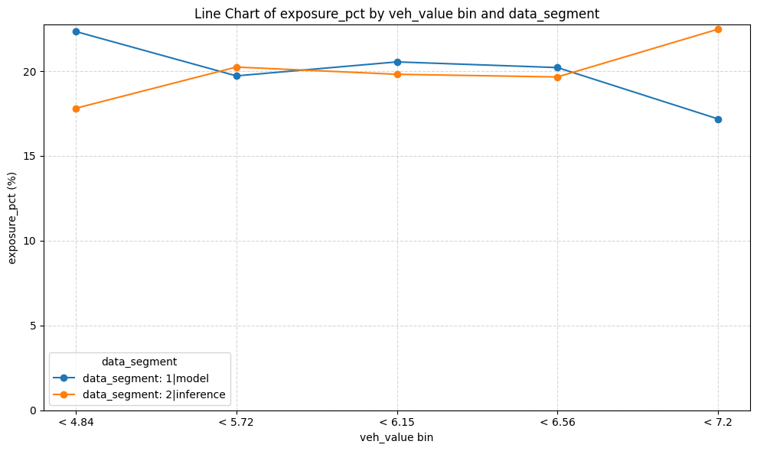
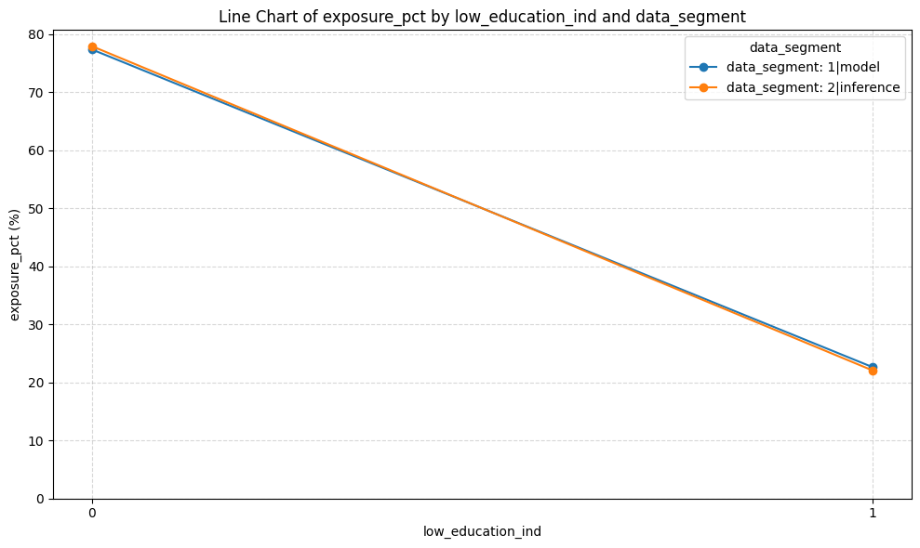
Data Exploration

Slide 7
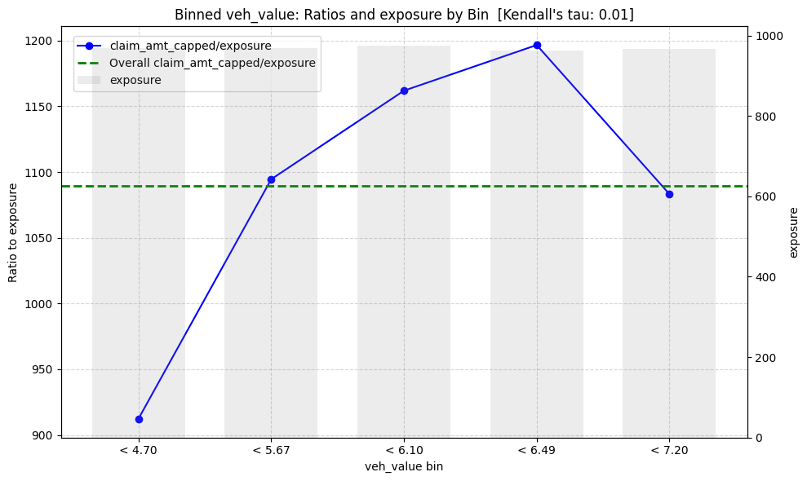
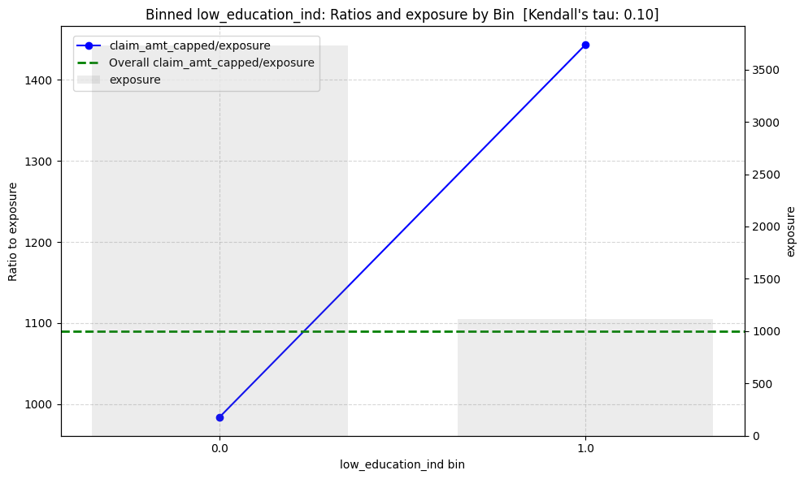
Data Exploration

Slide 8
Data Exploration: Variable Reduction
First Round: Variable Reduction via Tree-based Model
Start with the most promising data source and train a tree-based model.
Remove low-importance predictors, keeping only a handful of strong variables.
Add the next data source, retrain, and again remove weak predictors.
Repeat for the rest of the data sources until all sources have been screened.
Vehicle Data
Train tree-based model
Compute variable importance
Drop low-importance variables
Demographic Data
Retrain combined model
Recalculate importance
Drop weakest predictors
Driving Behavior Data
Retrain combined model
Recalculate importance
Drop weakest predictors

Slide 9
Data Exploration: Variable Reduction
Second Round: Variable Reduction via VarClusHi
What VarClusHi Does:
Groups variables into clusters based on shared variance (similar to hierarchical PCA).
Identifies sets of predictors that carry redundant information.
Helps reduce multicollinearity by selecting one representative variable per cluster.
How It Works:
Computes each variable’s R² with its own cluster vs. R² with the nearest competing cluster.
Variable | RS_OWN | RS_NC | RS_RATIO | Importance | Kendall Tau
veh_value | 0.753764 | 0.105931 | 0.275410 | 0.148462 | 0.005068
max_power | 0.803129 | 0.114554 | 0.222341 | 0.061292 | 0.000277
veh_age | 0.753764 | 0.009796 | 0.248672 | 0.058669 | 0.021723
veh_body_SUV | 0.573698 | 0.028331 | 0.438731 | 0.042644 | 0.048809
driving_history_score | 0.506224 | 0.006829 | 0.497172 | 0.038845 | -0.041404
veh_body_SEDAN | 0.499745 | 0.037815 | 0.519915 | 0.034991 | -0.031615
low_education_ind | 0.000624 | 0.000874 | 1.000250 | 0.031098 | 0.101715
credit_score | 0.003006 | 0.001924 | 0.998916 | 0.028970 | -0.060454
time_driven_6am - 12pm | 0.834657 | 0.006283 | 0.166388 | 0.015685 | 0.009180
veh_body_PANVN | 0.027737 | 0.002069 | 0.974279 | 0.012804 | -0.007882

Slide 10
Model Selection: Overview
Built Base Model
Hyperparameter Tuning of Tree-Based model
TabPFN
Composite Poisson-Gamma Model
Model Comparisons and Conclusions
Constructed a Tweedie-based XGBoost model to predict claim cost per exposure.
Generated predictions, evaluated performance (Top-Lift, Gini, RMSE, MAE, R²).
Implemented TabPFNRegressor on a subsample (1,000 train / 500 val) due to CPU constraints.
Evaluated model performance.
Poisson regression for claim frequency
Gamma regression for claim severity (only on positive losses)
Combined frequency × severity to obtain total loss predictions.
Compared all models across validation metrics (RMSE, MAE, Gini, R², Top-Lift).
Summarized strengths/weaknesses of Linear/GLM, Tree-based, Deep learning/TabPFN models
Identified where each model type is most
Tuned parameters in sequential blocks for interpretability and efficiency.
Performed XGBoost CV for each grid and selected best combination by lowest RMSE.
Trained a fully tuned model and re-evaluated using validation metrics.

Slide 11
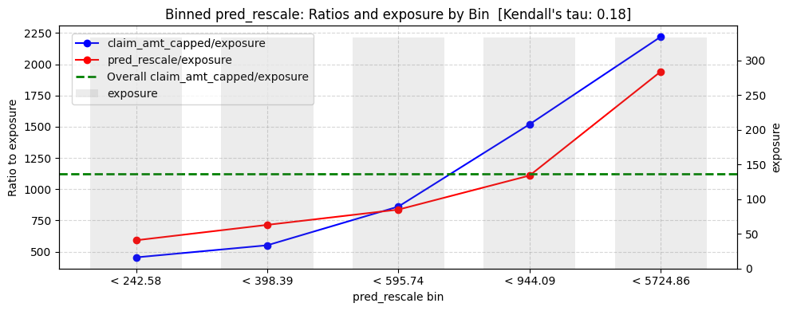
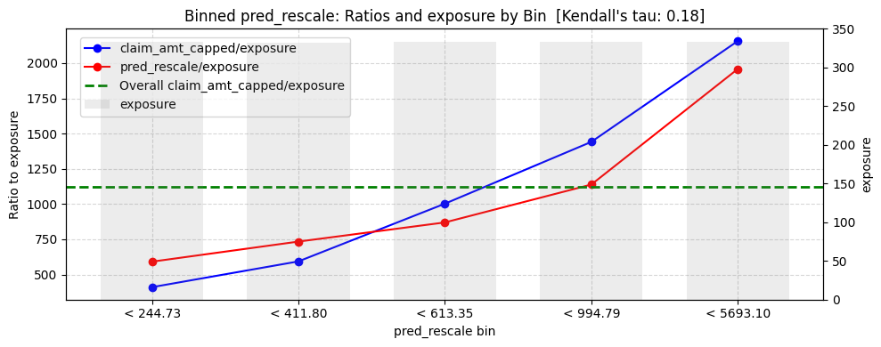
Model Selection: Tree-Based Models
XGBoost Base Model
Built an initial Tweedie-based XGBoost model using default or lightly-adjusted hyperparameters.
Provided strong baseline metrics with minimal tuning, capturing nonlinearities and interaction effects automatically
XGBoost Tuned Model
Improved the base model through staged hyperparameter tuning (learning rate, subsampling, tree depth, regularization).
Achieved lower RMSE and higher R², indicating better generalization and more stable predictions.

Slide 12
Model Selection: Deep Learning/TabPFN
TabPFN
Transformer-based model pretrained on millions of synthetic tabular datasets, enabling zero-shot prediction with no training or tuning.
Designed for small, fully numeric, complete datasets, where it delivers fast and competitive performance.
Acts as a universal learner by using in-context learning rather than gradient-based training.
Results
In this project, TabPFN was applied to a small subset (1,000 training / 500 validation) due to compute constraints.
On this subset, it produced higher RMSE and MAE and negative R², performing worse than XGBoost and the composite model.
Still captured some predictive signal, achieving moderate Gini values, despite using less than 10% of the full data.
RMSE: 2504.53, MAE: 1156.35, R^2: -0.1021, Gini: 0.4625

Slide 13
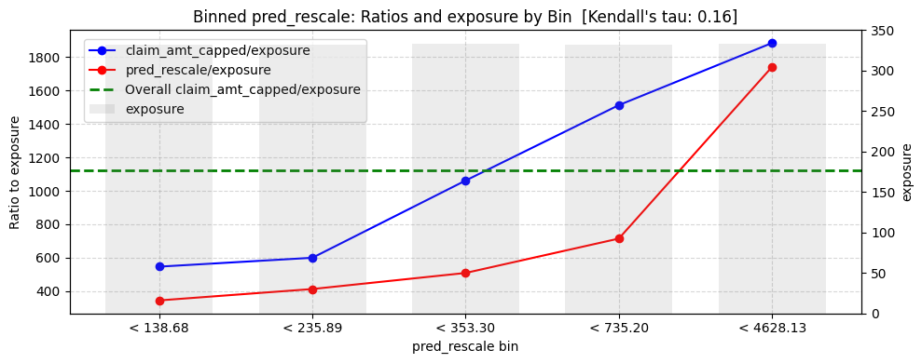
Model Selection: Composite Model
What It Is
A traditional actuarial modeling framework that separates claim frequency and claim severity.
Uses Poisson regression to model the claim frequency.
Uses Gamma regression (on positive losses) to model the claim severity.
Combines the two components to produce expected total loss = frequency × severity.
Why It’s Used
Mirrors the structure used in real insurance pricing, making results easy to justify to stakeholders.
Useful when modeling skewed, zero-inflated loss data where frequency and severity behave differently.
Results
Achieved RMSE = 2341.77, MAE = 867.54, R² = 0.03, and Gini = 0.34.
Performed reasonably well, but both the base and tuned XGBoost models achieved lower RMSE/MAE and Gini values higher by ~0.2, showing significantly stronger ranking ability.

Slide 14
Model Selection: Comparison
Tree-Based Models
Pros
Cons
TabPFN
Pros
Cons
Strong predictive accuracy on tabular data
Captures nonlinearities & interactions automatically
Robust to outliers and skewed loss distributions
Tuned model improves stability & generalization
Requires tuning for best performance
Harder to interpret than GLMs
Training can be computationally heavier than linear models
No training or hyperparameter tuning needed
Extremely fast inference
Captures complex patterns through pretraining
Works best on small datasets
Sensitive to input encoding and sampling
Composite Model
Pros
Cons
Highly interpretable and industry-standard
Separates frequency and severity for clarity
Simple, transparent, and easy to communicate
Limited ability to capture nonlinear interactions
Predictive accuracy generally lower than ML models
Relies heavily on correct distributional assumptions
Tuned XGBoost Tweedie Regression model is the best model for predictability.
The Composite Model is the best for interpretability.

Slide 15
Model Performance Summary
XGBoost Tweedie clearly dominates TabPFN and the composite model.
  TabPFN has the highest errors and even a negative R^2
  Composite Poisson-Gamma improves MAE but still lags in RMSE and Gini
Base vs tune XGBoost: only incremental changes, but tuned has the best overall fit
  Tuning slightly reduces RMSE and improves R^2, with essentially the same Gini as the base model, showing the base model was already strong.
Final choice for deployment: tuned XGBoost Tweedie
Model | RMSE | MAE | R^2 | Gini
Base XGBoost Tweedie | 2336.32 | 695.18 | 0.0319 | 0.5656
Tuned XGBoost Tweedie | 2327.12 | 746.63 | 0.0395 | 0.5631
TabPFN | 2504.53 | 1156.35 | -0.1021 | 0.4625
Composite Poisson-Gamma | 2341.77 | 867.54 | 0.0274 | 0.3423

Slide 16
Model Deployment:
Once the final model was selected, we operationalized it to generate predictions on the unseen inference dataset using the following workflow:
Loaded the cleaned inference dataset and finalized modeling objects.
Applied consistent preprocessing steps to inference data.
Loaded the trained tuned XGboost model.
Generated expected loss predictions at the policy level.
Assigning risk tiers based on modeled expected loss
Provided explanation explanation outputs for business users through top-reason summaries and SHAP rA

Slide 17
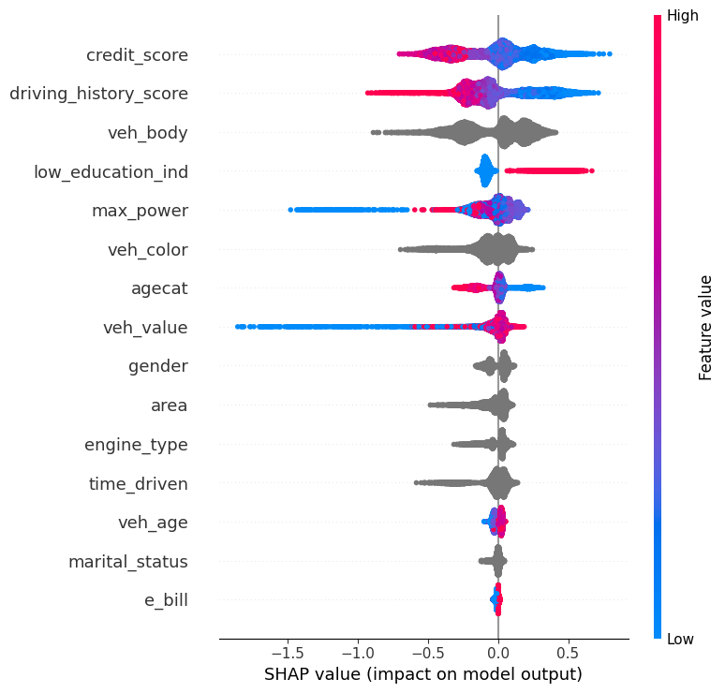
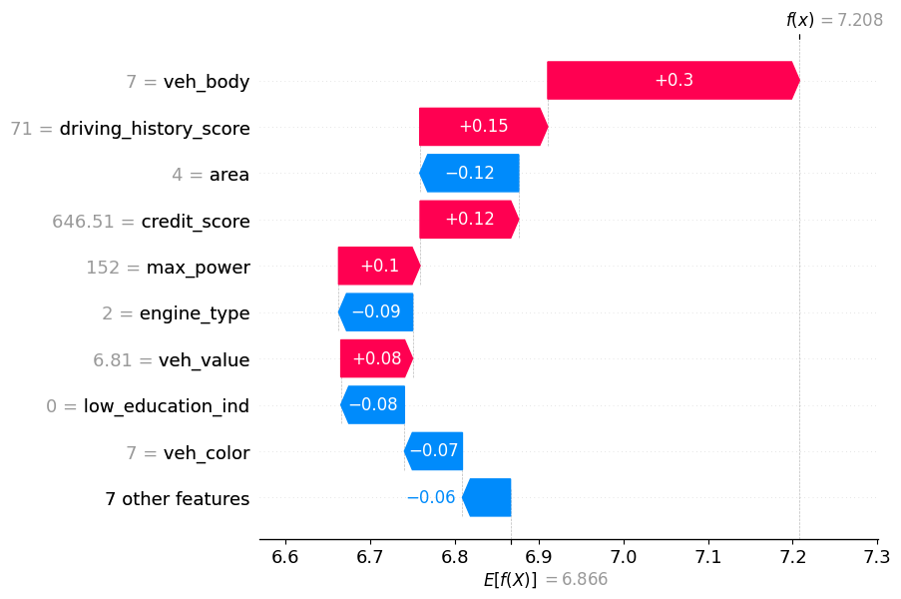
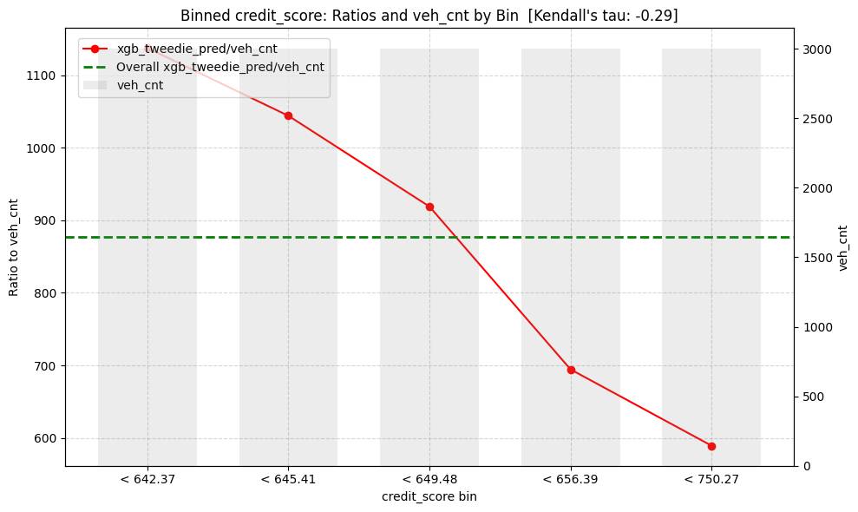
Model Deployment: SHAP & Top Reasons
SHAP identified global drivers of risk (credit, driving history, vehicle body)
Waterfall plots show why an individual customer's risk is high or low (example: Quote 55)
Top Reasons confirm monotonic patterns (higher credit → lower predicted loss

Slide 18
Model Deployment: SHAP & Top Reasons
Business Results: Insights
Risk is driven by vehicle + behavior more than demographics
  The model shows higher risk for SUV's, high value, high- powered vehicles and worse driving history/ low credit scores
  Hybrid engines, higher education, and some areas reduce risk.
Example quote (ID 55) is slightly above average risk.
  The waterfall plot shows this customer's SUV body, driving_history_score, credit_score, max_power, and veh_value push expected loss about 5% above the portfolio average.
  This is partly offset by living in a safer area, driving a hybrid, and having higher education
Recommendations
  Underwriters should prioritize reviewing quotes where modeled risk is elevated due to vehicle attributes, driving history, or credit indicators. Consider pricing surcharges or coverage modifications
Model Performance Summary
Model Performance Summary
Model Performance Summary

Slide 19
Final Takeaways
Tuned XGBoost Tweedie is the best-performing model, showing the strongest ranking ability and lowest error metrics
Model is operationalized and explainable, producing policy-level predictions, risk tiers, and transparent explanations.
Risk is primarily driven by vehicle attributes and driving behavior, not demographics.
Underwriters can take action by focusing review or pricing adjustments on SUV's, high-powered vehicles, low credit scores, and poor driving histories.
Prototype is ready for next steps, such as calibration, integration into rating engines, and ongoing monitoring.

Slide 20
END

