Slide 1
Parallelization of Algorithms Final Project
3D Heat Diffusion
MCS-2502: Dinmukhammed Abdiyev, Madiyar Zulpykhar
MCS-2501: Aldiyar Appaz
Notes:
Introduce the team and the project: we compute how a hot region cools inside a three-dimensional block, and compare ways to parallelize the same numerical update.

Slide 2
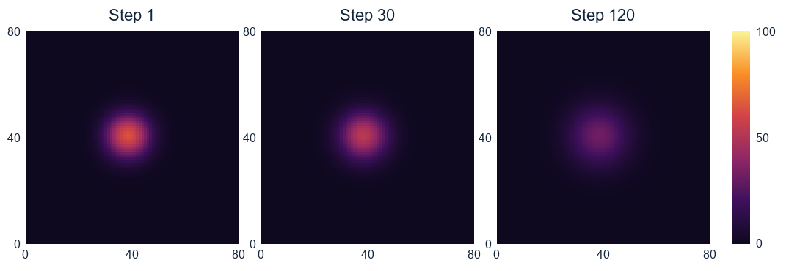
Heat spreading through a solid
A hot spot diffuses inside a solid while all six faces stay at zero.
Central z slice, 81 × 81 × 81 grid. Color scale: model temperature units.
Notes:
These images were generated from central slices exported by the solver during the original run. The cut is z=40. Color scales are identical, so peak cooling and the spread of warm values can be compared directly.

Slide 3
The seven-point update
∂T/∂t = α ∇²T
Tnew = (1 − 6r) Told + r × sum of the six neighbors
Stable step
Two buffers
r = αΔt/h² = 0.12, below the limit 1/6 for a uniform 3D grid.
Read only the old field, write the new one, then swap the arrays.
T: Temperature | t: time | α: Thermal diffusivity | r: Mesh Fourier number / CFL (Courant–Friedrichs–Lewy) stability parameter | sum: sum of neighbouring temperatures | h: spatial grid steps
Notes:
The heat equation is discretized using forward Euler in time and centered second differences in space. The stencil has six neighbors plus the center. With equal spacing h, the coefficient r=alpha*dt/h² must be at most 1/6; our r=0.12 keeps all seven weights nonnegative. Fixed-temperature boundaries model heat leaving the block, so total heat need not be conserved.

Slide 4
Who owns each part of the grid
Serial
One process updates all interior cells in z, y, x order.
OpenMP
Threads divide rows with static scheduling. Each output cell has one writer.
MPI + OpenMP
Each MPI process owns a slab of z planes. Two ghost planes hold its neighbors’ data.
Notes:
Grid::rows flattens the (z,y) pair so the inner x loop stays contiguous. The interior z planes are divided using quotient and remainder. Rank r has base plus one plane if r is below the remainder. Ghosts store copies of neighboring planes, never authoritative data. All MPI calls are made by the main thread under MPI_THREAD_FUNNELED.

Slide 5
Correctness checks
0
5.56 × 10⁻¹⁶
maximum cell difference vs serial
upper bound on measured sine-mode error
10 checks passed across serial, OpenMP and both hybrid modes.
Tests include uneven slab sizes and five MPI processes with one plane each.
Notes:
The original verification suite ran ten checks. The discrete sine mode is independent of the serial stencil reference: its amplitude after k steps is lambda^k, lambda=1−6r+2r[cos(pi/(Nx−1))+cos(pi/(Ny−1))+cos(pi/(Nz−1))]. Cases include an uneven partition and the one-plane-per-rank edge case. The solver also checks finite values, the allowed range and zero boundaries.

Slide 6
Benchmark setup
Test machine
Single Windows PC · Intel Core i5-11400H · 12 logical processors · MSVC /O2.
Strong scaling
Fixed grid: 224 × 224 × 226, 42 steps. Speedup S = T₁/Tₚ; efficiency E = S/p.
Weak scaling
24 interior z planes per rank, 160 × 160 plane, 55 steps. Compare to the one-rank time.
Three timed runs after warm-up. For strong scaling, p = MPI ranks × threads per rank.
Notes:
Source: original benchmark runs on the test PC. Each recorded replicate starts with the same initial field; a warm-up of up to four steps is separate. An MPI barrier precedes timing. Each replicate uses the slowest rank's elapsed time; the reported result is the median of three replicates. Wall time includes halo transfers and OpenMP synchronization but not setup, validation, reductions of timings, or CSV output.

Slide 7
Strong scaling: speedup
2.22×
Speedup
Best measured speedup: OpenMP with 4 threads.
Baseline: 0.798 s serial. Both curves use the serial baseline at one worker.
Notes:
Source: original benchmark runs on the test PC. OpenMP uses one rank. The hybrid curve at p=1 uses serial as the shared baseline; p=2,4,8 use 2 MPI ranks × 1,2,4 threads respectively. Hybrid uses blocking MPI_Sendrecv. Speedup is relative to the serial time of 0.7981668 s.

Slide 8
Strong scaling: efficiency
26%
Parallel efficiency
OpenMP efficiency at 8 threads. Extra workers did not reduce runtime.
Efficiency is relative to the same serial reference, using all MPI ranks × threads.
Notes:
Source: original benchmark runs on the test PC. Efficiency divides the same serial-relative speedup by total worker count. Increasing workers from four to eight does not reduce the time for either of these two curves. Memory bandwidth, synchronization and thread placement are possible contributors, but not isolated by this experiment.

Slide 9
Weak scaling: cost per rank
23%
Weak scaling efficiency at 8 ranks on one PC.
Vertical axis: milliseconds for 55 steps. Weak efficiency = one-rank time / measured time.
Notes:
Source: original benchmark runs on the test PC. Each rank updates 158 × 158 × 24 interior cells per step. Increasing ranks increases the problem volume but all processes still share one PC. Ideal weak scaling would give a flat line. The time rise shows that this single-machine experiment does not deliver constant time per rank.

Slide 10
Overlapping MPI communication
Blocking version
MPI_Sendrecv completes both halo transfers before any cell updates.
Overlap version
Post MPI_Irecv and MPI_Isend, compute inner planes, then wait and update slab edges.
2 × 1 workers: 0.475 → 0.452 s | 2 × 2 workers: 0.365 → 0.409 s
Blocking → overlap. The change helped at 2 × 1 and hurt at 2 × 2 on this machine.
Notes:
Source: original benchmark runs on the test PC. For overlap, post receives before sends, update independent planes, wait for the halos, then update the first and last planes. Some MPI implementations do not advance all communication during computation without explicit progress. More OpenMP regions also introduce overhead. These are plausible explanations, not separately measured mechanisms.

Slide 11
Live demonstration
Heat3D.sln → Ctrl+F5
Notes:
Open Heat3D.sln in Visual Studio, select Release x64, and press Ctrl+F5. The program prints all mode comparisons and a sine-mode check. Explain why boundary planes wait for MPI and why swapping buffers prevents races. Open diffusion.png and show the central slice spreading. Slides 7–10 show the original benchmark; the live demo uses three MPI ranks.

