Slide 1
Predicting Tv Show Ratings
Dylan Davis

Slide 2
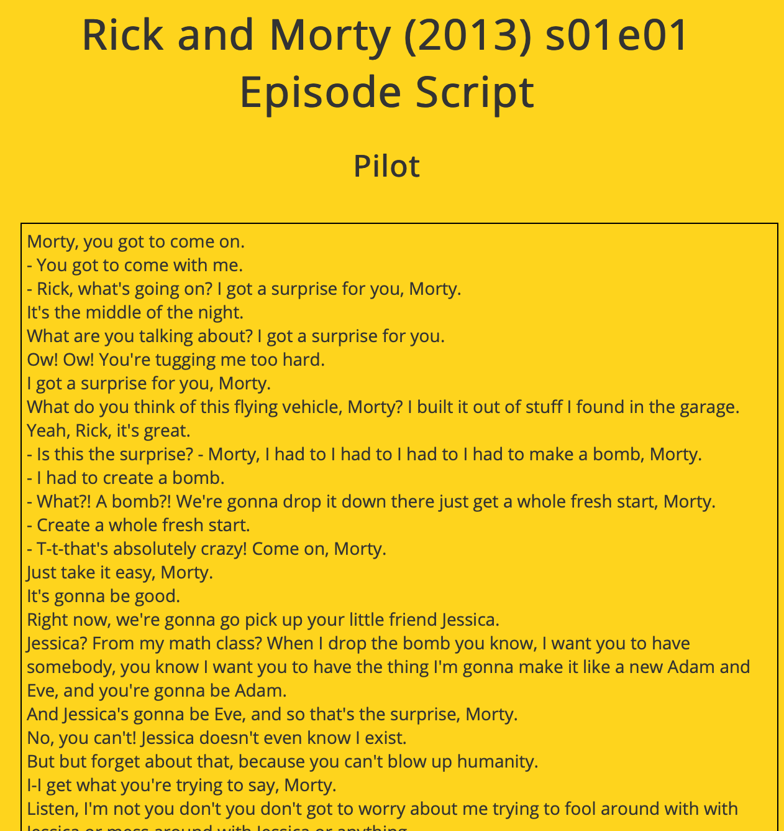
Data collection
www.springfieldspringfield.co.uk
Used web scraping to obtain the scripts in the format wanted
used the package “rvest”
rick and morty, south park, family guy, simpsons, bob's burgers, futurama, bojack horseman, archer episode
IMDB website
Obtain TSV files and imported them into R

Slide 3
Data INFO
Word Count Data
Each episode was a sample
Made simple script to grab the show script from each episode
IMDB Data
Consisted of three tables
Tv show ratings, number of votes, episode length, etc.
Episode basics (primary title, year show started, etc)
Episode info (season number, episode number, parent tv show code)

Slide 4
DATA cleaning
Word Count Data
Used the package “tm”
Removed punctuation, made everything lower case
IMDB Data
Used the parentTconst to subset the dataset by only the shows that I wanted
Merged the three tables by the corresponding tconst codes, represented each episode

Slide 5
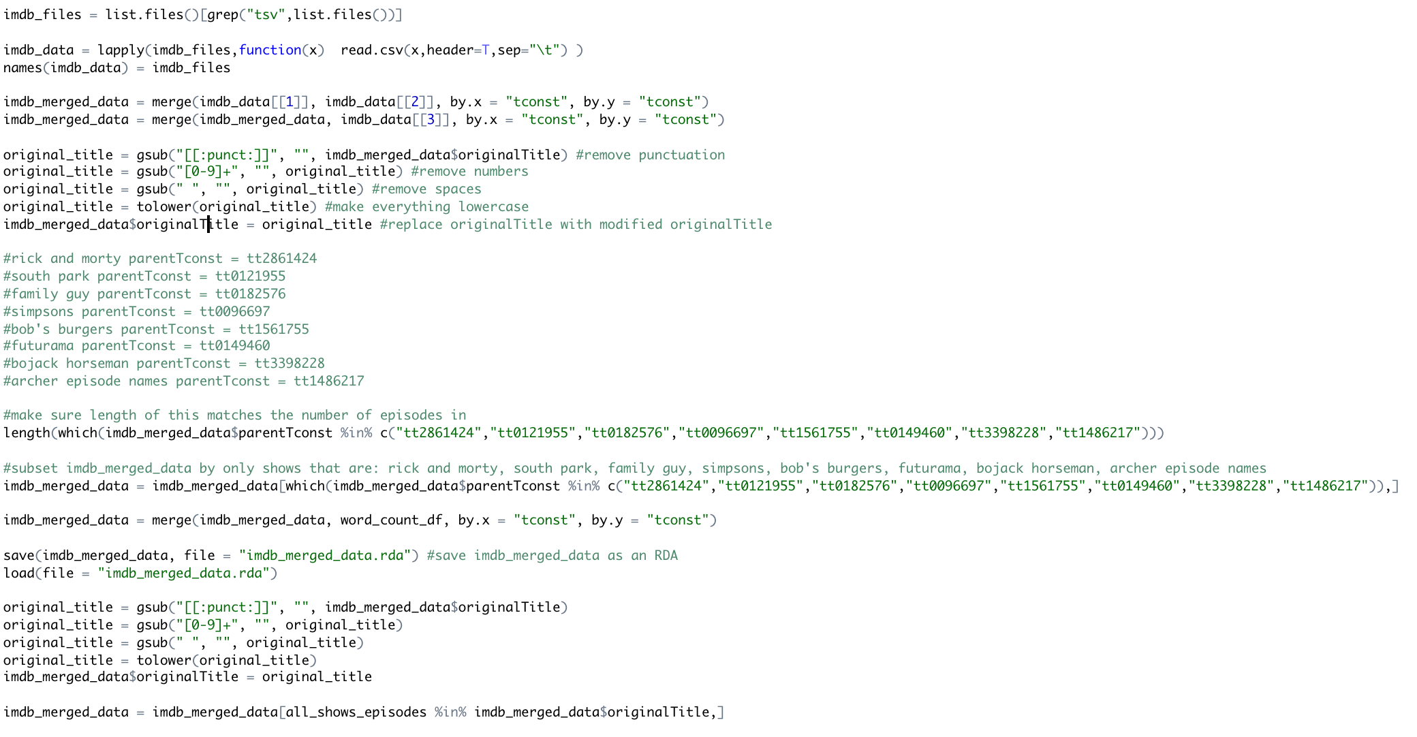
Further Cleaning

Slide 6
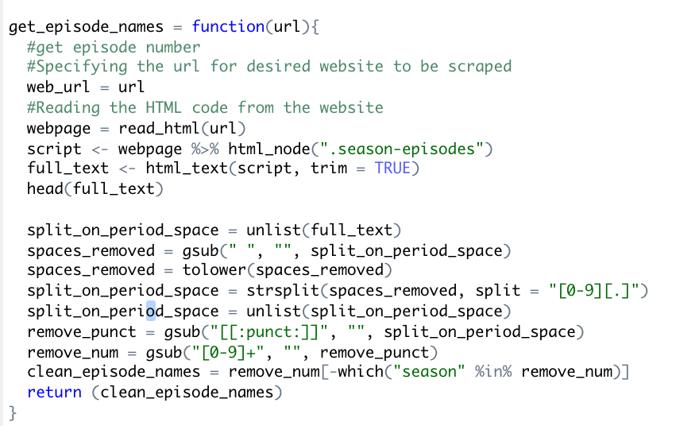
Further Cleaning
I wrote a function to grab the episode names for a specific TV show link
The function formats the titles so that they can be paired with the word count data for each episode
I check to make sure each show isn’t missing any episodes

Slide 7
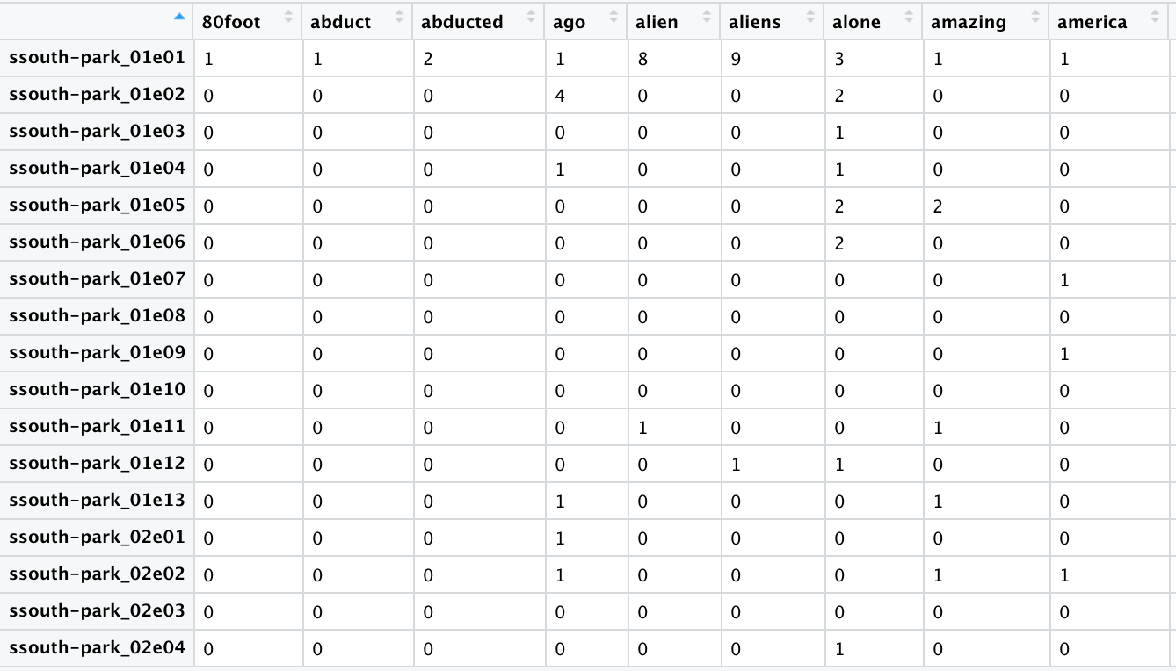
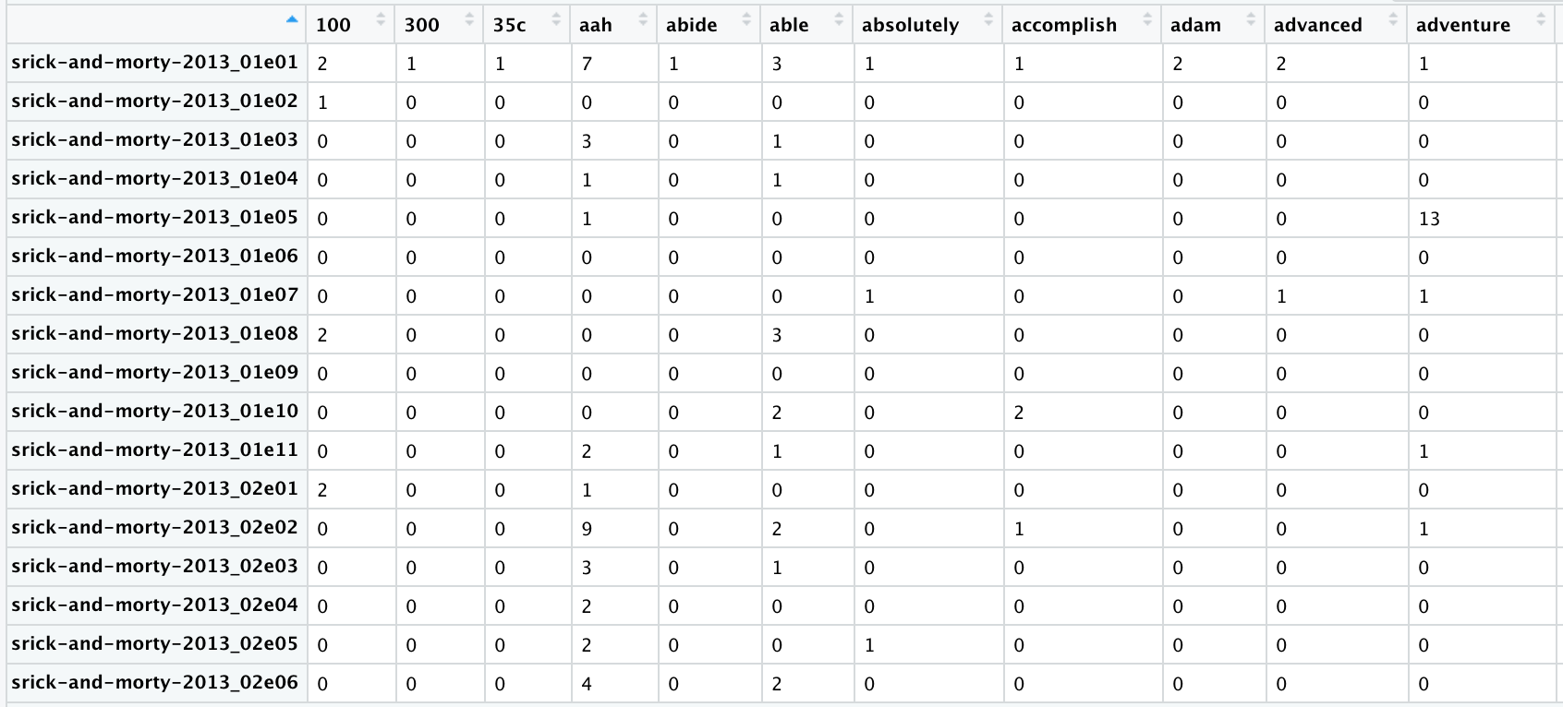

Slide 8
NEXT STEPS
I need to finish appending the titles of each episode to its word count data
I then need to merge the word count data frame with the current data frame containing all of the episode information
Finally I need to train a model on this data in order to predict the episode rating

