Slide 1
Company A 2022 Annual Sales Report
Notes:
Credits: This presentation template was created by Slidesgo, and includes icons by Flaticon, and infographics & images by Freepik

Slide 2
Table of contents
01
02
03
Overview
Market
Next Steps
Breif overview on daily, monthly, and quarterly trends.
Price and market sementation.
Recommendations based on the analysis.

Slide 3
01
Overview

Slide 4
Sales Overview
Number of Order | Number of Return | Returned share %
20,727 | 5,141 | 24.8034%
Sold items | Returned items | Returned share %
5,660,979 | 484,499 | 8.5585%
Total revenue | Returned Amount | Returned share %
10,630 799 | 661,531 | 6.2227%
Nearly 1 in 4 orders have returns, but this accounts for very little revenue returned
Customers | Revenue Amount | Revenue per customer
4,373 | 9,969,268 | 2279.7

Slide 5
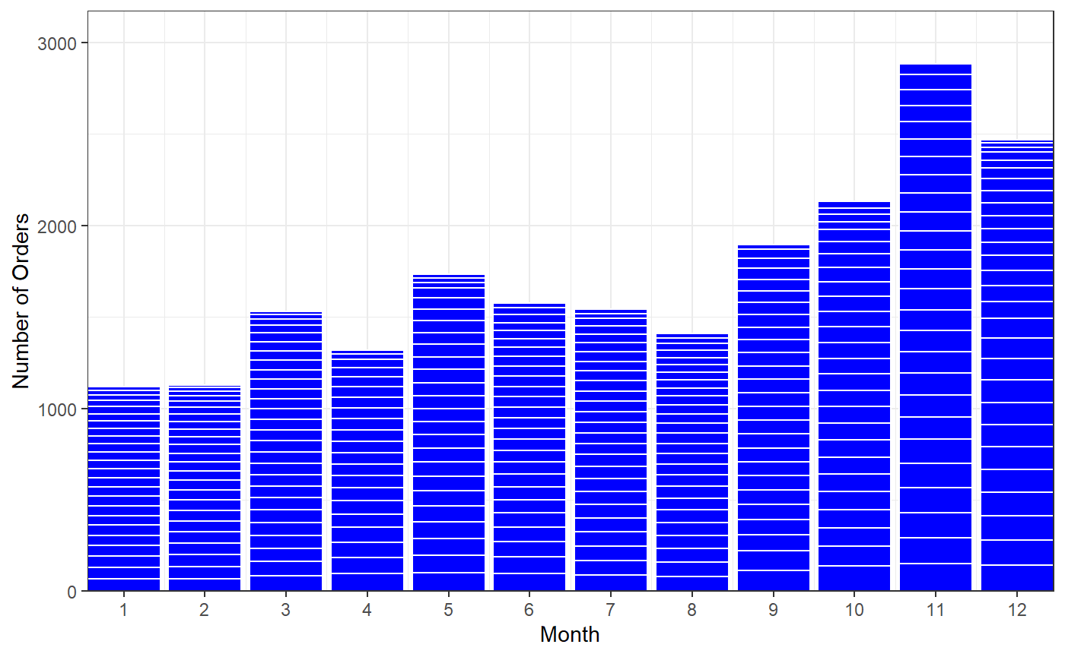
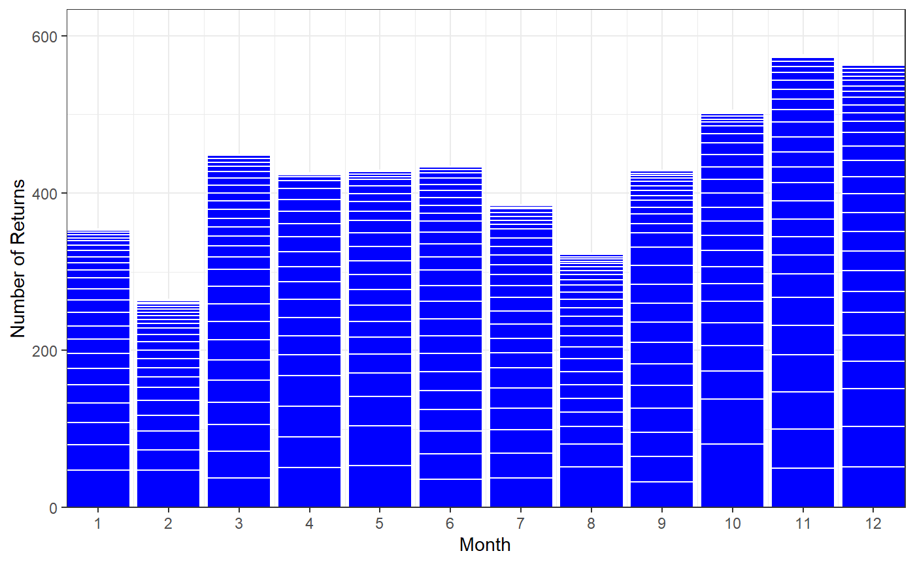
A clear correlation between orders and returns. They both increase consistently throughout the year and reach their peak in November and December.

Slide 6
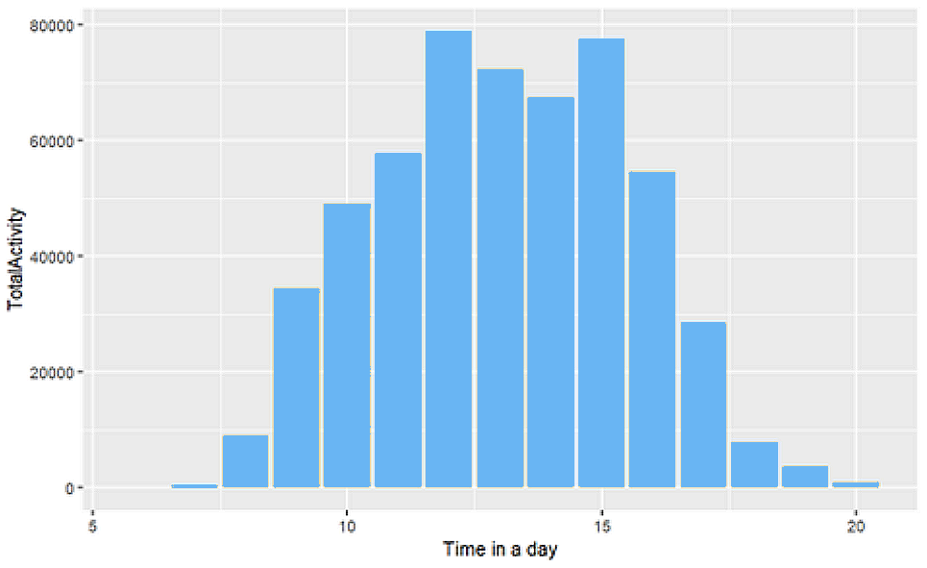
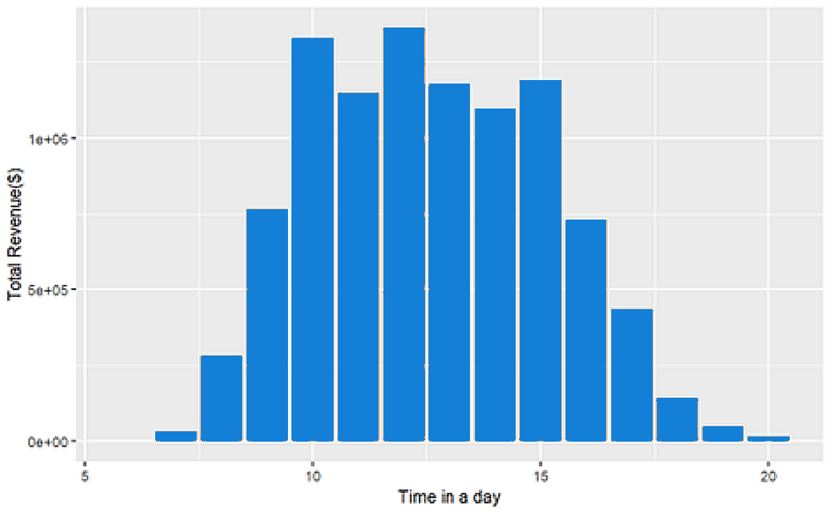
Activity Pattern
Revenue Pattern

Slide 7
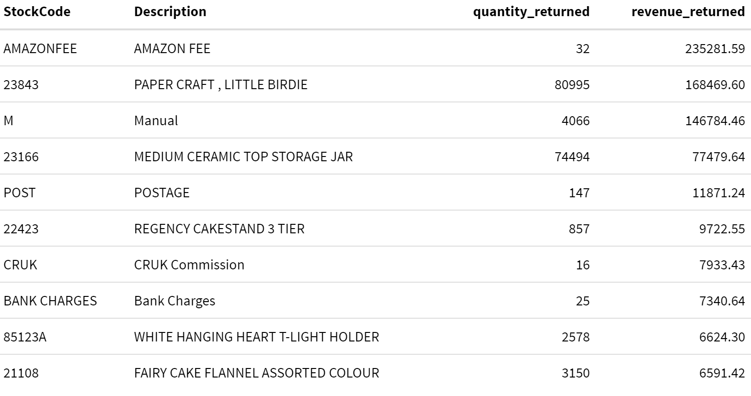
Returns Summary

Slide 8
Notable Returns
Description | Unit Price | CustomerID | Quantity Returned | Revenue Returned
Paper Craft, Little Birdie | 2.08 | 16446 | 80,995 | $168,469.60
Medium Ceramic Top Storage Jar | 1.04 | 12346 | 74,215 | $77,183.60
Manual | 3,8970.00 | 15098 | 1 | $38,970.00
Amazon Fee | 13,541.33 | NA | 1 | $27,082.66
Amazon Fee | 17,836.46 | NA | 1 | $17,836.46
Amazon Fee | 16,888.02 | NA | 1 | $16,888.02
Amazon Fee | 16,453.71 | NA | 1 | $16,452.71
Amazon Fee | 13,474.79 | NA | 1 | $13,474.79
Amazon Fee | 5,942.57 | NA | 1 | $11,855.44
Amazon Fee | 11,596.50 | NA | 1 | $11,586.50
The top 2 returns were 1-time purchases, so we considered them outliers. Also, Amazon Fee returns happened a lot and in total they were the most returned item. But there was no description of what Amazon Fee was so we excluded it from our returns analysis.

Slide 9
02
Market

Slide 10
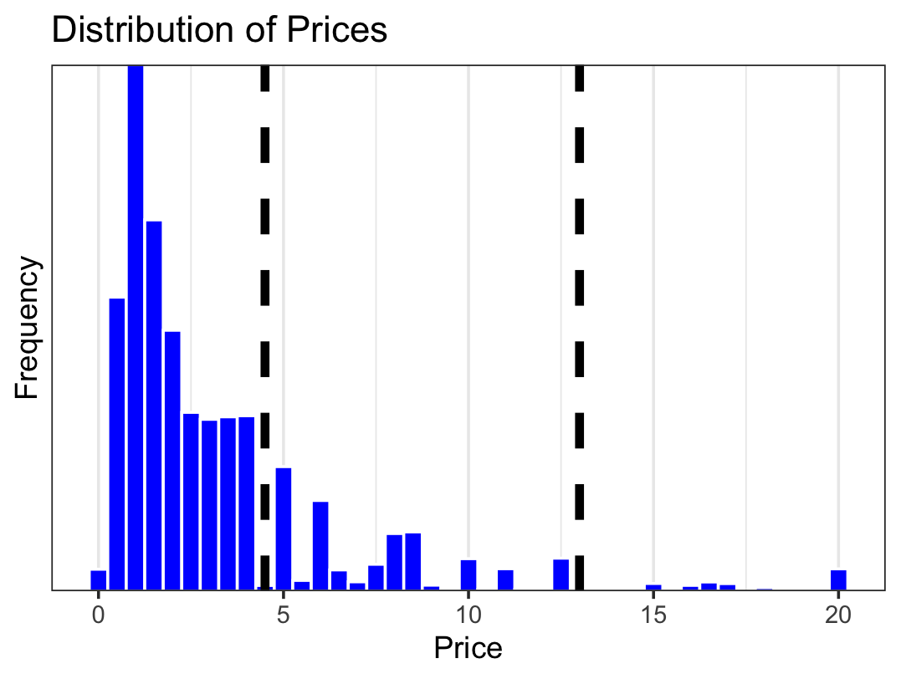
Price Differentiation
Cheap Goods: Unit Price is less than $4.95
Total Revenue | Revenue per Customer | Share of Revenue | Quantity per Customer
$7,399,432 | $2,213 | 71.98% | 1,218 Units
Medium Priced Goods: Unit Price is between $4.95 - $13
Total Revenue | Revenue per Customer | Share of Revenue | Quantity per Customer
$2,483,926 | $1,559 | 24.16% | 92.25 Units
Low
Medium
High
High Priced Goods: Unit Price is greater $13 (max price = 649.50)
Total Revenue​ | Revenue per Customer​ | Share of Revenue​ | Quantity per Customer​
$400,224 | $1,050.45 | 3.89%​ | 13.4 Units​

Slide 11
Country-Level Data
Highest Number of Customers | Highest Revenue | Highest Number of Sales | Highest Revenue Per Customer
United Kingdom | United Kingdom | United Kingdom | Netherlands
Germany | Netherlands | Ireland | Australia
France | Ireland | Netherlands | Japan
Countries can be segmented into high revenue, medium revenue, and low revenue.
No significant correlation between Average Revenue Per Customer and GDP per capita.
Market size might be a determinant factor.
Categories | Low Revenue | Medium | High Revenue
GDP per Capita | 34814.01 | 56853.14 | 50303.41
Population | 37818479 | 27984312 | 42081627
Revenue | 6287.188 | 36061.834 | 1428703.96
Revenue Per Customer | 25.97 | 40.78 | 54.44
Number of Customers | 242 | 1266 | 80619
Average Sales | 3065 | 21290.6 | 765954.5
Average Order size | 12.57 | 27.94 | 33.96
Number of Countries | 21 | 8 | 6
Notes:
Overview
1: Provided are the countries with the highest revenue, number of countries, number of sales, and revenue per customer. Things to note
- All in western europe
- United Kingdom dominates: % of overall customers, % of revenue, % of sales.
- Revenue per customer (how much a customer every year) introduces some outliers.
Segmentation
- Added country-level data (literacy rates, access to electricity, GDP per capita).
- Ran a regression tree and realized we had three segments of countries
- High revenue countries had much higher revenue, larger markets, revenue per customer, customers, sales.
- Not higher GDP. Their markets are larger than medium countries.
- Low revenue has some developing countries.
Correlation w/ GDP per Capita
Scatterplot shows no significant correlation w/ GDP per capita. Plays an important role but not the only factor. Need to consider market size and other variables.

Slide 12
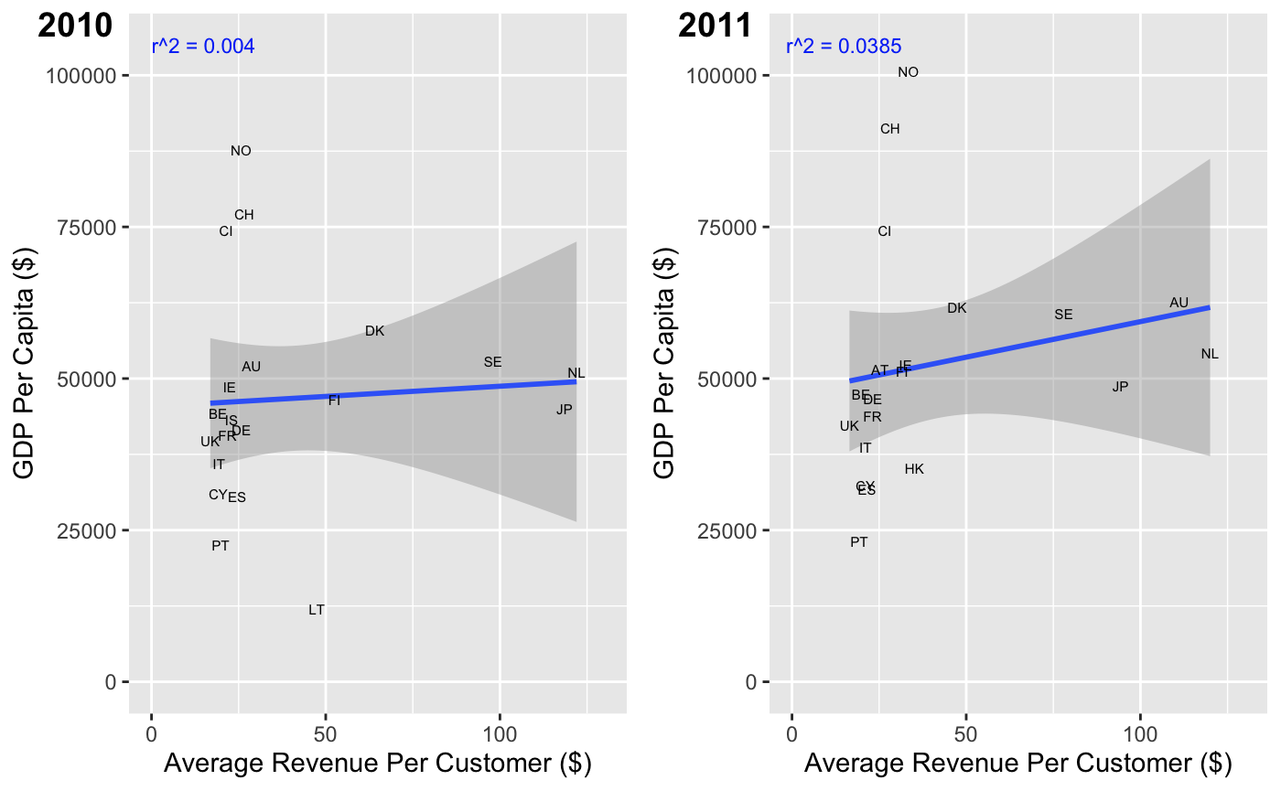
Country-Level Data
Countries can be segmented into high revenue, medium revenue, and low revenue.
No significant correlation between Average Revenue Per Customer and GDP per capita.
Market size might be a determinant factor.
Notes:
Overview
1: Provided are the countries with the highest revenue, number of countries, number of sales, and revenue per customer. Things to note
- All in western europe
- United Kingdom dominates: % of overall customers, % of revenue, % of sales.
- Revenue per customer (how much a customer every year) introduces some outliers.
Segmentation
- Added country-level data (literacy rates, access to electricity, GDP per capita).
- Ran a regression tree and realized we had three segments of countries
- High revenue countries had much higher revenue, larger markets, revenue per customer, customers, sales.
- Not higher GDP. Their markets are larger than medium countries.
- Low revenue has some developing countries.
Correlation w/ GDP per Capita
Scatterplot shows no significant correlation w/ GDP per capita. Plays an important role but not the only factor. Need to consider market size and other variables.

Slide 13
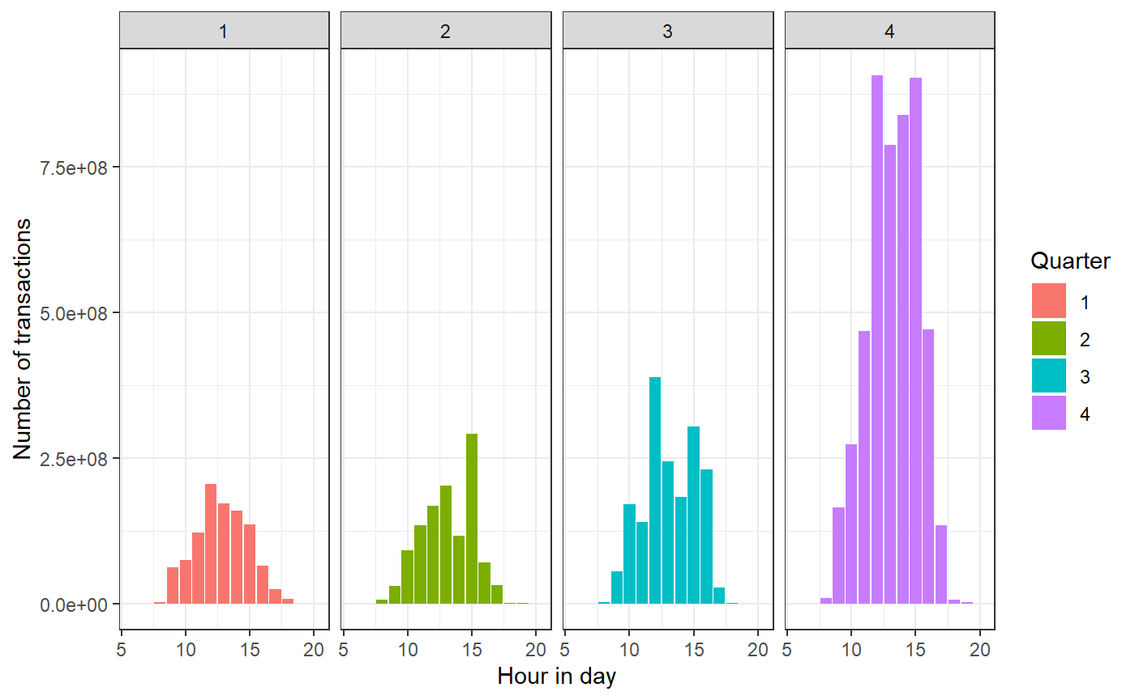
Country-Level Data
Country | Quarter | Growth Rate | Revenue | Popular Product | Share of Revenue
Australia | 2011 Q1 | 3800% | 40,937 | Wrap Doiley Design | 0.2%
Spain | 2011 Q1 | 800% | 17,563 | Wrap English Rose | 6.0%
Netherlands | 2011 Q1 | 700% | 72,039 | Yellow metal chicken heart | 0.2%
Most quarterly increase in revenue comes from holiday purchases.
Increase in number of orders does not equal to growth in revenue.

Slide 14
03
Next Steps

Slide 15
Conclusions / Next Steps
1.Consider
Consider specializing in low price goods
2.Promote
Promote gift related goods in Q1
3.Investigate
Investigate expanding operations in Australia and Sweden
Notes:
1: High price goods account for >4% of total revenue and if the margins are thin for those, we should specialize
2: Largest growth in revenue in high revenue countries happen in Q1
3:
Investigate Further
- Sweden & Australia
1: High GDP per capita. People have the money to spend
2: Higher Revenue per Customer than Germany + UK + Ireland. We are getting the big spenders. We can expand to those purchasing lower quantities. Get more customers. Like UK and Germany.
3: Massive growth between 2010 and 2011.
- In Australia: Customers increased 350%. Revenue increase 135 times over.

