Slide 1


1 | Section-header | Wid 100%, backgroundcolor(), height 120px
2 | inner-header | 반응형추후에/ width:1100px height:100%; margin:auto;
3 | logo | Width 75px, height 75px
4 | Space-nav | Li: inline-block, padding-right:15px, padding-left 15px, boarder-right 1px solid lightgrey
5 | top-nav
6 | bottom-nav | Display:flex

Slide 2





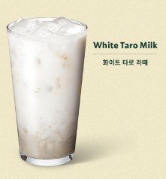
1 | Section-one | Width:100%, height:32vw; background image
2 | text-img | Position: absolute
3 | detail-btn | Position: absolute
4 | milk-tea | Position: absolute
5 | grape-tea | Position: absolute
6 | cookie-latte | Position: absolute

