Slide 1
Home Credit Default Risk Kaggle
Dan Daly

Slide 2
How do we help Home Credit to use statistical and machine learning methods to make their clients’ repayment abilities predictive?
Notes:
This is the question that your experiment answers

Slide 3
Project Overview
Many people struggle to get loans due to insufficient or non-existent credit histories. And, unfortunately, this population is often taken advantage of by untrustworthy lenders.
Home Credit strives to broaden financial inclusion for the unbanked population by providing a positive and safe borrowing experience. In order to make sure this underserved population has a positive loan experience, Home Credit makes use of a variety of alternative data--including telco and transactional information--to predict their clients' repayment abilities.
While Home Credit is currently using various statistical and machine learning methods to make these predictions, they're challenging Kagglers to help them unlock the full potential of their data. Doing so will ensure that clients capable of repayment are not rejected and that loans are given with a principal, maturity, and repayment calendar that will empower their clients to be successful.

Slide 4
Overall Process
Import Data
A) Polynomial Features
Grid Search (Cross Validation)
Align Test & Training Data
Feature Importance
Data Cleaning
Logistical Regression
B) Domain Knowledge Features
Hyperparameter
Tuning
Random Search (Cross Validation)
ID Correlations
Random Forest
Grid Search
EDA
Align Test & Training Data
Random Search Hyperparameters trained against full data used against test data and submitted to kaggle
Random Search
Encode Categorical Values
Feature Engineering
Scale Data
Notes:
Summarize your research in three to five points.

Slide 5
Modelling Process vs Score
Process | Score
Logistical Regression | 0.671
Random Forest | 0.678
Random Forest & Engineered Features | 0.679
Light Gradient Boosting Machine (cross validation) | 0.70147
Light Gradient Boosting Machine (test set) | 0.72644
LGBM with Grid Search (test set) | 0.72694
LGBM with Random Search (cross validation) | 0.72420
LGBM with Random Search (test set) | 0.71347
LGBM Grid Search (cross validation) – highest score | 0.74137
LGBM Random Search (cross validation) – highest score | 0.73985
LGBM Random Search full dataset (cross validation) | 0.74604
LGBM Random Search – Test Data submission | 0.72757

Slide 6
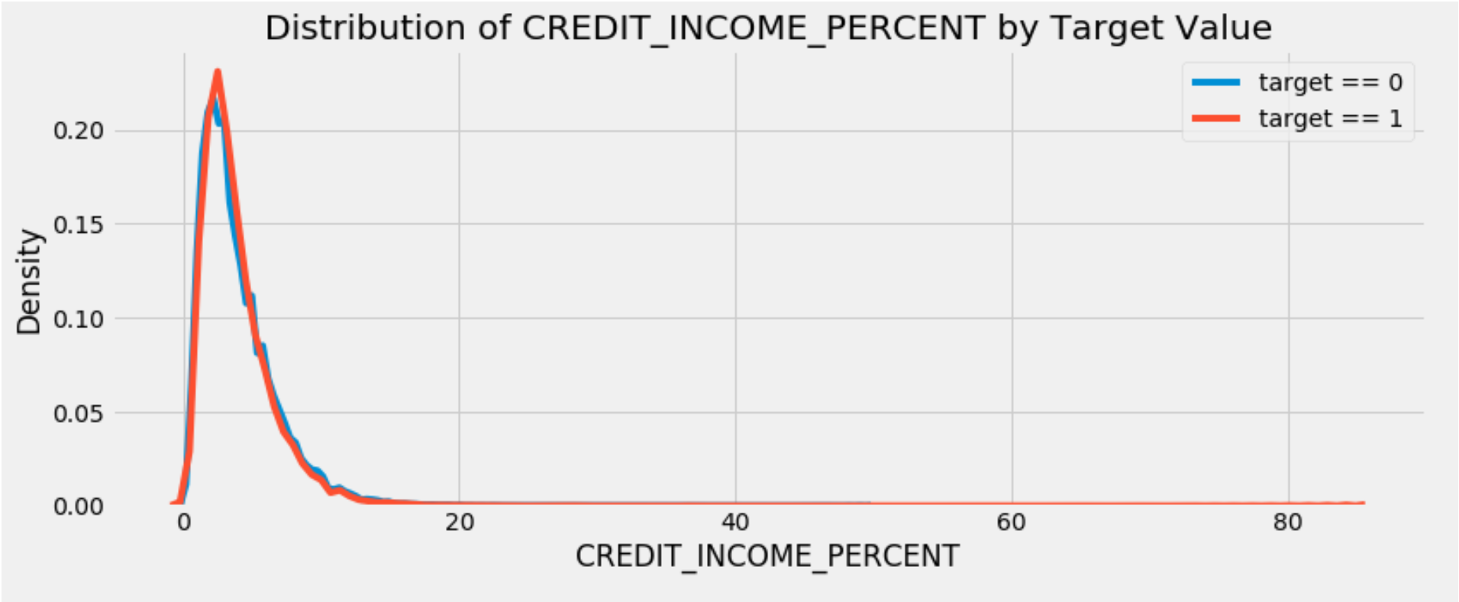
Visualization of Domain Variables
This is a KDE chart of the CREDIT_INCOME_PERCENT domain variable vs the target variable.
A density estimator is an algorithm which takes a D-dimensional dataset and produces an estimate of the D-dimensional probability distribution which that data is drawn from. The Kernel density estimation (KDE) is in some senses an algorithm which takes the mixture-of-Gaussians idea to its logical extreme: it uses a mixture consisting of one Gaussian component per point, resulting in an essentially non-parametric estimator of density.

Slide 7
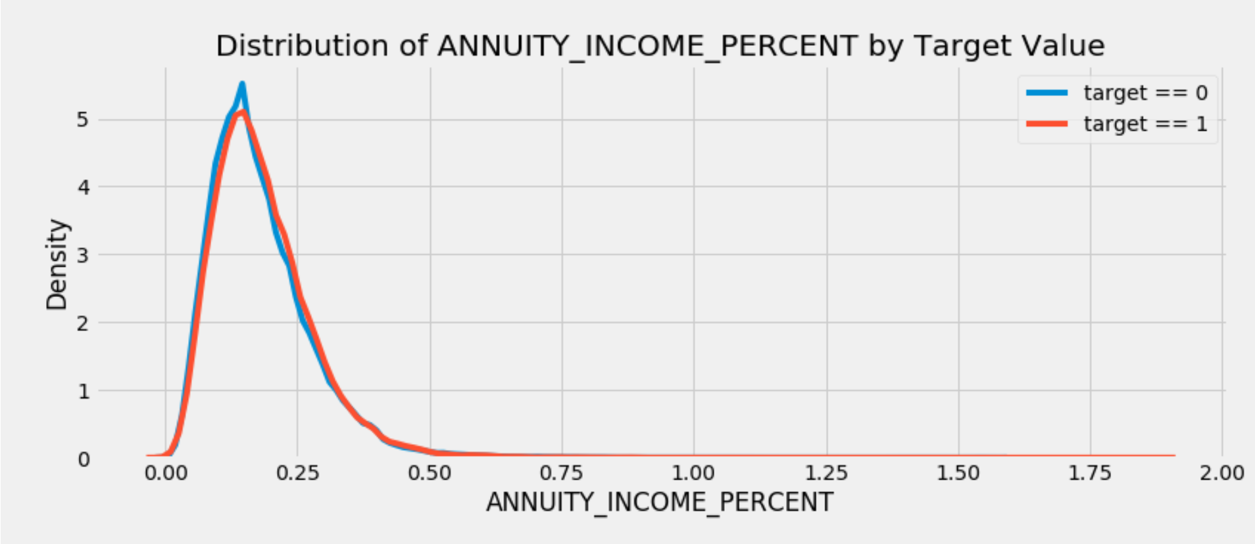
Visualization of Domain Variables
This is a KDE chart of the ANNUITY_INCOME_PERCENT domain variable vs the target variable.
A density estimator is an algorithm which takes a D-dimensional dataset and produces an estimate of the D-dimensional probability distribution which that data is drawn from. The Kernel density estimation (KDE) is in some senses an algorithm which takes the mixture-of-Gaussians idea to its logical extreme: it uses a mixture consisting of one Gaussian component per point, resulting in an essentially non-parametric estimator of density.

Slide 8
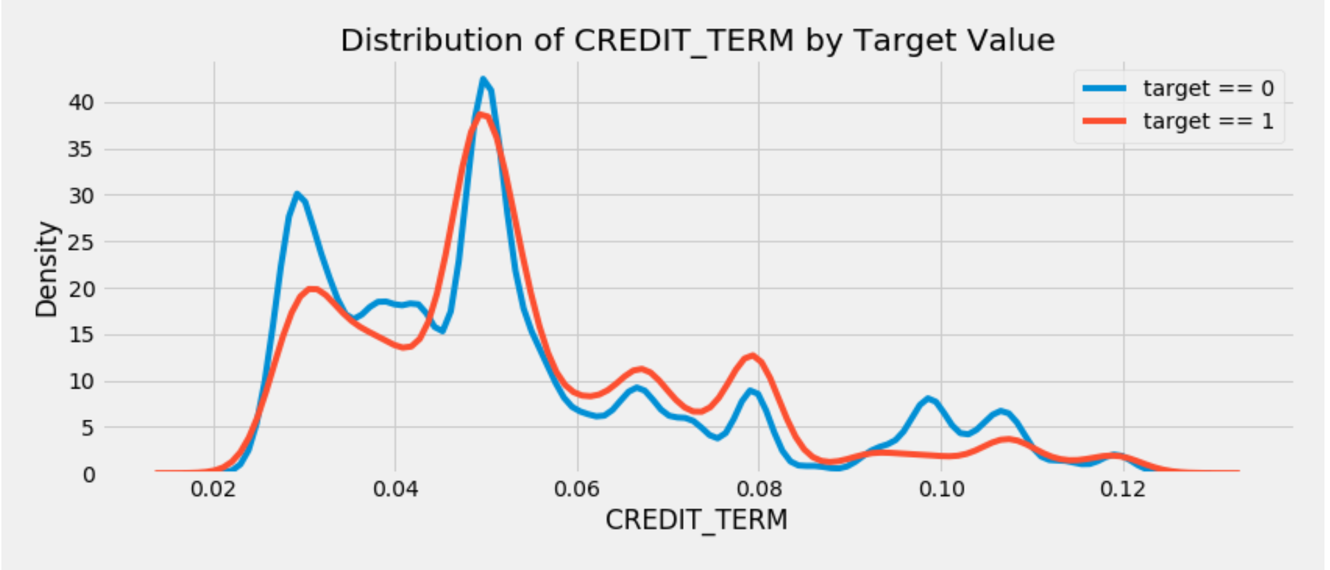
Visualization of Domain Variables
This is a KDE chart of the CREDIT_TERM domain variable vs the target variable.
A density estimator is an algorithm which takes a D-dimensional dataset and produces an estimate of the D-dimensional probability distribution which that data is drawn from. The Kernel density estimation (KDE) is in some senses an algorithm which takes the mixture-of-Gaussians idea to its logical extreme: it uses a mixture consisting of one Gaussian component per point, resulting in an essentially non-parametric estimator of density.

Slide 9
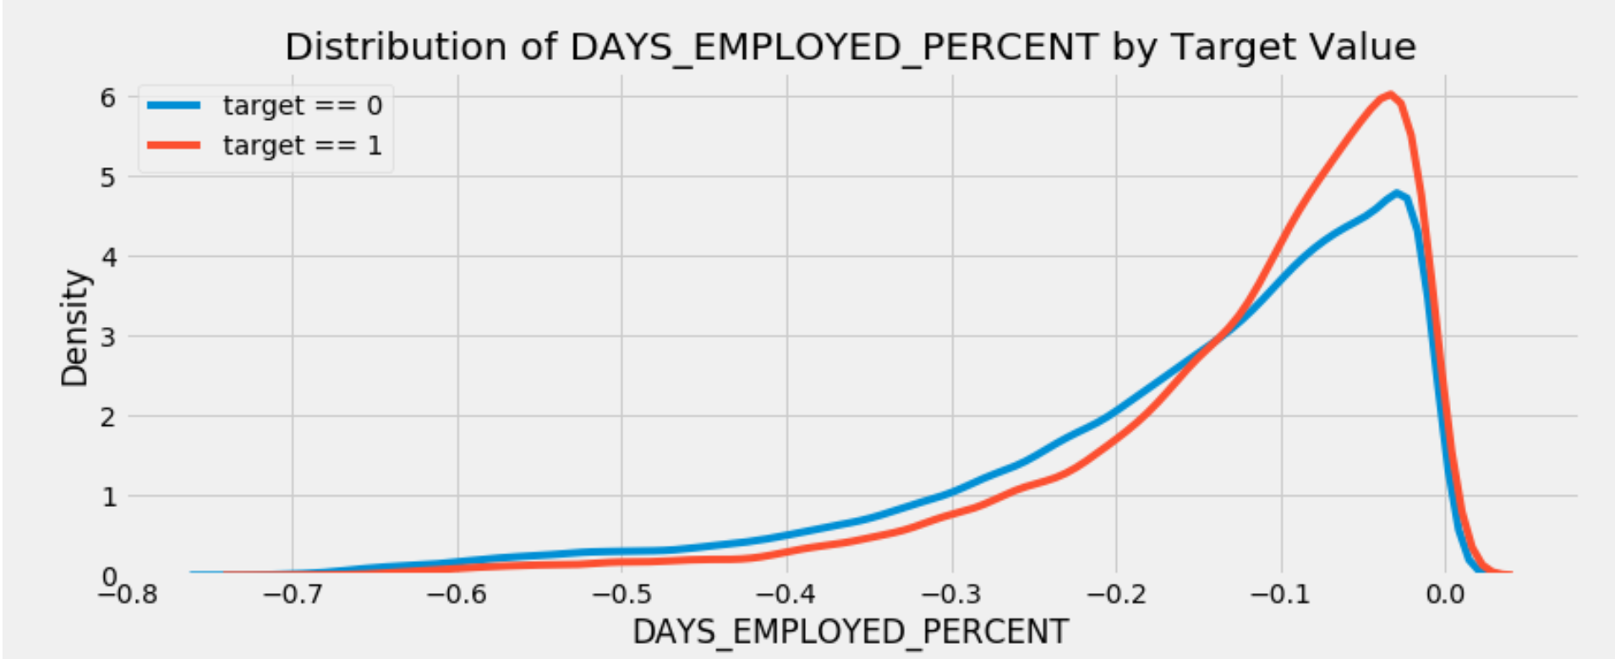
Visualization of Domain Variables
This is a KDE chart of the DAYS_EMPLOYED_PERCENT domain variable vs the target variable.
A density estimator is an algorithm which takes a D-dimensional dataset and produces an estimate of the D-dimensional probability distribution which that data is drawn from. The Kernel density estimation (KDE) is in some senses an algorithm which takes the mixture-of-Gaussians idea to its logical extreme: it uses a mixture consisting of one Gaussian component per point, resulting in an essentially non-parametric estimator of density.

Slide 10
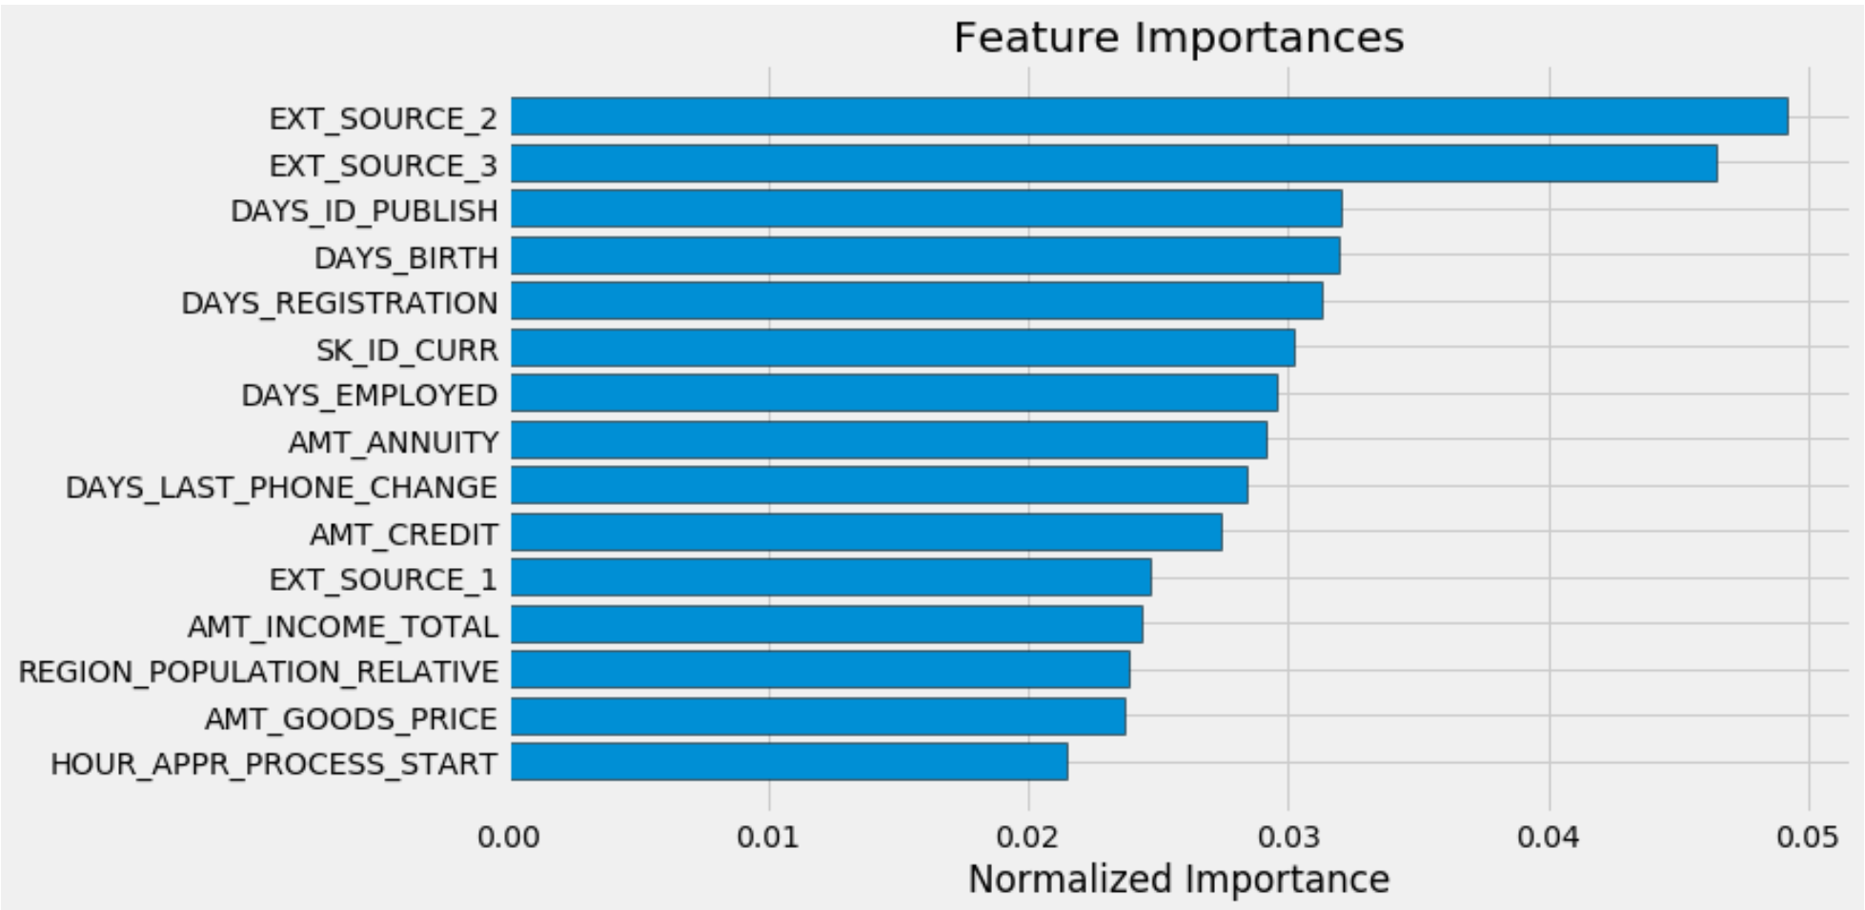
Feature Importance
Feature Importance is the process of ranking the attributes by their value to the predictive ability of the model.
The most important features are those dealing with EXT_SOURCE and DAYS_BIRTH. We see that there are only a handful of features with a significant importance to the model, which suggests we may be able to drop many of the features without a decrease in performance (and we may even see an increase in performance.) Feature importance is not the most sophisticated method to interpret a model or perform dimensionality reduction, but it lets us start to understand what factors our model takes into account when it makes predictions.

Slide 11
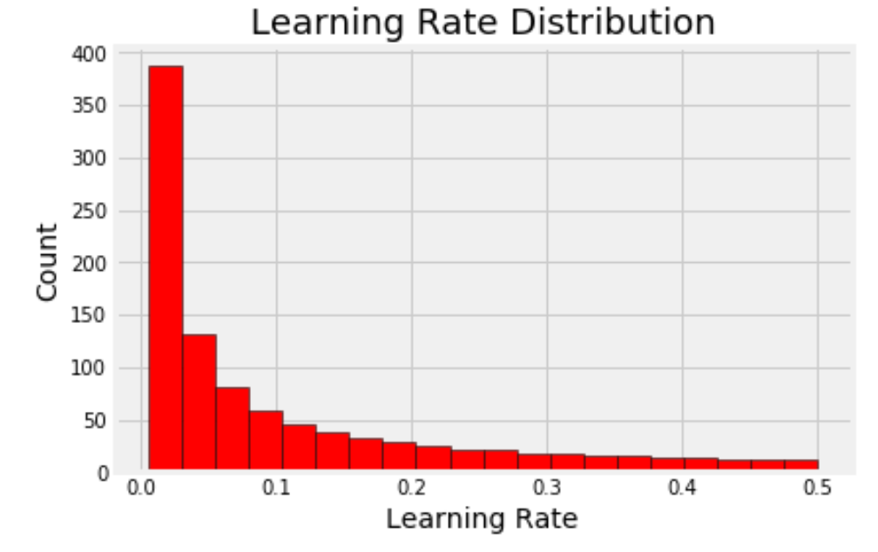
Learning Rate Distribution
The learning rate domain is from 0.005 to 0.5. Using a logarithmic uniform distribution allows us to create a domain where there are as many values from 0.005 to 0.05 as from 0.05 to 0.5. In a linear space, there would be far more values from 0.05 to 0.5 because this represents a larger distance in linear space but in logarithmic space each of these two intervals is the same width because they are multiples of 10 of each other. (Think about going from 1 to 10 and then from 10 to 100. On a logarithmic scale, these intervals are the same size, but on a linear scale the latter is 10 times the size of the former). In other words, a logarithmic uniform distribution lets us sample more evenly from a domain that varies over several orders of magnitude.

Slide 12
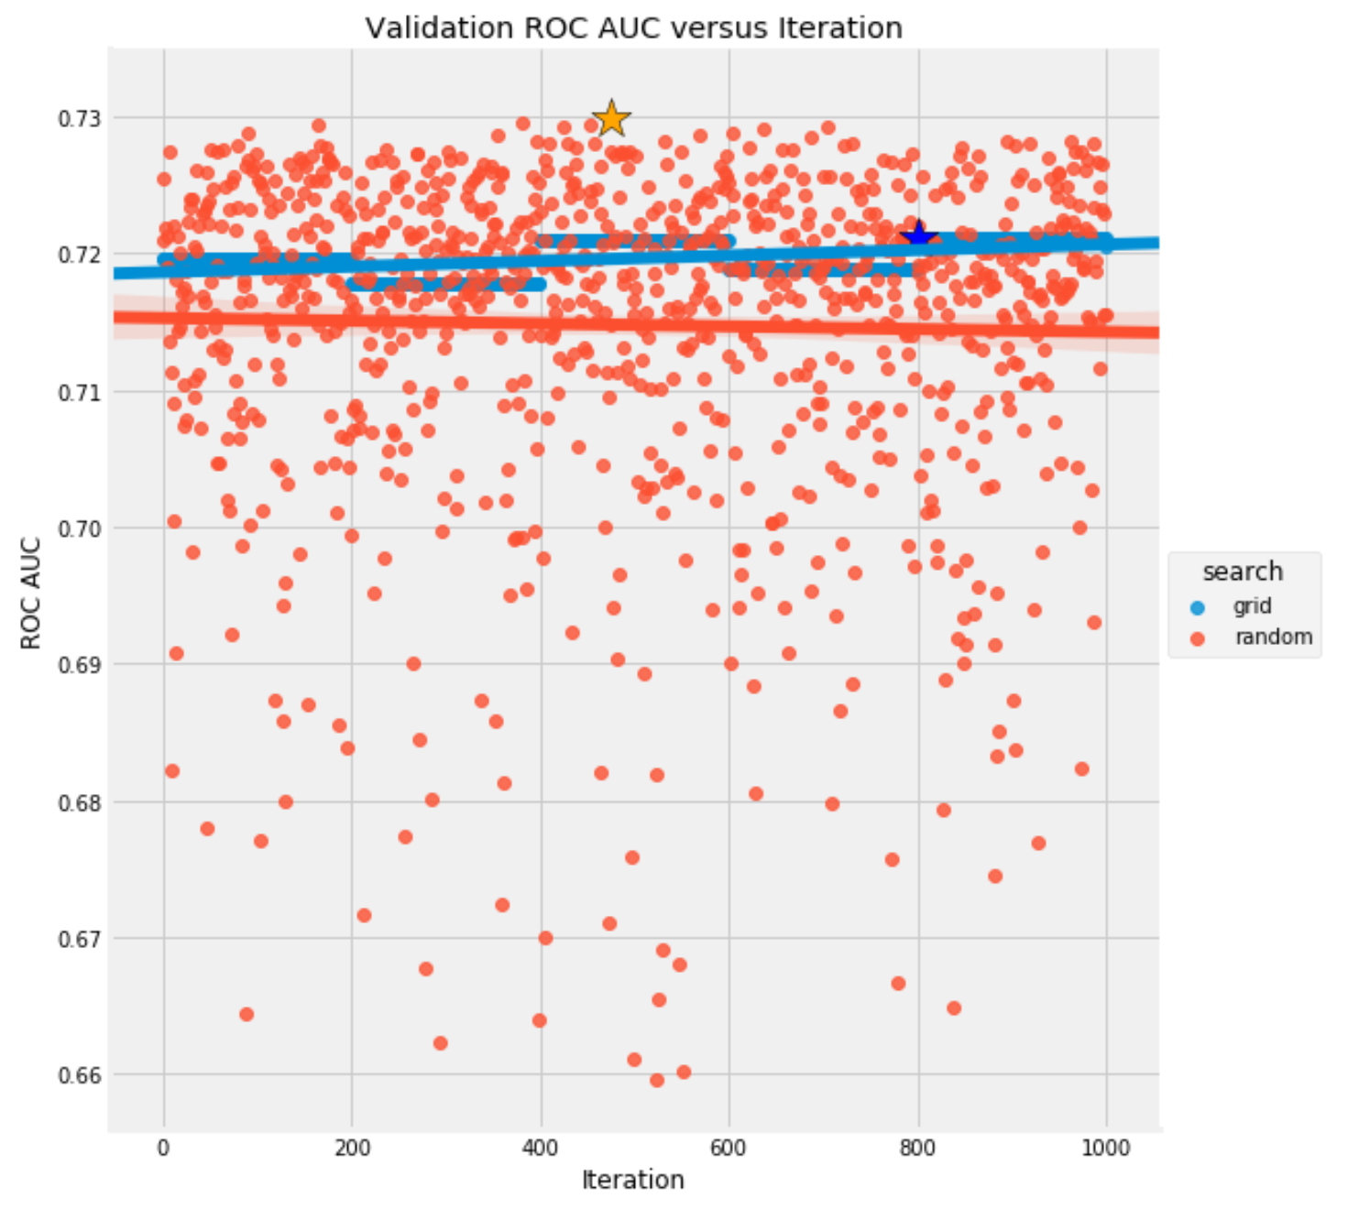
Validation ROC AUC versus iteration
This is a graph showing the ROC AUC score vs the number of iterations of the grid search and random search.
ROC curve
A ROC curve (receiver operating characteristic curve) is a graph showing the performance of a classification model at all classification thresholds. This curve plots two parameters:
True Positive Rate
False Positive Rate
True Positive Rate (TPR) is a synonym for recall and is therefore defined as follows:
TPR=TPTP+FN
False Positive Rate (FPR) is defined as follows:
FPR=FPFP+TN
AUC stands for "Area under the ROC Curve." That is, AUC measures the entire two-dimensional area underneath the entire ROC curve. AUC provides an aggregate measure of performance across all possible classification thresholds.
Here we can see that the random search has a higher ROC AUC score than the grid search.

Slide 13
Conclusion (1 of 2)
In this notebook, we saw how to get started with a Kaggle machine learning competition. We first made sure to understand the data, our task, and the metric by which our submissions will be judged. Then, we performed a fairly simple EDA to try and identify relationships, trends, or anomalies that may help our modeling. Along the way, we performed necessary preprocessing steps such as encoding categorical variables, imputing missing values, and scaling features to a range. Then, we constructed new features out of the existing data to see if doing so could help our model.
Once the data exploration, data preparation, and feature engineering was complete, we implemented a baseline model upon which we hope to improve. Then we built a second slightly more complicated model to beat our first score. We also carried out an experiment to determine the effect of adding the engineering variables.
We followed the general outline of a machine learning project:
Understand the problem and the data
Data cleaning and formatting
Exploratory Data Analysis
Baseline model
Improved model
Model interpretation
Model hyperparameter tuning

Slide 14
Conclusion (2 of 2)
Model tuning is the process of finding the best machine learning model hyperparameters for a particular problem. Random and grid search are two uniformed methods for hyperparameter tuning that search by selecting hyperparameter values from a grid domain.
The four parts of hyperparameter tuning are:
Objective function: takes in hyperparameters and returns the cross validation score we want to maximize or minimize
Domain of hyperparameters: values over which we want to search
Algorithm: method for selecting the next hyperparameter values to evaluate in the objective function
Results: history of hyperparameters and cross validation scores
These four parts apply to grid and random search as well as to Bayesian optimization, a form of automated hyperparameter tuning. In this notebook, we implemented both random and grid search on a reduced dataset, inspected the results, and tried to translate the optimal hyperparameters to a full dataset (from this kernel). As a small note, it's important to remember that we tune the hyperparameters to the training data - using cross validation - so the hyperparameter values we find are only optimal for the training data. Although the best hyperparameters from the smaller dataset did not work that well on the full dataset, we were still able to see the ideas behind these two tuning methods. Moreover, we can take the functions developed here and apply them to any dataset or to any machine learning model, not just the gradient boosting machine.
Random search turns out to work pretty well in practice (because it is good at exploring the search domain), but it still is not a reasoning method because it does not use past evaluation results to choose the next hyperparameter values. A better approach would be to use the past results to reason about the best values to try next in the objective function, especially because as we saw, evaluating the objective function is time-consuming.
Hyperparameter tuning is a crucial part of the machine learning pipeline because the performance of a model can depend strongly on the choices of the hyperparameter values. Random and grid search are two decent methods to start tuning a model (at least they are better than manual tuning) and are important tools to have in the data science skillset.

Slide 15
Works Cited
I would like to thank Will Koehrsen for his kernals that helped me put this analysis together.

