Slide 1
Programming Language Team Project
20144320 김경현
20141775 박진혁
20146703 박지호
20143592 최영재

Slide 2
INDEX
Basic Operations
if expression
Sub expression
Sub expression 2

Slide 3
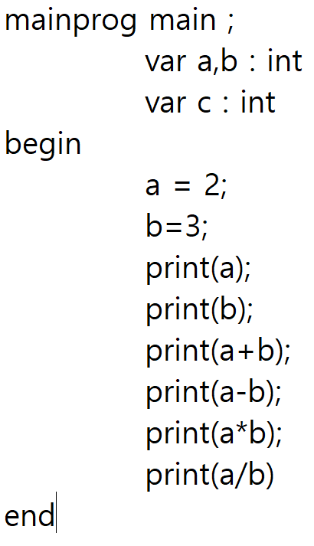

Basic Operations

Slide 4
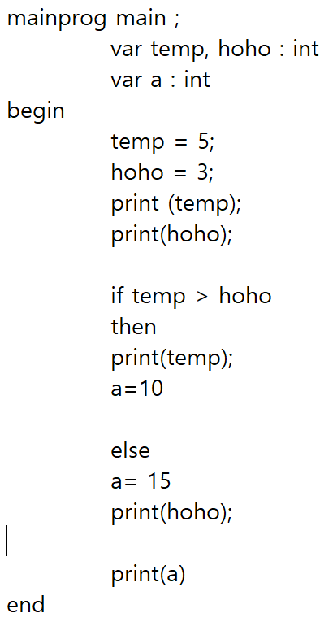
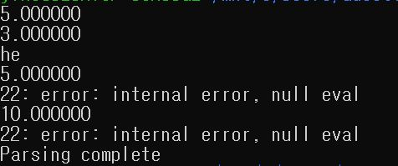
If expression

Slide 5
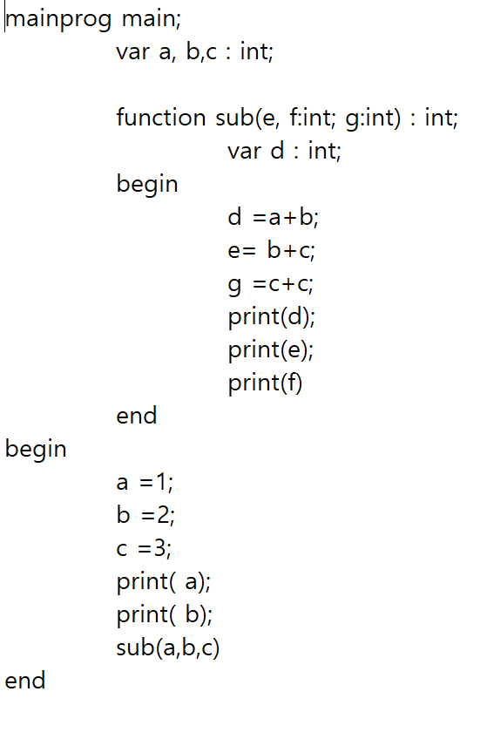
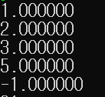
Sub expression

Slide 6
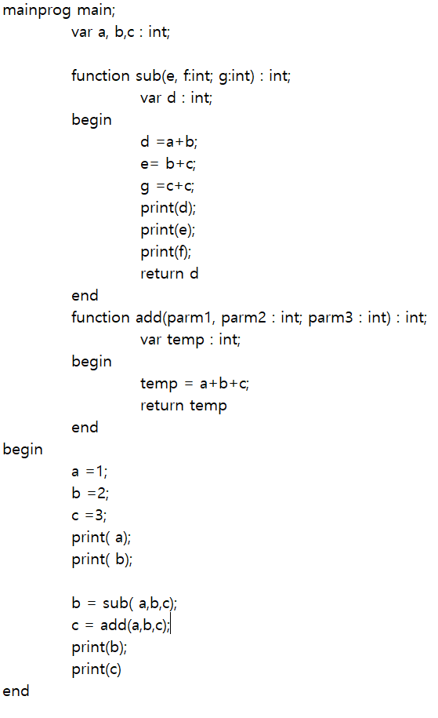
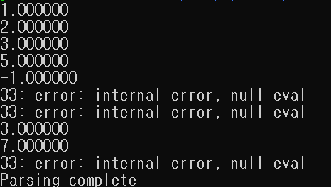
Sub expression 2

Slide 7
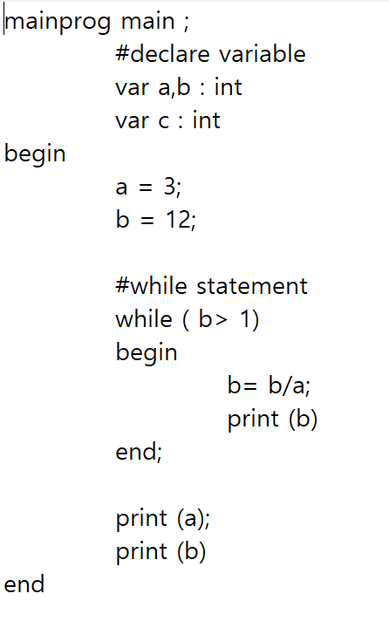
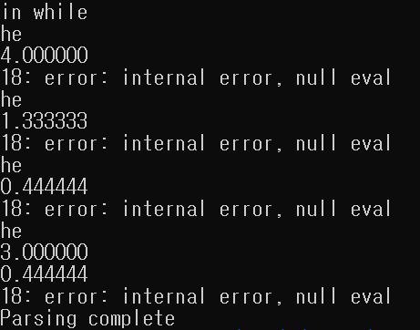
While expression

