Slide 1

The Application of Blockchain in Voting Systems
Dilans Damme

Slide 2
Agenda
Introduction
What is Blockchain?
How Blockchain Works
Current Challenges in Voting Systems
Blockchain Solutions for Voting
Benefits of Blockchain-Based Voting Systems
Challenges and Considerations
Case Studies
Conclusion
Q&A

Slide 3
Introduction
Importance of Secure Voting Systems
The foundation of democratic societies
Trust in electoral processes is crucial for political stability
Recent Challenges
Foreign interference and election fraud claims
Vulnerabilities detected in electronic voting machines
Objective
Explore how blockchain could address challenges in the voting system
Discuss benefits and other considerations in regards to blockchain voting systems

Slide 4
What is Blockchain?
A decentralized, distributed digital ledger technology.
Records transactions in a secure, transparent, and immutable manner.
Decentralization: No central authority, data is shared across a network
Transparency: Transactions are visible to participants, enhancing trust
Immutability: Once data is recorded, it cannot be altered
Security: Cryptography ensures data integrity and confidentiality

Slide 5
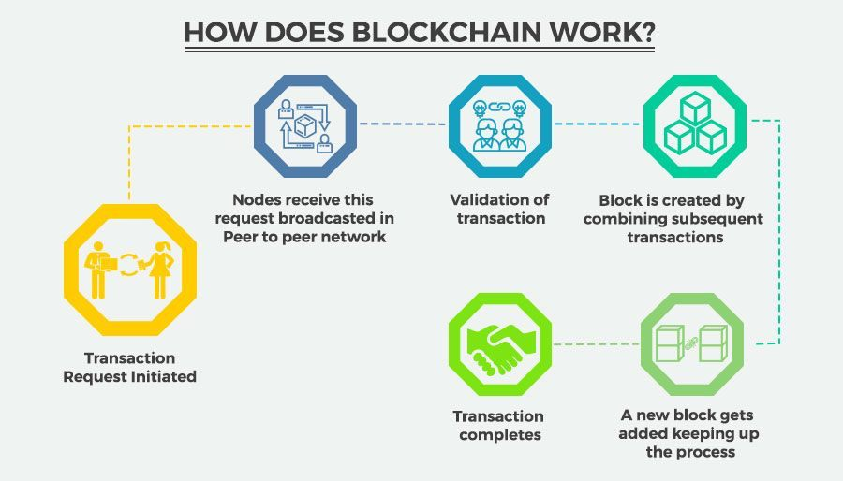
How Blockchain Works
A user initiates a transaction
The transaction is sent to all network participants in the network
Nodes verify the transaction’s legitimacy
Verified transactions are grouped into a block
The new block is linked to the previous block, forming a chain
The transaction is confirmed and permanently recorded

Slide 6
Current Challenges in Voting Systems
Security Issues
Vulnerabilities to hacks and cyber-attacks
Risk of ballet tampering and/or manipulation
Transparency Issues
Difficulty in verifying that votes are counted correctly
Accessibility Issues
Hard for some people to vote due to things like disability or being overseas
Slow Processes
Long lines at polling stations and delayed/slow results
High Costs
Expensive to run elections (staffing, equipment etc.)

Slide 7
Blockchain Solutions for Voting
Casting Votes
Voter identities can be identified securely via apps
Each vote is an encrypted transaction on the chain
Verification and Recording
Network nodes validate the vote without revealing identities
The vote is added to the immutable blockchain
Automation
Automate processes like vote tallying and sending out results through Smart Contracts

Slide 8
Benefits of Blockchain-Based Voting Systems
Improved Security
Hard to hack or change votes once they’re on the blockchain
Greater Transparency
Voters can verify themselves that their vote was counted
Privacy Protection
Keeps personally identifying information confidential
More Accessible
People can vote from anywhere securely
Cost-Effective
Saves money on paper, staffing, and equipment

Slide 9
Challenges and Considerations
Technical Hurdles
Need for reliable internet
Ensuring user-friendly accessible interfaces
Scalability Issues
Handling a large volume of votes without slowing down
Legal and Regulatory Considerations
Laws may need to be updated or created
Security Risks
May introduce new types of attacks and must be able to guard against them
Adoption Issue
People may not want to switch over to new technologies

Slide 10



Case Studies
Estonia’s i-Voting
Pioneered internet voting with secure digital ID cards
High adoption rates due to convenience for citizens
Not blockchain-based but demonstrates the potential for digital voting systems
Sierra Leone
Used blockchain to store and verify election results
Increased transparency but faced scalability issues
West Virginia’s Mobile Voting App
Blockchain-based app for overseas military voters
Improved accessibility although concerns over security led to discontinuation

Slide 11
Conclusion
Summary
Blockchain has the potential to transform voting systems
Blockchain offers solutions to security, transparency, and accessibility issues
Final Thoughts
Successful implementation requires addressing technical and social challenges
Blockchain voting systems still have a long way to go
They must find out how to best increase adoption rates among citizens
Must increase the amount of case studies and pilot programs to gauge feasibility

Slide 12


