Slide 1
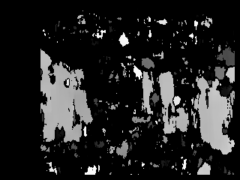
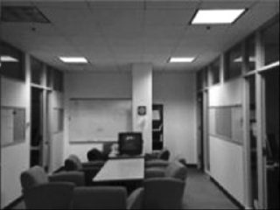
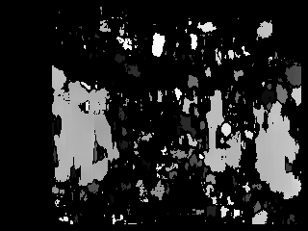
Stereo Vision for Depth Estimation (GitHub link) Uma Maheshwari, Dana Diaconu
Summary
Plan – To accelerate median_blur
Final project – Used median_blur and hist_equalizer to try to improve stereo vision for depth estimation
What did we learn?
Results
Stereo Camera Input
+ Median Blur
+ Histogram Equalization
Original

Slide 2
Part of the template – we’re going to delete this
Stereo Vision for Depth Estimation (GitHub link) Uma Maheshwari Dana Diaconu
What did you learn, or what was interesting/difficult?
Summary of what you did
Plan – what you tried
Final project – what you ended up doing
Block diagram?
Results

Slide 3
Extra info, we’re going to delete this
- Stereo vision for depth estimation
- Applications:
- Disparity map refers to the apparent pixel difference or motion between a pair of stereo images
-The InitUndistortRectifyMapInverse function generates mapx and mapy, based on a set of camera parameters, where mapx and mapy are inputs for the xf::cv::remap function. That is, for each pixel in the location (u, v) in the destination (corrected and rectified) image, the function computes the corresponding coordinates in the source image (the original image from camera). The InitUndistortRectifyMapInverse module is optimized for hardware, so the inverse of rotation matrix is computed outside the synthesizable logic. Note that the inputs are fixed point, so the floating point camera parameters must be type casted to Q12.20 format.
-The remap function takes pixels from one place in the image and relocates them to another position in another image. Two types of interpolation methods are used here for mapping the image from source to destination image.

Slide 4
Extra info, we’re going to delete this
Stereo Local Block Matching
Stereo block matching is a method to estimate the motion of the blocks between the consecutive frames, called stereo pair. The postulate behind this idea is that, considering a stereo pair, the foreground objects will have disparities higher than the background. Local block matching uses the information in the neighboring patch based on the window size, for identifying the conjugate point in its stereo pair. While, the techniques under global method, used the information from the whole image for computing the matching pixel, providing much better accuracy than local methods. But, the efficiency in the global methods are obtained with the cost of resources, which is where local methods stands out.
Local block matching algorithm consists of pre-processing and disparity estimation stages. The pre-processing consists of Sobel gradient computation followed by image clipping. And the disparity estimation consists of SAD (Sum of Absolute Difference) computation and obtaining the disparity using winner takes all method (least SAD will be the disparity). Invalidity of the pixel relies upon its uniqueness from the other possible disparities. And the invalid pixels are indicated with the disparity value of zero.

