Slide 1

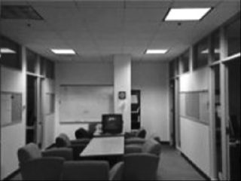

Image Processing for Depth Estimation from Stereo Vision Uma Maheshwari (TU Delft), Dana Diaconu (https://github.com/ddanag/stereo_vision_depth_estimation.git)
Summary
Plan – To accelerate median_blur
Final project – Used median_blur and hist_equalizer to try to improve stereo vision for depth estimation by removing some of the noise and enhancing contrast
What did we learn?
We got a sense about the L1, L2, L3 library abstraction
Got more accustomed to the Vitis Flow
The impact of the inputs on the speed of emulations
Understood how the functions are accelerated (pragma Pipeline, Dataflow)
Results
Stereo Camera Input
+ Median Blur
+ Histogram Equalization
Original

