Slide 1
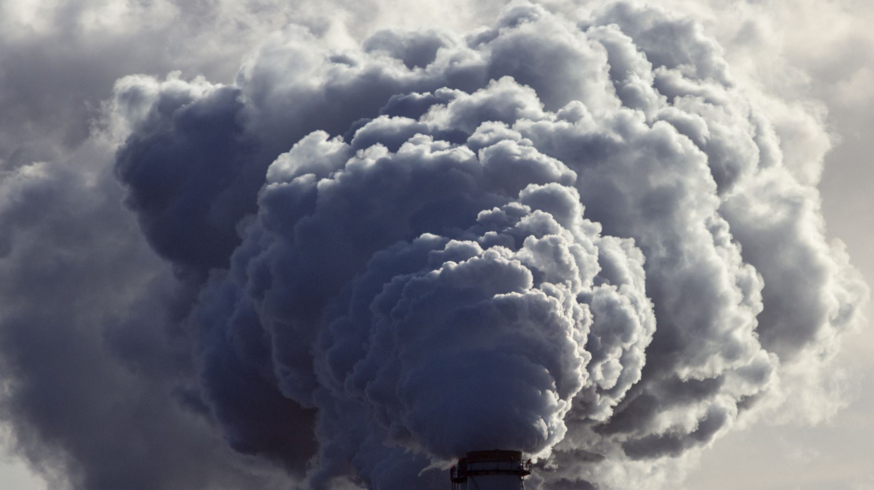
Project 3 Data Visualization of CO₂ emissions
Edward Vaughan, Daniel Daniel, Essa Bostan, Mujahid Iqbal

Slide 2
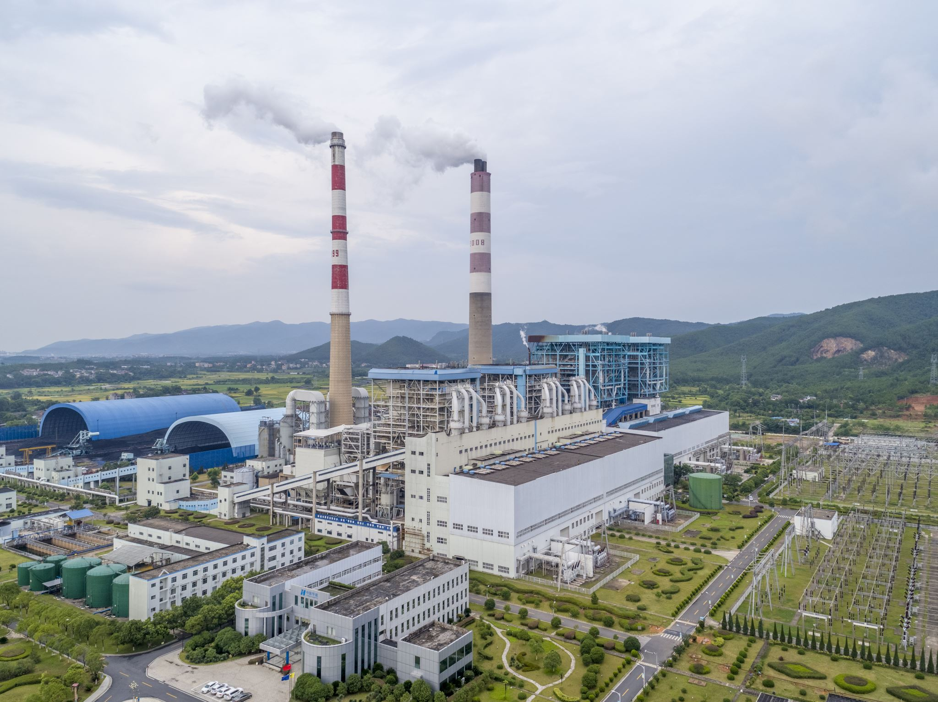
Background

Slide 3
Background
Human activities are causing CO2 to increase.
Fossil fuels like coal and oil contain carbon that plants gathered by photosynthesis over many millions of years; we are returning that carbon to the atmosphere in just a few hundred.

Slide 4

Background
CO2 is a greenhouse gas, absorbing heat from the earth and releasing it in all directions, including back to earth. This causes global temperatures to rise, bringing starvation and disease. Glaciers and ice caps melt, causing sea levels to rise. People in low-lying areas such as the Netherlands, Bangladesh and Florida USA could be displaced. Countries like India, Bolivia and Peru depend on glacial meltwater. Loss of these glaciers could be devastating.
Also, CO2 dissolves into the ocean and reacts with water to form carbonic acid, raising its acidity.

Slide 5
Aims
To create an interactive dashboard for CO2 emissions
Investigate different variables to see if there are any correlations:
GDP
Population
To ensure that this endeavour is as user friendly as possible

Slide 6

Quick look at the dashboard

Slide 7
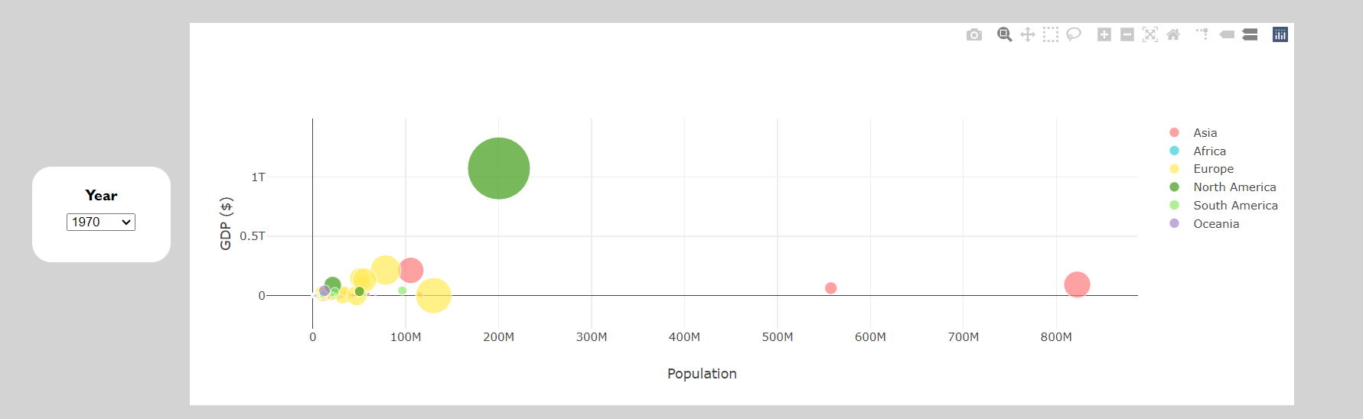
Dashboard – Global Focus
Bubble plot: GDP vs Population
Interactivity: Dropdown menu for year selection
Colour coded
Selectable traces

Slide 8
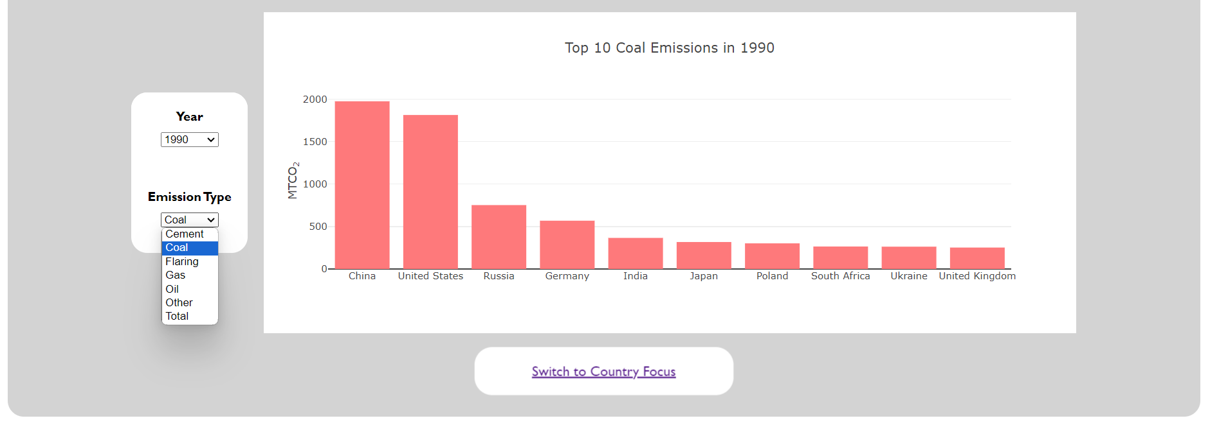
Dashboard – Global Focus
Bar plot: Top 10 countries by emission type for a giver year
Interactivity: Dropdown menu for year and emission type selection

Slide 9
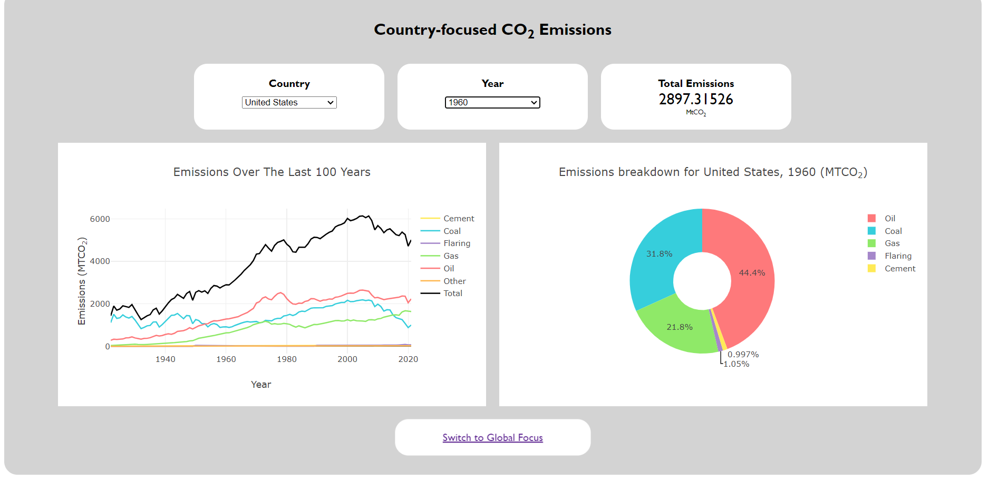
Dashboard – Country Focus
Line plot: Emissions over the last 100 years for a selected country
Selectable traces
Pie chart: Emissions breakdown for a selected year and country
Interactivity: Dropdown menus for year and country selection

Slide 10

Coding, Process, and Data wrangling
- Data sources

Slide 11
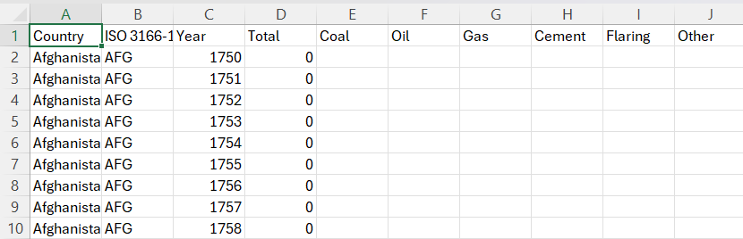
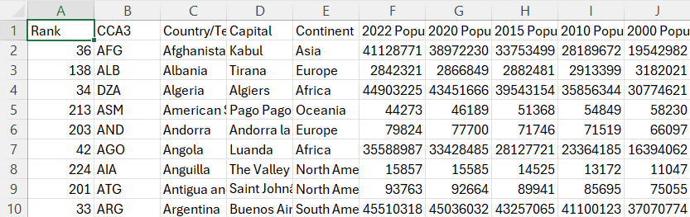
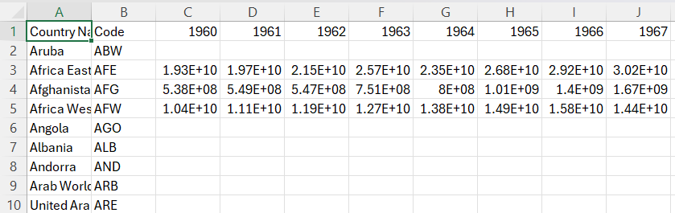
MetaData Sources - kaggle
CO2 Emissions Original source – The Global Carbon Project's fossil CO2 emissions dataset, from Zenodo.org
World Population Original source – World Population Review
GDP Original source – World Bank

Slide 12
Coding, Process, and Data wrangling
- Data storage

Slide 13
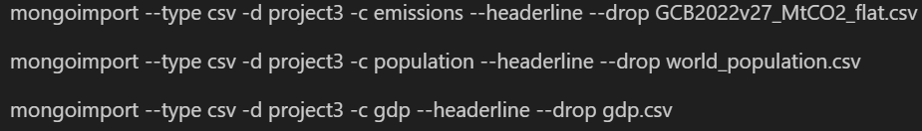
Data Storage - MongoDB

Slide 14
Coding, Process, and Data wrangling
- Data cleaning

Slide 15
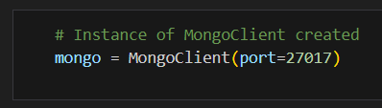
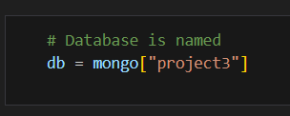
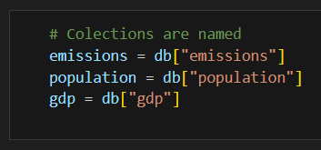
Data extraction
Connection to MongoDB
Database assigned to variable
Collections assigned to variables

Slide 16
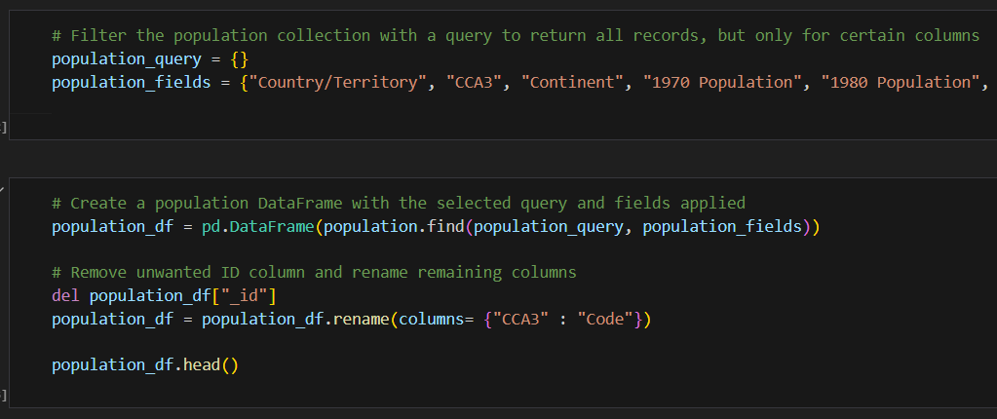
Data Frames Creation
Collections queried if necessary
Data Frames created for each of the three datasets with pd.DataFrame
Filtered for year

Slide 17
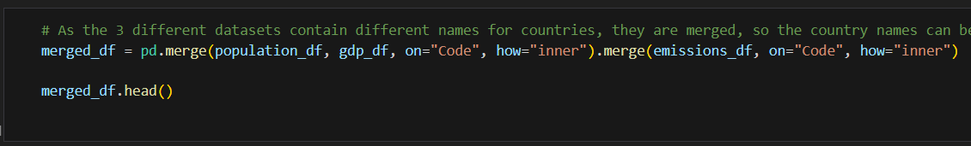
Merging
Merged with pd.merge
“Code” column is common to all 3 datasets
ISO Codes are internationally recognized

Slide 18
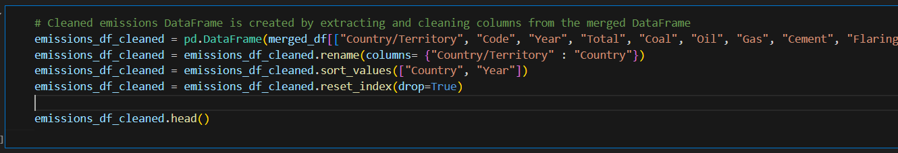
Data Frame Extraction
pd.DataFrame used to create 3 cleaned data frames for:
Emissions
GDP
Population
Further cleaning
.rename()
.sort_values()
.reset_index()

Slide 19
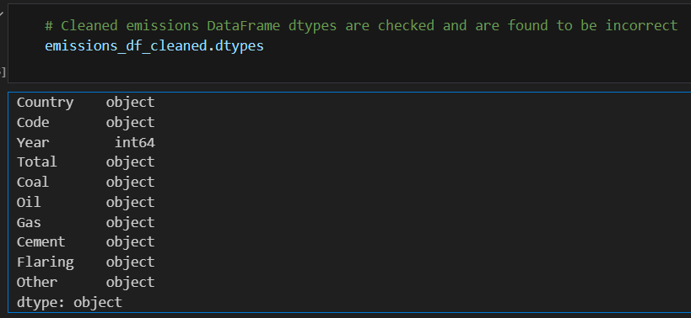
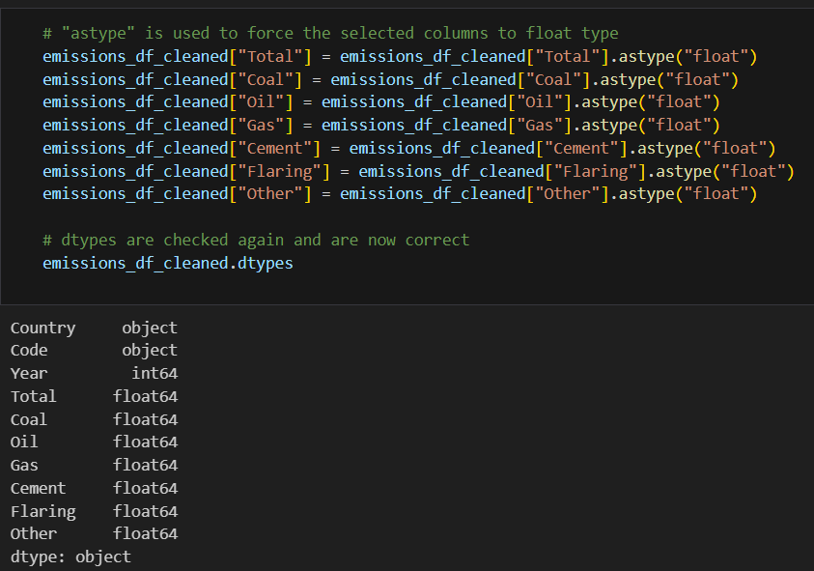
dtypes
Data types before
Data types after
Data types checked with .dtypes
Data types converted with .astype()
Data types checked again with .dtypes

Slide 20
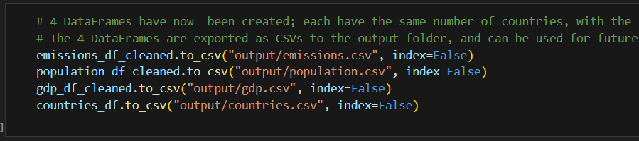
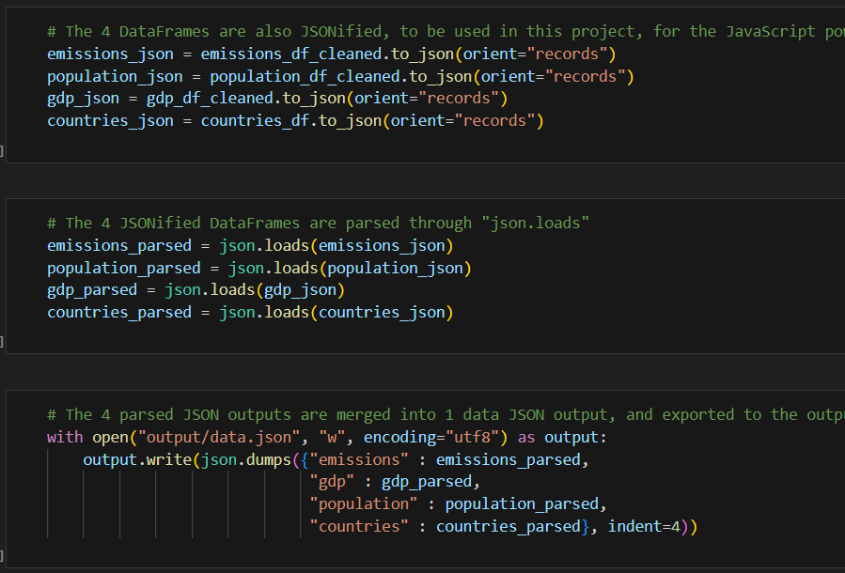
Exporting
3 Cleaned Data Frames
Exported as 3 separate CSVs
Exported as 1 JSON file
Converted to csv with .to_csv()
Converted to json with .to_json()
Parsed with json.loads()
Exported with json.dumps()

Slide 21
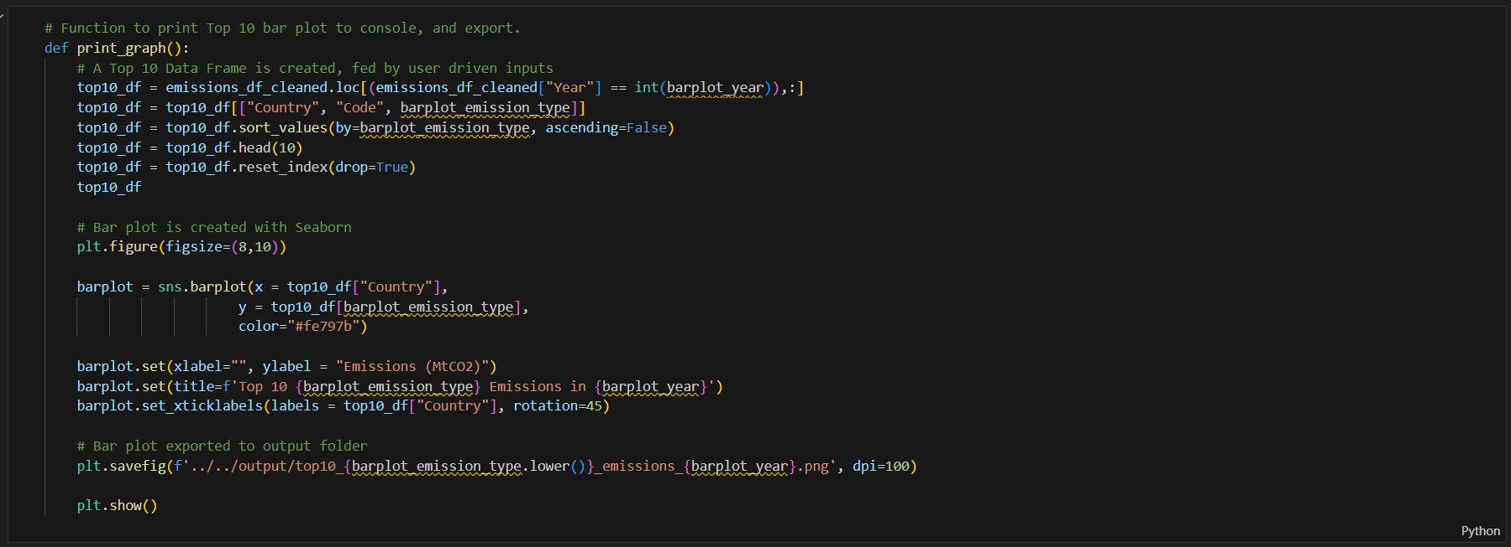
Behind the scenes - Jupyter
Python function to create and export a graph
The Seaborn library is incorporated

Slide 22
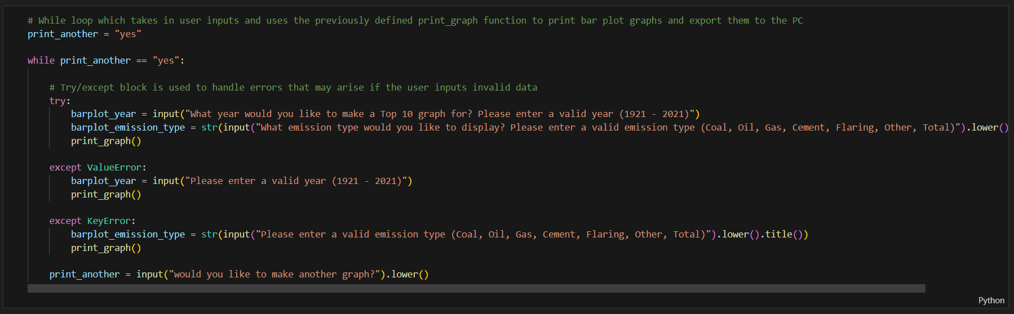
Behind the scenes - Jupyter
While loop to keep creating and exporting graphs
Try/Except block to catch errors

Slide 23
Coding, Process, and Data wrangling
- Webpage development

Slide 24


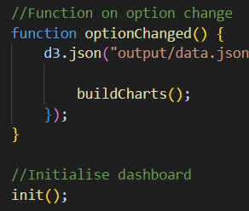
Functions
Build charts
Initialise
When an option is changed

Slide 25
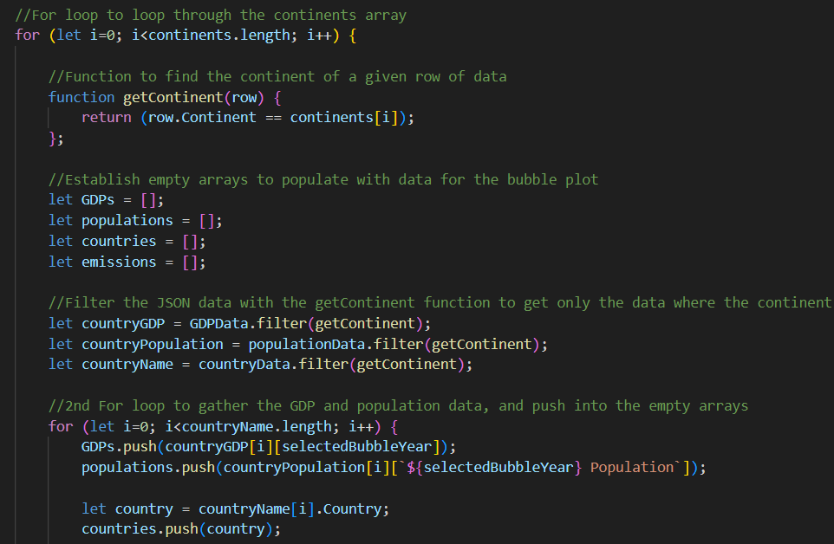
Loops
For loops
Functions
We started out writing the code as separate blocks before condensing it to a loop.

Slide 26
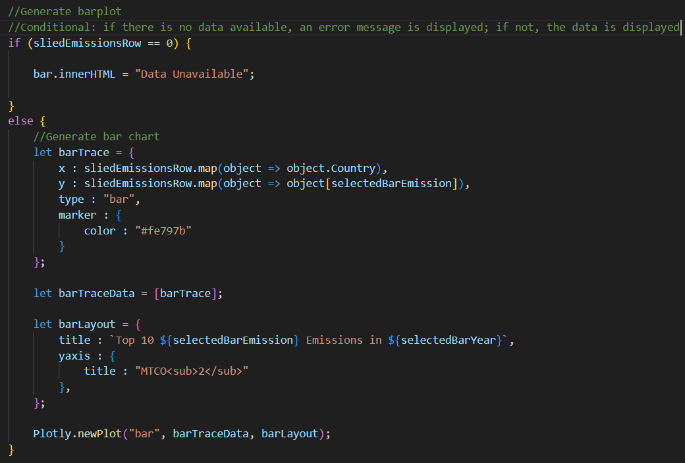
Conditionals
Conditional re-writes text in plot div element with an error message if invalid data is selected.
Otherwise, the plot is generated.

Slide 27
Coding, Process, and Data wrangling
- Webpage layout

Slide 28
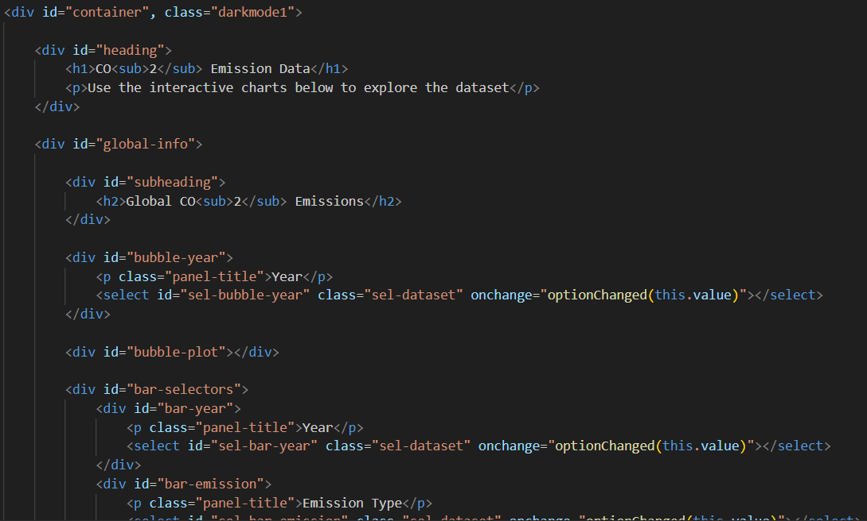
Webpage Layout - divs
Div layouts
Nested divs
onchange
Id’s and classes

Slide 29
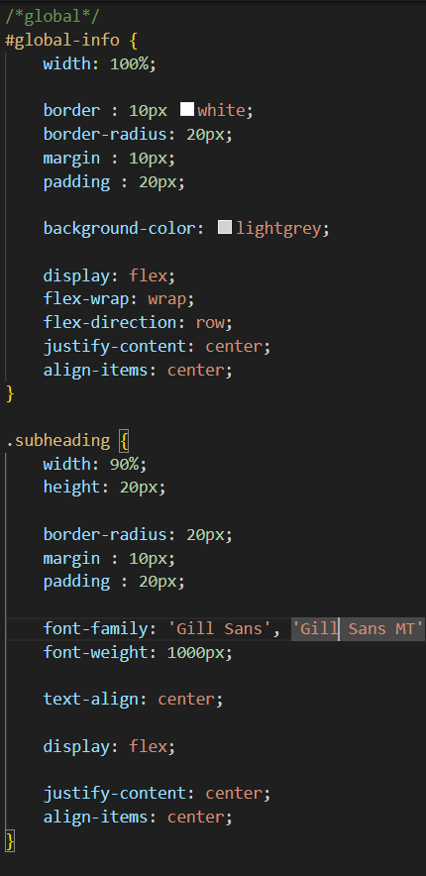
Webpage styling – CSS
Width
Height
Borders
Border radius
Margins
Padding
Colours
Font
Font family
Font size
Font weight
Text alignment
Div justification
Flex display

Slide 30
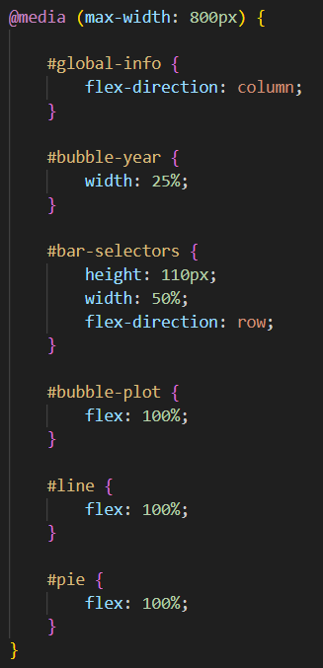

Webpage styling – Responsive flex
Responsive flex - Adaptive to screen size
Config – resizes Plotly plots

Slide 31
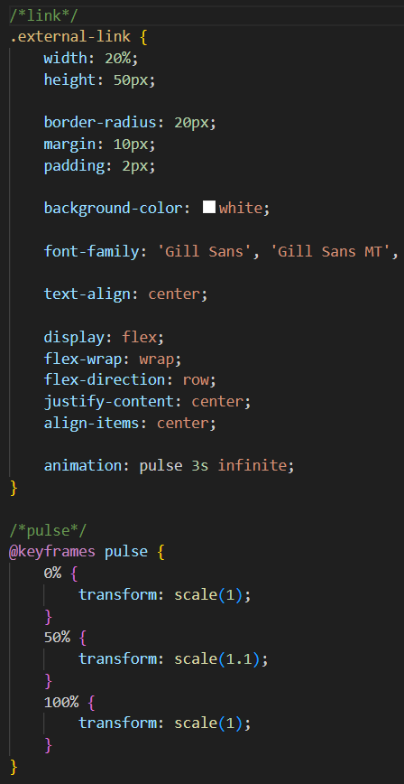
Webpage styling – CSS keyframes
Keyframes are animations that can be applied to HTML aspects
Pulse is used here for the internal link div

Slide 32
Coding, Process, and Data wrangling
- Interactivity

Slide 33
Interactivity
Points of interactivity:
Dropdown menus
Graph toggle
Hover
Internal link
Responsive flex
Keyframes
User friendly layout

Slide 34
Ethics

Slide 35
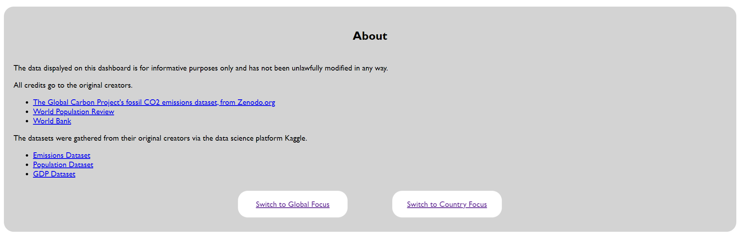
Ethical Considerations
Links directly to the 2 dashboards
Lays out source material for transparency

Slide 36
Thanks for watching!
https://ddaniel2024.github.io/Project-3/global

