Slide 1
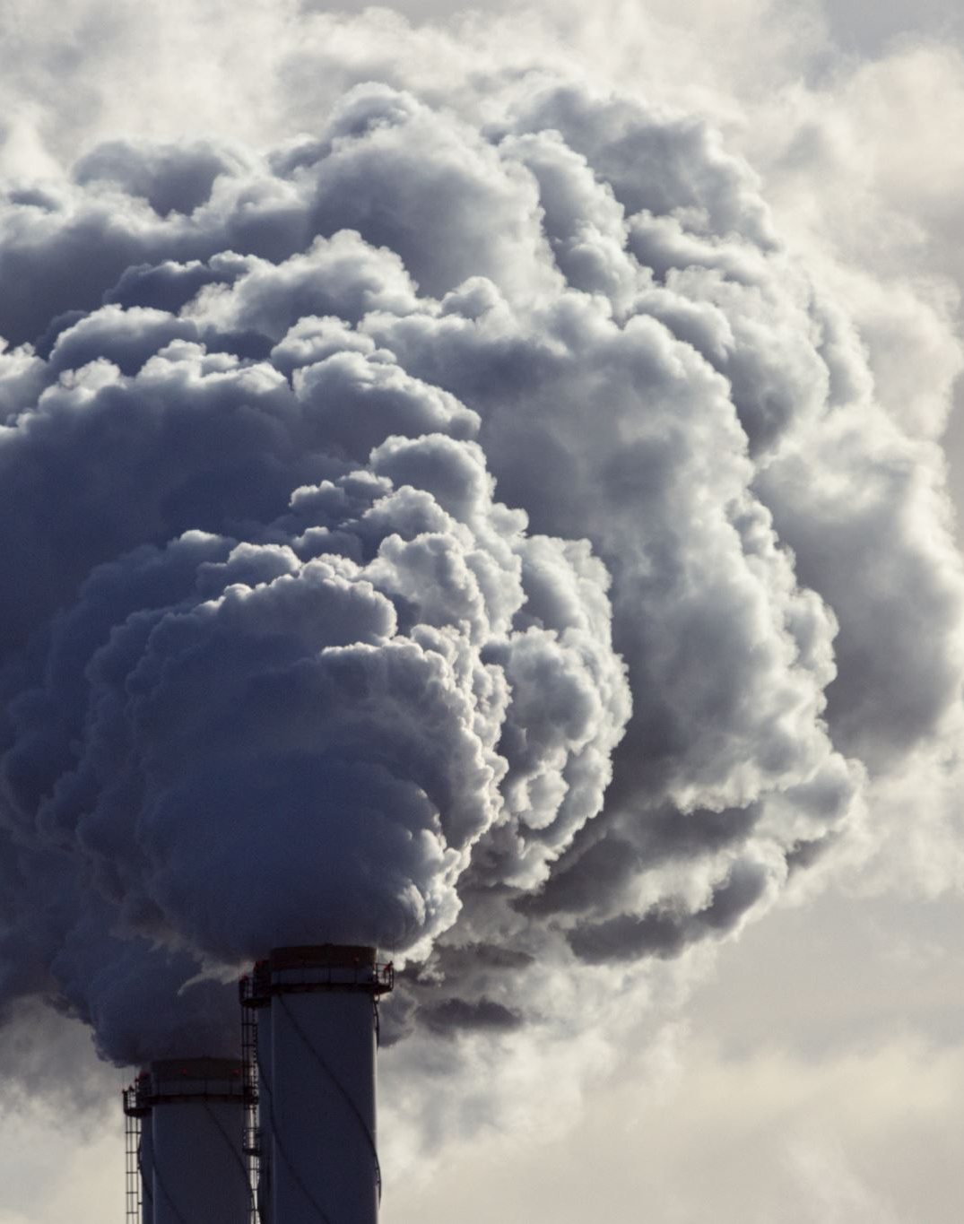
Project 3 Data Visualization of CO₂ emissions
Edward Vaughan, Daniel Daniel, Essa Bostan, Mujahid Iqbal

Slide 2
Background

Slide 3
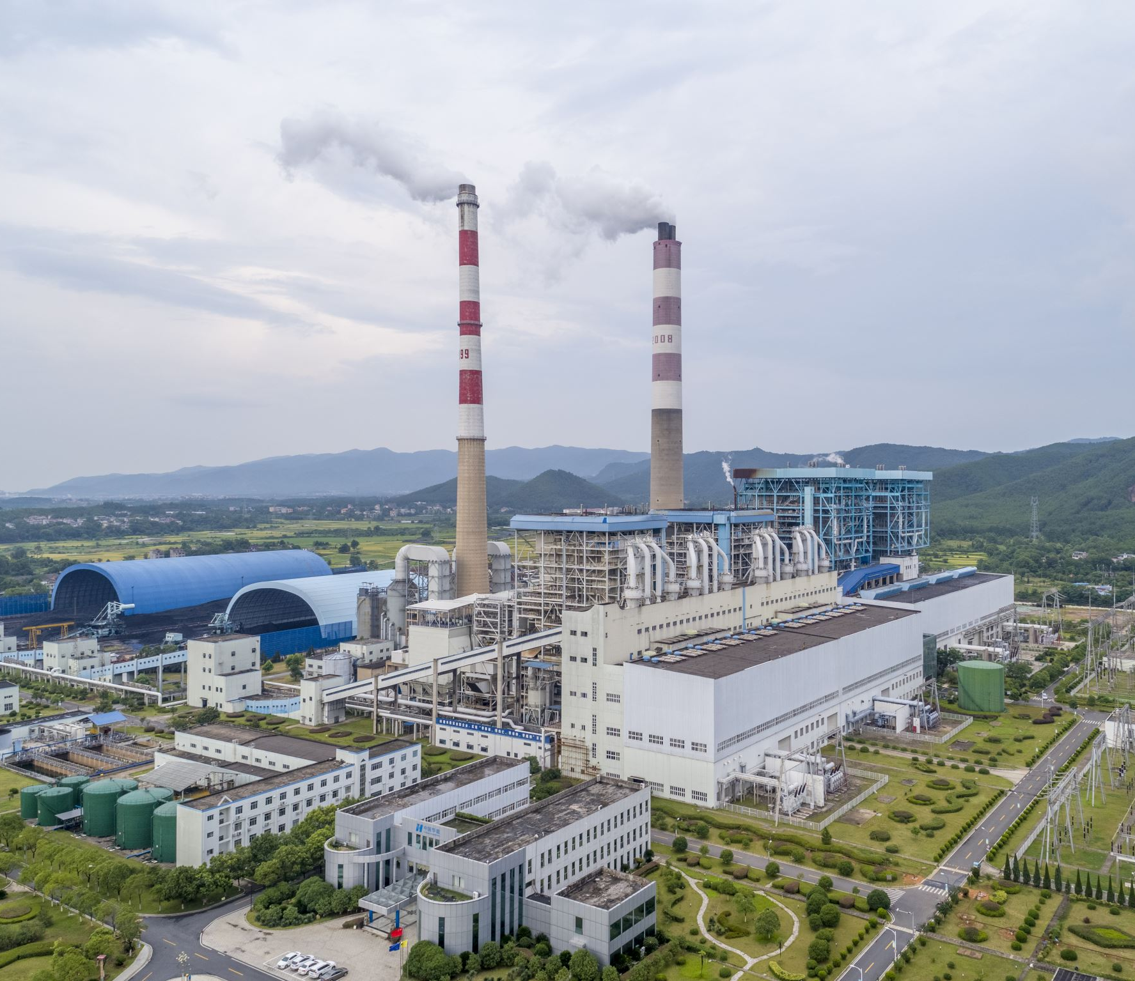
Background
Human activities are causing CO2 to increase.
Fossil fuels like coal and oil contain carbon that plants gathered by photosynthesis over many millions of years; we are returning that carbon to the atmosphere in just a few hundred.

Slide 4

Background
CO2 is a greenhouse gas, absorbing heat from the earth and releasing it in all directions, including back to earth. This causes global temperatures to rise, bringing starvation and disease. Glaciers and ice caps melt, causing sea levels to rise. People in low-lying areas such as the Netherlands, Bangladesh and Florida USA could be displaced. Countries like India, Bolivia and Peru depend on glacial meltwater. Loss of these glaciers could be devastating.
Also, CO2 dissolves into the ocean and reacts with water to form carbonic acid, raising its acidity.

Slide 5
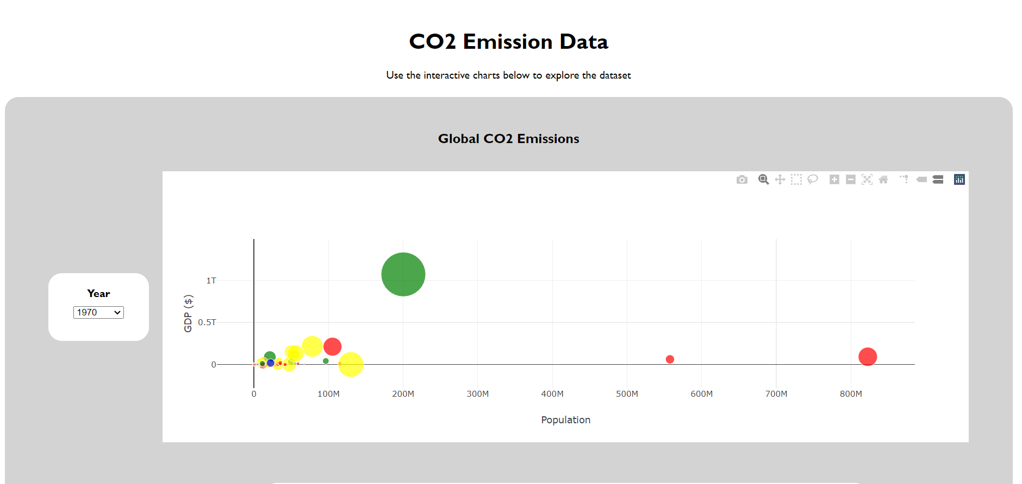
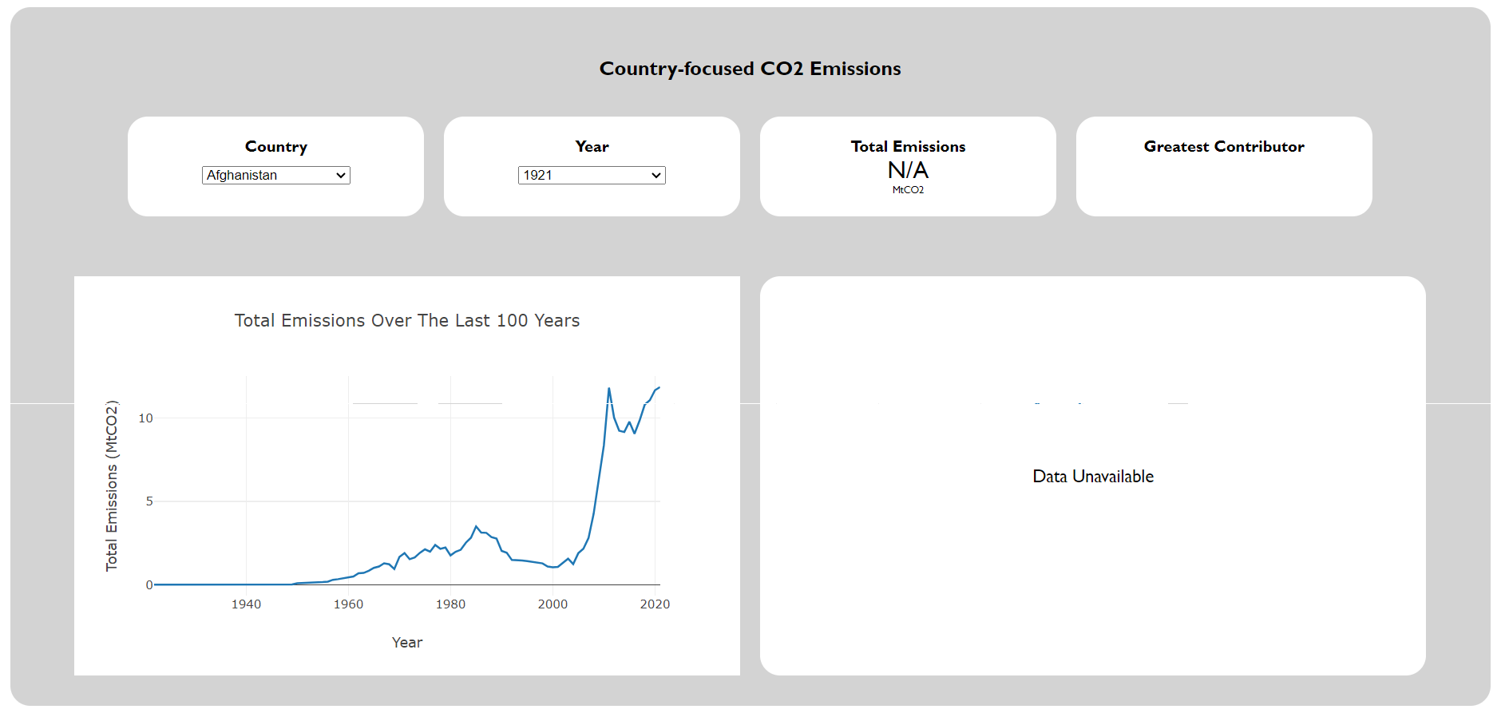


Slide 6

Coding and Process

Slide 7
Sources

Slide 8
Data Storage (MongoDB)

Slide 9
Data Extraction

Slide 10
Data Cleaning

Slide 11
Processing

Slide 12
Plots

Slide 13

Interactivity

Slide 14
Webpage Styling (CSS)

Slide 15
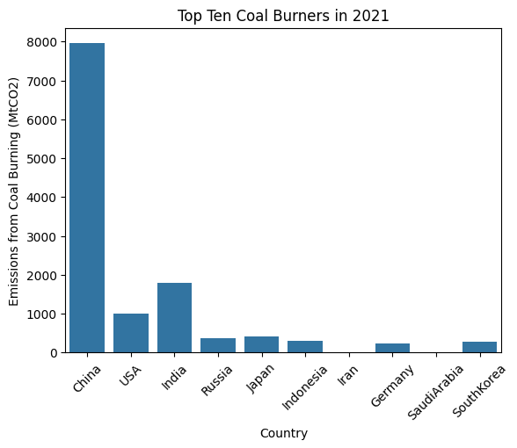
Over 2021, China produced a staggering 8 000 megatonnes of CO2 from burning coal alone. Based on burning coal again, India was a distant second worst culprit with 2 000 megatonnes, as this bar chart shows:

Slide 16
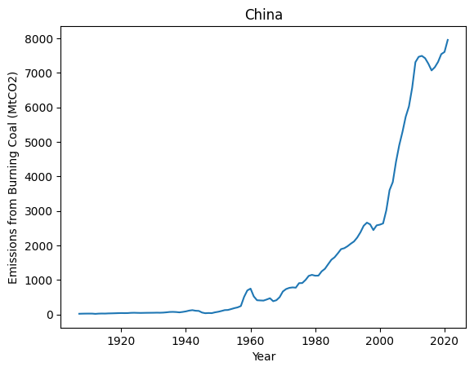
Looking at this line plot, China's CO2 production seems to be increasing exponentially:

Slide 17

This must stop. We must
Drive less
Fly less
Recycle more
Plant trees (trees absorb CO2)
Use less electricity
Eat less meat (cows produce methane, another greenhouse gas)
Use solar, wind and nuclear power etc rather than burn fossil fuels.
(Data source: Kaggle (www.kaggle.com))

Slide 18
A Description of the Code
This program looks at the world’s worst ten carbon producers. You can specify which of these countries you’d like a look at:
country_of_interest = input (‘Which country are you interested in?’)
Earlier, the dataframe is cleaned:
df.dropna (axis = 0, how = ‘any’, subset = ‘Country’, inplace = True)
df [‘Country’] = df [‘Country’].str.replace (r’\W’, ‘’, regex = True)
and a bar chart of the top ten coal burners in 2021 produced using Seaborn and MatPlotLib:
df1 = pd.DataFrame ({‘Country’: top_ten, ‘Emissions from Coal Burning (MtCO2)’: top_ten_Coal})
sns.barplot (x = ‘Country’, y = ‘Emissions from Coal Burning (MtCO2’, data = df1).set (title = ‘Top Ten Coal Burners in 2021’)
plt.xticks (rotation = 45)
plt.show ()

Slide 19
Once you’ve input which country you’re interested in, a line plot of emissions from burning coal in 2021 for that country is produced:
df1 = pd.DataFrame ({‘Year’: Country_Year, ‘Emission from Burning Coal (MtCO2)’: Country_Coal})
sns.lineplot (x = ‘Year’, y = ‘Emission from Burning Coal (MtCO2)’, data = df1).set (title = country_of_interest)
plt.show ().

Slide 20
Ethics

Slide 21
Ethical considerations
At the risk of promoting bias against Chinese and Indian people, we’ve established that production of CO2 by China and India runs at 8 000 and 2 000 megatonnes respectively as of 2021. This is irrefutable, despite ethical considerations.

Slide 22
Webpage Link
https://ddaniel2024.github.io/Project-3/

Slide 23

Thanks for watching!

