Slide 1

Chapter 11
THIRD EDITION
ECONOMICS
and
MICROECONOMICS Paul Krugman | Robin Wells
Behind the Supply Curve: Inputs and Costs

Slide 2

The importance of the firm’s production function, the relationship between quantity of inputs and quantity of output
Why production is often subject to diminishing returns to inputs
The various types of costs a firm faces and how they generate the firm’s marginal and average cost curves
Why a firm’s costs may differ in the short run versus the long run
How the firm’s technology of production can generate increasing returns to scale
WHAT YOU
WILL LEARN
IN THIS CHAPTER

Slide 3
The Production Function
A production function is the relationship between the quantity of inputs a firm uses and the quantity of output it produces.
A fixed input is an input whose quantity is fixed for a particular period and cannot be varied.
A variable input is an input whose quantity the firm can vary at any time.

Slide 4
Inputs and Output
The long run is the period in which all inputs can be varied.
The short run is the period in which at least one input is fixed.
The total product curve shows how the quantity of output depends on the quantity of the variable input, for a given quantity of the fixed input.

Slide 5
Production Function and TP Curve for George and Martha’s Farm
Quantity of wheat (bushels)
Adding a 7th worker leads to an increase in output of only 7 bushels
Quantity of labor L
Quantity
of wheat Q
MP of labor
MPL
Δ
Q
Δ
L
=
/
(worker)
(bushels)
(bushels per worker)
Adding a 2nd worker leads to an increase in output of 17 bushels
Total Product, TP
0
0
100
19
1
19
17
80
2
36
15
3
51
13
60
4
64
5
75
11
40
6
84
9
7
91
7
20
8
96
5
0
1
2
3
4
5
6
7
8
Quantity of labor (workers)
Although the total product curve in the figure slopes upward along its entire length, the slope isn’t constant: as you move up the curve to the right, it flattens out due to changing marginal product of labor.
Notes:
Figure Caption: Figure 11-1: Production Function and Total Product Curve for George and Martha’s Farm
The table shows the production function, the relationship between the quantity of the variable input (labor, measured in number of workers) and the quantity of output (wheat, measured in bushels) for a given quantity of the fixed input. It also calculates the marginal product of labor on George and Martha’s farm. The total product curve shows the production function graphically. It slopes upward because more wheat is produced as more workers are employed. It also becomes flatter because the marginal product of labor declines as more and more workers are employed.

Slide 6
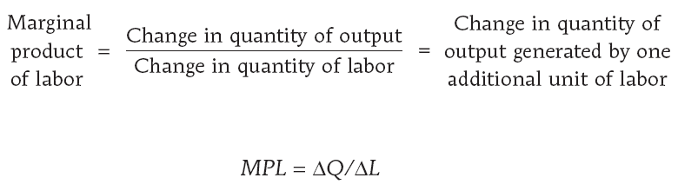
Marginal Product of Labor
The marginal product of an input is the additional quantity of output that is produced by using one more unit of that input.

Slide 7
Diminishing Returns to an Input
There are diminishing returns to an input when an increase in the quantity of that input, holding the levels of all other inputs fixed, leads to a decline in the marginal product of that input.
The following marginal product of labor curve illustrates this concept clearly.

Slide 8
Marginal Product of Labor Curve
Marginal product of labor (bushels per worker)
There are diminishing returns to labor.
19
17
15
13
11
9
7
5
Marginal product of labor, MPL
0
1
2
3
4
5
6
7
8
Quantity of labor (workers)
Here, the first worker employed generates an increase in output of 19 bushels, the second worker generates an increase of 17 bushels, and so on…
Notes:
Figure Caption: Figure 11-2: Marginal Product of Labor Curve for George and Martha’s Farm
The marginal product of labor curve plots each worker’s marginal product, the increase in the quantity of output generated by each additional worker. The change in the quantity of output is measured on the vertical axis and the number of workers employed on the horizontal axis. The first worker employed generates an increase in output of 19 bushels, the second worker generates an increase of 17 bushels, and so on. The curve slopes downward due to diminishing returns to labor.

Slide 9
Total Product, Marginal Product, and the Fixed Input
Quantity of wheat
(bushels)
Marginal product of labor
(bushels per worker)
160
30
140
TP
20
120
25
100
TP
20
10
15
80
60
10
40
MPL
20
5
MPL
20
10
0
1
2
3
4
5
6
7
8
0
1
2
3
4
5
6
7
8
Quantity of labor (workers)
Quantity of labor (workers)
(a) Total Product Curves
(b) Marginal Product Curves
With more land, each worker can produce more wheat. So an increase in the fixed input shifts the total product curve up from TP₁₀ to TP₂₀.
This shift also implies that the marginal product of each worker is higher when the farm is larger. As a result, an increase in acreage also shifts the marginal product of labor curve up from MPL₁₀ to MPL₂₀.
Notes:
Figure Caption: Figure 11-3: Total Product, Marginal Product, and the Fixed Input
This figure shows how the quantity of output—illustrated by the total product curve—and marginal product depend on the level of the fixed input. Panel (a) shows two total product curves for George and Martha’s farm, TP10 when their farm is 10 acres and TP20 when it is 20 acres. With more land, each worker can produce more wheat. So an increase in the fixed input shifts the total product curve up from TP10 to TP20. This also implies that the marginal product of each worker is higher when the farm is 20 acres than when it is 10 acres. As a result, an increase in acreage also shifts the marginal product of labor curve up from MPL₁₀ to MPL₂₀. Panel (b) shows the marginal product of labor curves. Note that both marginal product of labor curves still slope downward due to diminishing returns to labor.

Slide 10
From the Production Function to Cost Curves
A fixed cost is a cost that does not depend on the quantity of output produced. It is the cost of the fixed input.
A variable cost is a cost that depends on the quantity of output produced. It is the cost of the variable input.

Slide 11
Total Cost Curve
The total cost of producing a given quantity of output is the sum of the fixed cost and the variable cost of producing that quantity of output.
TC = FC + VC
The total cost curve becomes steeper as more output is produced due to diminishing returns.

Slide 12
Total Cost Curve for George and Martha’s Farm
Cost
Total cost, TC
$2,000
I
1,800
H
1,600
G
1,400
F
1,200
E
1,000
D
800
C
600
B
400
A
200
0
19
36
51
64
75
84
91
96
Quantity of wheat (bushels)
Point on graph
Quantity of labor L
Quantity of wheat Q
Variable cost
(VC)
Fixed Cost (FC)
Total cost
(worker)
(bushels)
(TC = FC + VC)
A
0
0
$
O
$400
$
400
B
1
19
200
400
600
C
2
36
400
400
800
D
3
51
600
400
1,000
E
4
64
800
400
1,200
F
5
75
1,000
400
1,400
G
6
84
1,200
400
1,600
H
7
91
1,400
400
1,800
I
8
96
1,600
400
2,000
Notes:
Figure Caption: Figure 11-4: Total Cost Curve for George and Martha’s Farm
The table shows the variable cost, fixed cost, and total cost for various output quantities on George and Martha’s 10-acre farm. The total cost curve shows how total cost (measured on the vertical axis) depends on the quantity of output (measured on the horizontal axis). The labeled points on the curve correspond to the rows of the table. The total cost curve slopes upward because the number of workers employed, and hence total cost, increases as the quantity of output increases. The curve gets steeper as output increases due to diminishing returns to labor.

Slide 13
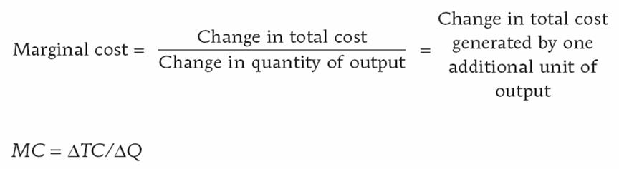
Two Key Concepts: Marginal Cost and Average Cost
As in the case of marginal product, marginal cost is equal to rise (the increase in total cost) divided by run (the increase in the quantity of output).

Slide 14
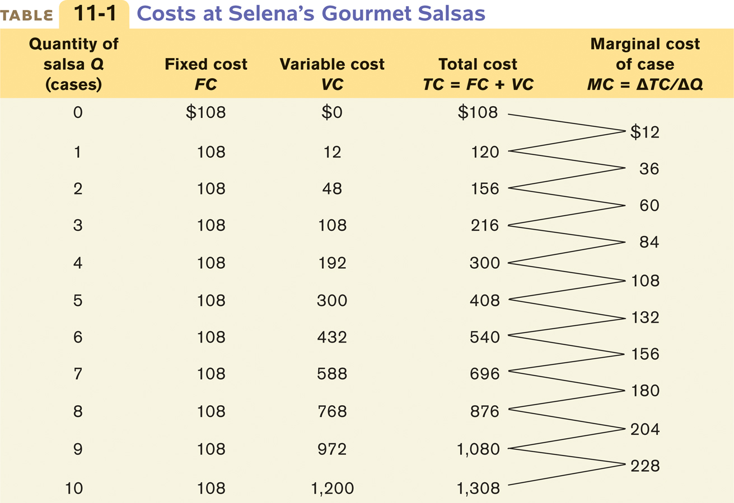
Costs at Selena’s Gourmet Salsas

Slide 15
Total Cost and Marginal Cost Curves for Selena’s Gourmet Salsas
(a) Total Cost
(b) Marginal Cost
Cost
Cost of case
8th case of salsa increases total cost by $180.
$1,400
T
C
$250
MC
1,200
2nd case of salsa increases total cost by $36.
200
1,000
800
150
600
100
400
200
50
0
1
2
3
4
5
6
7
8
9
10
0
1
2
3
4
5
6
7
8
9
10
Quantity of salsa (cases)
Quantity of salsa (cases)
Notes:
Figure Caption: Figure 11-6: Total Cost and Marginal Cost Curves for Selena’s Gourmet Salsas
Panel (a) shows the total cost curve from Table 12-1. Like the total cost curve in Figure 12-4, it slopes upward and gets steeper as we move up it to the right. Panel (b) shows the marginal cost curve. It also slopes upward, reflecting diminishing returns to the variable input.

Slide 16
Why is the Marginal Cost Curve Upward Sloping?
The marginal cost curve is upward sloping because there are diminishing returns to inputs in this example. As output increases, the marginal product of the variable input declines.
This implies that more and more of the variable input must be used to produce each additional unit of output as the amount of output already produced rises.
And since each unit of the variable input must be paid for, the cost per additional unit of output also rises.

Slide 17
Average Cost
Average total cost, often referred to simply as average cost, is total cost divided by quantity of output produced.
ATC = TC/Q = (Total Cost) / (Quantity of Output)
A U-shaped average total cost curve falls at low levels of output, then rises at higher levels.

Slide 18
Average Cost
Average fixed cost is the fixed cost per unit of output.
AFC = FC/Q = (Fixed Cost) / (Quantity of Output)
Average variable cost is the variable cost per unit of output.
AVC = VC/Q= (Variable Cost) / (Quantity of Output)

Slide 19
Average Total Cost Curve
Increasing output, therefore, has two opposing effects on average total cost—the spreading effect and the diminishing returns effect:
The spreading effect: the larger the output, the greater the quantity of output over which fixed cost is spread, leading to lower the average fixed cost
The diminishing returns effect: the larger the output, the greater the amount of variable input required to produce additional units leading to higher average variable cost

Slide 20
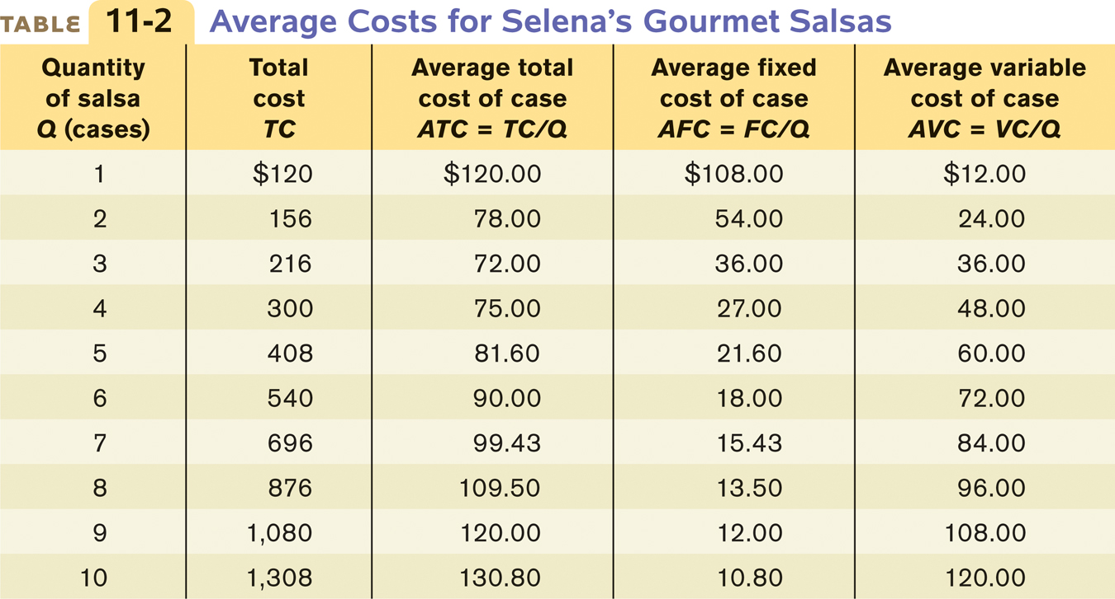
Average Costs for Selena’s Gourmet Salsas

Slide 21
Average Total Cost Curve for Selena’s Gourmet Salsas
Cost of case
$140
Average total cost, ATC
Minimum average total cost
120
100
80
M
60
40
20
0
1
2
3
4
5
6
7
8
9
10
Quantity of salsa (cases)
Minimum-cost output
Notes:
Figure Caption: Figure 11-7: Average Total Cost Curve for Selena’s Gourmet Salsas
The average total cost curve at Selena’s Gourmet Salsas is U-shaped. At low levels of output, average total cost falls because the “spreading effect” of falling average fixed cost dominates the “diminishing returns effect” of rising average variable cost. At higher levels of output, the opposite is true and average total cost rises. At point M, corresponding to an output of three cases of salsa per day, average total cost is at its minimum level, the minimum average total cost.

Slide 22
Putting the Four Cost Curves Together
Note that:
Marginal cost is upward sloping due to diminishing returns.
Average variable cost also is upward sloping, but is flatter than the marginal cost curve.
Average fixed cost is downward sloping because of the spreading effect.
The marginal cost curve intersects the average total cost curve from below, crossing it at its lowest point. This last feature is our next subject of study.

Slide 23
Marginal Cost & Average Cost Curves for Selena’s Gourmet Salsas
The bottom of the U curve is at the level of output at which the marginal cost curve crosses the average total cost curve from below.
Is this an accident? No!
Cost of case
$250
MC
200
150
A
T
C
A
VC
100
M
50
AFC
0
1
2
3
4
5
6
7
8
9
10
Quantity of salsa (cases)
Minimum-cost output
Notes:
Figure Caption: Figure 11-8: Marginal Cost and Average Cost Curves for Selena’s Gourmet Salsas
Here we have the family of cost curves for Selena’s Gourmet Salsas: the marginal cost curve (MC), the average total cost curve (ATC), the average variable cost curve (AVC), and the average fixed cost curve (AFC). Note that the average total cost curve is U-shaped and the marginal cost curve crosses the average total cost curve at the bottom of the U, point M, corresponding to the mini- mum average total cost from Table 12-2 and Figure 12-7.

Slide 24
General Principles that Are Always True About a Firm’s Marginal and Average Total Cost Curves
The minimum-cost output is the quantity of output at which average total cost is lowest—the bottom of the U-shaped average total cost curve.
At the minimum-cost output, average total cost is equal to marginal cost.
At output less than the minimum-cost output, marginal cost is less than average total cost and average total cost is falling.
And at output greater than the minimum-cost output, marginal cost is greater than average total cost and average total cost is rising.

Slide 25
The Relationship Between the Average Total Cost and the Marginal Cost Curves
Cost of unit
If marginal cost is above average total cost, average total cost is rising.
MC
MC
A
T
C
H
B
2
A
1
A
M
B
2
1
MC
L
If marginal cost is below average total cost, average total cost is falling.
Quantity
When marginal cost equals average total cost, we must be at the bottom of the U, because only at that point is average total cost neither falling nor rising.
Notes:
Figure Caption: Figure 11-9: The Relationship Between the Average Total Cost and the Marginal Cost Curves
To see why the marginal cost curve (MC) must cut through the average total cost curve at the minimum average total cost (point M), corresponding to the minimum-cost output, we look at what happens if marginal cost is different from average total cost. If marginal cost is less than average total cost, an increase in output must reduce average total cost, as in the movement from A₁to A₂. If marginal cost is greater than average total cost, an increase in output must increase average total cost, as in the movement from B₁ to B₂.

Slide 26
Does the Marginal Cost Curve Always Slope Upward?
In practice, marginal cost curves often slope downward as a firm increases its production from zero up to some low level, sloping upward only at higher levels of production.
This initial downward slope occurs because a firm that employs only a few workers often cannot reap the benefits of specialization of labor.
This specialization can lead to increasing returns at first, and so to a downward-sloping marginal cost curve.
Once there are enough workers to permit specialization, however, diminishing returns set in.

Slide 27
More Realistic Cost Curves
Cost of unit
2. … but diminishing returns set in once the benefits from specialization are exhausted and marginal cost rises.
MC
A
T
C
A
VC
1. Increasing specialization leads to lower marginal cost…
Quantity
Notes:
Figure Caption: Figure 11-10: More Realistic Cost Curves
A realistic marginal cost curve has a “swoosh” shape. Starting from a very low output level, marginal cost often falls as the firm increases output. That’s because hiring additional workers allows greater specialization of their tasks and leads to increasing returns. Once specialization is achieved, however, diminishing returns to additional workers set in and marginal cost rises. The corresponding average variable cost curve is now U-shaped, like the average total cost curve.
Marginal cost curves do not always slope upward. The benefits of specialization of labor can lead to increasing returns at first represented by a downward-sloping marginal cost curve. Once there are enough workers to permit specialization, however, diminishing returns set in.

Slide 28
Short-Run versus Long-Run Costs
In the short run, fixed cost is completely outside the control of a firm. But all inputs are variable in the long run: This means that in the long run fixed cost may also be varied.
In the long run, in other words, a firm’s fixed cost becomes a variable it can choose.
The firm will choose its fixed cost in the long run based on the level of output it expects to produce.

Slide 29
Choosing the Level of Fixed Cost of Selena’s Gourmet Salsas
At low output levels, low fixed cost yields lower average total cost
Cost of case
At high output levels, high fixed cost yields lower average total cost
There is a trade-off between higher fixed cost and lower variable cost for any given output level, and vice versa.
But as output goes up, average total cost is lower with the higher amount of fixed cost.
$250
200
150
Low fixed cost
A
T
C
1
100
A
T
C
2
50
High fixed cost
0
1
2
3
4
5
6
7
8
9
10
Quantity of salsa (cases)
Low fixed cost (FC = $108)
High fixed cost (FC = $216)
Quantity of salsa
High variable cost
Total cost
Average total cost of case
Low variable cost
Total cost
Average total cost of case
(salsa)
A
T
C
1
A
T
C
2
1
$
12
$
120
$120.00
$
6
$222
$222.00
2
48
156
78.00
24
240
120.00
3
108
216
72.00
54
270
90.00
4
192
300
75.00
96
312
78.00
5
300
408
81.60
150
366
73.20
6
432
540
90.00
216
432
72.00
7
588
696
99.43
294
510
72.86
8
768
876
109.50
384
600
75.00
9
972
1,080
120.00
486
702
78.00
10
1,200
1,308
130.80
600
816
81.60
Notes:
Figure Caption: Figure 11-11: Choosing the Level of Fixed Cost for Selena’s Gourmet Salsas
There is a trade-off between higher fixed cost and lower variable cost for any given output level, and vice versa. ATC₁is the average total cost curve corresponding to a fixed cost of $108; it leads to lower fixed cost and higher variable cost. ATC₂ is the average total cost curve corresponding to a higher fixed cost of $216 but lower variable cost. At low output levels, at 4 or fewer cases of salsa per day, ATC₁lies below ATC₂: average total cost is lower with only $108 in fixed cost. But as output goes up, average total cost is lower with the higher amount of fixed cost, $216: at more than 4 cases of salsa per day, ATC₂ lies below ATC₁.

Slide 30
The Long-Run Average Total Cost Curve
The long-run average total cost curve shows the relationship between output and average total cost when fixed cost has been chosen to minimize average total cost for each level of output.

Slide 31
Short-Run and Long-Run Average Total Cost Curves
Cost of case
Constant returns to scale
Increasing returns to scale
Decreasing returns to scale
A
T
C
3
A
T
C
6
A
T
C
9
L
R
A
T
C
B
Y
A
C
X
0
3
4
5
6
7
8
9
Quantity of salsa (cases)
Notes:
Figure Caption: Figure 11-12: Short-Run and Long-Run Average Total Cost Curves
Short-run and long-run average total cost curves differ because a firm can choose its fixed cost in the long run. If Selena has chosen the level of fixed cost that minimizes short-run average total cost at an output of 6 cases, and actually produces 6 cases, then she will be at point Con LRATC and ATC₆. But if she produces only 3 cases, she will move to point B. If she expects to produce only 3 cases for a long time, in the long run she will reduce her fixed cost and move to point A on ATC₃. Likewise, if she produces 9 cases (putting her at point Y) and expects to continue this for a long time, she will increase her fixed cost in the long run and move to point X.

Slide 32
Returns to Scale
There are increasing returns to scale (economies of scale) when long-run average total cost declines as output increases.
There are decreasing returns to scale (diseconomies of scale) when long-run average total cost increases as output increases.
There are constant returns to scale when long-run average total cost is constant as output increases.

Slide 33
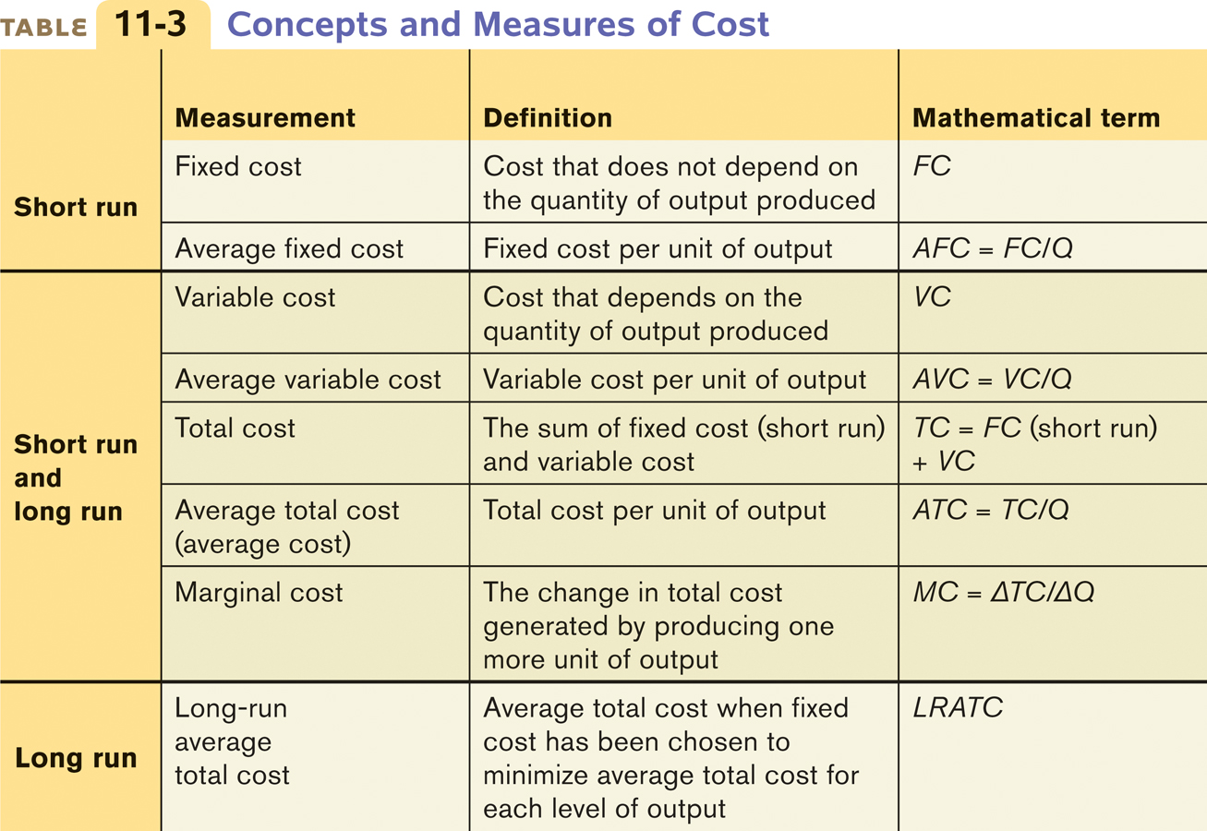
Summing Up Costs

Slide 34
Summary
The relationship between inputs and output is a producer’s production function. In the short run, the quantity of a fixed input cannot be varied but the quantity of a variable input can. In the long run, the quantities of all inputs can be varied. For a given amount of the fixed input, the total product curve shows how the quantity of output changes as the quantity of the variable input changes.

Slide 35
Summary
There are diminishing returns to an input when its marginal product declines as more of the input is used, holding the quantity of all other inputs fixed.
Total cost is equal to the sum of fixed cost, which does not depend on output, and variable cost, which does depend on output.

Slide 36
Summary
Average total cost, total cost divided by quantity of output, is the cost of the average unit of output, and marginal cost is the cost of one more unit produced. U-shaped average total cost curves are typical, because average total cost consists of two parts: average fixed cost, which falls when output increases (the spreading effect), and average variable cost, which rises with output (the diminishing returns effect).

Slide 37
Summary
When average total cost is U-shaped, the bottom of the U is the level of output at which average total cost is minimized, the point of minimum-cost output. This is also the point at which the marginal cost curve crosses the average total cost curve from below.

Slide 38
Summary
In the long run, a producer can change its fixed input and its level of fixed cost. The long-run average total cost curve shows the relationship between output and average total cost when fixed cost has been chosen to minimize average total cost at each level of output.
As output increases, there are increasing returns to scale if long-run average total cost declines; decreasing returns to scale if it increases; and constant returns to scale if it remains constant. Scale effects depend on the technology of production.

Slide 39
KEY TERMS
Production function
Fixed input
Variable input
Long run
Short run
Total product curve
Marginal product
Diminishing returns to an input
Fixed cost
Variable cost
Total cost
Total cost curve
Average total cost
Average cost
U-shaped average total cost curve
Average fixed cost
Average variable cost
Minimum-cost output
Long-run average total cost curve
Increasing returns to scale
Decreasing returns to scale
Constant returns to scale

