Slide 1

INTRODUCTION IN HTML TAGs, elements & attributes
Instructor: sonny boy r. Ellema, jr.

Slide 2
HtMl tAGS
Definition and Usage
The <html> tag represents the root of an HTML document
The <html> tag is the container for all other HTML elements (except for the <!DOCTYPE> tag).
Note: You should always include the lang attribute inside the <html> tag, to declare the language of the Web page. This is meant to assist search engines and browsers.

Slide 3
HtMl tAGS
TAG | DESCRIPTION
<!--...--> | Defines a comment
<!DOCTYPE> | Defines the document type
<a> | Defines a hyperlink
<abbr> | Defines an abbreviation or an acronym
<acronym> | Not supported in HTML5. Use <abbr> instead. Defines an acronym
<address> | Defines contact information for the author/owner of a document
<applet> | Not supported in HTML5. Use <embed> or <object> instead. Defines an embedded applet
<area> | Defines an area inside an image map
<article> | Defines an article
<aside> | Defines content aside from the page content
<audio> | Defines embedded sound content

Slide 4
TAG | DESCRIPTION
<b> | Defines bold text
<base> | Specifies the base URL/target for all relative URLs in a document
<basefont> | Not supported in HTML5. Use CSS instead. Specifies a default color, size, and font for all text in a document
<bdi> | Isolates a part of text that might be formatted in a different direction from other text outside it
<bdo> | Overrides the current text direction
<big> | Not supported in HTML5. Use CSS instead. Defines big text
<blockquote> | Defines a section that is quoted from another source
<body> | Defines the document's body
<br> | Defines a single line break
<button> | Defines a clickable button
<canvas> | Used to draw graphics, on the fly, via scripting (usually JavaScript)
<caption> | Defines a table caption

Slide 5
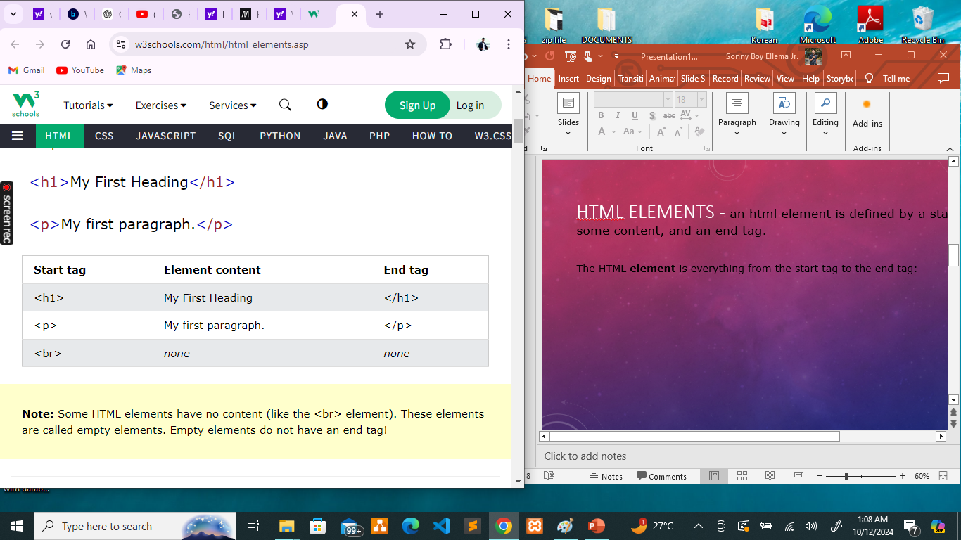
HtMl ELEMENTS - an html element is defined by a start tag, some content, and an end tag.
The HTML element is everything from the start tag to the end tag:

Slide 6
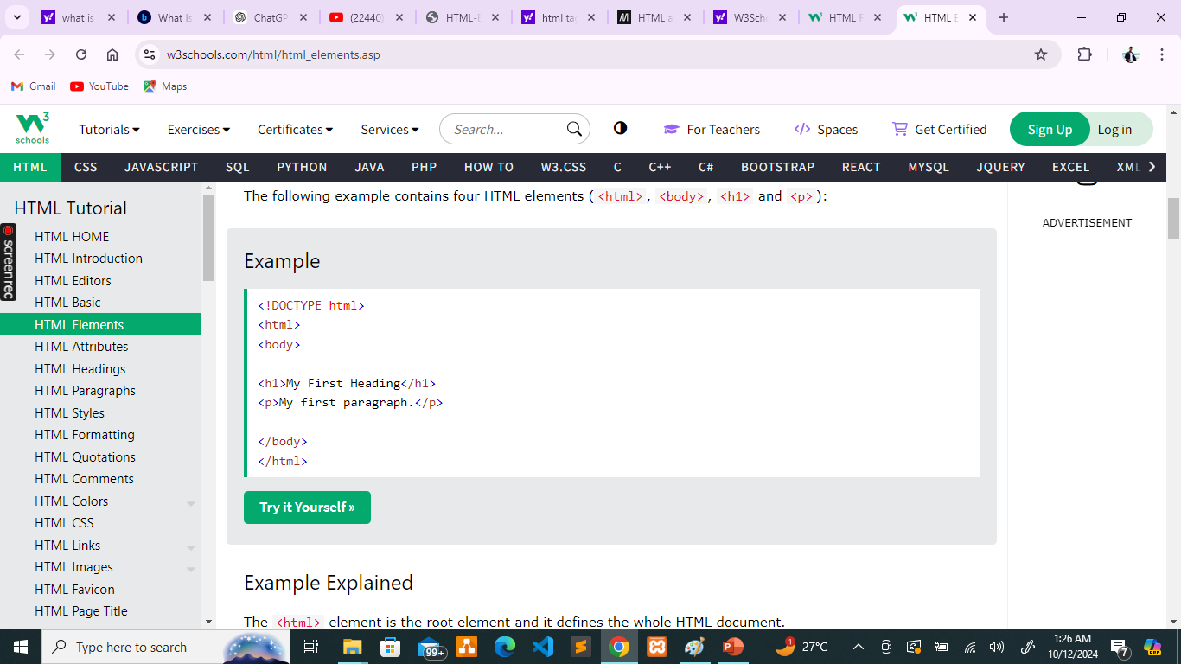
Nested HTML Elements HTML elements can be nested (this means that elements can contain other elements). All HTML documents consist of nested HTML elements. The following example contains four HTML elements (<html>, <body>, <h1> and <p>):

Slide 7
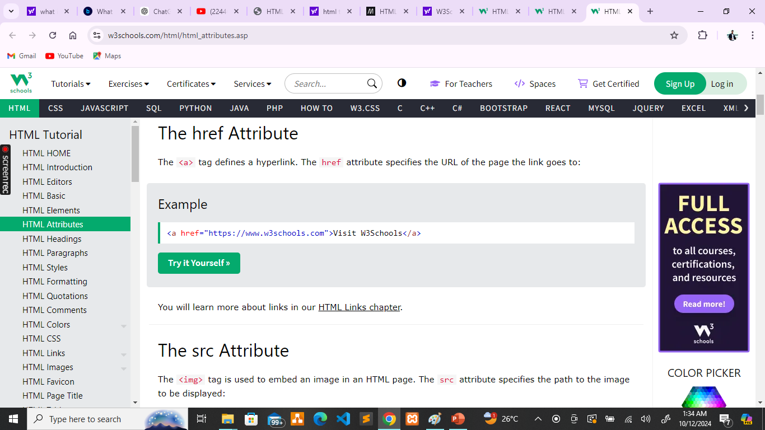
HtMl ATTRIBUTES -
All HTML elements can have attributes
Attributes provide additional information about elements
Attributes are always specified in the start tag
Attributes usually come in name/value pairs like: name="value"
The href Attribute
The <a> tag defines a hyperlink. The href attribute specifies the URL of the page the link goes to:

Slide 8
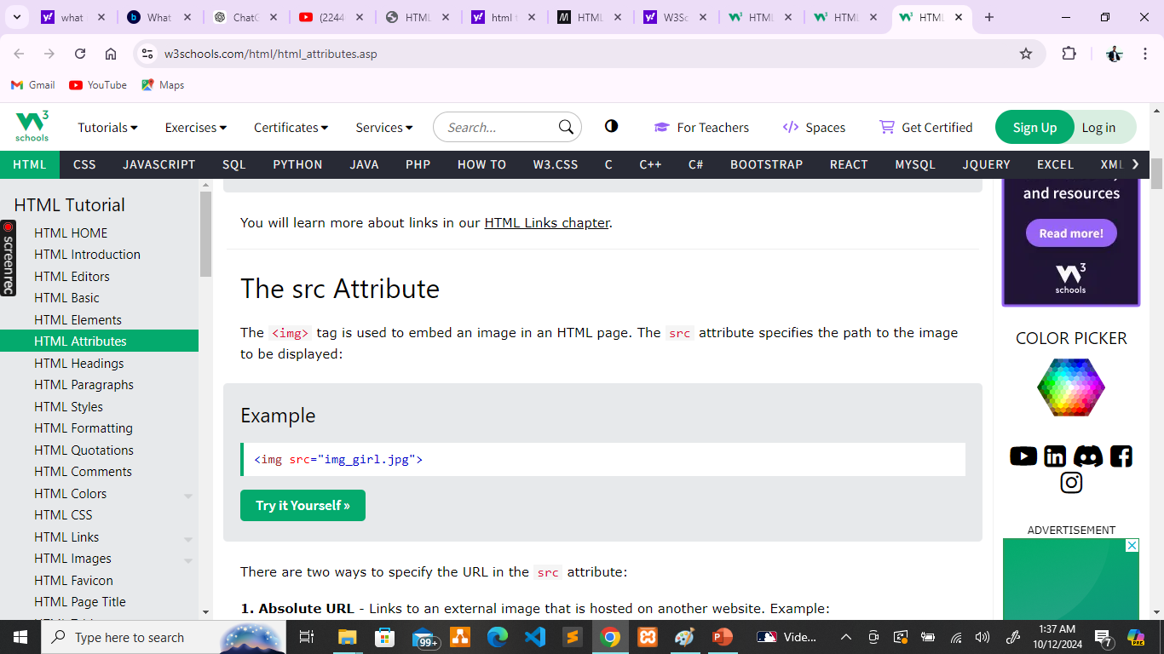
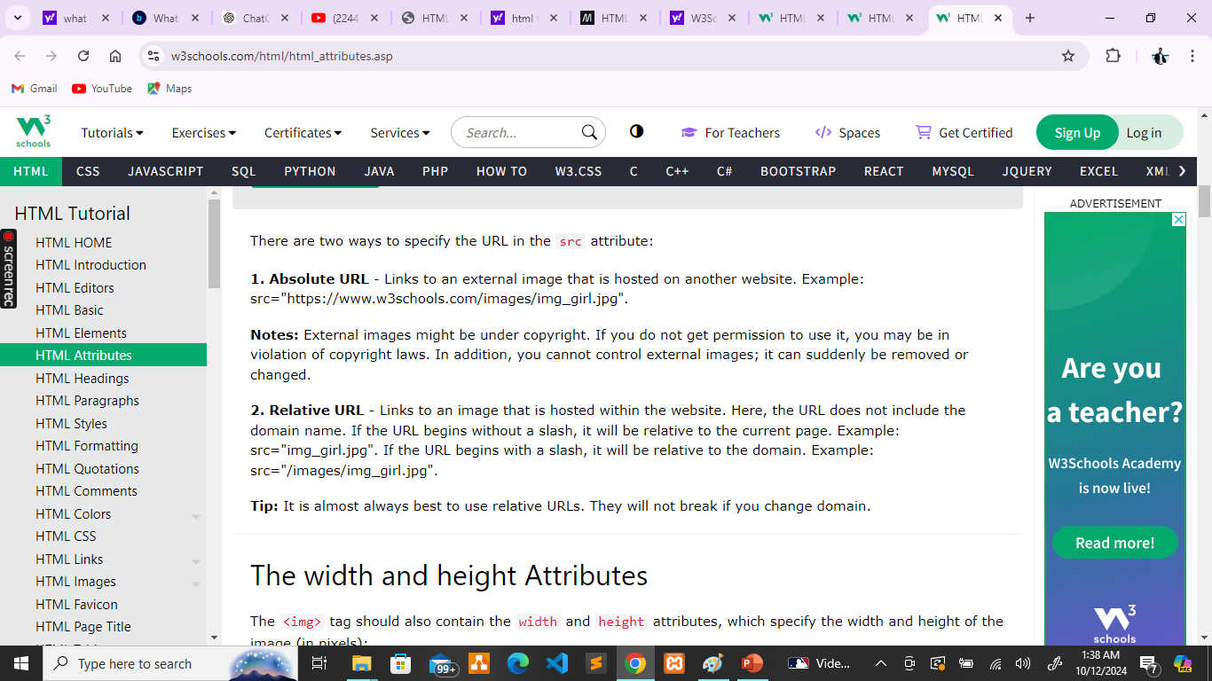
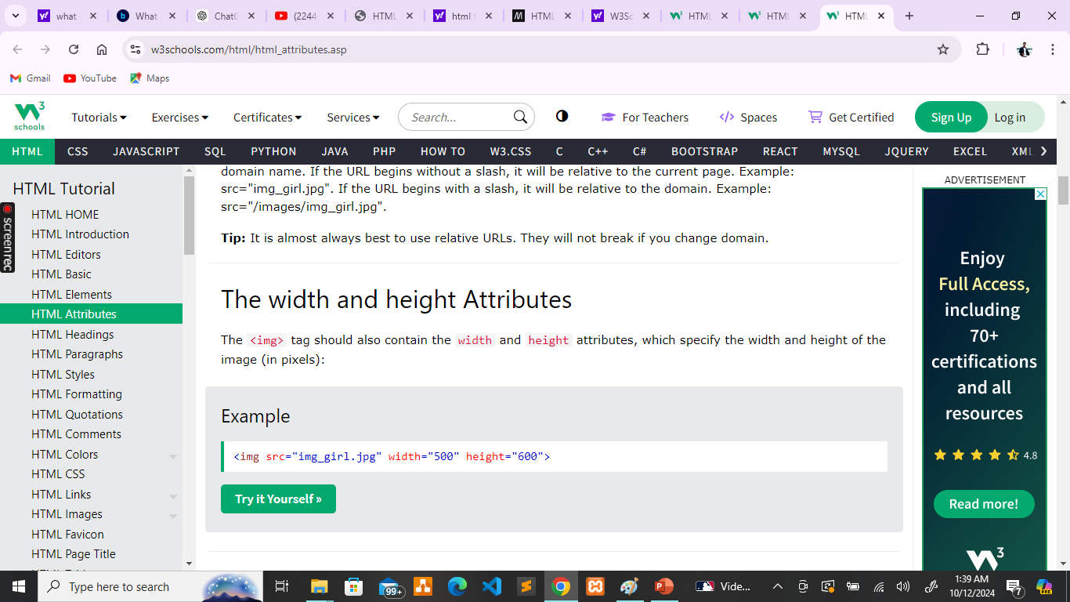

Slide 9

Thank You!!☺

