Slide 1

WEB DEVELOPMENT
AND
APPLICATION

Slide 2

What is web development?
Web development encompasses a broad range of tasks from coding, to technical design, to performance of a website or application running on the internet.
Web development is the act of building, creating and maintaining websites. The field encompasses a broad range of tasks including everything from coding, to technical design, to the performance of a website or application running on the internet. Web development consists of front-end and back-end components:
Front-end development consists of the user interface (UI) and the look and feel of the website or application.
Back-end development consists of the databases, logic, APIs, servers and everything else that powers the website behind the scenes.

Slide 3
What are the 3 types of web development?
Web development - This involves the technical aspects of creating a website, including:
Front-end development is responsible for the aspects of a website that users see and interact with: the user interface (UI). Front-end developers are well-versed in HTML, CSS and JavaScript, often working closely with design and UX teams to capture both the intended look and feel of the site, while also creating a quality user experience across multiple device types.
Back-end development is responsible for all the aspects of a website that users do not see. This is also known as server-side development because back-end developers focus primarily on the behind-the-scenes logic, APIs and database interactions that power the site.
Full-stack development is a more holistic approach where the developers responsible for the site or app take care of the entire development stack, from the inner workings typically performed on the back-end to the presentation layer normally handled by front-end developers.

Slide 4
Web Application Development: This is focused on creating software applications that run in a web browser, allowing users to perform tasks or access functionalities through the internet. Web applications are interactive, often requiring more sophisticated client-side and server-side programming. Examples include e-commerce platforms, social media sites, or online banking systems.

Slide 5
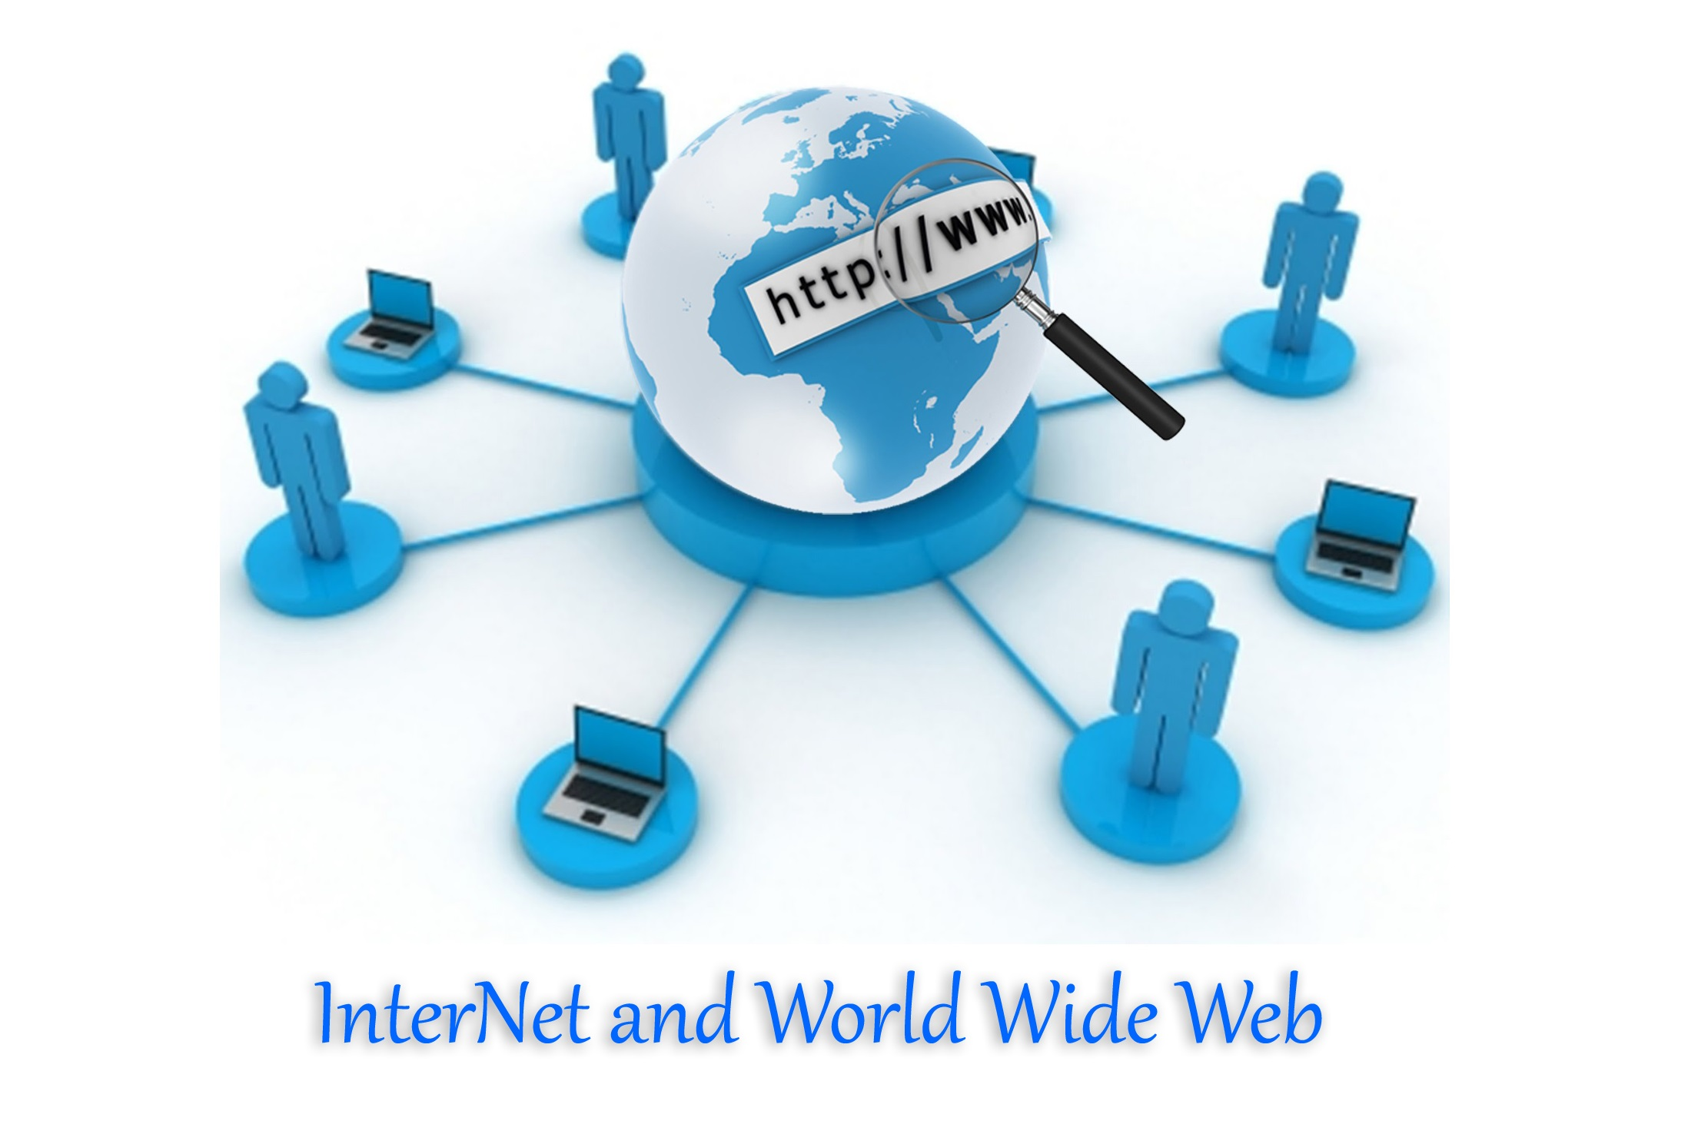

Slide 6
What is internet?
The internet is a world-wide system of computer networks that are connected to each other. These networks connect with each other using cables, telephone lines and communication satellites.

Slide 7
What is world wide web?
The world wide web (WWW) is a part of the internet where documents and other resources can be accessed. The WWW is often called “The Web”. The internet and the WWW are often confused. The internet is, in fact, the biggest network in the world; while the WWW is a collection of documents and other resources that you can browse, or access, through the internet.
Most resources are websites that can consist of text, pictures, audio clips, video clips, animations, etc. After connecting to the internet, you can browse websites using a type of application called a web browser.

Slide 8
Important concepts used with the World Wide Web
A web server is a computer that hosts a website, for example if you want to access www.wikipedia.org, the web server receives this request and uses hypertext transfer protocol (HTTP) to format and then present the website to you.
A website is a collection of web pages, for example Wikipedia is a website that has billions of web pages about different topics and articles. A web page is a single page of mark-up language (HTML) text, which can display text, media, images, or interactive material, such as audio files.
HTML is a type of coding language used on web pages to display text, images and audiovisuals. Documents on the internet that are not in HTML are not web pages.

Slide 9
What is web browser?
A web browser is a type of software that lets you browse websites or web pages. Every time you Google something, you are using a web browser to read what is on the web page. There are different types of web browsers, for example Google, Mozilla Firefox and Internet Explorer.

Slide 10
What is the difference between a web page and a web site?
A web page refers to the text, images, or graphics displayed in a web browser. A web page is generally a single page of content on a website. You can access a web page by entering the URL into the address bar of a web browser.
A website is a collection of web pages that are usually linked by hyperlinks. For example, if you go to the Sunday Times website, it consists of many web pages. On each page, you will find various articles, columns and content that have been grouped into different categories.

Slide 11
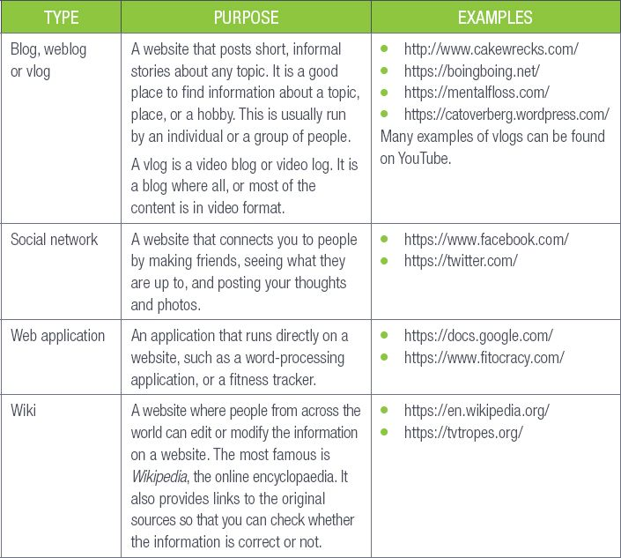
Types of websites :

Slide 12

URLs and the address bar
Each web page on the internet has its very own unique address called a URL, which tells the internet exactly what page you want to see on a website. Think of a URL as a street address that tells the web browser where to go on the internet.
When you type a URL into the address bar of the web browser and press Enter, the browser will take you to that specific page. For example, in the figure below, we typed www.bbc.com in the address bar (highlighted in green), which will then load the BBC web page.

Slide 13
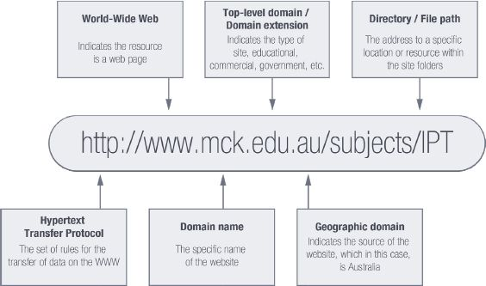
The domain name is the most important part of an internet address. This could be a word or a phrase that an internet site has identified as the name of the website. People use it to find information on the internet, for example businesses use it to get people to visit their websites.

Slide 14
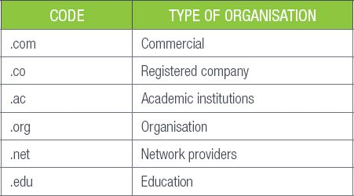
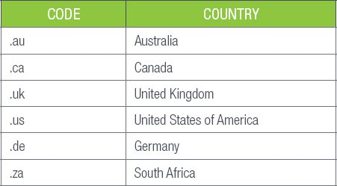
The tables on the following page show the different codes you could come across indicating an organisation type and the country of origin.
Code showing the different type of organization :
Example of country code found in the URL :

