Slide 1
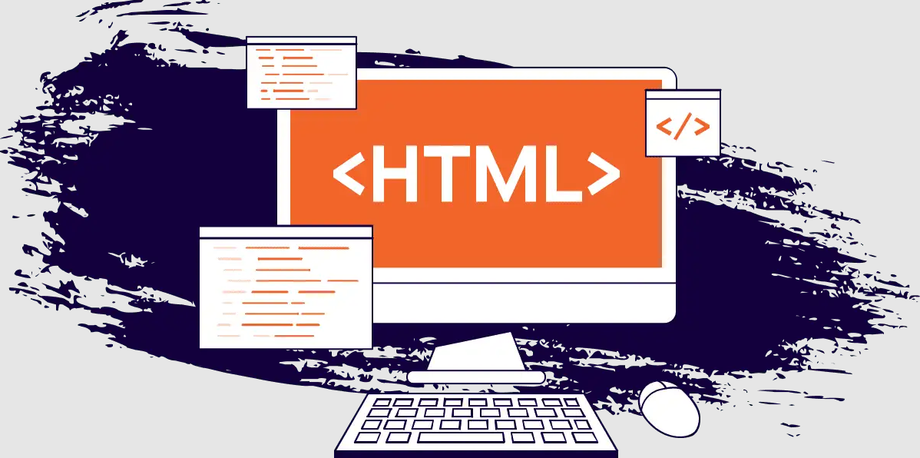
INTRODUCTION TO MARKUP

Slide 2
Introduction to markup languages
Markup languages are the backbone of the internet. They are used to create and structure content on web pages, making it easier for users to navigate and interact with websites. Markup languages are designed to be read by both humans and machines, making them an essential part of web development. In this section, we will provide an introduction to markup languages, their types, and their uses.

Slide 3
What are markup languages?
Markup Languages are a set of codes that are used to describe the structure of a document. They are used to create web pages, documents, and other types of digital content. Markup Languages use tags to define the structure of the content. These tags are enclosed in angle brackets and are used to define the elements of a document, such as headings, paragraphs, lists, and links.
There are two main types of markup languages: procedural and descriptive. Procedural markup languages are used to define how a document should be displayed. Examples of procedural markup languages include CSS and XSL. Descriptive markup languages, on the other hand, are used to describe the structure of a document. Examples of descriptive markup languages include HTML and XML.

Slide 4
Uses of markup languages?
Markup languages are used for a variety of purposes, including web development, document creation, and data exchange. HTML is the most commonly used markup language for web development. It is used to create web pages and define their structure. XML, on the other hand, is used for data exchange between different systems. It is used to define the structure of data and make it easier to share between different applications.

Slide 5
Comparison of HTML and XML?
HTML and XML are two of the most commonly used markup languages. HTML is used for web development, while XML is used for data exchange. HTML is a procedural markup language, while XML is a descriptive markup language. HTML has a limited set of tags, while XML allows developers to define their own tags. HTML is designed to display content, while XML is designed to describe content.

