Slide 1

Customer Shopping Behavior Analysis
Key insights and actionable recommendations from 3,900 purchase records — prepared for the data analytics team.

Slide 2

Dataset Overview
3,900 purchases analyzed
Spanning 4 product categories and 18 behavioral and demographic features
50 locations covered
Customers aged 18–70, offering broad demographic representation
Rich feature set
Includes purchase details, subscription status, discount usage, and loyalty signals

Slide 3
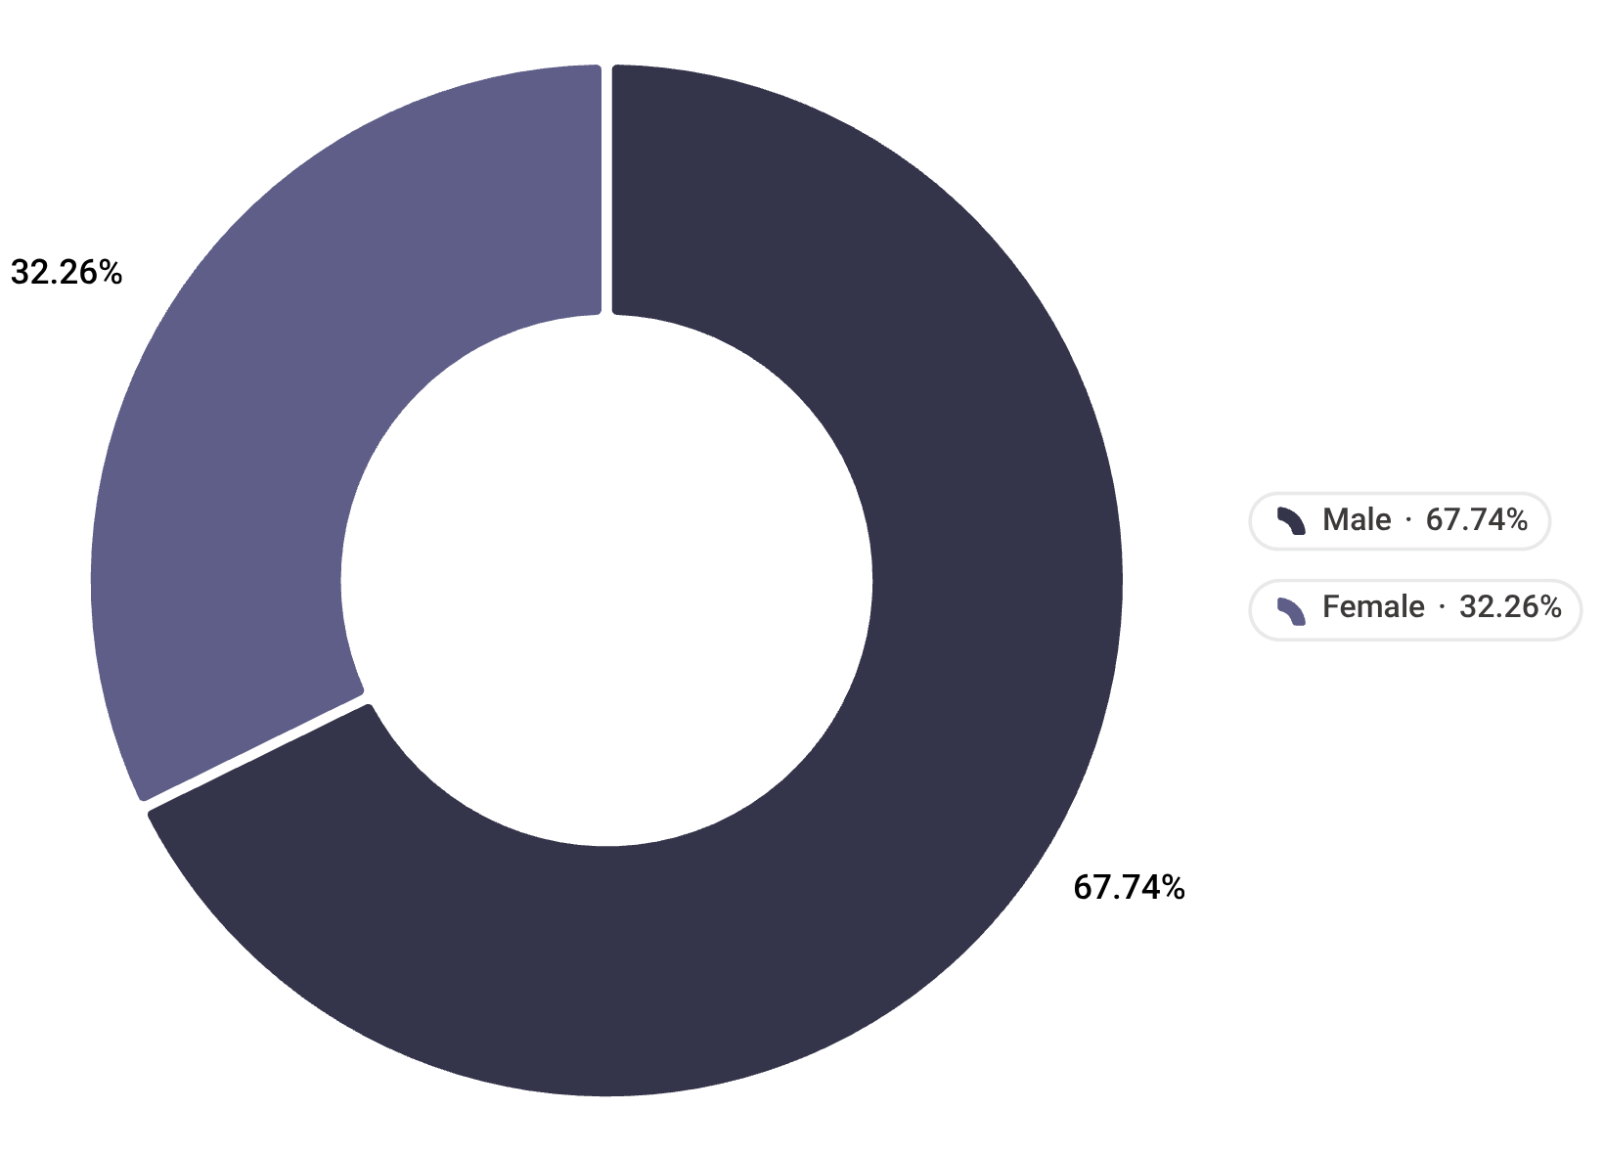

Revenue Concentration by Gender
A significant spending gap
Male customers generate $157,890 — 68% of total revenue — while female customers account for $75,191 (32%). The gap is nearly 2:1.
This disparity is not necessarily a demographic reality but a targeted marketing opportunity. Female customer engagement strategies remain underdeveloped relative to their potential share.
Closing even half the gender revenue gap could unlock ~$40K in incremental revenue.

Slide 4
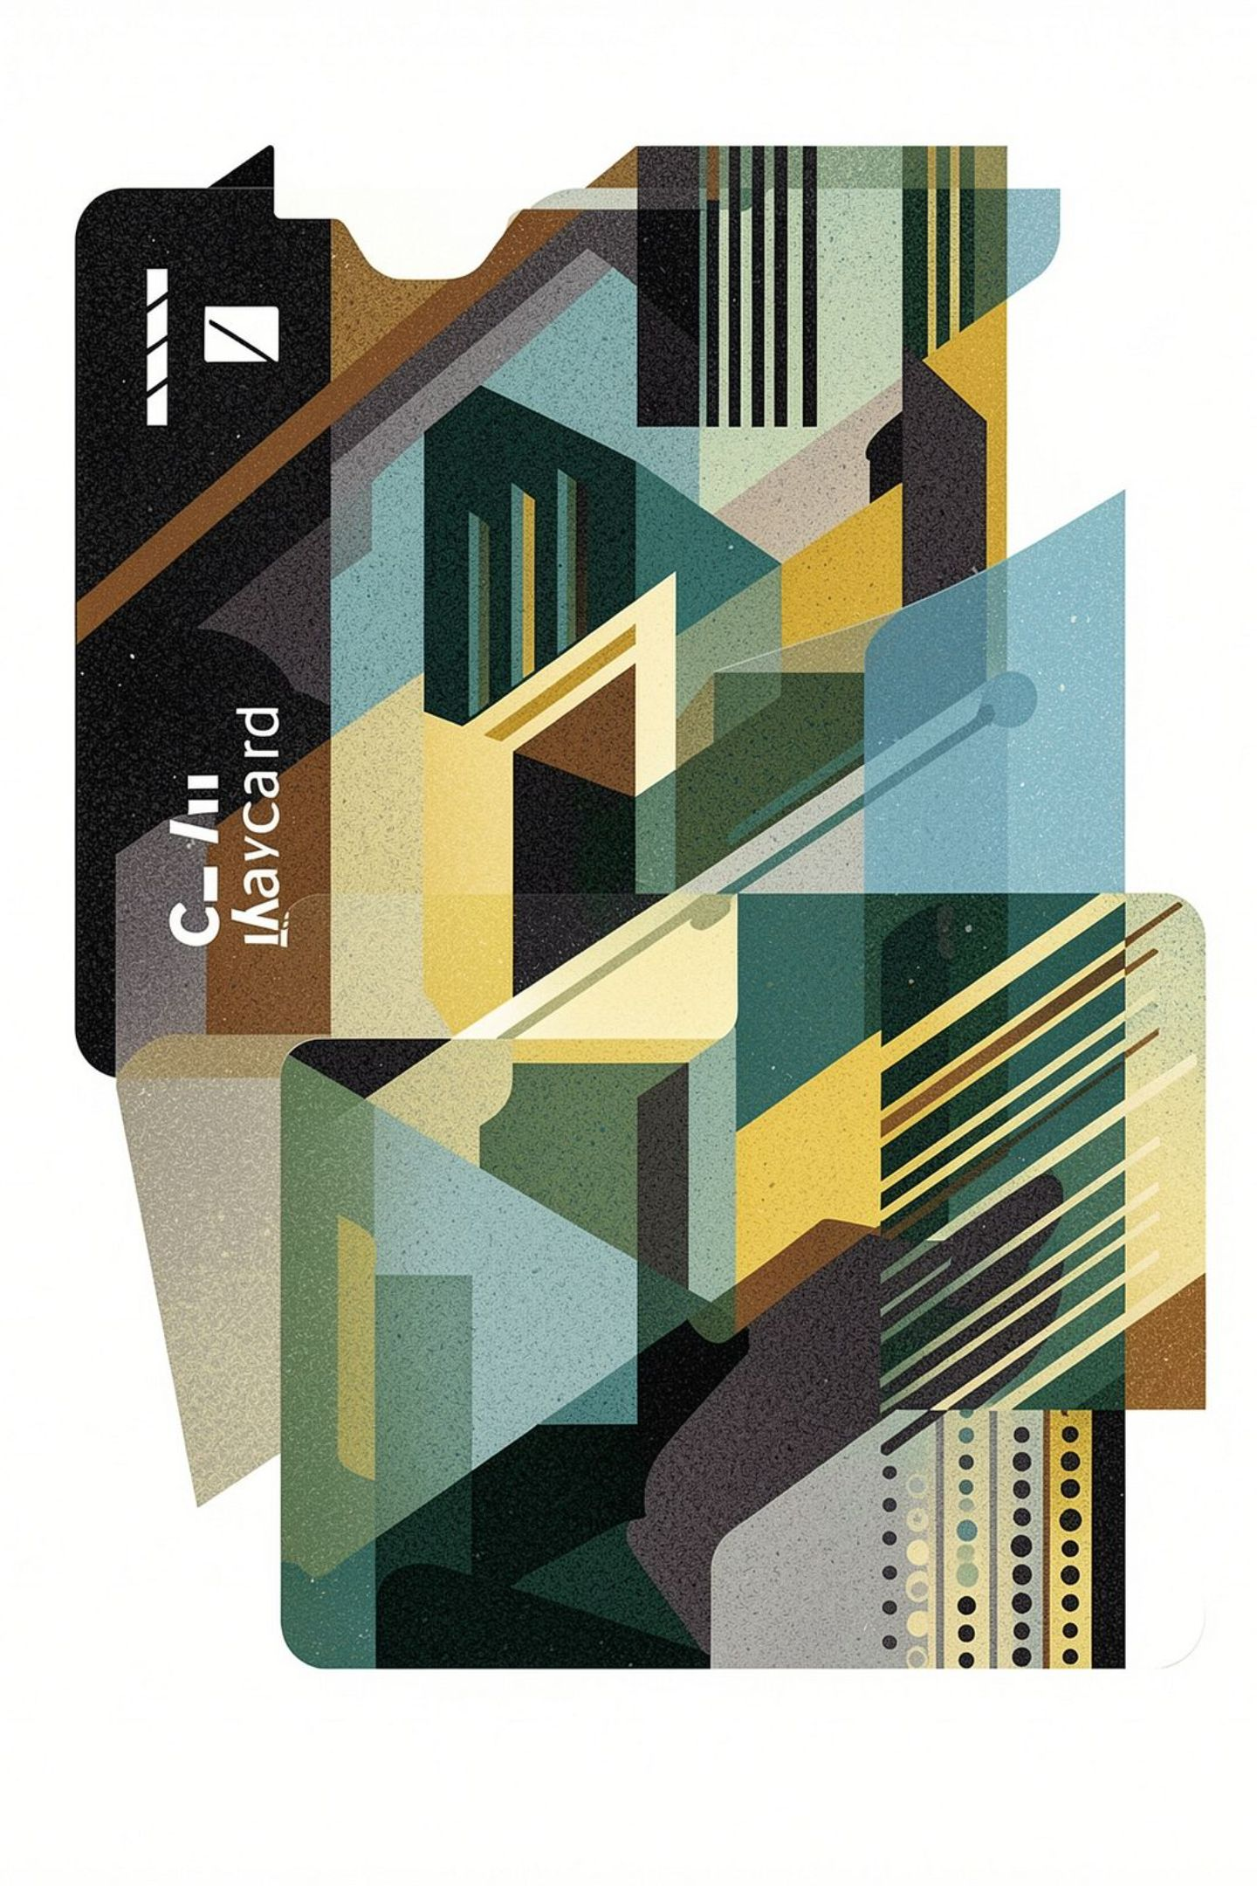
The Subscription Paradox
Subscribers spend less per transaction than non-subscribers — undermining the core assumption of the subscription model.
Subscribers (27% of base)
$59.49 avg spend
$62,645 total revenue
Non-Subscribers (73% of base)
$59.87 avg spend
$170,436 total revenue
Subscription status does not drive higher individual spending. The current value proposition needs a fundamental redesign.

Slide 5
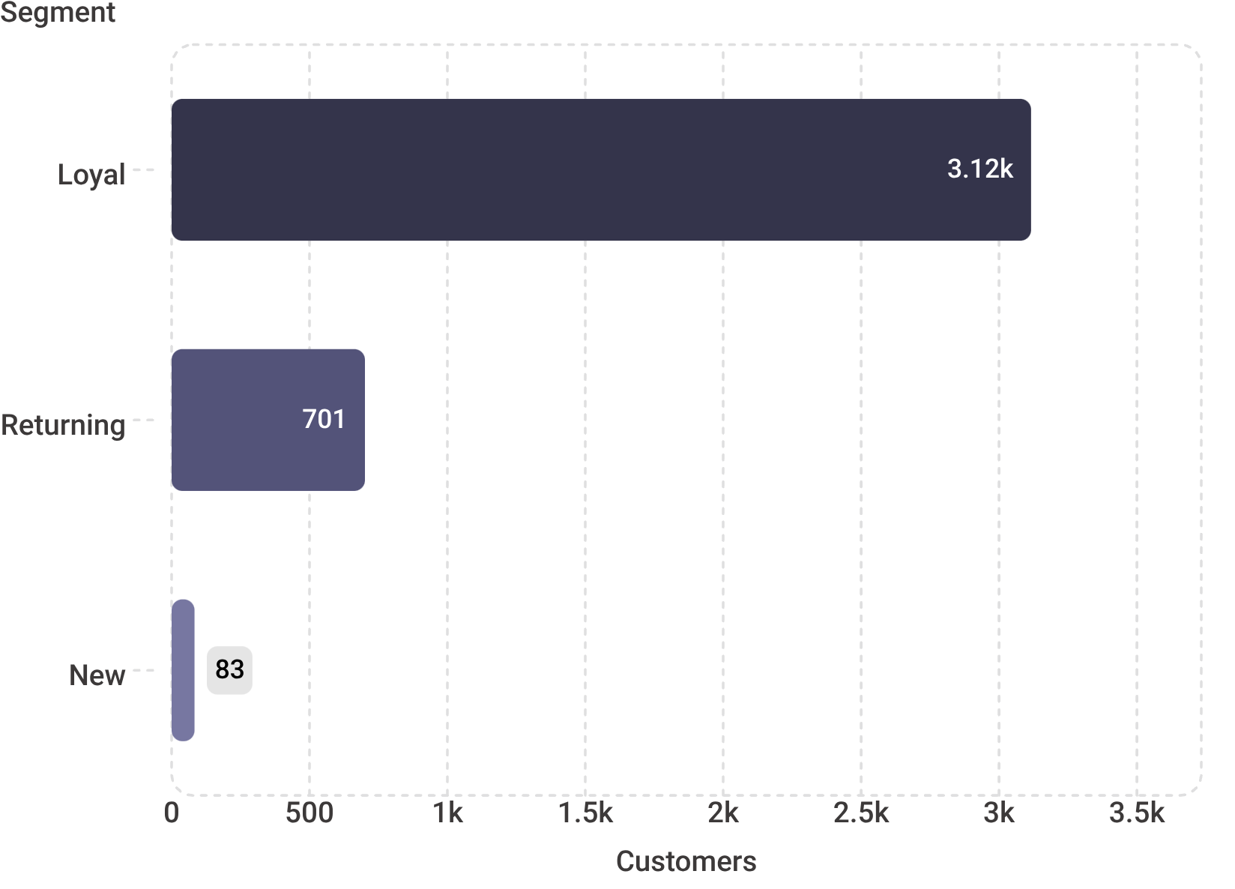

Customer Segmentation Breakdown
The base is heavily skewed toward loyalty
Loyal — 3,116 customers (80%)
Highest lifetime value. The backbone of revenue — protect and reward this segment above all.
Returning — 701 customers (18%)
A meaningful growth lever. Nurturing returning buyers into loyal status is the clearest near-term opportunity.
New — 83 customers (2%)
Acquisition is critically underdeveloped. Pipeline replenishment must be prioritized.

Slide 6



Gloves — 3.86★
Sandals — 3.84★
Boots — 3.82★
Top-rated product. Strong candidate for feature placement in campaigns.
High satisfaction drives repeat purchases in the footwear category.
Consistently rated product — strong loyalty anchor for returning buyers.
Top-Rated Products Drive Loyalty
High customer ratings correlate directly with repeat purchase behavior. Featuring these products in marketing campaigns is a low-cost, high-signal strategy.

Slide 7
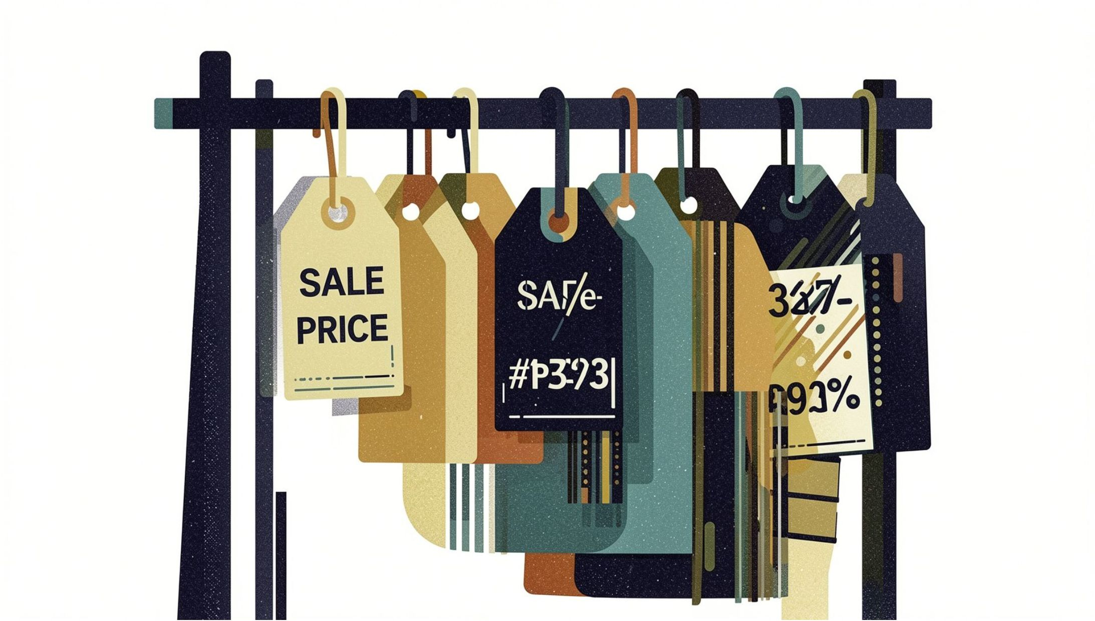
Discount Dependency Risk
Heavy discounting concentrated in key SKUs
Three products account for the most aggressive promotional activity:
Critically, 839 customers spend above average even when discounts are applied — signaling that promotions may be unnecessary for a meaningful portion of buyers.
Hat
Sneakers
Coat
50% discount rate
49.66% discount rate
49.07% discount rate

Slide 8
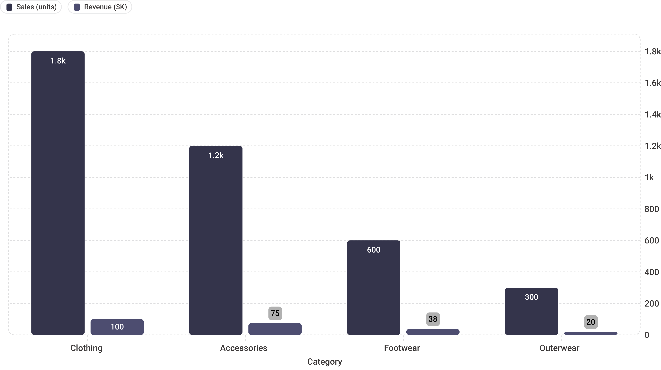
Category Performance
Clothing dominates at ~1,800 units and ~$100K revenue. Accessories trail at ~$75K. Footwear and Outerwear significantly underperform relative to category potential — both represent untapped expansion opportunities.

Slide 9
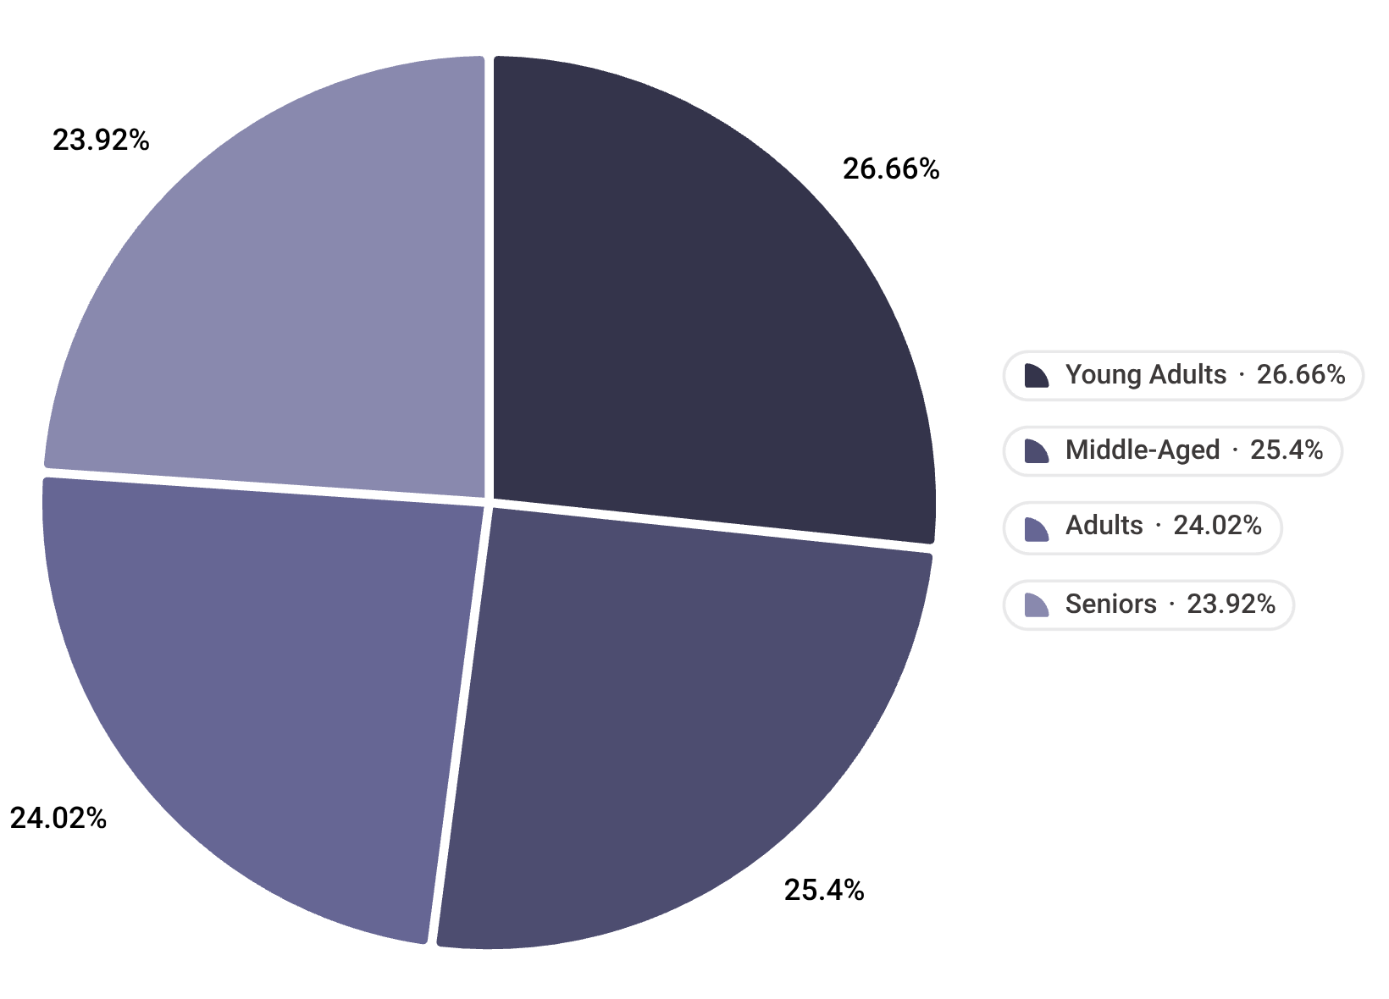

Age Group Revenue Contribution
Revenue is remarkably balanced across age groups — but Young Adults lead at $62,143 (27% of total revenue), pulling ahead of all other cohorts.
Young Adults — $62,143 (27%)
Middle-Aged — $59,197 (26%)
Adults & Seniors — ~24% each
Top revenue cohort. High engagement potential warrants a premium strategy.
Close second. Stable and reliable spenders.
Consistent contributors — retention focus recommended.

Slide 10



Strategic Recommendations
Redesign the subscription model
1
Current subscribers spend less per transaction. Rebuild the value proposition — exclusive perks, early access, or tier-based incentives to convert spend lift.
Reinforce the loyal segment
2
80% of customers are loyal — protect this base with structured rewards programs before focusing on acquisition.
Target high-revenue demographics
3
Deploy campaigns focused on male customers, Young Adults, and top-rated products (Gloves, Sandals, Boots) to maximize ROI.
Reduce promotional dependency
4
Hat, Sneakers, and Coat carry ~50% discount rates. With 839 above-average spenders unaffected by discounts, margin recovery is achievable through targeted rollback.

