Slide 1
Java
GUI building with Swing

Slide 2
AWT (Abstract Window Toolkit)
Present in all Java implementations
Described in (almost) every Java textbook
Adequate for many applications
Uses the controls defined by your OS (whatever it is)
  therefore it's “least common denominator”
Difficult to build an attractive GUI
import java.awt.*;
import java.awt.event.*;

Slide 3
Swing
Present in all modern Java implementations (since 1.2)
More controls, and they are more flexible
Gives a choice of “look and feel” packages
Much easier to build an attractive GUI
import javax.swing.*;
import javax.swing.event.*;
and
import java.awt.*;
import java.awt.event.*;
You may not need all of these packages

Slide 4
Swing vs. AWT
Swing is built “on top of” AWT, so you need to import AWT and use a few things from it
Swing is bigger and slower
Swing is more flexible and better looking
Swing and AWT are incompatible--you can use either, but you can’t mix them
  Actually, you can, but it’s tricky and not worth doing
Basic controls are practically the same in both
  AWT: Button b = new Button ("OK");
  Swing: JButton b = new JButton("OK");
Swing gives far more options for everything (buttons with pictures on them, etc.)

Slide 5
To build a GUI...
Make somewhere to display things (a Container)
  Usually you would use a JFrame or a JApplet
Create some Components (buttons, text areas, panels, etc.)
  It’s usually best to declare Components as instance variables, and
  Define them in your applet’s init() method or in some application method
Add your Components to your display area
  Choose a layout manager
  Add your Components to your JFrame or JApplet according to the rules for your layout manager
Attach Listeners to your Components
  Interacting with a Component causes an Event to occur
  A Listener gets a message when an interesting event occurs, and executes some code to deal with it

Slide 6
Containers and Components
A GUI is built by putting components into containers
The job of a Container is to hold and display Components
Some frequently used types (subclasses) of Component are JButton, JCheckbox, JLabel, JTextField, and JTextArea
A Container is also a Component
  This allows Containers to be nested
Important Container classes are JFrame, JApplet, and JPanel
  JFrame and JApplet both contain other containers; use getContentPane() to get to the container you want
  You typically create and use JPanels directly

Slide 7
Starting with a Container
First, import some packages:
  import javax.swing.*;
  import javax.swing.event.*;
  import java.awt.*;
  import java.awt.event.*;
Second, extend a Container type:
  For an application, extend JFrame
    public class MyClass extends JFrame { ... }
  For an applet, extend JApplet
    public class MyApplet extends JApplet { ... }
Neither of these returns a Container that you use directly; instead,
Both JFrame and JApplet have a getContentPane() method that returns a Container you can use:
  getContentPane( ).doSomething( );

Slide 8
A JApplet is a Panel is a Container
java.lang.Object
|
java.awt.Component
|
java.awt.Container
|
java.awt.Panel
|
java.applet.Applet
|
javax.swing.JApplet
…so you can display things in an Applet

Slide 9
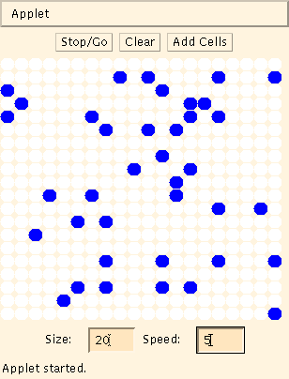
Example: A "Life" applet
Container (Applet)
Containers (Panels)
Component (Canvas)
Components (Buttons)
Components (TextFields)
Components (Labels)

Slide 10
Applets
An application has a
public static void main(String args[ ]) method, but an applet usually does not
An applet's main method is in the Browser
To write an applet, you extend JApplet and override some of its methods
The most important methods are init( ), start( ), and paint(Graphics g)

Slide 11
To create an applet
public class MyApplet extends JApplet { … }
  The only way to make an applet is to extend Applet or JApplet
You can add components to the applet
The best place to add components is in init( )
You can paint directly on the applet, but…
…it’s better to paint on a contained component
Do all painting from paint(Graphics g)

Slide 12
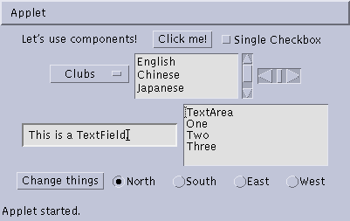
Some types of components
Button
Checkbox
Label
Choice
Scrollbar
TextField
List
TextArea
Button
Checkbox
CheckboxGroup

Slide 13
Creating components
JLabel lab = new JLabel ("Hi, Dave!");
JButton but = new JButton ("Click me!");
JCheckBox toggle = new JCheckBox ("toggle");
JTextField txt =
new JextField ("Initial text.", 20);
JScrollbar scrolly = new JScrollbar
(JScrollbar.HORIZONTAL, initialValue,
bubbleSize, minValue, maxValue);

Slide 14
Adding components to the Applet
class MyApplet extends JApplet {
  public void init () {
    getContentPane().add(lab);
    // or this.getContentPane().add(lab);
    getContentPane().add(but);
    getContentPane().add(toggle);
    getContentPane().add(txt);
    getContentPane().add(scrolly);
    ...

Slide 15
Creating a JFrame
When you create an JApplet,
  The size of the applet is determined by the HTML page
  The browser makes the applet visible
When you write a GUI for an application, you need to do these things yourself
  public class MyApplication extends JFrame {
  void createMyGUI() {
  ... add components ...
  pack(); // compute the size and lay it out
  setVisible(true); // make the JFrame visible
  }
  }

Slide 16
Arranging components
Every Container has a layout manager
  You do not directly control where components are placed; the layout manager does this for you
The default layout for a Panel or JPanel is FlowLayout
  A JApplet is a Panel; therefore, the default layout for a JApplet is FlowLayout
The default layout for a JFrame is BorderLayout
You can set the layout manager explicitly; for example,
  setLayout(new FlowLayout());
  setLayout(new BorderLayout());

Slide 17
FlowLayout
Use add(component); to add to a component when using a FlowLayout
Components are added left-to-right
If no room, a new row is started
Exact layout depends on size of Applet
Components are made as small as possible
FlowLayout is convenient but often ugly
Note: The following code and screenshots use AWT Components rather than Swing Components
  I haven’t had a chance to make new screenshots
  The layout managers are identical, not just similar
  There is no real difference with Swing instead of AWT

Slide 18
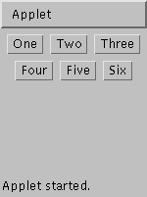
Complete example: FlowLayout
import java.awt.*;
import java.applet.*;
public class FlowLayoutExample extends Applet {
public void init () {
setLayout (new FlowLayout ()); // default
add (new Button ("One"));
add (new Button ("Two"));
add (new Button ("Three"));
add (new Button ("Four"));
add (new Button ("Five"));
add (new Button ("Six"));
}
}

Slide 19
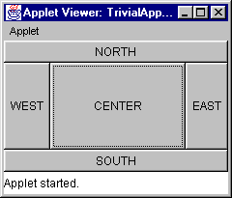
BorderLayout
At most five components can be added
If you want more components, add a Panel, then add components to it.
setLayout (new BorderLayout());
add (new Button("NORTH"), BorderLayout.NORTH);

Slide 20
BorderLayout with five Buttons
public void init() {
setLayout (new BorderLayout ());
add (new Button ("NORTH"), BorderLayout.NORTH);
add (new Button ("SOUTH"), BorderLayout.SOUTH);
add (new Button ("EAST"), BorderLayout.EAST);
add (new Button ("WEST"), BorderLayout.WEST);
add (new Button ("CENTER"), BorderLayout.CENTER);
}

Slide 21
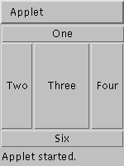
Complete example: BorderLayout
import java.awt.*;
import java.applet.*;
public class BorderLayoutExample extends Applet {
public void init () {
setLayout(new BorderLayout());
add(new Button("One"), BorderLayout.NORTH);
add(new Button("Two"), BorderLayout.WEST);
add(new Button("Three"), BorderLayout.CENTER);
add(new Button("Four"), BorderLayout.EAST);
add(new Button("Five"), BorderLayout.SOUTH);
add(new Button("Six"), BorderLayout.SOUTH);
}
}

Slide 22
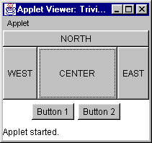
Using a Panel
Panel p = new Panel();
add(p, BorderLayout.SOUTH);
p.add(new Button ("Button 1"));
p.add(new Button ("Button 2"));

Slide 23
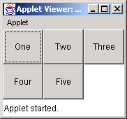
GridLayout
The GridLayout manager divides the container up into a given number of rows and columns:
new GridLayout(rows, columns)
All sections of the grid are equally sized and as large as possible

Slide 24
Complete example: GridLayout
import java.awt.*;
import java.applet.*;
public class GridLayoutExample extends Applet {
public void init () {
setLayout(new GridLayout(2, 3));
add(new Button("One"));
add(new Button("Two"));
add(new Button("Three"));
add(new Button("Four"));
add(new Button("Five"));
}
}

Slide 25
Making components active
Most components already appear to do something--buttons click, text appears
To associate an action with a component, attach a listener to it
Components send events, listeners listen for events
Different components may send different events, and require different listeners

Slide 26
Listeners
Listeners are interfaces, not classes
  class MyButtonListener implements
  ActionListener {
An interface is a group of methods that must be supplied
When you say implements, you are promising to supply those methods

Slide 27
Writing a Listener
For a JButton, you need an ActionListener
  b1.addActionListener
  (new MyButtonListener ( ));
An ActionListener must have an actionPerformed(ActionEvent) method
  public void actionPerformed(ActionEvent e) {
  …
  }

Slide 28
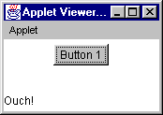
MyButtonListener
public void init () {
...
b1.addActionListener (new MyButtonListener ());
}
class MyButtonListener implements ActionListener {
public void actionPerformed (ActionEvent e) {
showStatus ("Ouch!");
}
}

Slide 29
Listeners for JTextFields
An ActionListener listens for someone hitting the Enter key
An ActionListener requires this method:
  public void actionPerformed (ActionEvent e)
You can use getText( ) to get the text
A TextListener listens for any and all keys
A TextListener requires this method:
  public void textValueChanged(TextEvent e)

Slide 30
Summary I: Building a GUI
Create a container, such as JFrame or JApplet
Choose a layout manager
Create more complex layouts by adding JPanels; each JPanel can have its own layout manager
Create other components and add them to whichever JPanels you like

Slide 31
Summary II: Building a GUI
For each active component, look up what kind of Listeners it can have
Create (implement) the Listeners
  often there is one Listener for each active component
  Active components can share the same Listener
For each Listener you implement, supply the methods that it requires
For applets, write the necessary HTML

Slide 32
Vocabulary
AWT – The Abstract Window Toolkit provides basic graphics tools (tools for putting information on the screen)
Swing – A much better set of graphics tools
Container – a graphic element that can hold other graphic elements (and is itself a Component)
Component – a graphic element (such as a Button or a TextArea) provided by a graphics toolkit
listener – A piece of code that is activated when a particular kind of event occurs
layout manager – An object whose job it is to arrange Components in a Container

Slide 33
The End

