Slide 1
Aastha – an easy and powerful traffic generator
Publish date: 12.08.2023

Slide 2
What is Aastha
Aastha is a tool developed by Cisco engineering from DCN BU.
Aastha is L2-L7 realistic traffic generator that supports HTTP(S), FTP(S), IMAP/POP3/SMTP protocols natively and any other through TRex integration. Generates up to 10000 virtual clients on a single node, supports distributed tests started simultaneously in different machines/VMs/places. Support IP pools, VLANs, QOS, Mac address generation.
Support using through simple intuitive Web UI, REST API, CLI tool, Python API. Web and PDF reports with charts and tables stored on the server.
trex-aastha@cisco.com is the internal contact

Slide 3
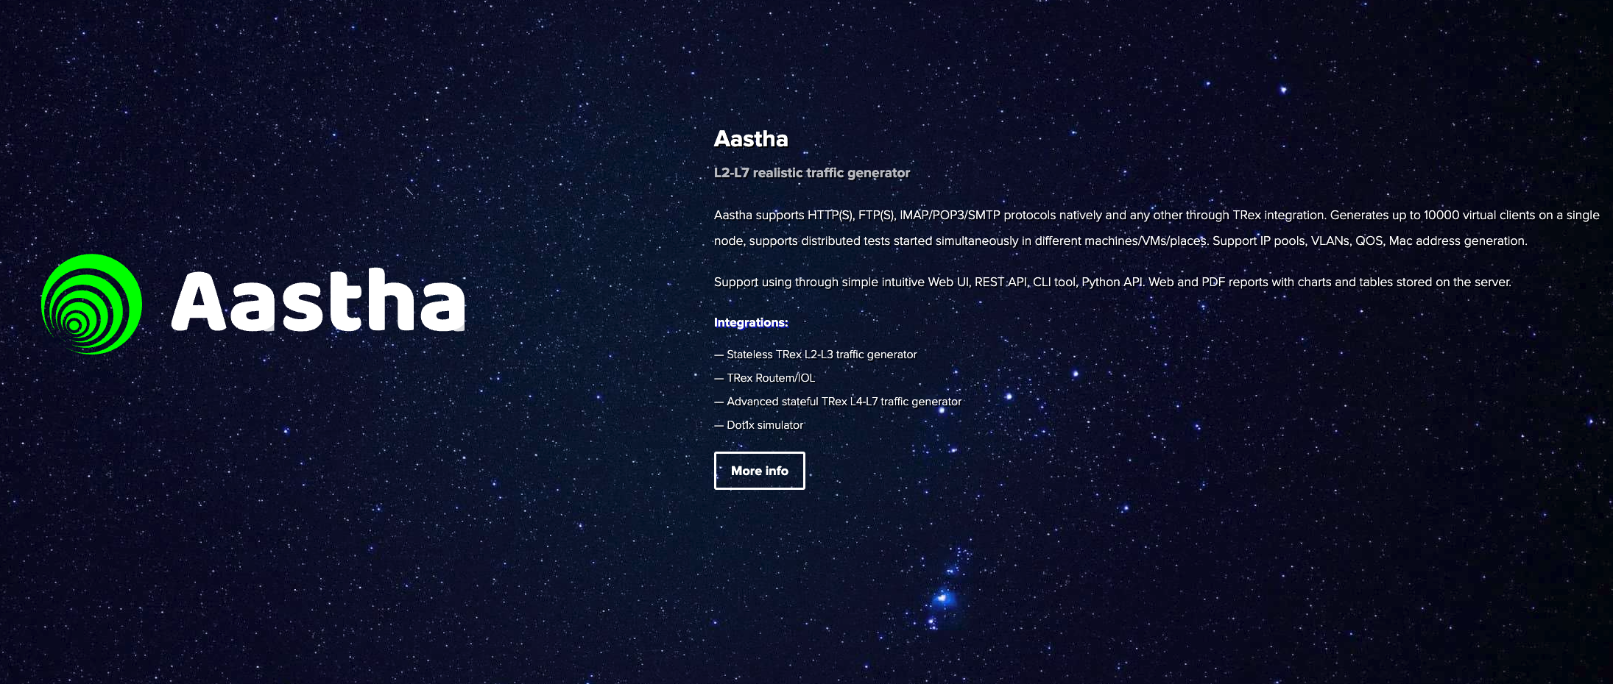
Where is it?
https://aastha.cisco.com/
No license is needed.

Slide 4
How to install
Images can be found here https://aastha.cisco.com:9005/aastha/release/latest/
Images are available for Windows, MacOS, Ubuntu, Docker. I have tested only Ubuntu.
You can run one node for the Web and API and one or more nodes for generating traffic agent.
You can also run a single node with both web and agent.
You can assign multiple interfaces to each node. Clients and servers can’t run on the same interface, so you either need two nodes (one for client one for server) or two interfaces (one for client, one for server).

Slide 5
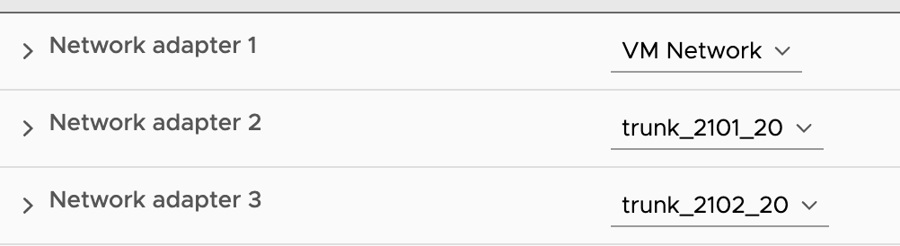

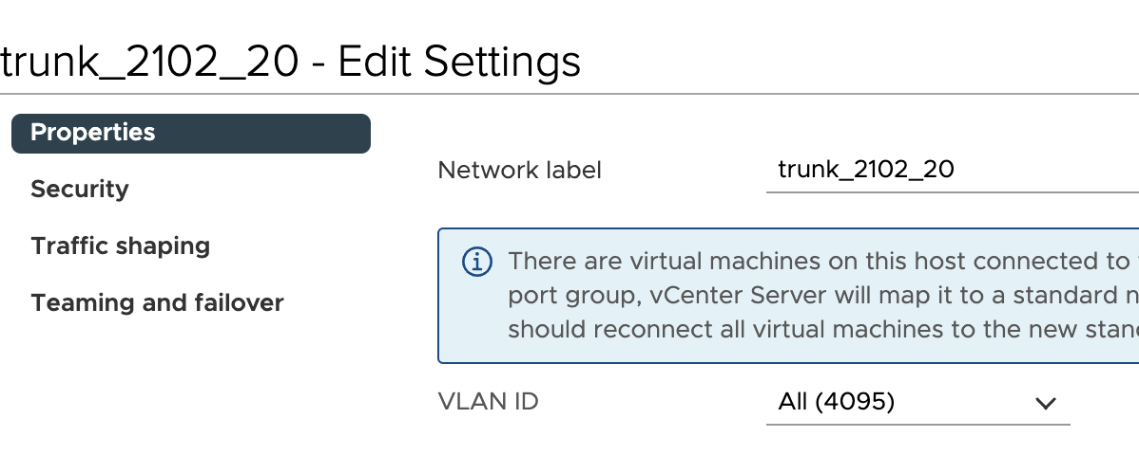
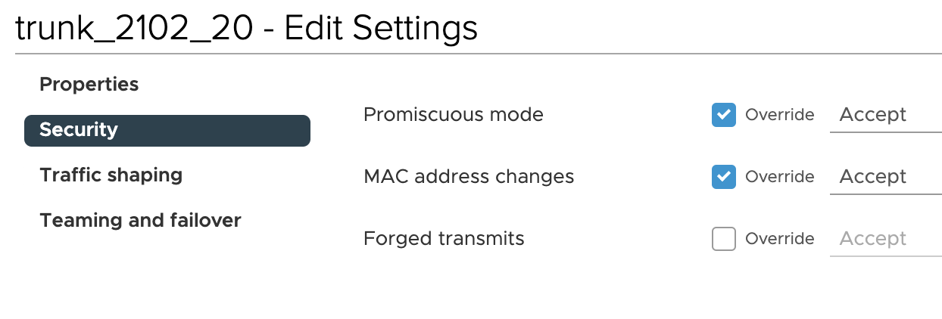
Basic Topology
One single VM with both web and agent.
3 Port groups, one for mgmt OOB
2 ports should be trunk promiscous for generating dot1q tagged traffic
eth1/20
eth1/20
vNIC2
ens192
vNIC3
ens224
vNIC1
ens160
OOB

Slide 6
Ubuntu Installation
Ubuntu 20.04 at least 24GB RAM, 4vCPUs, 20GB HDD (this is what I have tested in the lab, but Aastha does not expose any specific requirements)
Download https://aastha.cisco.com:9005/aastha/release/latest/focal/aastha-bundle.tar.gz and untar
Install as a service ./aastha-services
Install npm
Install
npm install mime-types
npm install debug
You may have to copy /node_modules to /opt/aastha/

Slide 7
Start the service
On the web node you should start the web service:
service aastha-web start
On the agent node you should start the node service:
service aastha-agent start

Slide 8
Access web UI
Once web service runs, it opens portal on port 80 (make sure it is free)
So just login to http://<aastha_web_IP>

