Slide 1
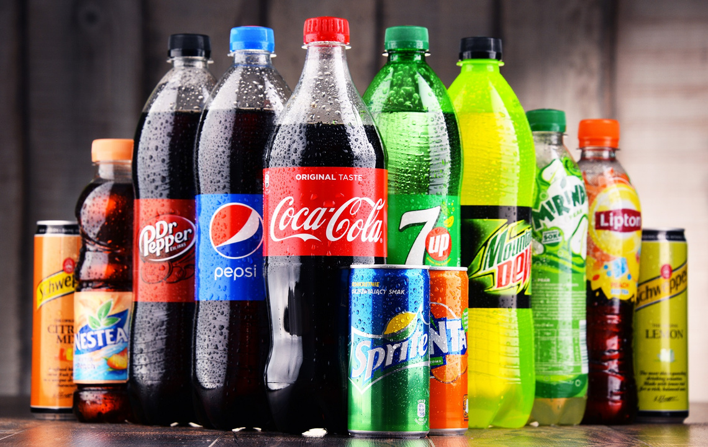
BEVERAGE MARKET DYNAMICS & FORECASTING: B2B FOCUS AND INVENTORY OPTIMIZATION
Data Source
The dataset used in this analysis is sourced from the Kaggle. This dataset was created to simulate realistic sales patterns in the beverage industry
Python:
Reading and cleaning the dataset
Performing EDA
Building SARIMAX model to forecast total sales and quantities of each products (monthly)
Technology used

Slide 2
Table of contents
Purpose and Outcome
EDA
Forecasting
Actionable plans
BEVERAGE MARKET DYNAMICS & FORECASTING: B2B FOCUS AND INVENTORY OPTIMIZATION

Slide 3
Purpose and Outcome

Slide 4
Purpose
Understanding the distinct characteristics and purchasing behaviors of different customer types B2B and B2C.
Evaluating the performance of individual products and categories to identify high-potential offerings and areas for improvement.
Sales Forecasting and Planning: Identifying temporal sales patterns and trends to improve inventory management, promotional planning, and overall sales forecasting accuracy.

Slide 5
Outcomes
✅ Identified the significant revenue contribution of B2B customers.
✅ Demonstrated the profitability of premium alcoholic beverages, supporting the expansion of this category and targeted marketing to capitalize on high-margin products.
✅ Provide Sales Forecasting and Seasonal Planning

Slide 6
Exploratory Data Analysis

Slide 7
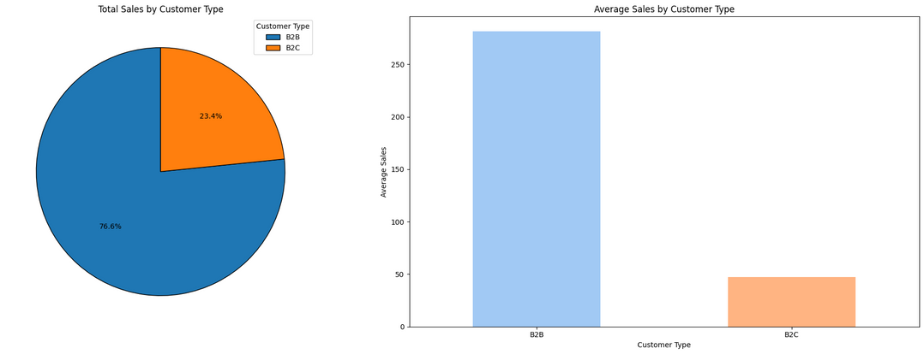
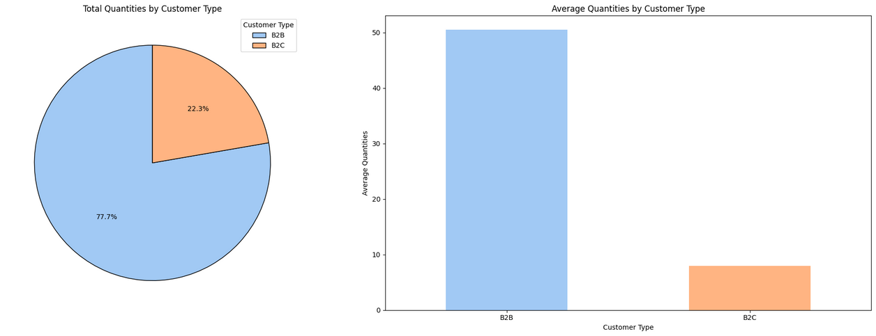
Customer type analysis
B2B customers dominate both sales (76.6%) and quantities (77.7%)
B2B customers have significantly higher average sales ($280) and quantities (50 units) compared to B2C customers ($45 and 8 units)

Slide 8
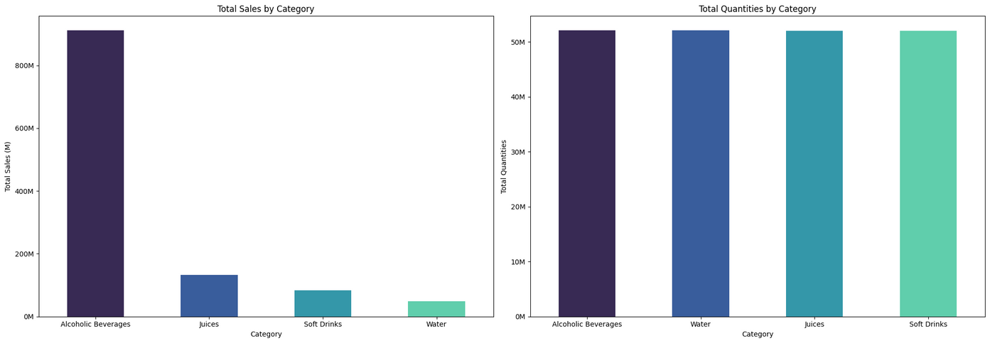
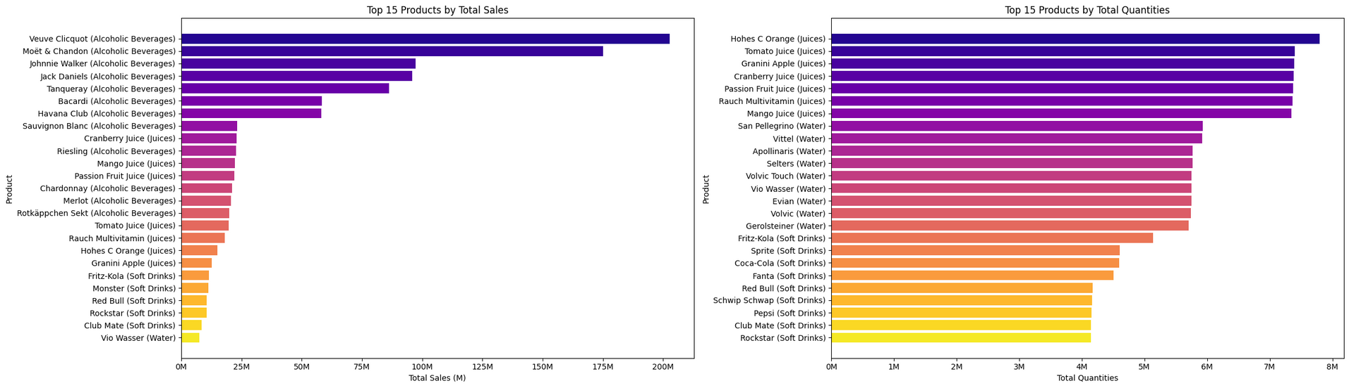
Product performance analysis

Slide 9
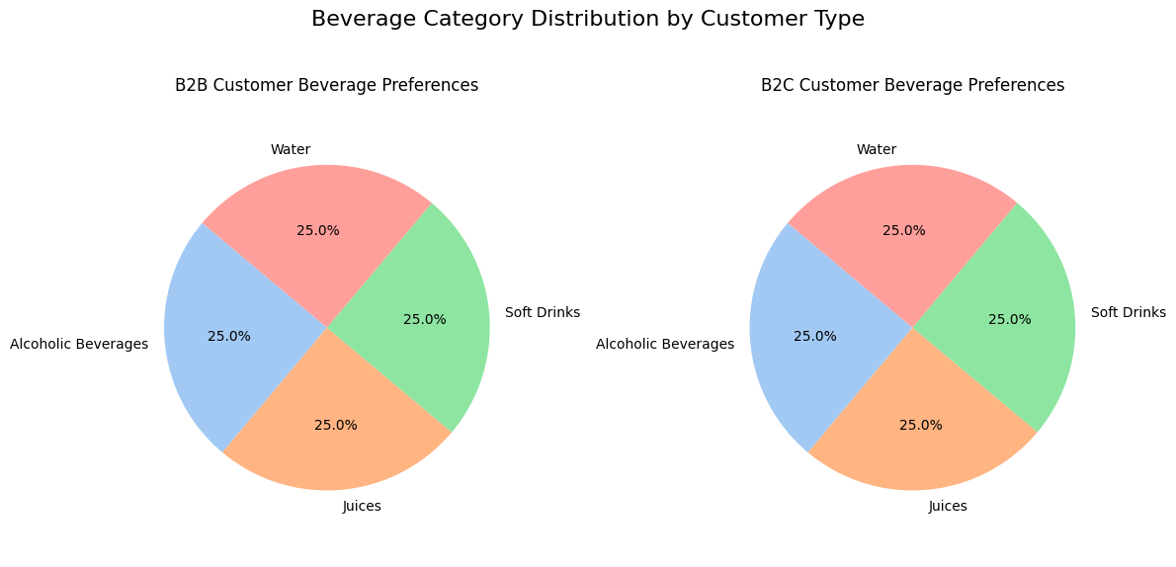
Product performance analysis
Premium alcoholic beverages drive revenue
Sales-quantity mismatch
Both B2B and B2C customers appear to order equally across categories

Slide 10
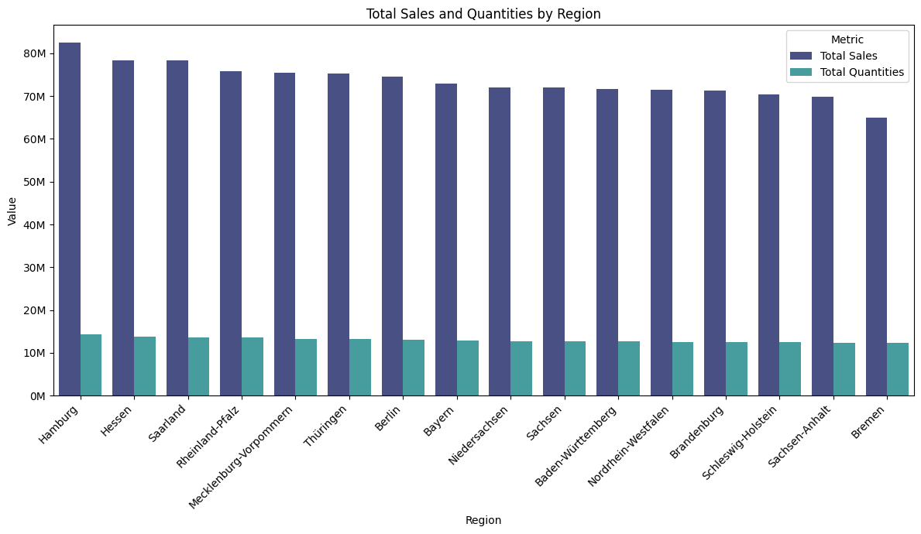
Regional sales analysis
Similar quantity-to-sales ratios across regions indicates consistent pricing across regions

Slide 11
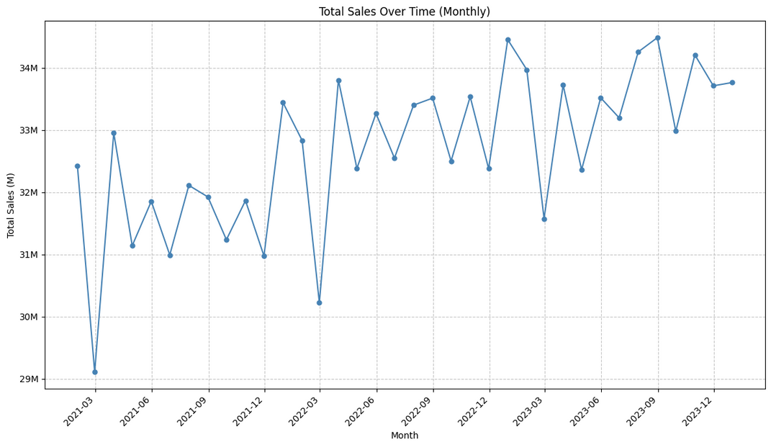
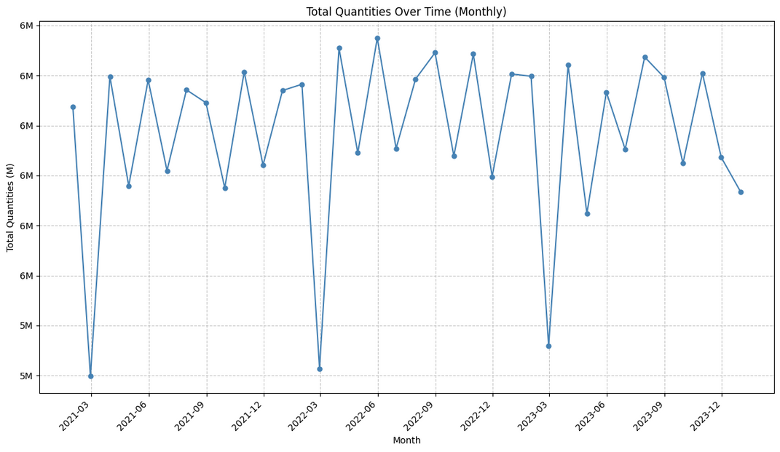
Time series analysis
Consistent March sales dips across all three years (15-20% decrease)

Slide 12
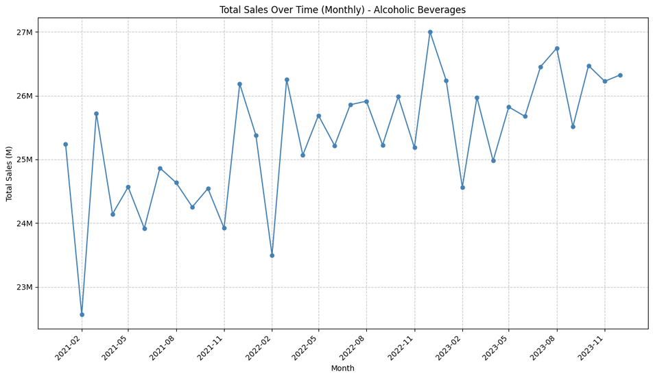
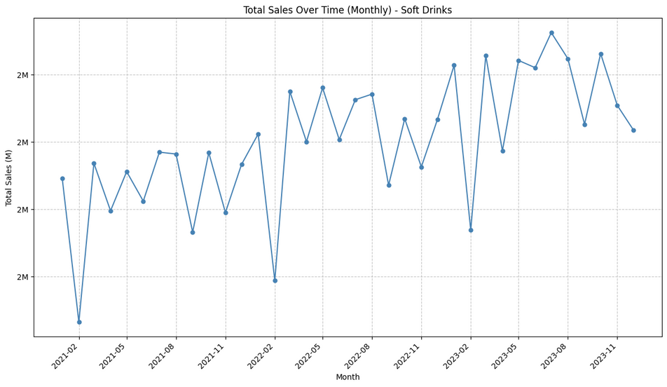
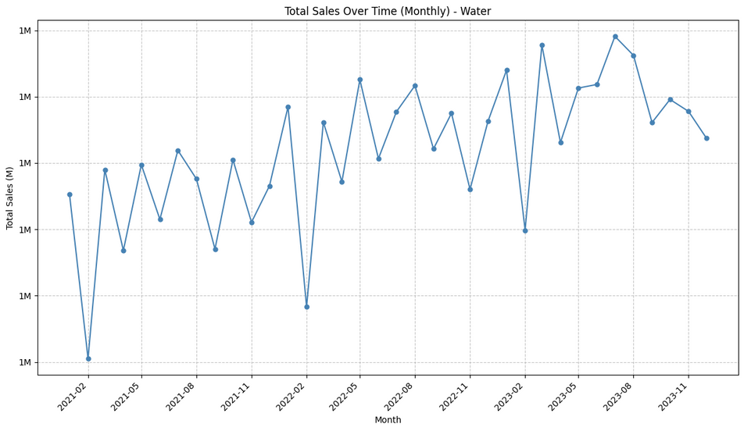
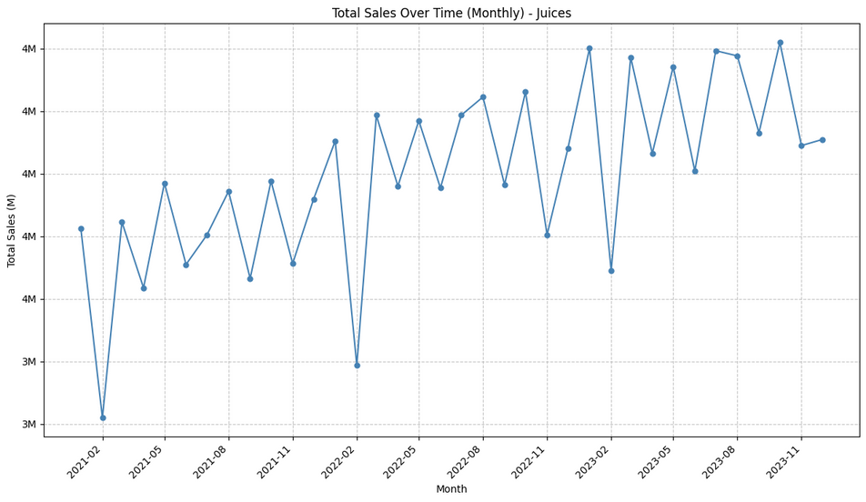
Time series analysis

Slide 13
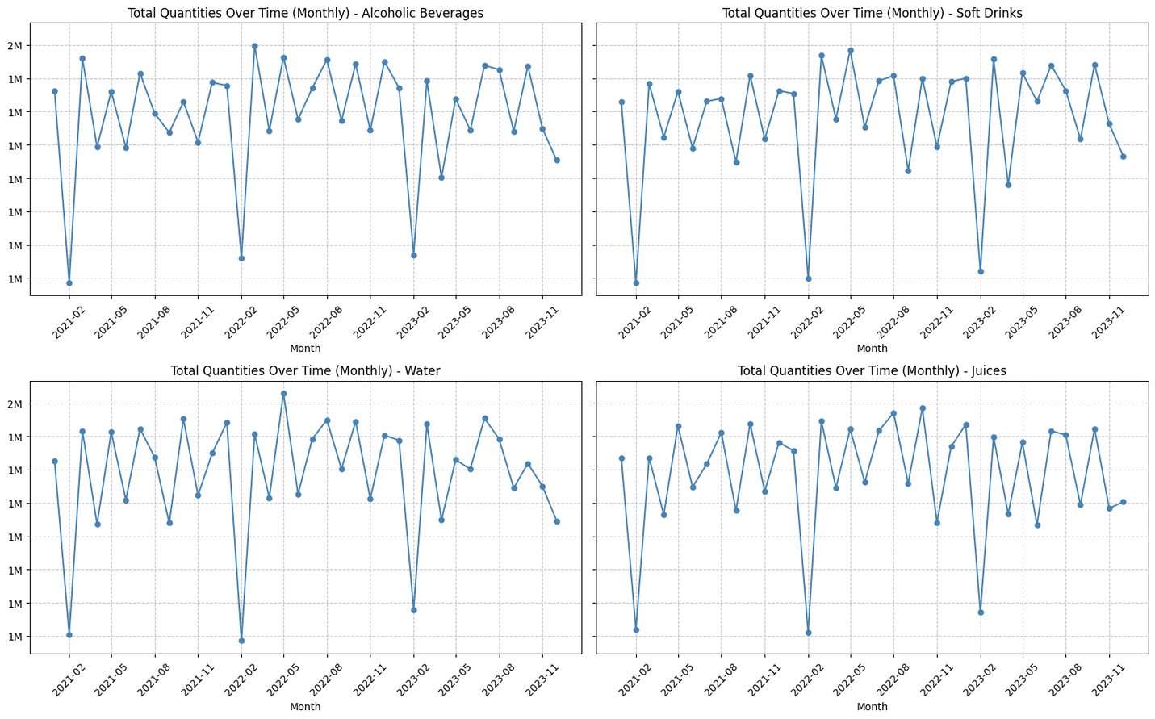
Time series analysis
All beverage categories show identical seasonal patterns in sales and quantities

Slide 14
Key Findings
Optimize B2B Focus: Restructure sales organization to capitalize on high-value B2B opportunities
Premium Product Leadership: Position as premium beverage provider, especially in alcoholic category
Seasonal Planning: Implement coordinated inventory and marketing strategies for predictable seasonal patterns such as:
Launch a promotional campaigns in March to counter seasonal dips
Coordinate inventory reduction across all categories during predictable low periods

Slide 15
Forecasting

Slide 16
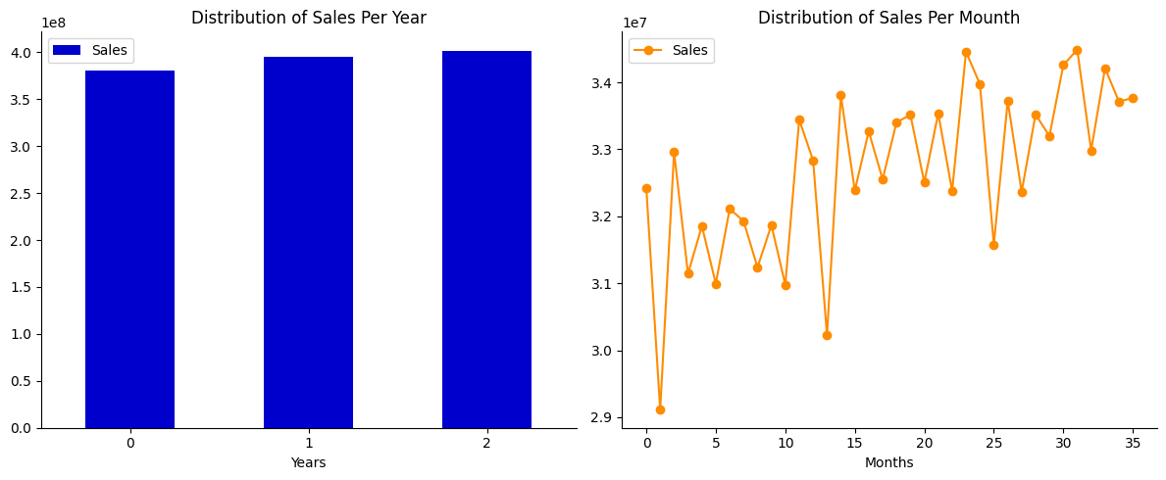
Total sales forecasting
Stable Annual Sales, Strong Monthly Seasonality: Total sales remain consistent year-over-year, but exhibit a clear and repeating pattern within each year
Underlying Upward Trend: Monthly sales data shows a general increasing trend over the observed period

Slide 17
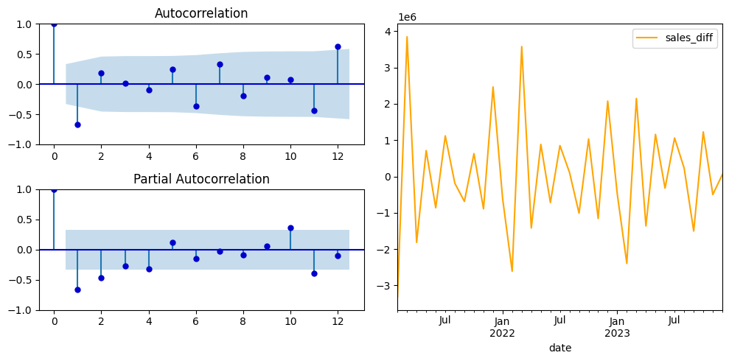
Total sales forecasting
Non-Seasonal Components (2, 0, 0)
Seasonal Components (1, 1, 1, 12)

Slide 18
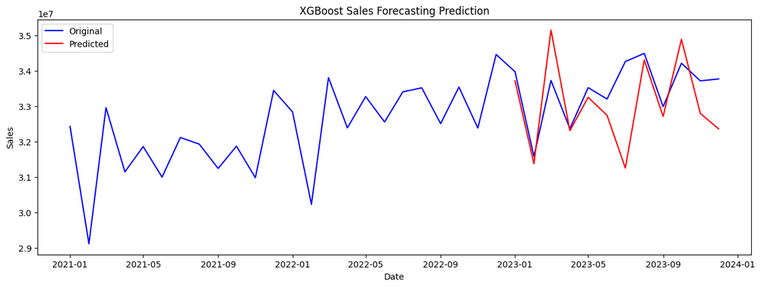
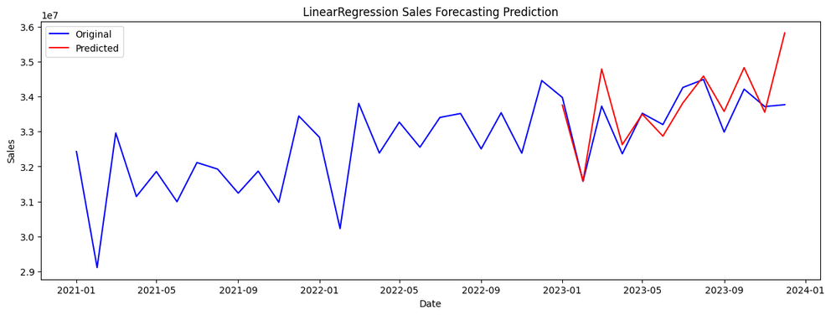
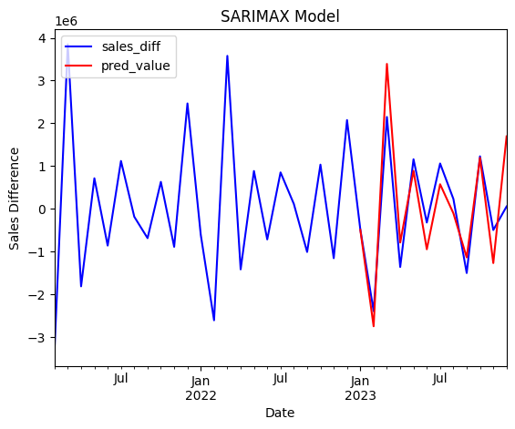
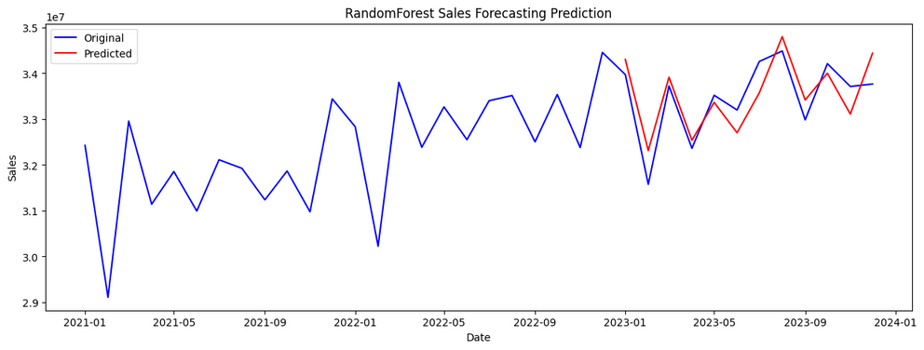
Total sales forecasting

Slide 19
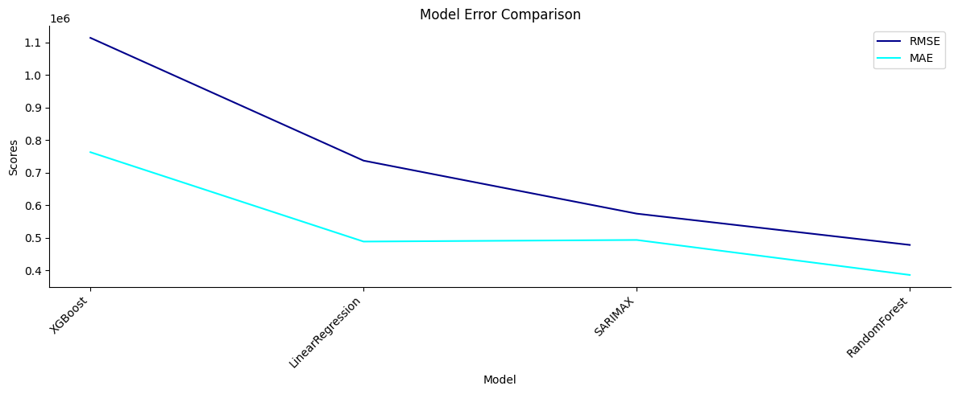
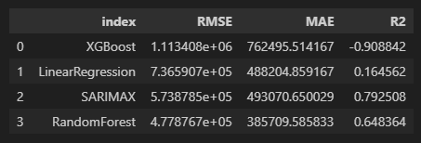
Total sales forecasting
RandomForest shows the lowest error metrics among the compared models, with SARIMAX having the second lowest.
The R2 value for SARIMAX is 0.792508, which is the highest among all the models presented.

Slide 20
Quantities of each products forecasting
Based on the charts, the SARIMAX model with order (2,0,0)×(1,1,0,12) is adjusted to forecast quantities of each product.

Slide 21

Quantities of each products forecasting
Forecast Result:
The SARIMA forecasting model demonstrates excellent performance with an R-squared of 0.9923, explaining nearly all variance in product quantity data.
The low MAPE of 2.8619% indicates high prediction accuracy, making this model highly reliable for inventory planning and supply chain decisions.

Slide 22
Actionable Plans

Slide 23
Offer personalized service plans to the top 20% of B2B clients.
Implement a tiered loyalty program with volume-based benefits and exclusive access.
Focusing Retention Efforts On Top B2B Customers

Slide 24
Launch targeted social media and digital campaigns highlighting luxury beverage experiences.
Redesign store layouts to showcase luxury brands like Veuve Clicquot and Johnnie Walker.
Targeted Maketing Strategies

Slide 25
Create a promotional campaign with time-limited offers to boost sales during the typical March decline period.
Adjust inventory based on forecasting results to optimize inventory costs.
Implement dynamic pricing strategies during peak and low seasons.
Shift marketing budget allocation seasonally based on historical performance data.
Seasonal Sales Patterns and Forecasting

Slide 26

THANKS YOU FOR YOUR ATTENTIONS

