Slide 1

Bohdan Khmelnytsky National University of Cherkasy
Academic School of Computer Engineering, Intelligent and Control Systems
Software Of Automated Systems Department
DEVELOPMENT
OF THE
“PONG” GAME
Done by
Denys Datsenko
Mentored by
Julia Grebenovich
Background picture designed by starline / Freepik

Slide 2
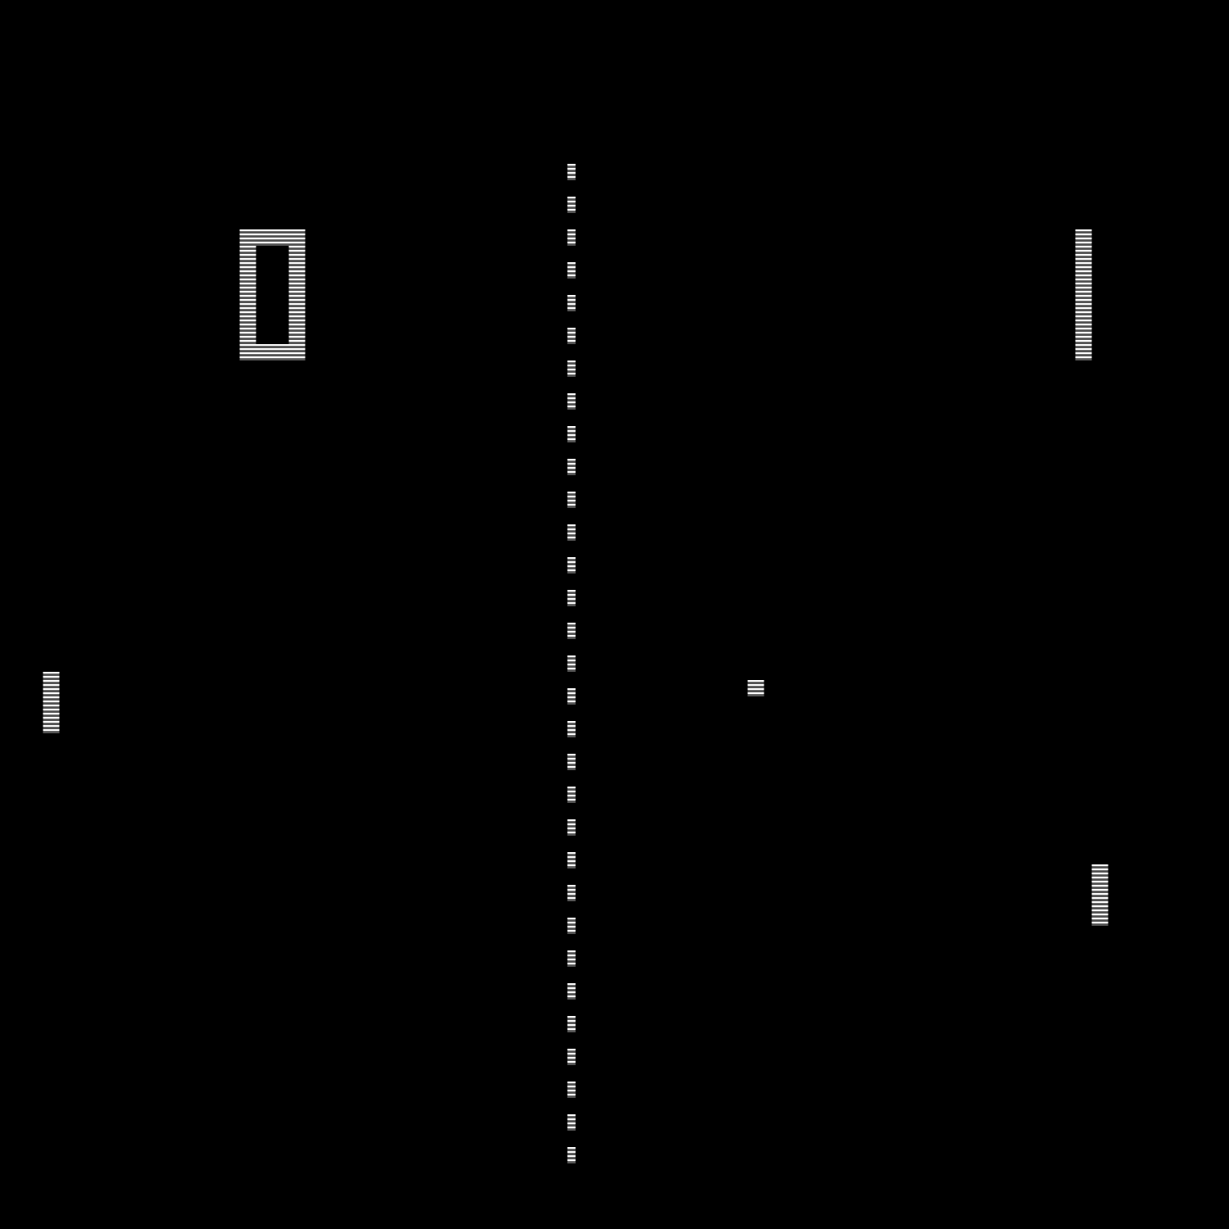
Objective of the work and
the main tasks
An objective of the work was to become acquainted and to learn the algorithms of movement in two-dimensional graphics and to create a computer game “Pong” for amusement.
The main tasks of the work were to analyze the methods of movement implementation and to implement the actual game in a type of software format which would be easy to use.
— DEVELOPMENT OF THE “PONG” GAME 2

Slide 3
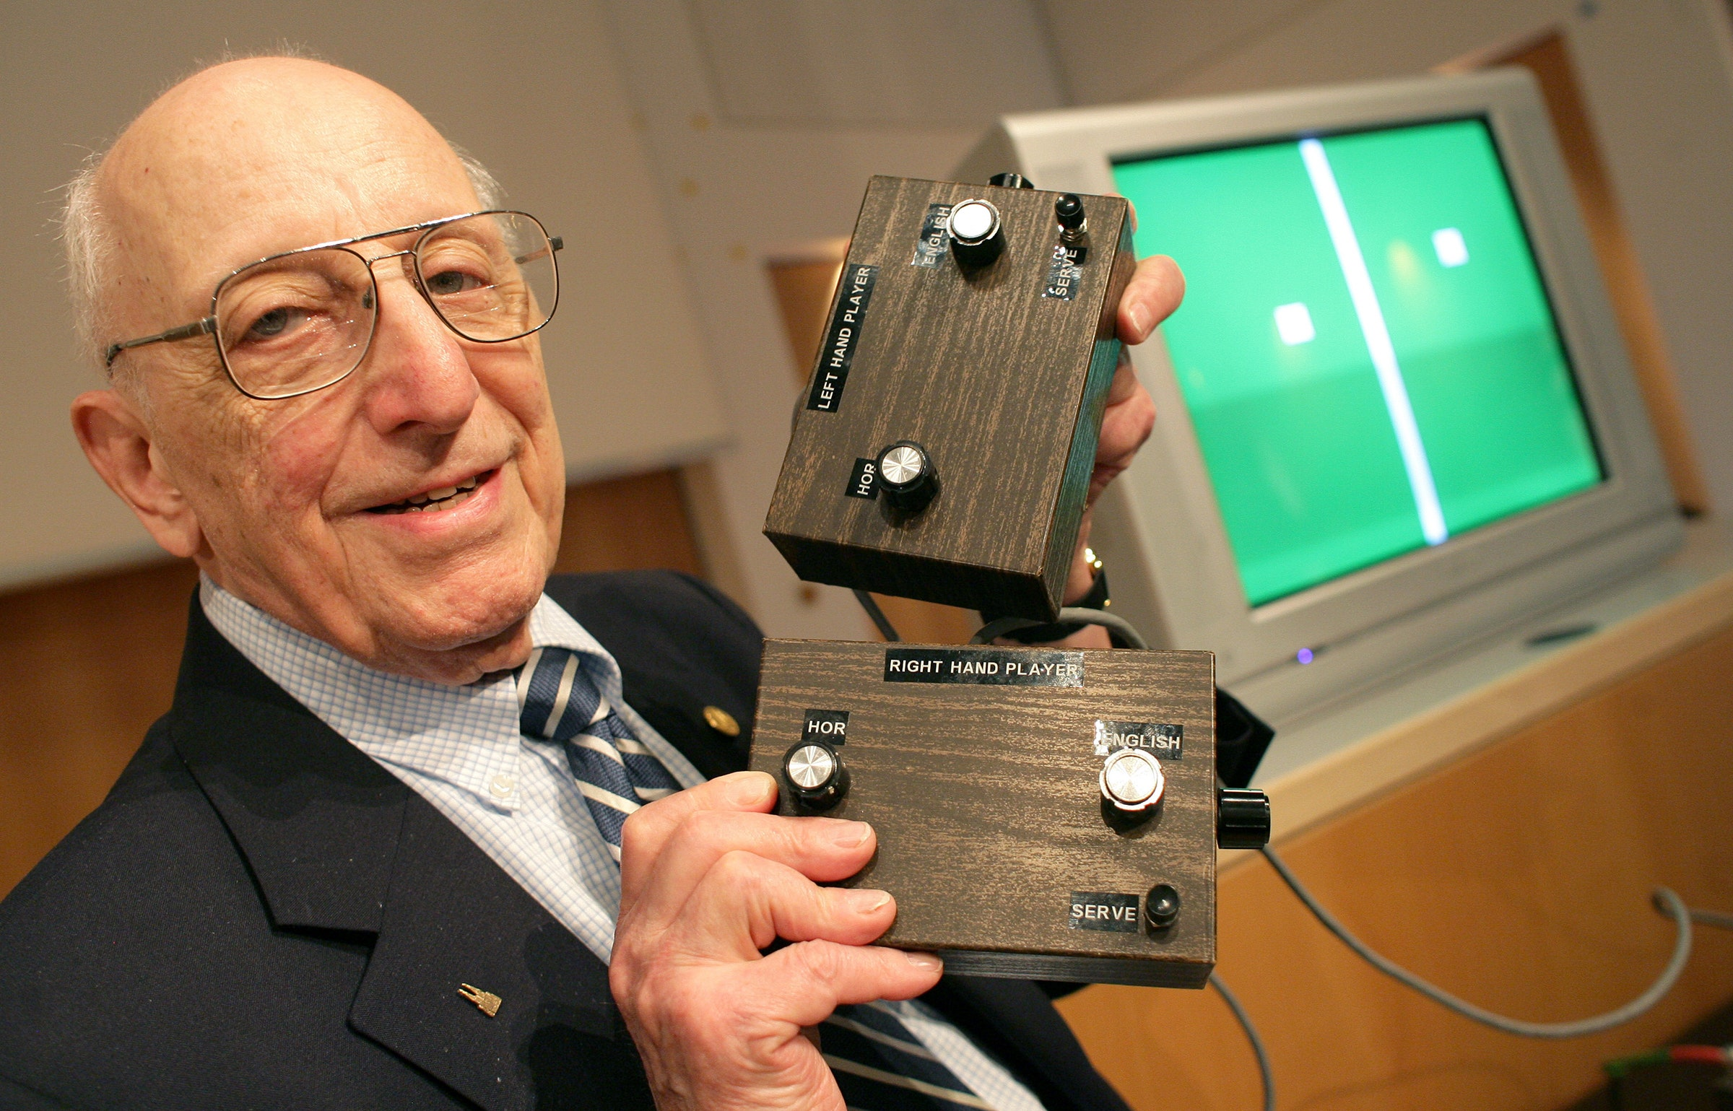
Game concept and its history
“Pong” is one of the earliest arcade video games and the very first sports arcade video game. It is a table tennis sports game featuring simple two-dimensional graphics. Pong was one of the first video games to reach mainstream popularity. This simple game features two paddles and a ball. The goal is to defeat your opponent by being the first one to gain 10 points, a player gets a point once the opponent misses a ball.
Ralph Henry Baer, the inventor of the game
— DEVELOPMENT OF THE “PONG” GAME 3

Slide 4
— DEVELOPMENT OF THE “PONG” GAME 4

Slide 5
: algorithms
— СУЧАСНА УКРАЇНСЬКА КУЛЬТУРА 5
— DEVELOPMENT OF THE “PONG” GAME 5

Slide 6
Imitation of movement
Each of the paddles and a ball are controlled by timers which run very quickly creating a new element on the screen and deleting the previous one. This algorithm is used to imitate the movement.
Two sequential frames taken from the demo of
the program drawn on top of each other with 50%
transparency
— DEVELOPMENT OF THE “PONG” GAME 6

Slide 7
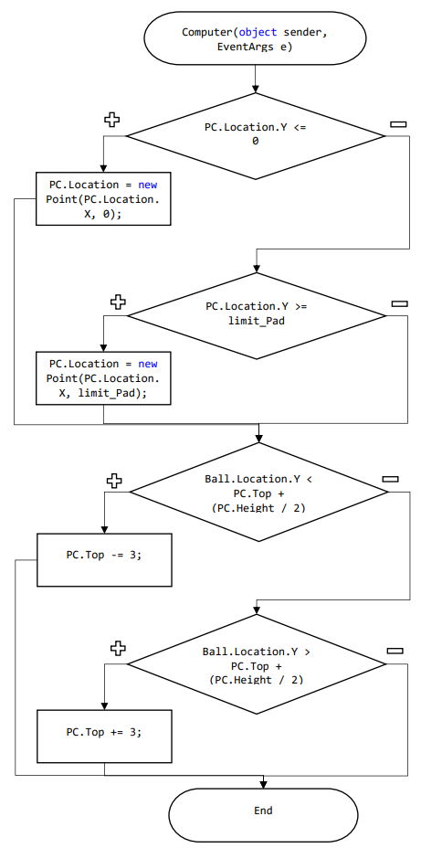
Flow chart describing the mentioned algorithm
PC paddle
Algorithm of the movement of computer-controlled paddle is pretty simple as well. It consists of two if-statements. One of them will not let the paddle leave the form borders and the second one always follows the ball depending on its location.
— DEVELOPMENT OF THE “PONG” GAME 7

Slide 8
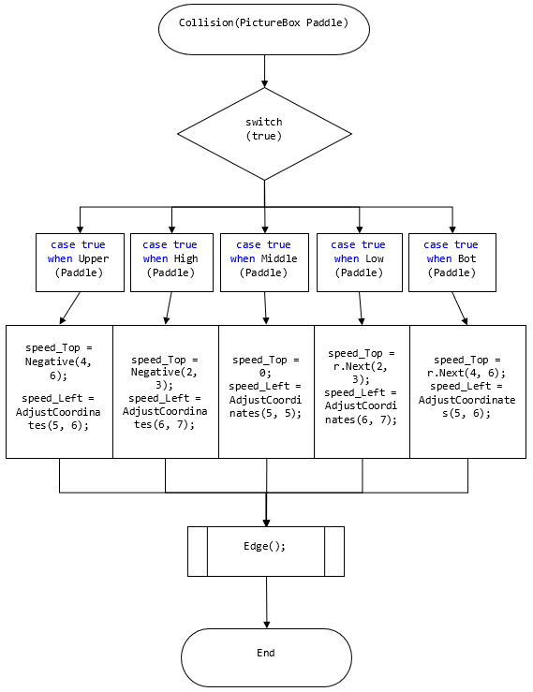
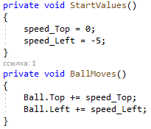
Movement of the ball
The movement of the ball is controlled by two variables which can take positive or negative numbers and which change with each collision with either horizontal borders of the form or the paddles.
Initialization of the variables
which control the ball
Collision of the ball with paddles
— DEVELOPMENT OF THE “PONG” GAME 8

Slide 9
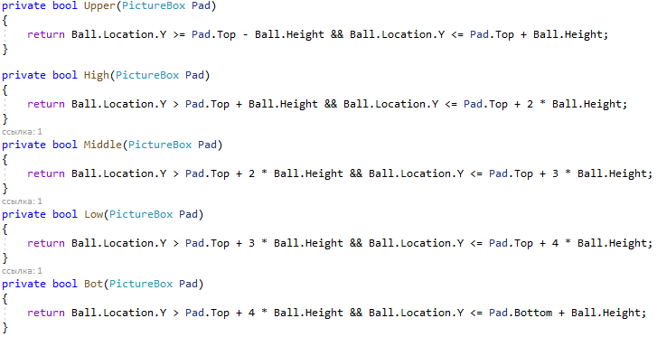
Each of the paddles is divided into 5 identical parts, represented as a bool method and called in a “Collision” subprogram which detects the exact numbers for the variables controlling the ball and assigns them.
— DEVELOPMENT OF THE “PONG” GAME 9

Slide 10
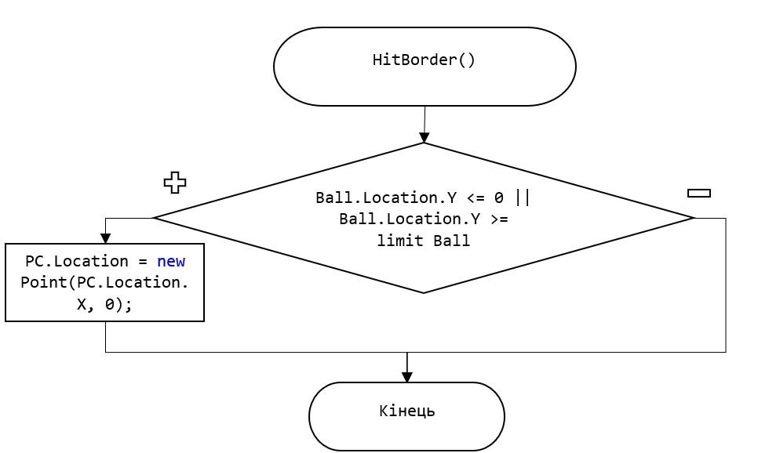
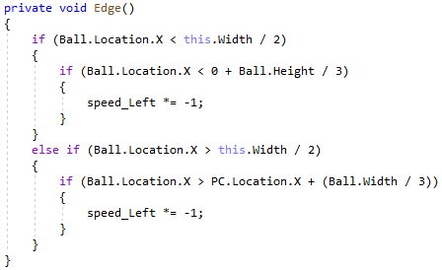
HitBorder() subprogram
which controls the direction
of the ball while hitting one
of the horizontal borders of
the game field
Edge() method deals with
not letting the horizontal borders of the paddles to
hit the ball
— DEVELOPMENT OF THE “PONG” GAME 10

Slide 11
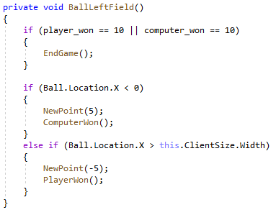
When the ball leaves the playing field, it is checked whether one of the players have gained 10 points. If this statement is true, the variables where the score is stored change their value to 0, each of the paddles and a ball are coming back to their start positions and the “Start Game” button is being shown. If it is false, then one of the players gets one point depending on the ball’s position on the playing field (is it on the left or the right part of it) and the ball comes back on its starting position which is center of the field.
— DEVELOPMENT OF THE “PONG” GAME 11

Slide 12
This course work was dedicated to creating a software product for entertaining and learning the basics of movement algorithms in simple video games like this one. This project may be useful for other people who have started learning programming. It is really easy to use and simple. In the future this work may be improved by adding more graphic elements, the possibility of playing with 2, 3 or 4 players, adding the parameters which will control the speed of the paddles and the ball or their appearance and the possibility to create a ranking for different players playing on the same device.
Conclusions
Conclusions
— DEVELOPMENT OF THE “PONG” GAME 12

Slide 13

THANK YOU FOR YOUR
ATTENTION!
Any
questions?
— DEVELOPMENT OF THE “PONG” GAME 13

