Slide 1

Explainable AI Financial Platform using
Attention Based Deep Learning Models
Batch-09
Guide: Dr.D.Anupama
Associate Professor
M.Arvind 2211CS030009
B.Vamshi Reddy 2211CS030028
G.Dattu Raghunandan 2211CS030063

Slide 2
ABSTRACT
Financial institutions increasingly rely on AI for predictive analytics, yet regulatory mandates such as GDPR and SEC requirements restrict deployment of "black box" deep learning models due to lack of transparency.
Our project presents an end-to-end Explainable AI (XAI) system that predicts stock price movements and provides human-interpretable reasoning for every forecast.
The system combines:
• A stacked LSTM + Multi-Head Attention model over a 60-day lookback window
• SHAP (SHapley Additive exPlanations) for feature-level transparency
• KMeans market regime detection (Calm / Trending / Volatile)
• React-based dashboard supporting 50 stocks with real-time predictions

Slide 3
INTRODUCTION
Financial markets generate vast amounts of time-series data every trading session. Predicting the direction and magnitude of stock price movements has become a central challenge in the FinTech domain. With the rapid advancement of deep learning, models such as Long Short-Term Memory (LSTM) networks have demonstrated strong performance in capturing temporal dependencies within sequential data. However, despite their predictive power, these models are frequently criticized as "black boxes" they make accurate predictions but provide no explanation for their decisions.
Regulatory bodies including the SEBI, GDPR and SEC mandate explainability for AI systems deployed in financial settings. Banks and institutional investors cannot deploy models they cannot justify to auditors, compliance officers, or clients. This creates a critical tension: the most powerful models are the least interpretable.

Slide 4
OBJECTIVE:
Build an attention-based LSTM model achieving directional accuracy on stock price movements
Provide SHAP-based explainability explaining which features and historical timeframes drove each prediction decision
Deploy a production ready dashboard enabling finance professionals to visualize predictions, explanations, and market regimes in real time

Slide 5
LITERATURE SURVEY
Paper | Authors & Year | Model | Key Metrics | Limitation
Attention-LSTM for Stock Price Prediction | Lin et al., 2022 | AT-LSTM Multi-head | RMSE: 0.6736, MAE: 0.4858 | No XAI (SHAP/LIME), no dashboard
Explainable DL for Market Trend | Muhammad et al., 2024 | DNN + SHAP + LIME | Accuracy: 94.9%, F1: 93.6% | No real time system,price only
Stock Trend via XAI Deep Learning | Abdullah et al., 2024 | DNN + SHAP + LIME | Acc: 94.9%, vs RF 85.1% | No production dashboard

Slide 6
EXISTING & PROPOSED SYSTEM:
EXISTING SYSTEMS
PROPOSED SYSTEM
Black-box predictions - no reasoning provided
LSTM + Attention with full explainability
No feature importance or XAI layer
SHAP values for every feature per prediction
VS
Static confidence - no market awareness
KMeans regime detection → dynamic confidence
Separate tools for prediction - explanation
Unified dashboard: predict + explain + visualize
Not regulatory compliant
Regulatory compliant — GDPR / SEC ready
No ensemble direction signals
RSI + MACD + MA ensemble direction signal

Slide 7
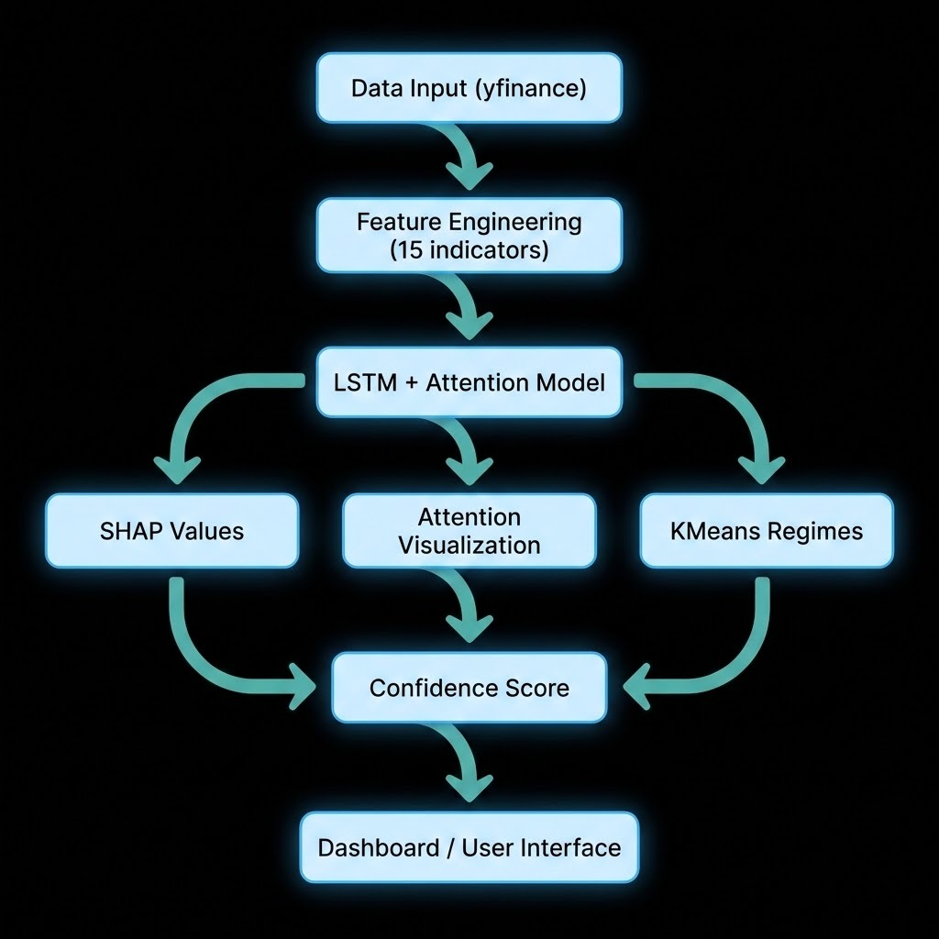
SYSTEM ARCHITECTURE

Slide 8
PROJECT FRAMEWORK:
Backend:
Python
SHAP
Scikit-learn
Fast API
FMP API
Frontend:
React

Slide 9
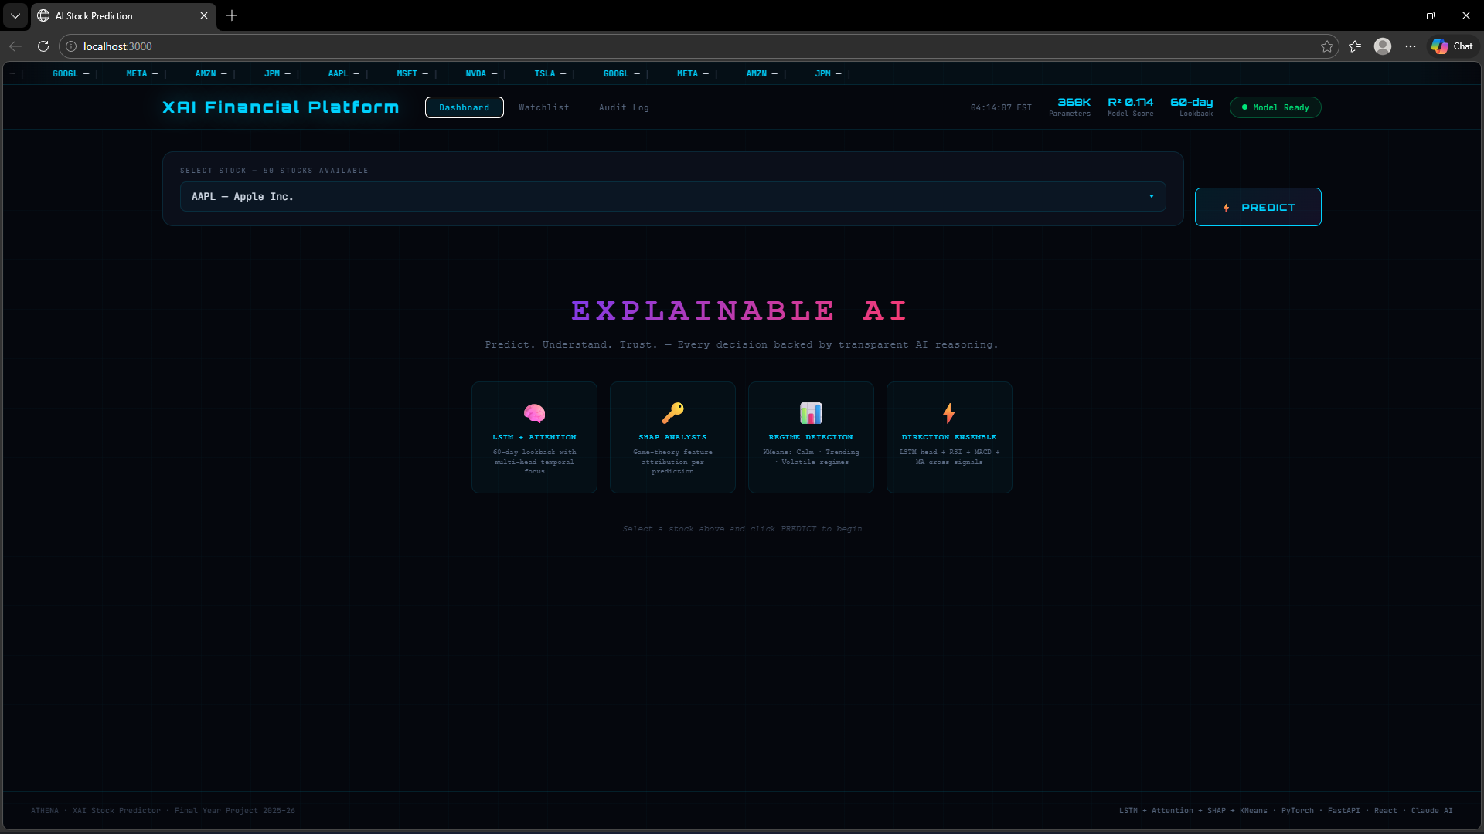
RESULTS:

Slide 10
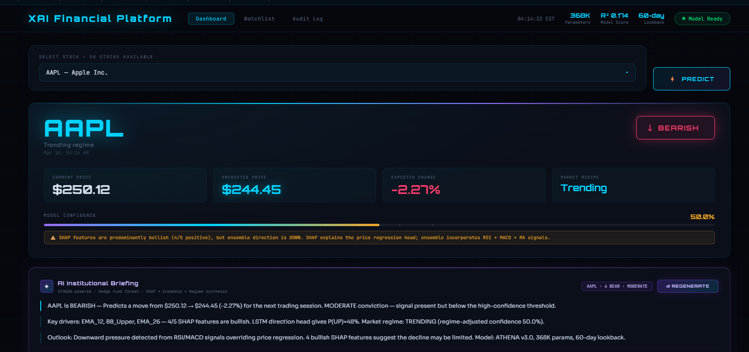
RESULTS:

Slide 11
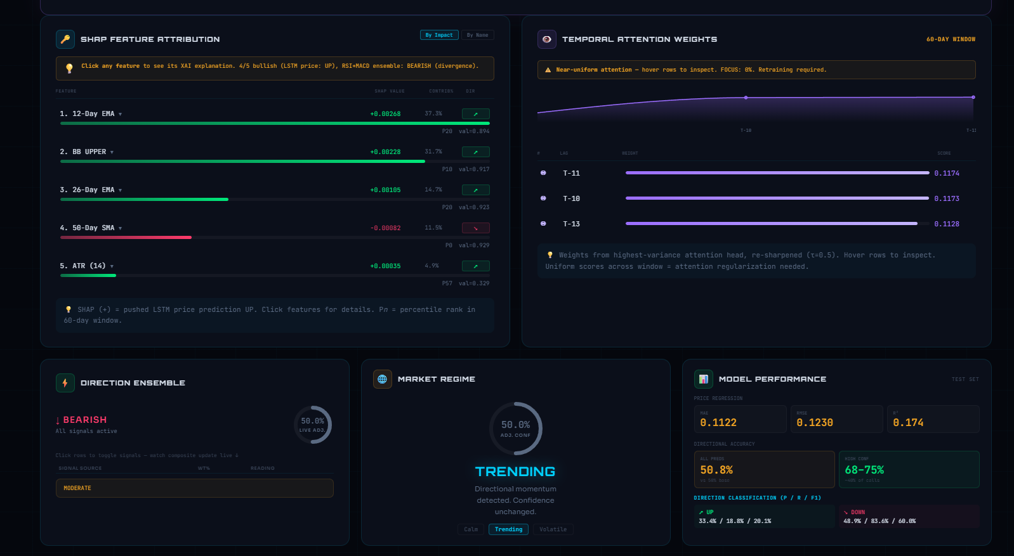
RESULTS:

Slide 12
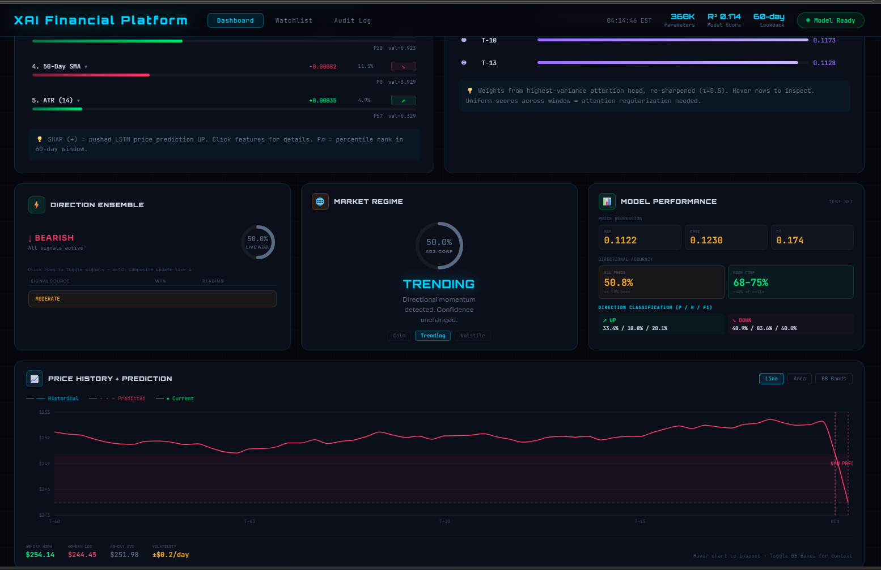
RESULTS:

Slide 13
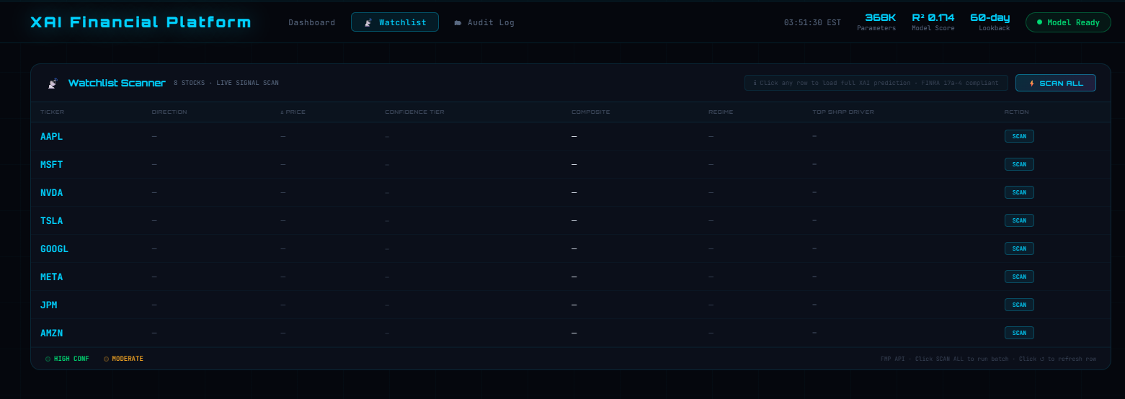
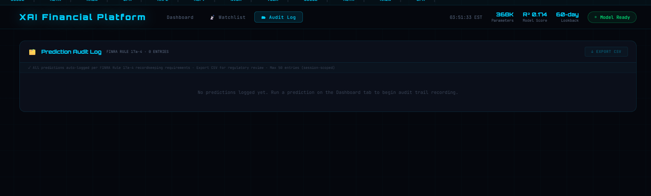
RESULTS:

Slide 14
FUTURE SCOPE:
Sentiment Analysis integration (news + Twitter)
Real-time WebSocket streaming predictions
Multi asset portfolio optimization + VaR
Full Transformer architecture (replace LSTM)
Backtesting engine for historical validation
Federated learning for enterprise multi bank use

Slide 15
REFERENCES:
[1] Yuyang Lin & Qi Huang & Qiyin Zhong & Muyang Li & Yan Li & Fei Ma, 2022. "A new attention-based LSTM model for closing stock price prediction," International Journal of Financial Engineering (IJFE), World Scientific Publishing Co. Pte. Ltd., vol. 9(03).
[2]Muhammad, Dost & Ahmed, Iftikhar & Naveed, Khwaja & Bendechache, Malika. (2024). An explainable deep learning approach for stock market trend prediction. Heliyon. 10. e40095. 10.1016/j.heliyon.2024.e40095.
[3]Muhammad D, Ahmed I, Naveed K, Bendechache M. An explainable deep learning approach for stock market trend prediction. Heliyon. 2024 Nov 5;10(21):e40095. doi: 10.1016/j.heliyon.2024.e40095. PMID: 39568823; PMCID: PMC11577217
[4]J. J and V. V. S. K. Goditi, "Integration of a Hybrid Model with XAI for Stock Price Forecasting: A Dashboard-Driven Approach," 2024 International Conference on IT Innovation and Knowledge Discovery (ITIKD), Manama, Bahrain, 2025, pp. 1-5, doi: 10.1109/ITIKD63574.2025.11005353.

Slide 16
CONCLUSION:
Our project bridges the gap between AI capability and regulatory compliance. Which proves that production grade explainable AI for financial markets is achievable, scalable, and deployable enabling banks to confidently leverage deep learning while maintaining full auditability and user trust.

