Slide 1
Clocking App
David Gibbs
Chyeeka Brown
Sheldon Gray
Dhara Shah
Thai Mai

Slide 2
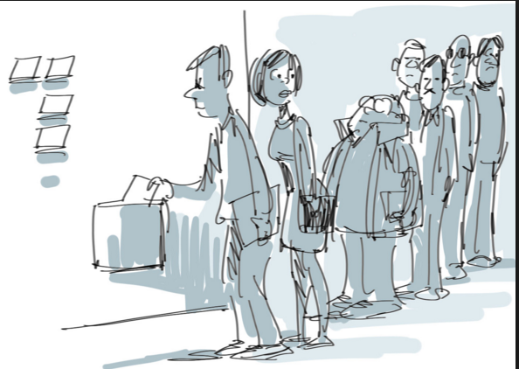


The demand:

Slide 3
The solution:
Employee has automated clock in /out ,notification
Employee has manual clock in/out , notification
calculate hours worked , see the spread sheet
Employee sets alarms for the shift start
Managers add employees, time schedules and work locations
Managers view reports

Slide 4
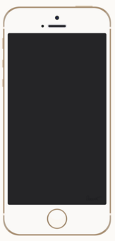



App Design: Basics

Slide 5
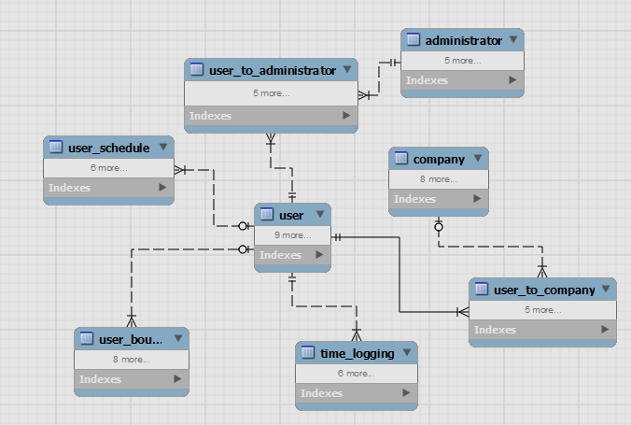
Data Model

Slide 6
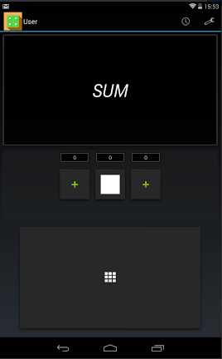
UC: 1,2
At
Current Android version shown
Notes:
For ergonomics, we talked with the business with the suggestion that there doesn’t need to be a +/- button for dice rolls nor a Submit button.

Slide 7
UC:
At
Current Android version shown
Notes:
For ergonomics, we talked with the business with the suggestion that there doesn’t need to be a +/- button for dice rolls nor a Submit button.

Slide 8
UC:
At
Current Android version shown
Notes:
For ergonomics, we talked with the business with the suggestion that there doesn’t need to be a +/- button for dice rolls nor a Submit button.

Slide 9
UC:
At
Current Android version shown
Notes:
For ergonomics, we talked with the business with the suggestion that there doesn’t need to be a +/- button for dice rolls nor a Submit button.

Slide 10
UC:
At
Current Android version shown
Notes:
For ergonomics, we talked with the business with the suggestion that there doesn’t need to be a +/- button for dice rolls nor a Submit button.

Slide 11
Web interface

Slide 12
Lessons learnt
Conclusion slide

Slide 13
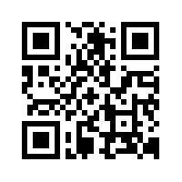
Download and Try it Yourself!
http://swe2313.com/group04
This will work on Android only! Please turn on “Unknown Sources”.

