Slide 1
Clocking App
David Gibbs
Chyeeka Brown
Sheldon Gray
Dhara Shah
Thai Mai

Slide 2
Overview
Demand for the app
Our custom solution
GPS based tracking for automated time logging
General Application flow
API
App use of the API
DB Layout
Use Cases
Web Interface
Demo!

Slide 3



The demand:

Slide 4
The solution:
Use an app that will automatically clock employees in/out dependent on their location
Employee has automated clock in /out ,notification
Employee has manual clock in/out , notification
calculate hours worked , see the spread sheet
Employee sets alarms for the shift start
Managers add employees, time schedules and work locations
Managers view reports

Slide 5




App Design: Basics

Slide 6
API overview
Used as an endpoint for our mobile app, website, and other future devices
DB schema and logic is kept separate
Security and maintaince is made easier
The API will control all data flowing in and out of the DB
Better error checking and validation
JSON is used for all communication
Good compression
Native use in almost all web applications
The new web standard

Slide 7
API Description
8 different end points
Website and app use identical endpoints
Example:
When a user clocks into the system, their User ID will be sent to the API
The API will lookup their GPS coordinates, get the time zone, and then log them into the system
Removes the possibility of users injecting their own time
As would be the case if they had direct DB access
AWS EC2 instance
Running Apache/PHP
group6project.com

Slide 8
API Interaction With the DB
The API solely interacts with the DB through SP’s
Removes the need for the API to know DB Schema
Allows for the DB to handle more logical operations
Returns only the exact data needed
DB Schema can be modified without the need to change many API operations
Only DB SP’s and views would need to be changed
Reduces the data transferred between DB and API
DB can be physically very distant from the web server
Where is the DB located for this project?

Slide 9
Application Internal Logic
All communication flows through a Transporter class
Login, GPS updates, setting schedule, getting schedule, etc.
Transporter accepts GET/POST request with URL and parameters
Returns a JSON object to the calling method, usually a Utilities class
Acts almost as an internal API for all requests to flow through
Greatly reduces the complexity of the app and amount of code written
HTTP requests can be somewhat complex
Very lengthy to write in Java

Slide 10
GPS Service class
The GPS service listens for a change event
Upon change, it checks the GPS coordinates
Is user inside the bounding box?
Tell the API to log in the user
Bounding Box Coordinates
Calculated in the API
Based on lat/long and distance from that point
Returned to the user’s phone at login
Selected by a manager’s app

Slide 11
Application flow for GPS
GPS Service gets an event
GPS Service sends request to Utilities class
Utilities class builds params and gets endpoint from config
Sends request to Transporter
Transporter responds back with response
User is alerted
API
DB
GPS
Service
Util
Class
Trans-porter

Slide 12
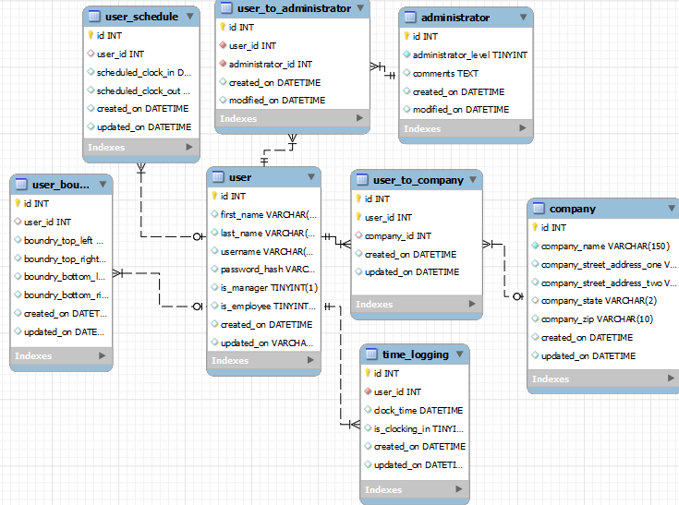
Data Model

Slide 13
UC:1,2,3,4
UC:1 Walk in the work place, get auto logged in by detection of their GPS coordinates
UC:3,4 Leave / return for lunch, auto log in/out
UC:2 Leave for the day, auto logout
Output: Employee is notified by a tone/visual

Slide 14
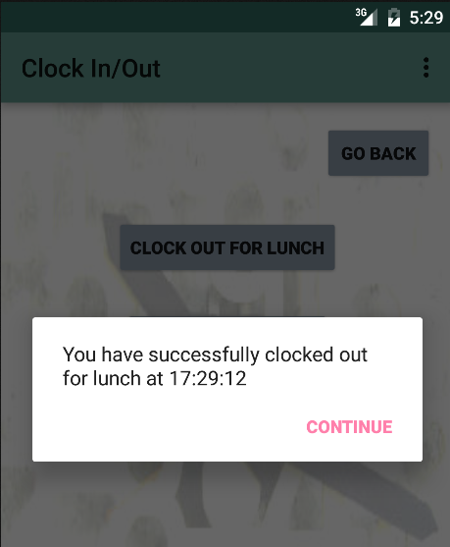
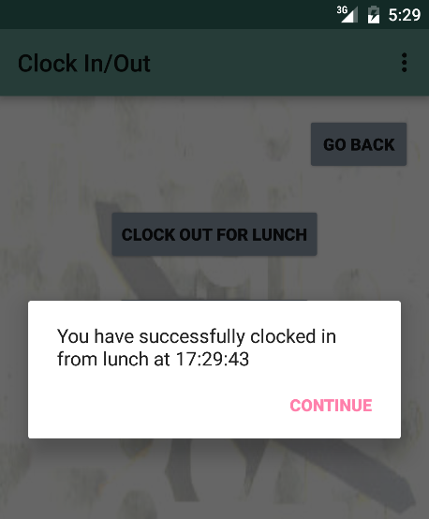
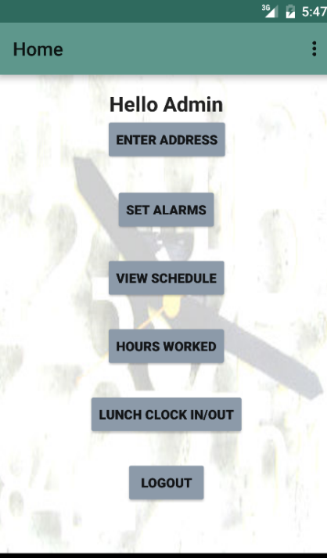
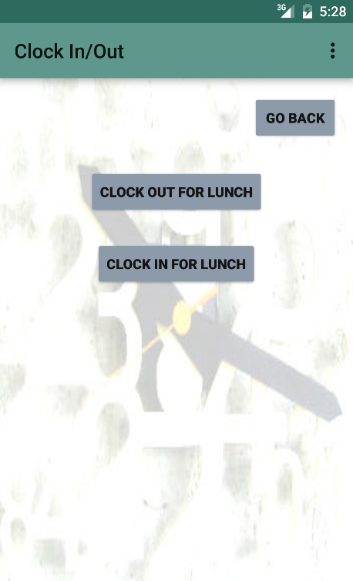
UC:5,6,9
UC:5,6 Employee could manually clock in/out from the app at lunch time
UC:9 Employee alerted of time stamp
Using: Database connection

Slide 15
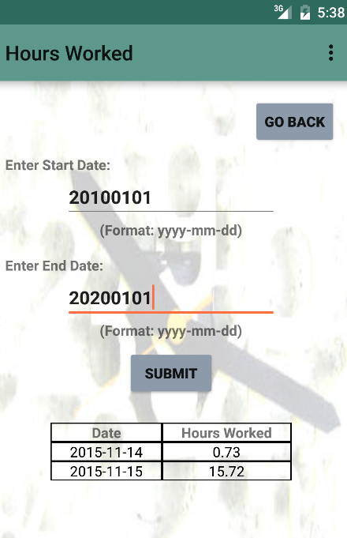
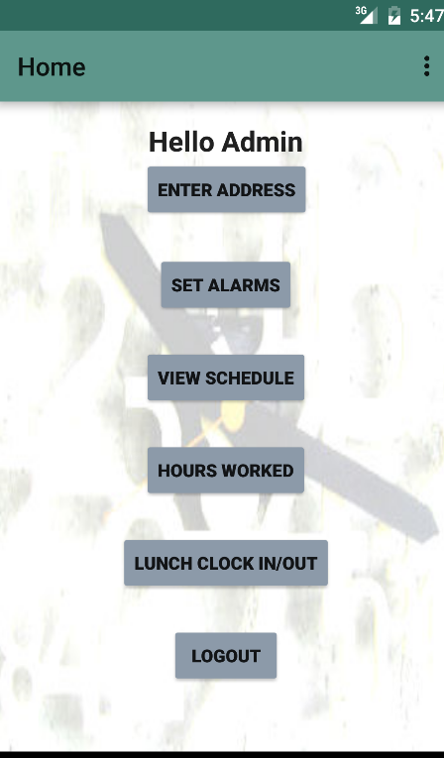
UC:11
Employee checks in the spreadsheet
Database connection

Slide 16
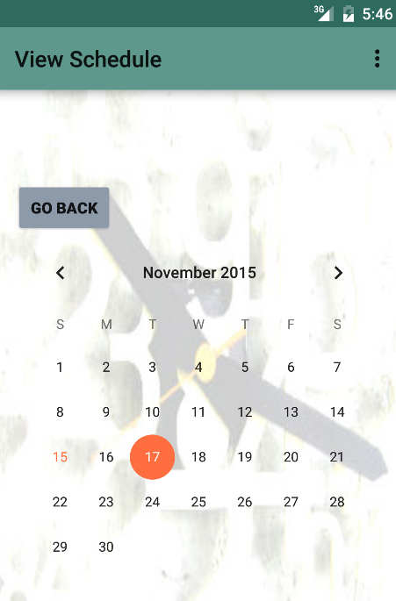
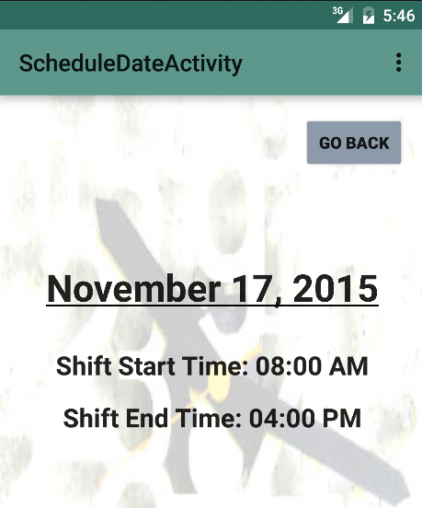
UC:7
Employee views schedule

Slide 17
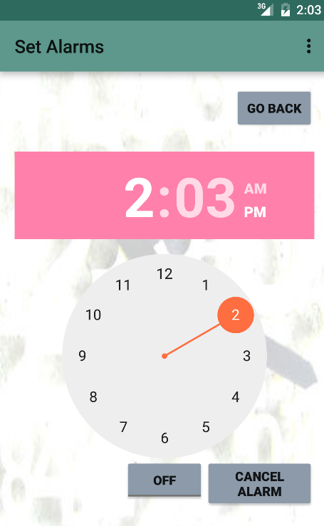
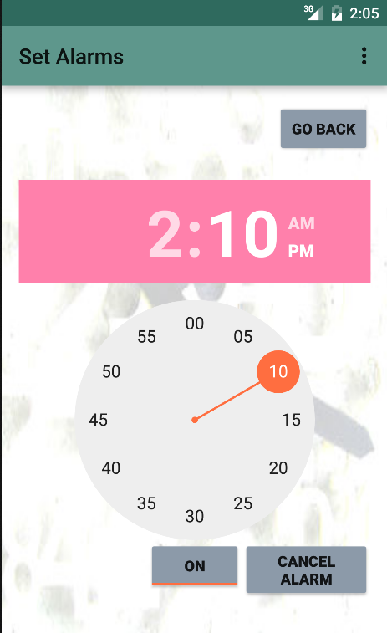
UC 12
Employee sets alarms for the reminder of the shift time

Slide 18
Web Interface
UC:16 Employee/manager logs in through the web interface
UC:10,14 Employee logs in/out from web interface
UC:13 Manager sets employee schedule
UC:15 Manager accesses the web based report
http://group6project.com/Group6/website/pages/login.php
Notes:
For ergonomics, we talked with the business with the suggestion that there doesn’t need to be a +/- button for dice rolls nor a Submit button.

Slide 19
Interesting Facts
API’s are extremely useful!
5000+ lines of code
Any app that requires GPS permission can track you EVERYWHRE

