Slide 1
Clocking App
David Gibbs
Chyeeka Brown
Sheldon Gray
Dhara Shah
Thai Mai

Slide 2
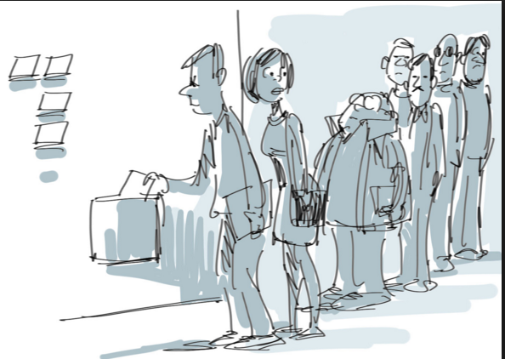


The demand:

Slide 3
The solution:
Employee has automated clock in /out ,notification
Employee has manual clock in/out , notification
calculate hours worked , see the spread sheet
Employee sets alarms for the shift start
Managers add employees, time schedules and work locations
Managers view reports

Slide 4
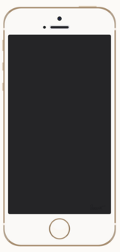



App Design: Basics

Slide 5
API overview
David, fill it in

Slide 6
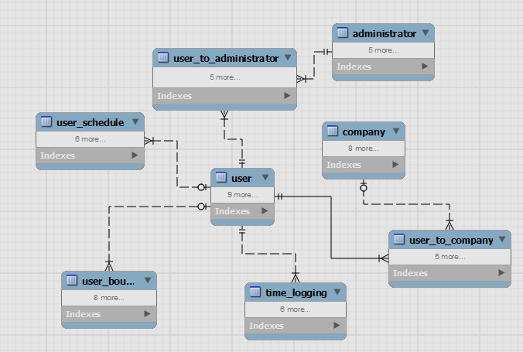
Data Model

Slide 7
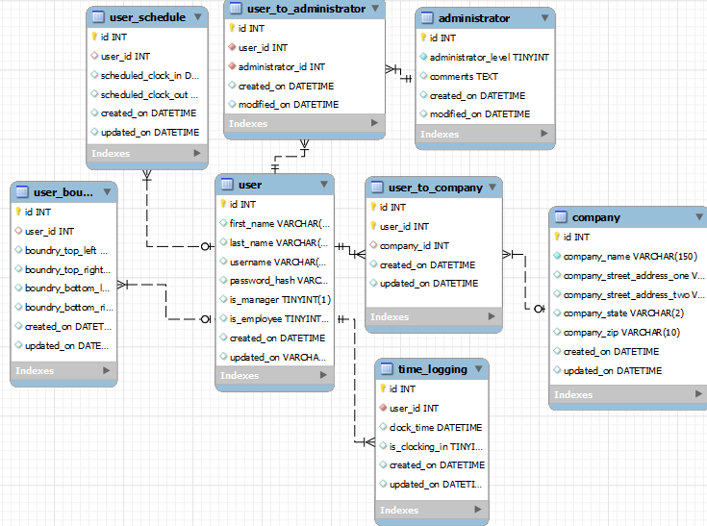
Data Model

Slide 8
UC:1,2,3,4
UC:1 Walk in the work place, get auto logged in by detection of their GPS coordinates
UC:3,4 Leave / return for lunch, auto log in/out
UC:2 Leave for the day, auto logout
Output: Employee is notified by a tone/visual

Slide 9
GPS Service class
David, explain functions in GPS service and how we hook it to app

Slide 10
David: Relation between
David: Relation between
<app> <transporter> <GPS service> <Api>

Slide 11
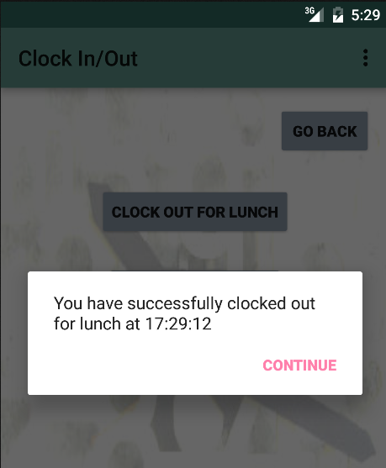
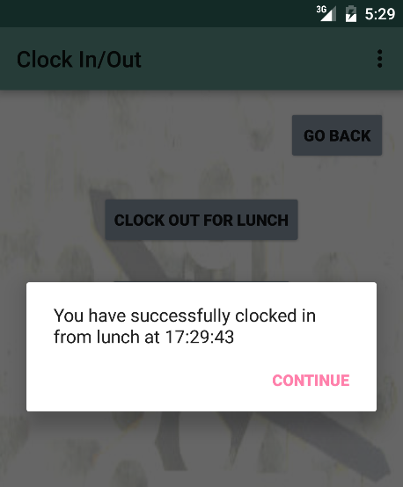
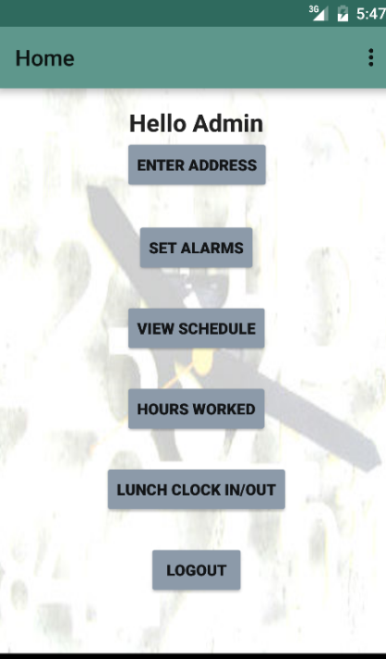
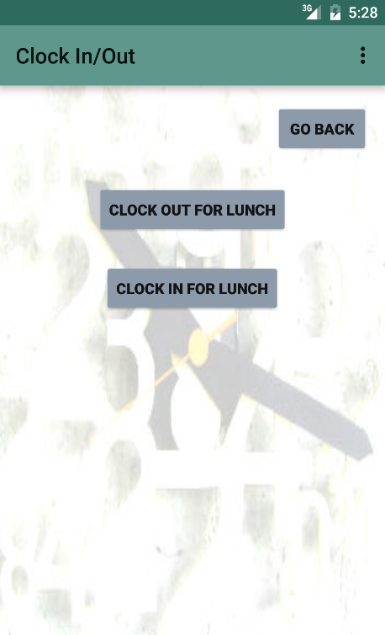
UC:5,6,9
UC:5,6 Employee could manually clock in/out from the app at lunch time
UC:9 Employee alerted of time stamp
Using: Database connection

Slide 12
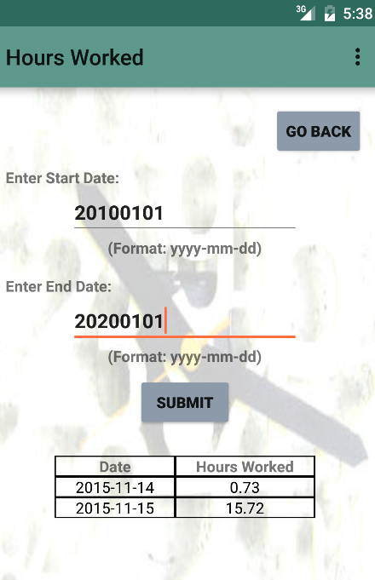
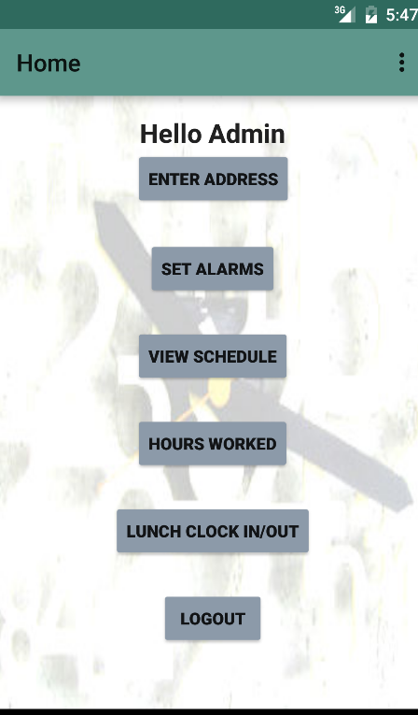
UC:11
Employee checks in the spreadsheet
Database connection

Slide 13
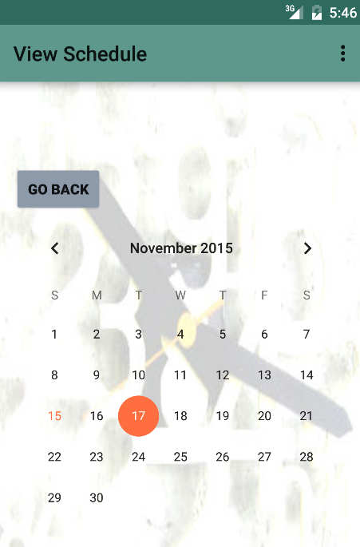
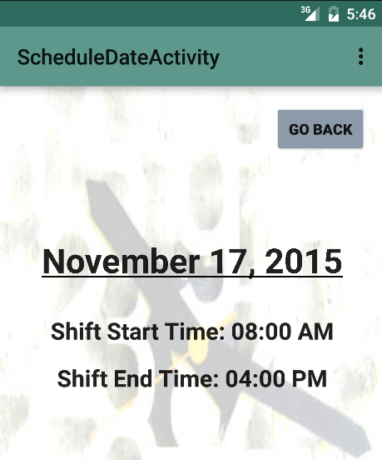
UC:7
Employee views schedule

Slide 14
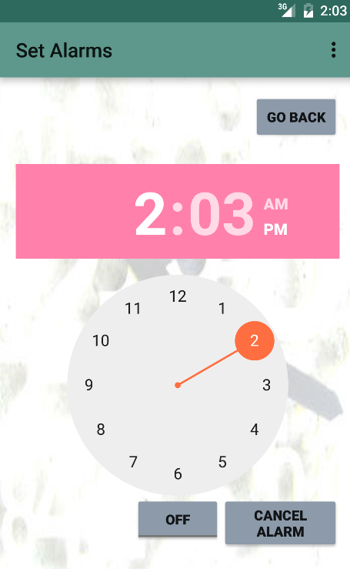
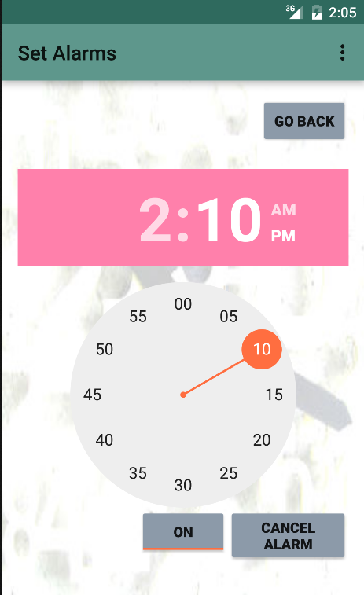
UC 12
Employee sets alarms for the reminder of the shift time

Slide 15
Web Interface
UC:16 Employee/manager logs in through the web interface
UC:10,14 Employee logs in/out from web interface
UC:13 Manager sets employee schedule
UC:15 Manager accesses the web based report
http://group6project.com/Group6/website/pages/login.php
Notes:
For ergonomics, we talked with the business with the suggestion that there doesn’t need to be a +/- button for dice rolls nor a Submit button.

Slide 16
Lessons learnt
API’s are extremely useful

Slide 17
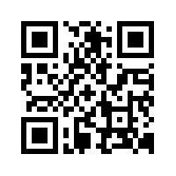
Download and Try it Yourself!
http://swe2313.com/group04
This will work on Android only! Please turn on “Unknown Sources”.

