Slide 1

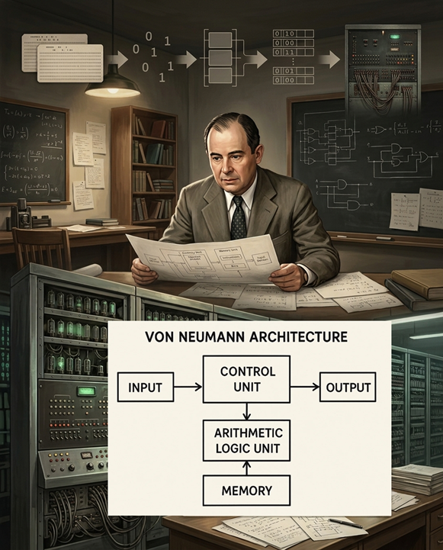
TITLE
SUB-TITLE
Notes:
Generate a vertical A6 card illustration for a card game. Theme: The birth of calculation (calculus). The image depicts a prehistoric shepherd counting his animals with pebbles. In the foreground, a close-up of the shepherd’s hands placing small, smooth, rounded pebbles into neat rows on a flat stone slab. In the background, slightly out of focus, sheep are visible near a cave entrance. The composition is strictly vertical, with the stone slab taking up the lower half and the shepherd's torso and cave background in the upper half. Style: Rich digital painting, visible brushstrokes, warm atmospheric firelight. No text, no borders, edge-to-edge illustration. High quality, artistic and historical feel.

Slide 2

DATE
TITLE
CONTENT

