Slide 1
INTRODUCTION
Notes:
The goal of this course is to teach designers that it isn’t that hard to code web applications and you don’t need to have a computer science degree to understand and jump into learning about code. There are benefits to learning and understanding code as a designer. Becoming a skilled individual opens you open to more job opportunities, it creates a knowledge base that you can work with in the industry allowing you to work better as a team, it opens up ways to solve more complex workflow problems that you probably haven’t though about before, and it enables you to control you work and evokes a sense of craftsmanship.

Slide 2
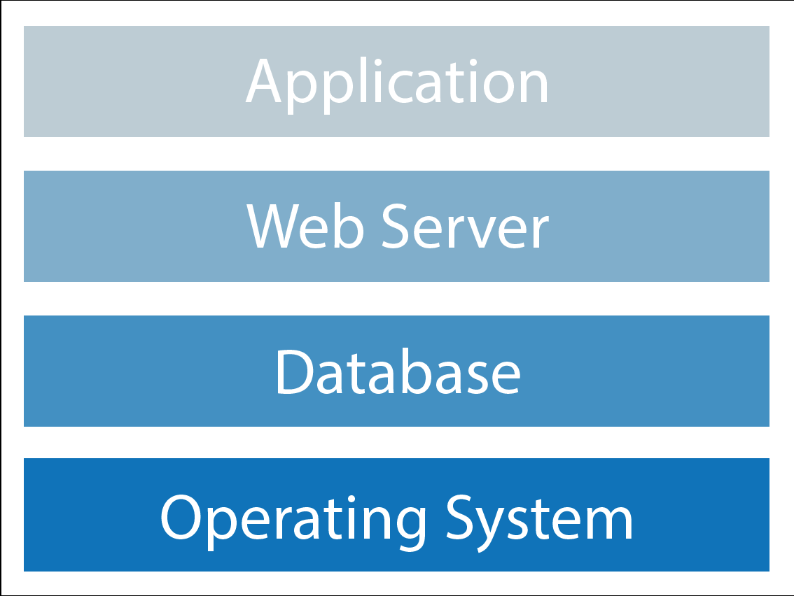
What is a Web Stack
Notes:
Web stack is the collection of software required for Web development. At a minimum, a Web stack contains an operating system (OS), a programming language, database software and a Web server. There are hundreds of possibilities to use for you web stack and what matters is that the core aspects of each one are there.

Slide 3
Notes:
Lamp is the traditional stack that is behind a lot of technology today. The LAMP stack refers to an operating system of PHP, a database of MYSQL, Apache (Web Server), and Linux as the OS.

Slide 4
LEMP
Notes:
A LEMP stack replaces the server with NginX which according the sales pitch is supposed to be able to handle requests much faster. It is also common in a LEMP stack to see that MySQL has been replaced by MariaDB and that PHP has been replaced with Ruby.

Slide 5
MEAN
Notes:
A mean stack is a full stack Javascript system that uses Mongo DB, Express JS Web Socket, Node JS Server, And Angular as a front-end tooling language.

Slide 6
Notes:
A common Illustration used to describe the meteor framework is how it binds all of those utilities together. The mean stack is a collaboration of elements in a cart similar to a raw LAMP stack, but once you add Meteor you have a full fledged framework that provides an easy to use development environment.

Slide 7
CRUD
Create
Read
Update
Delete
This is the most basic example of what a database needs to be able to do for a web application. This concept is going to help us in creating and planning for our web application.

Slide 8
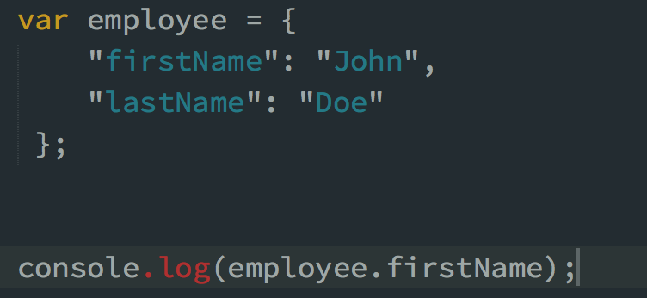
JSON
Notes:
JSON stands for JavaScript Object Notation
JSON is a lightweight data-interchange format
JSON is language independent *
JSON is "self-describing" and easy to understand

Slide 9
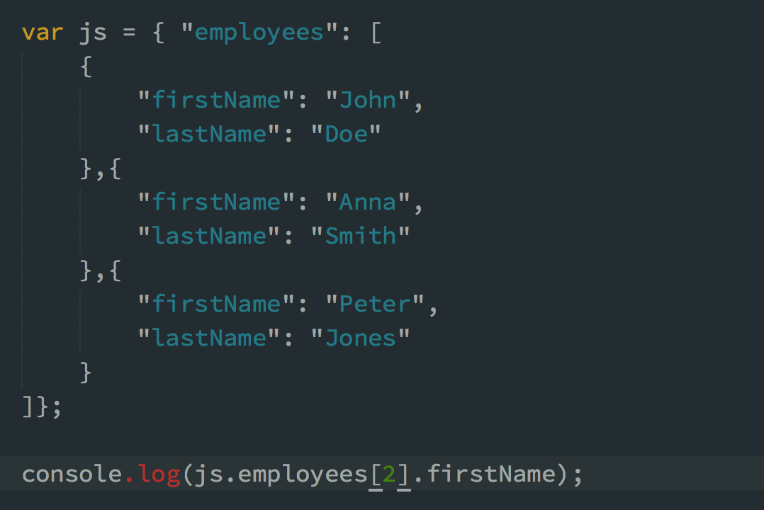

Slide 10
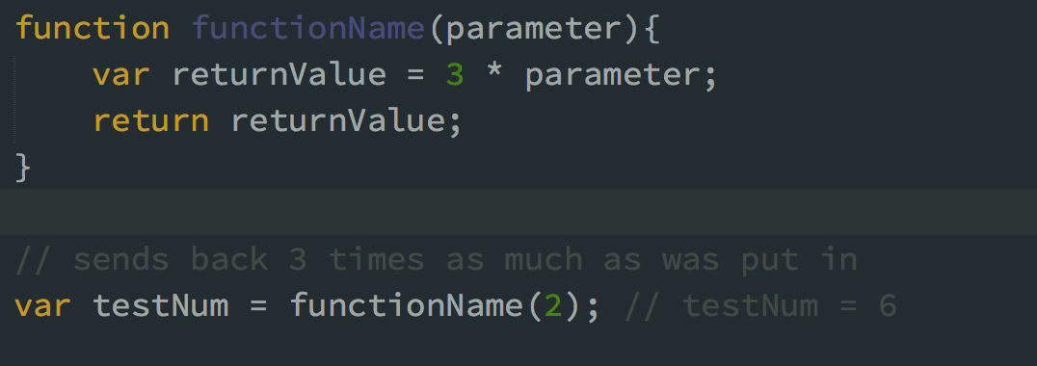
Functions

Slide 11
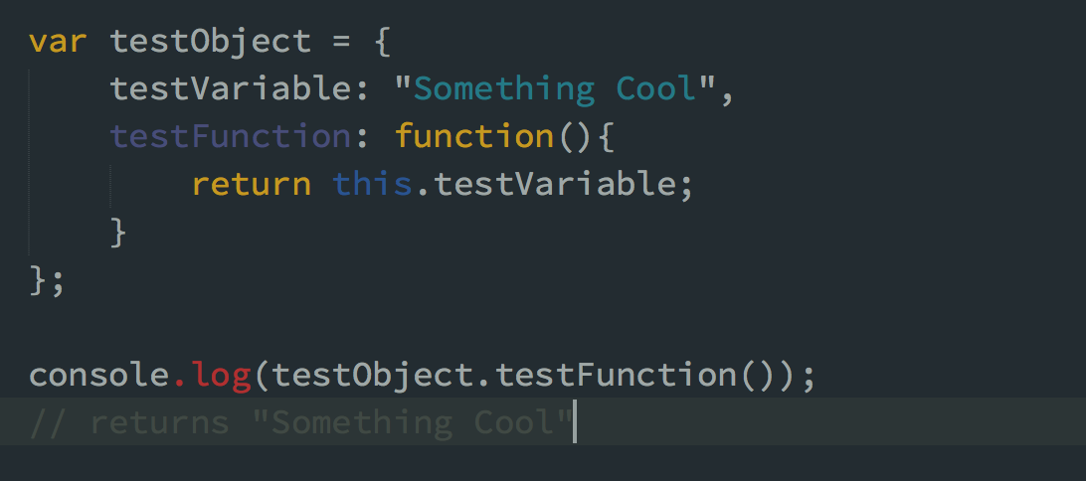
Functions as a Method

Slide 12

Prototyping
Notes:
Wireframing and Sketching are great ways to start out a rapid prototype.
What makes a good wire frame and what level of fidelity should we be looking to achieve and the type of role you have amongst your design team. An interaction designer will often times look at how the flow, functionality, usability and visual aspects of the application, a designer will often focus on the aesthetics of the project, engineers will often focus on the security, performance, and functionality of the application. Each one has an important perspective, but a much different level of prototype fidelity.

Slide 13
