Slide 1

Introduction to the Human Full-Length cDNA Annotation Project (H-Invitational)

Slide 2
Goals of the H-Invitational Project
Complete collection of high-quality human full-length cDNA clones and sequences.
Integrative annotation of these clones, especially, the human curation under the unified criteria.
Construction of a database (H-InvDB) and tools to further facilitate transcriptome researches.

Slide 3
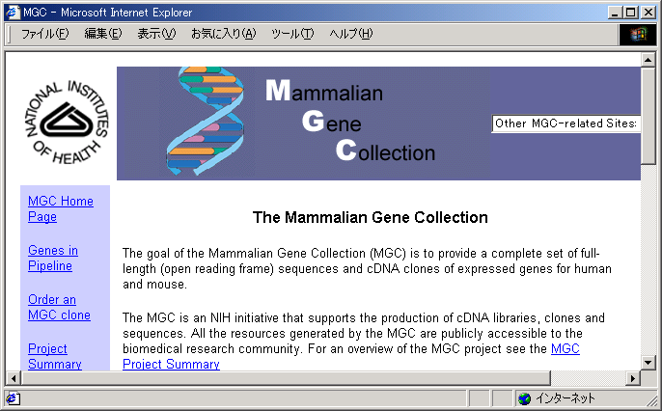
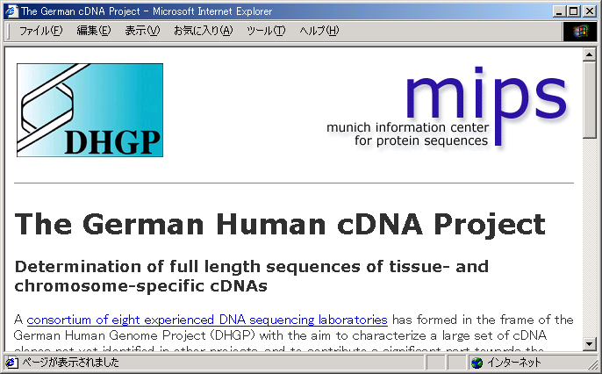
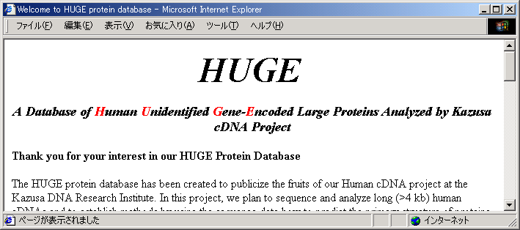
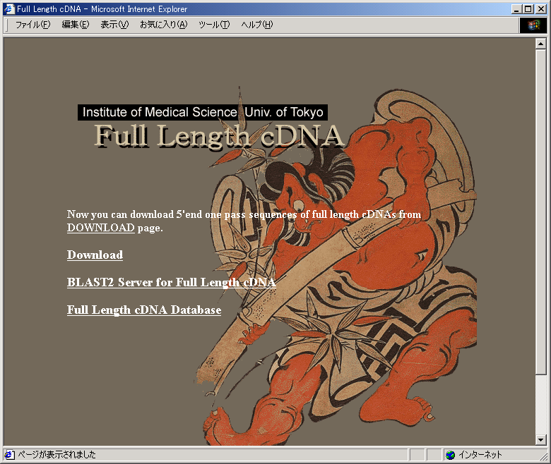
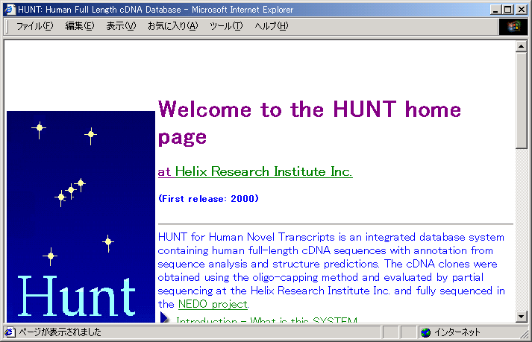
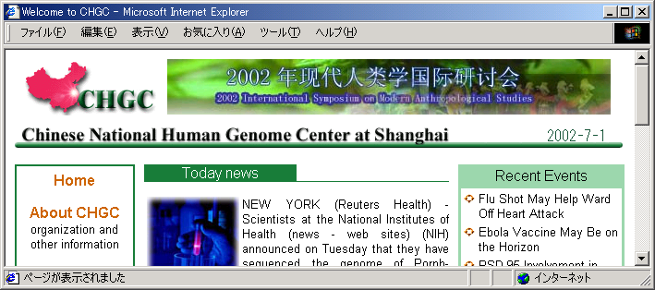
H-Invitational

Slide 4
The H-Invitational Dataset
Six FLcDNA Clone producers
and DDBJ conducted a data
freeze on July 15, 2002.
A total of 41,118 cDNAs were
collected, and a number of
annotation activities were carried
out.
NCBI has supplied their latest
genome assembly (build 34).
EBI provided a non-redundant
SwissProt/TrEMBL protein set.
Organization entries
KIAA/KDRI 2,000
FLJ/Total 20,999
FLJ/KDRI 348
FLJ/IMSUT 4,842
FLJ/Helix 15,809
DKFZ/MIPS 5,555
MGC/NIH 11,806
CHGC 758
Total: 41,118

Slide 5
Two Important Steps in H-Inv Annotation
1. Pre-computing
Mapping on to the genome
Sequence similarity search
ORF prediction
Functional motif prediction
Structural prediction
etc.
2. Human curation
(annotation jamboree)

Slide 6
“Human Full-Length cDNA Annotation Invitational” Jamboree
(H-Invitational)
August 25 - September 3, 2002
Co-organized by JBIRC and DDBJ/NIG
Attended by more than 118 people from 40 organizations such as
JBIRC, DDBJ, NCBI, EBI, Sanger Centre,NCI-MGC, DOE, NIH, DKFZ, CNHGC(Shanghai), RIKEN, Tokyo U, MIPS, CNRS, MCW, TIGR, CBRC, Murdoch U, U Iowa, Karolinska Int., WashU, U Cincinnati, Tokyo MD U, KRIBB, South African Bioinfor Inst, U College London, Reverse Proteomics Res. Inst., Kazusa DNA Inst, Weizmann Inst, Royal Inst. Tech. Sweden, Penn State U, Osaka U, Keio U, Kyushu U, TIT, Ludwig Inst. Brazil, Kyoto U, German Can.Inst., and NIG
Supported by
JBIC, METI, MEXT, NIH, and DOE

Slide 7
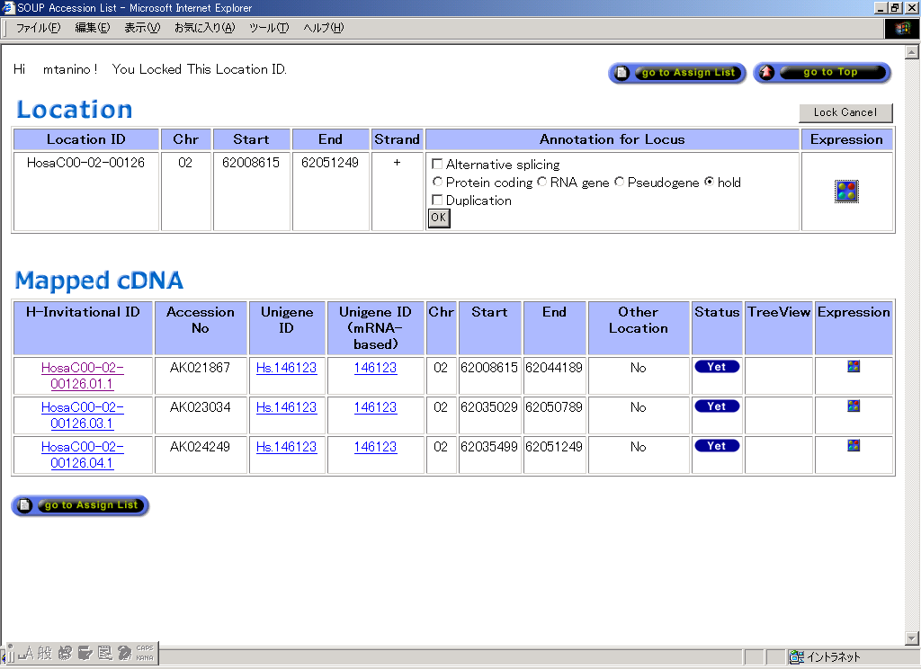
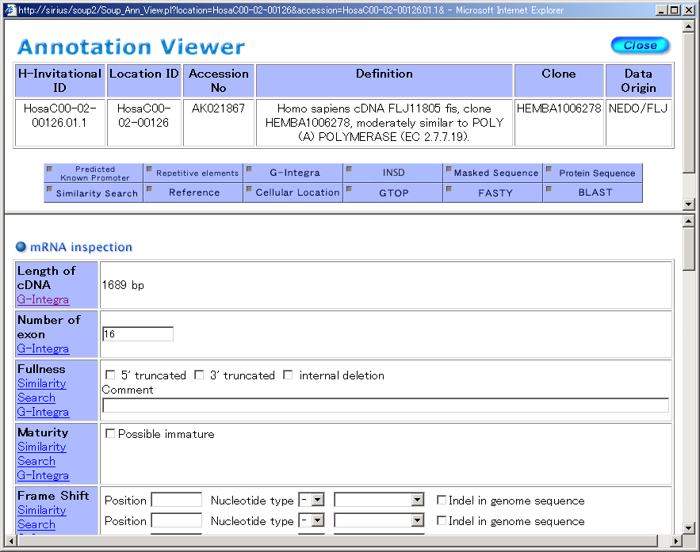
Annotation items
1. Locus
1-1. Alternative Splicing
  1-2. Protein coding/RNA gene/Pseudogene
  1-3. Duplication
2. cDNA
2-1. Features of genomic structure
  2-1-1. GC contents
  2-1-2. Repetitive elements
  2-1-3. SNPs
  2-1-4. CpG islands
  2-1-5. Predicted / known promoter
  2-1-6. Chromosome band
2-2. mRNA inspection
  2-2-1. Length of gene
  2-2-2. Number of exons
  2-2-3. Fullness
  2-2-4. Maturity
  2-2-5. Frame shift
  2-2-6. Chimeric sequence
2-3. Predicted ORF
  2-3-1. Coding potential
  2-3-2. Orientation
  2-2-3. Amino acid sequence
2-4. Function
  2-4-1. Homologous Gene – Homo sapiens
  2-4-2. Homologous Gene – Vertebrate
  2-4-3. Homologous Gene – Eukaryotes
  2-4-4. Homologous Gene – Bacteria and Viruses
  2-4-5. Definition
  2-4-6. Supplementary information
  2-4-7. Gene Ontology
  2-4-8. Cellular location
2-5. Structure
2-5-1. Secondary and Tertiary Structrure
2-6. Evolutionary Feature
  2-6-1. Ortholog
  2-6-2. Phylogenetic tree

Slide 8

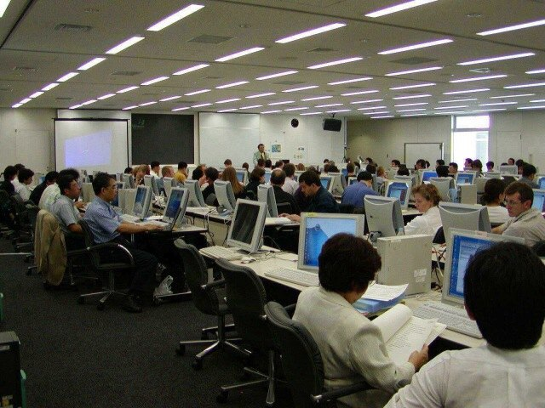
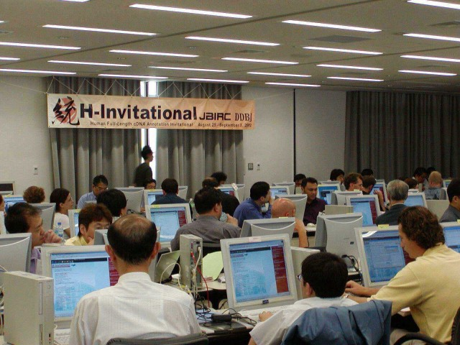
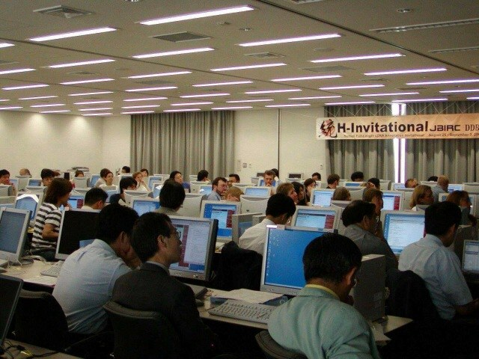
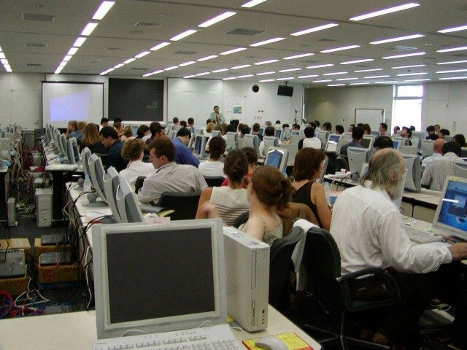

Slide 9
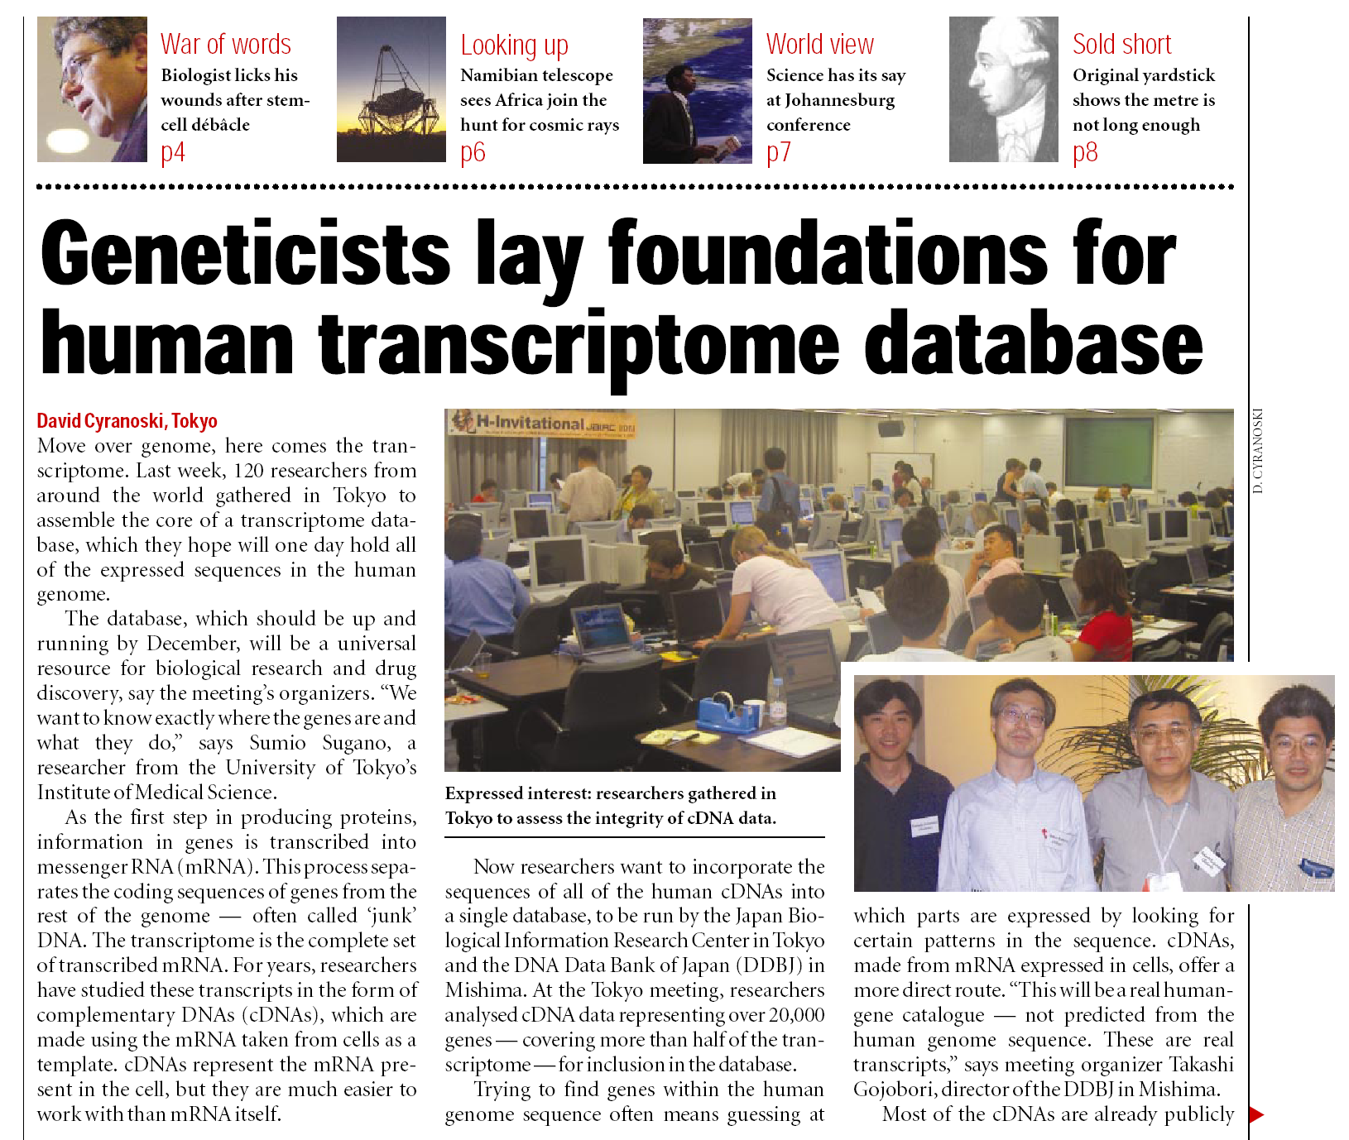
Nature (2002) 419: 3-4 News
September 5, 2002

Slide 10
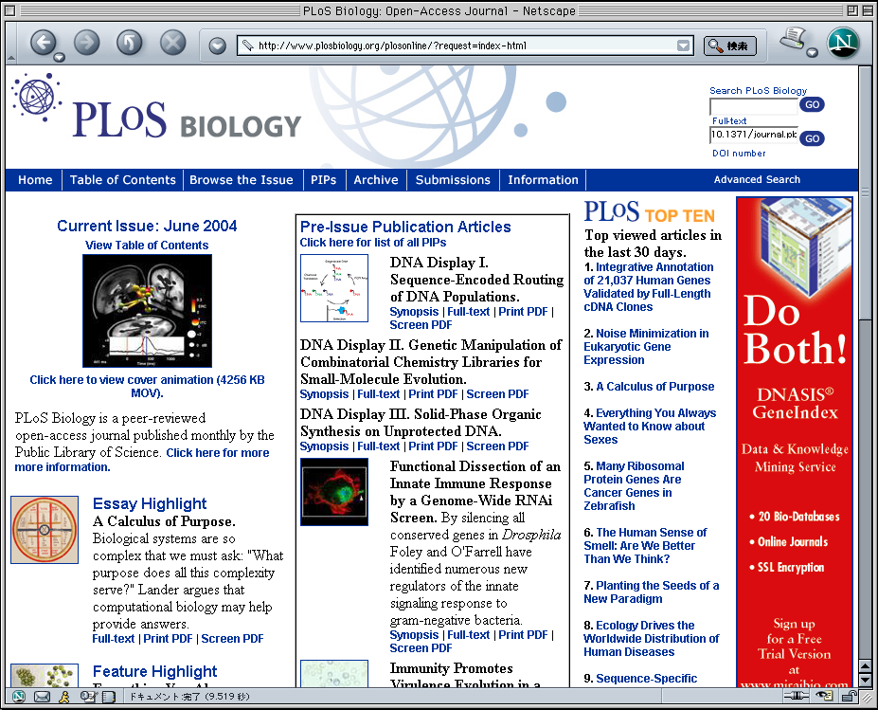
H-Inv Paper Published in PLoS Biology in June, 2004
http://www.plos.org

Slide 11
Integrative Annotation of 21, 037 Human Genes Validated by Full-Length cDNA Clones
Tadashi Imanishi, Takeshi Itoh, Yutaka Suzuki, Claire O’Donovan, Satoshi Fukuchi, Kanako O. Koyanagi, Roberto A. Barrero, Takuro Tamura, Yumi Yamaguchi-Kabata, Motohiko Tanino, Kei Yura, Satoru Miyazaki, Kazuho Ikeo, Keiichi Homma, Arek Kasprzyk, Tetsuo Nishikawa, Mika Hirakawa, Jean Thierry-Mieg, Danielle Thierry-Mieg, Jennifer Ashurst, Libin Jia, Mitsuteru Nakao, Michael A. Thomas, Nicola Mulder, Youla Karavidopoulou, Lihua Jin, Sangsoo Kim, Tomohiro Yasuda, Boris Lenhard, Eric Eveno, Yoshiyuki Suzuki, Chisato Yamasaki, Jun-ichi Takeda, Craig Gough, Phillip Hilton, Yasuyuki Fujii, Hiroaki Sakai, Susumu Tanaka, Clara Amid, Matthew Bellgard, Maria de Fatima Bonaldo, Hidemasa Bono, Susan K. Bromberg, Anthony Brookes, Elspeth Bruford, Piero Carninci, Claude Chelala, Christine Couillault, Sandro J. de Souza, Marie-Anne Debily, Marie-Dominique Devignes, Inna Dubchak, Toshinori Endo, Anne Estreicher, Eduardo Eyras, Kaoru Fukami-Kobayashi, Gopal Gopinathrao, Esther Graudens, Yoonsoo Hahn, Michael Han, Ze-Guang Han, Kousuke Hanada, Hideki Hanaoka, Erimi Harada, Katsuyuki Hashimoto, Ursula Hinz, Momoki Hirai, Teruyoshi Hishiki, Ian Hopkinson, Sandrine Imbeaud, Hidetoshi Inoko, Alexander Kanapin, Yayoi Kaneko, Takeya Kasukawa, Janet Kelso, Paul Kersey, Reiko Kikuno, Kouichi Kimura, Bernhard Korn, Vladimir Kuryshev, Izabela Makalowska, Takashi Makino, Shuhei Mano, Regine Mariage-Samson, Jun Mashima, Hideo Matsuda, Hans-Werner Mewes, Shinsei Minoshima, Keiichi Nagai, Hideki Nagasaki, Naoki Nagata, Rajni Nigam, Osamu Ogasawara, Osamu Ohara, Masafumi Ohtsubo, Norihiro Okada, Toshihisa Okido, Satoshi Oota, Motonori Ota, Toshio Ota, Tetsuji Otsuki, Dominique Piatier-Tonneau, Annemarie Poustka, Shuang-Xi Ren, Naruya Saitou, Katsunaga Sakai, Shigetaka Sakamoto, Ryuichi Sakate, Ingo Schupp, Florence Servant, Stephen Sherry, Rie Shiba, Nobuyoshi Shimizu, Mary Shimoyama, Andrew J. Simpson, Bento Soares, Charles Steward, Makiko Suwa, Mami Suzuki, Aiko Takahashi, Gen Tamiya, Hiroshi Tanaka, Todd Taylor, Joseph D. Terwilliger, Per Unneberg, Vamsi Veeramachaneni, Shinya Watanabe, Laurens Wilming, Norikazu Yasuda, Hyang-Sook Yoo, Marvin Stodolsky, Wojciech Makalowski, Mitiko Go, Kenta Nakai, Toshihisa Takagi, Minoru Kanehisa, Yoshiyuki Sakaki, John Quackenbush, Yasushi Okazaki, Yoshihide Hayashizaki, Winston Hide, Ranajit Chakraborty, Ken Nishikawa, Hideaki Sugawara, Yoshio Tateno, Zhu Chen, Michio Oishi, Peter Tonellato, Rolf Apweiler, Kousaku Okubo, Lukas Wagner, Stefan Wiemann, Robert L. Strausberg, Takao Isogai, Charles Auffray, Nobuo Nomura, Takashi Gojobori, and Sumio Sugano
(158 authors)
PLOS Biology 2: 856-875 (2004)

Slide 12
Most Interesting Findings in H-Invitational
(1) The 41,118 H-Inv cDNAs were found to represent 21,037 human gene candidates. Comparison with known and predicted human gene sets revealed that 5,155 among these 21,037 genes were unique to H-Inv.
H-Invitational
(1,233 genes with multiple-exons)
5,155
11,706
3,061
268
3,418
14,932
47
RefSeq curated mRNA
RefSeq model mRNA

Slide 13
Most Interesting Findings in H-Invitational
(2) The primary structure of 21,037 human genes are precisely described. In most cases we found that first introns and last exons tend to be longer.
Median
Mean±s.d.
Number of exons
5
7±7
Genomic extent (bp)
11,051
35,177±72,696
Length of first exons (bp)
149
251± 362
Length of internal exons (bp)
122
153± 181
Length of last exons (bp)
785
1,076± 946
Length of first introns (bp)
3,146
11,879±27,504
Length of internal introns (bp)
1,435
4,663±14,274
Length of last introns (bp)
1,352
4,125±12,650

Slide 14
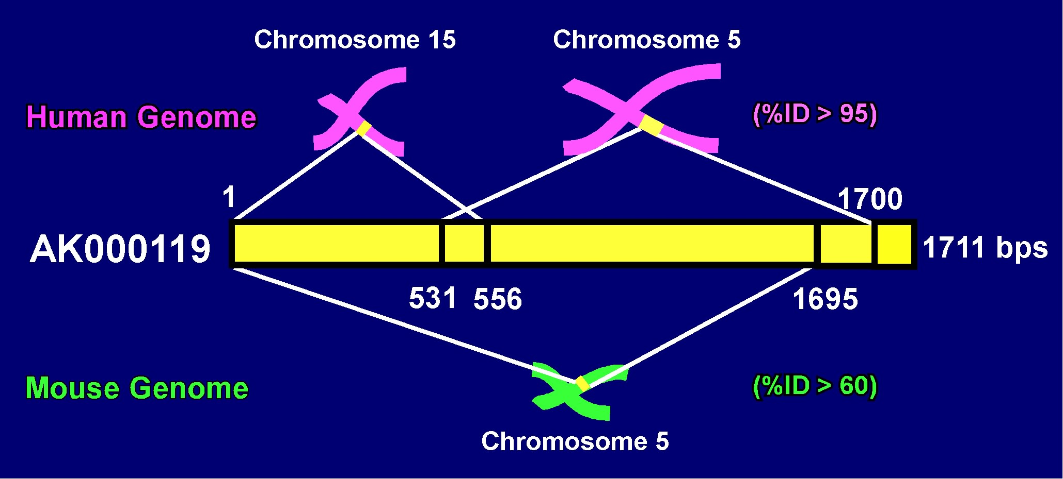
Most Interesting Findings in H-Invitational
(3) Existence of 847 cDNA clusters that could not be completely mapped to the human genome suggests that 4% of the current human genome sequences is incomplete, containing unsequenced regions and regions where sequence assembly is wrong.

Slide 15
Most Interesting Findings in H-Invitational
(4) Based on H-Inv cDNAs, we were able to define an experimentally validated alternative splicing (AS) dataset. The dataset was composed of 8,553 AS isoforms and encoded by 3,181 loci. 35% of AS isoforms contained AS exons that overlapped with ORFs. AS exons ware found to contain different functional domains in 55% of ORF containing AS isoforms.
Functional motif
Subcellular localization
Transmembrane domain
IN
23%
OUT
IN
55%
OUT
IN
49%
OUT
By using InterPro
By using PSORT2 and TargetP
By using TMHMM and SOSUI

Slide 16
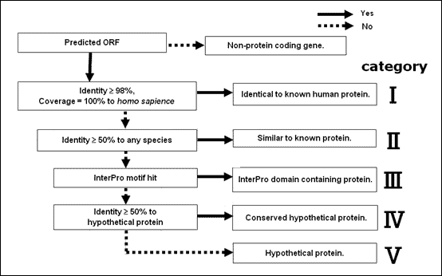
Most Interesting Findings in H-Invitational
(5) We established a standardized method of human curation for cDNAs, classifying 19,574 protein-coding cDNAs into 5 categories. The categories were based on sequence similarity and structural information. We assigned functional definitions to 9,139 proteins, and determined 2,503 domain-containing proteins and 7,800 hypothetical proteins.
Similarity category of H-Inv proteins | No. of cDNAs
I. Identical to known human protein | 5,074
II. Similar to known protein | 4,104
III. InterPro domain containing protein | 2,531
IV. Conserved hypothetical protein | 1,706
V. Hypothetical protein | 6,159
Total No. of H-Inv proteins | 19,574

Slide 17
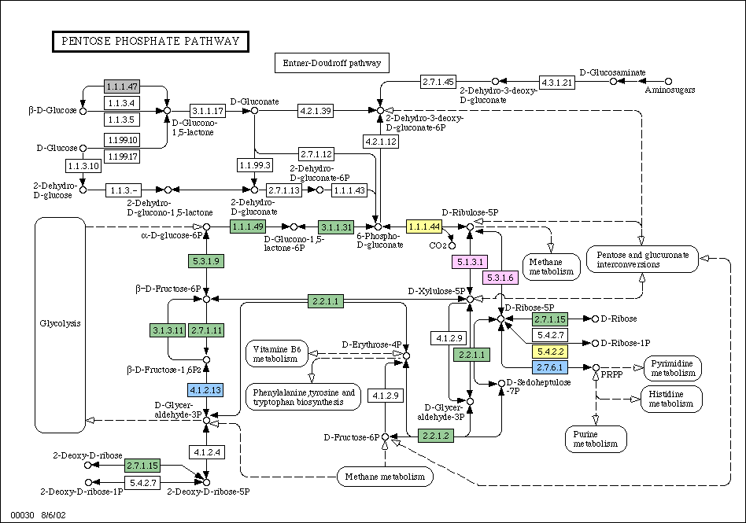
Most Interesting Findings in H-Invitational
(6) A total of 1,892 proteins were assigned to 656 different EC numbered enzymes. Currently this comprises the largest collection of functionally validated human enzymes. This enzyme library includes 32 newly identified human enzymes on known metabolic pathway maps.
mapped as KO genes | X
mapped by EC numbers | X
paralog (candidates) | X
novel (candidates) | X
KEGG only | X

Slide 18
Most Interesting Findings in H-Invitational
(7) Non-protein coding genes accounted for 6.5% (1,377 loci) of the H-Inv cDNAs. Of these 1,377 loci, 296 were classified as putative non-coding RNAs (ncRNAs) based on a variety of supporting evidence.
Grade C sequences
Category of grade C locus | Number of grade C loci
putative ncRNA | 296 (21.6%)
uncharacterized-EST | 675 (49.2%)
unclassifiable | 329 (24.0%)
hold | 77 (5.2%)
Total | 1,377 (100.0%)
1,377
Manual Annotation
296
Mapping onto
mouse genome
92
RNA structure test
47
Experimental evidence
28 selected ncRNAs were found expressed in up to eight human tissues

Slide 19
Most Interesting Findings in H-Invitational
(8) We identified 72,027 uniquely mapped SNPs and indels in 19,442 representative cDNAs. Of these, 13,573 SNPs and 452 indels were found in coding regions and may alter protein sequences, cause phenotypic effects or result in disease. We also identified 216 polymorphic microsatellite repeats in 213 genes.
Numbers of SNPs on representative cDNAs
Number
Synonymous
Non
synonymous
Termination
5’ UTR
10,715
[1/569bp]
Coding region
24,679
[1/833bp]
11,042
13,215
358
3’ UTR
31, 852
[1/536bp]

Slide 20
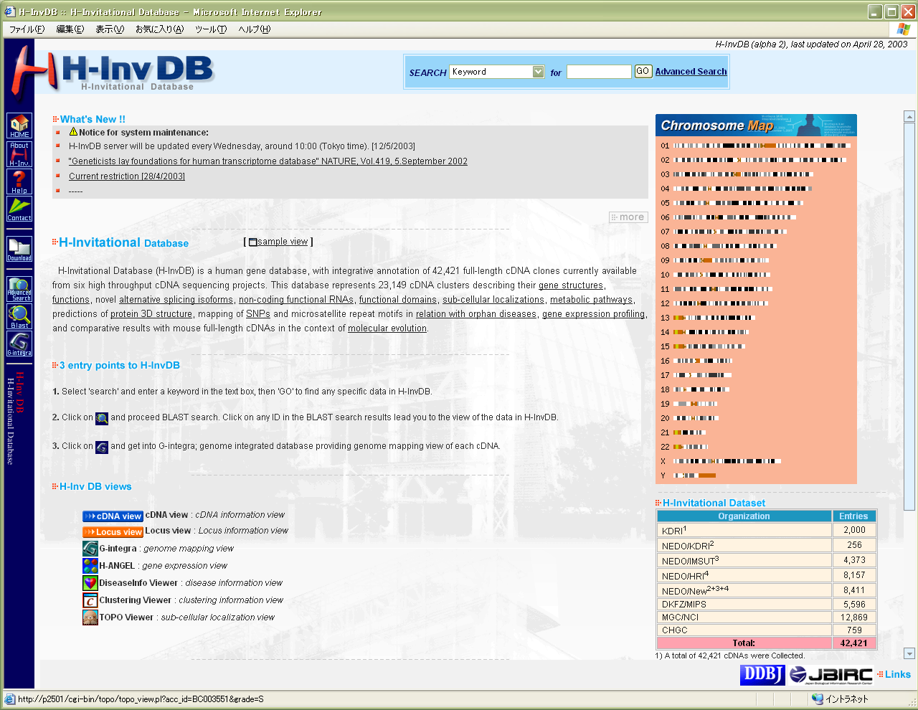
H-Invitational Database (H-InvDB)
Enter
keyword
eg.:
BC003551
News
Introduction
of H-InvDB
About
entry points
H-Inv
dataset
Viewers’
Icons
Released in April 2004 at http://www.h-invitational.jp/

Slide 21
Acknowledgement
The financial support was given from:
JBIC (Japan Biological Informatics Consortium, Japan)
METI (Ministry of Economy, Trade, and Industry, Japan)
MEXT (Ministry of Education, Science, Sports, and Culture, Japan)
NIH (National Institutes of Health, US)
DOE (Department of Energy, US)
CNRS (Centre National de la Recherche Scientifique, France)

