Slide 1

Python Sport Analytics
Spring 2025
A Comparison of the effects of Win Shares in he SEC and Big 12

Slide 2
Data used for this project - Big 12 and SEC - 2022-23 basketball season (last time Arkansas was good) - Conference game schedule data only (NOT non-conference) - data from basketball-reference.com
Python Sport analytics
Syracuse university
Spring 2025

Slide 3
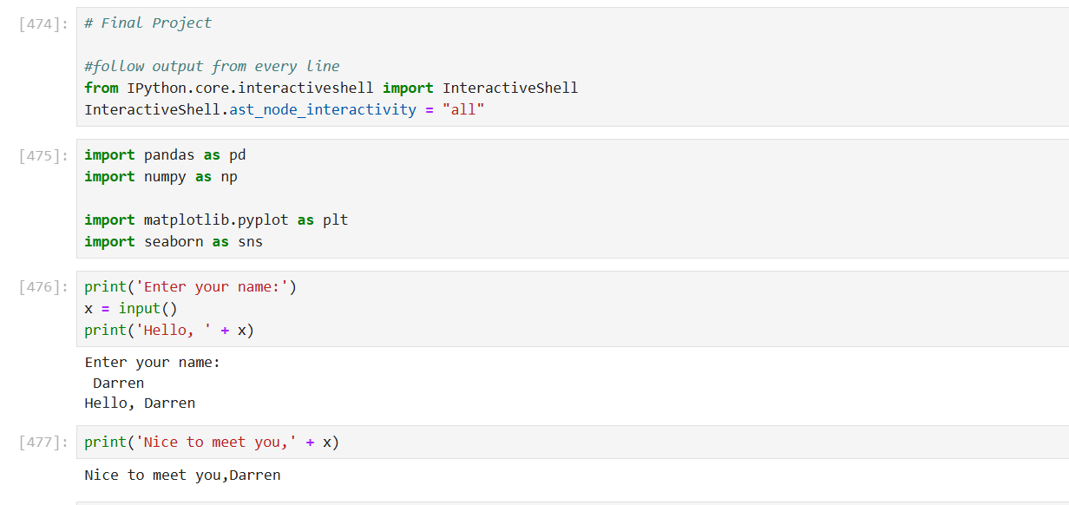
Input One of the requirements was to allow the user to provide input (I just included a basic “Hello World” type input for now…more to come later).

Slide 4
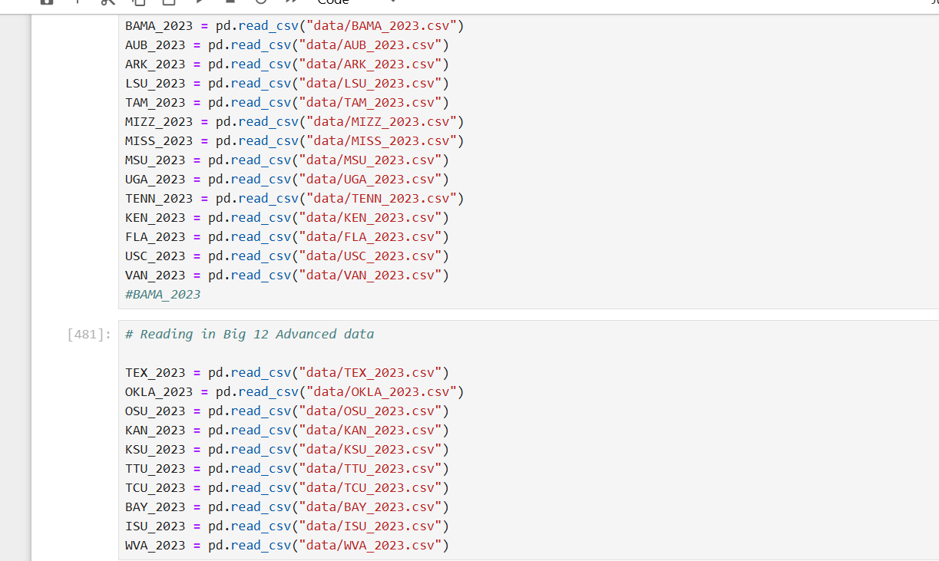
Read_csv
Secondly, I read in the data which I downloaded as csv files for all 24 teams from basketball-reference.com
Each file contained player data. I also read in team Won loss record data as well (used to calc win pct)

Slide 5
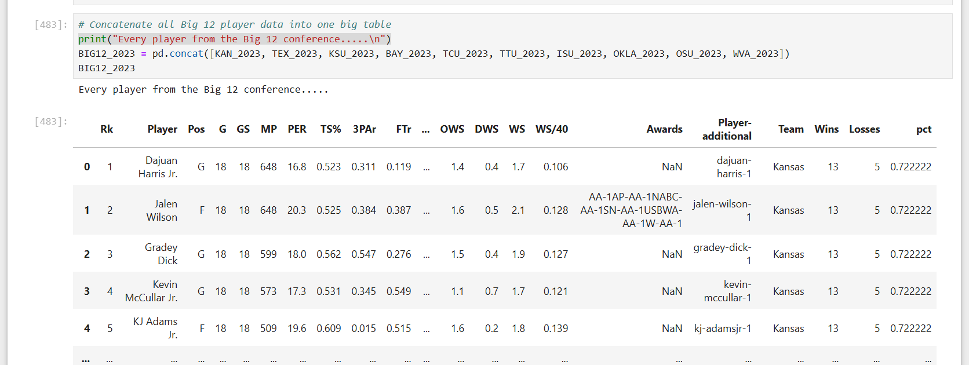
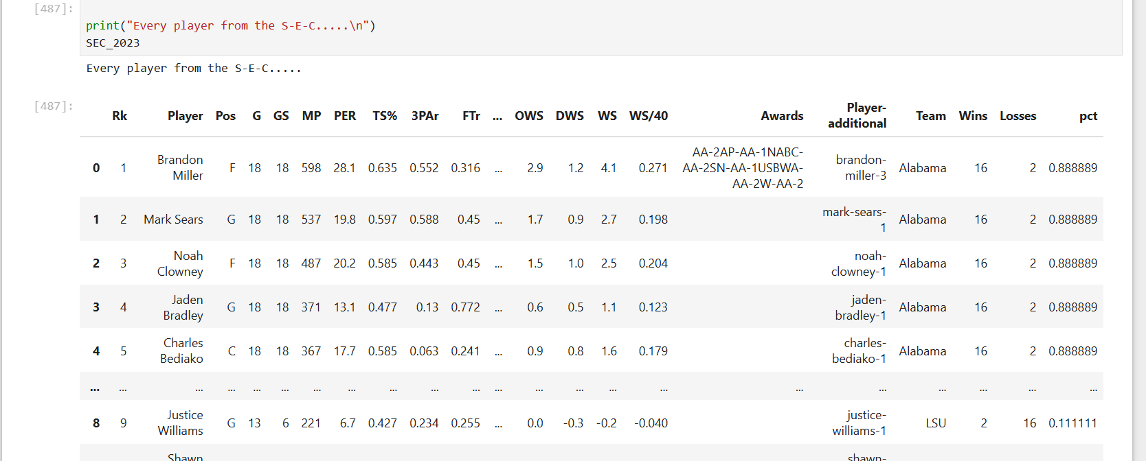
Combining data
To demonstrate the merging of data…
A) I combined each team’s individual cata using the concatenation of data frames into 2 large conference tables
B) Under the “Awards” section, there wasn’t an “NaN” award given in either conference, so we needed to get rid of the NaN (see bottom image)

Slide 6
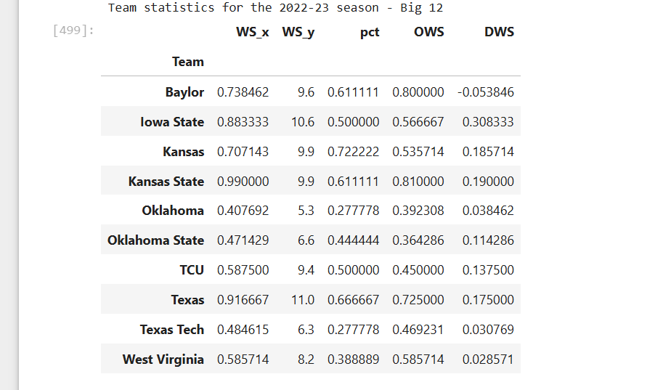
So about the WS data used…..
The WS_x category represents the average WS data for each team.
The WS_y data represents the overall SUM of the WS (Win Shares) for each team.

Slide 7
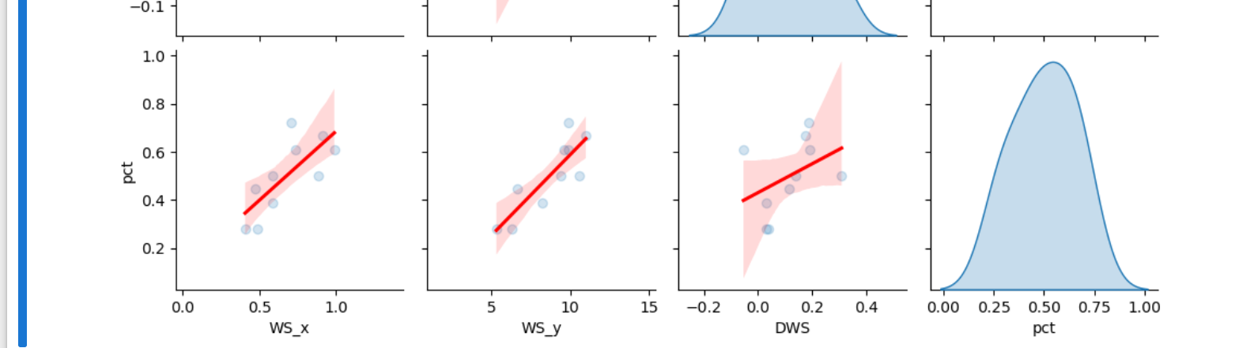
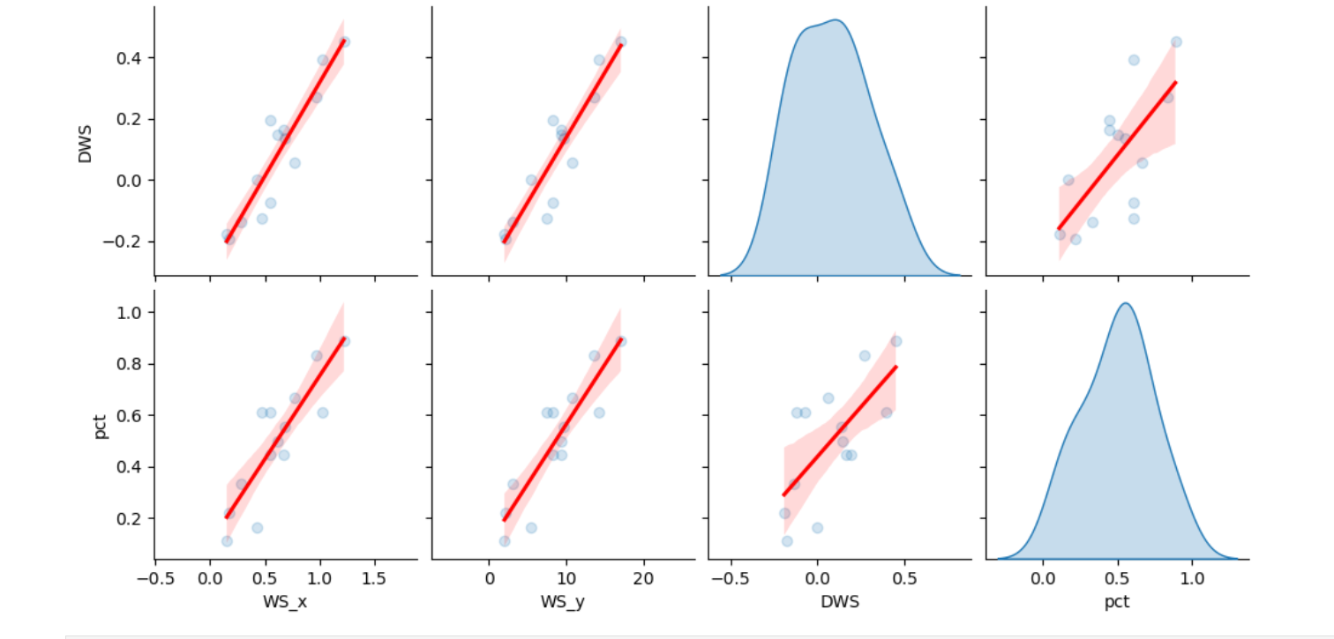
WS vs. Win %
Definitively speaking, there is a correlaton between Win shares and win pct. Looking at the graph, there is a more defined graph for the Overall SUM (WS_y) of win shares (slightly) than the avg.
Why is that? My theory: Most important factor is that this takes into consideration Games played, etc. so if a player has played 16 conference games, weight is heavier than a player that played in 8.

Slide 8
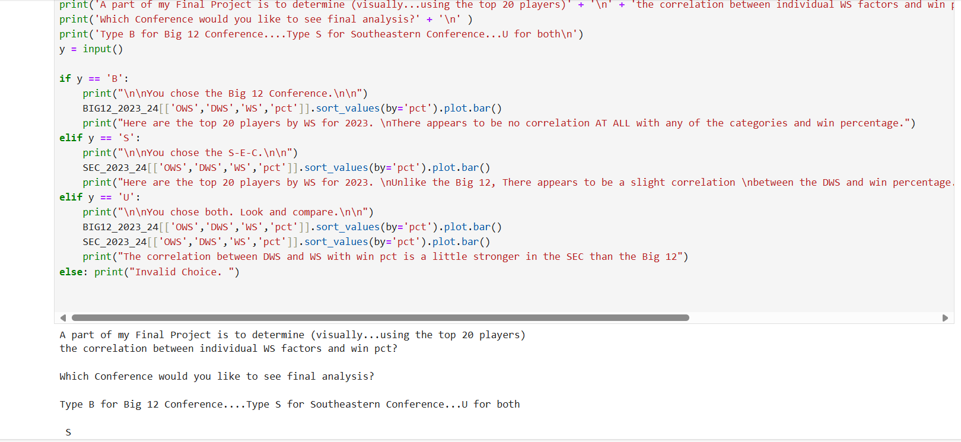
Interactive – Pt2 (Player data)
Here the user is prompted to input which conference (Big 12 or SEC) for the next portion of the project.
The idea is to determine of the minimum qualifiers (top 20 or 25 players by WS) do these players correlate to team success.

Slide 9
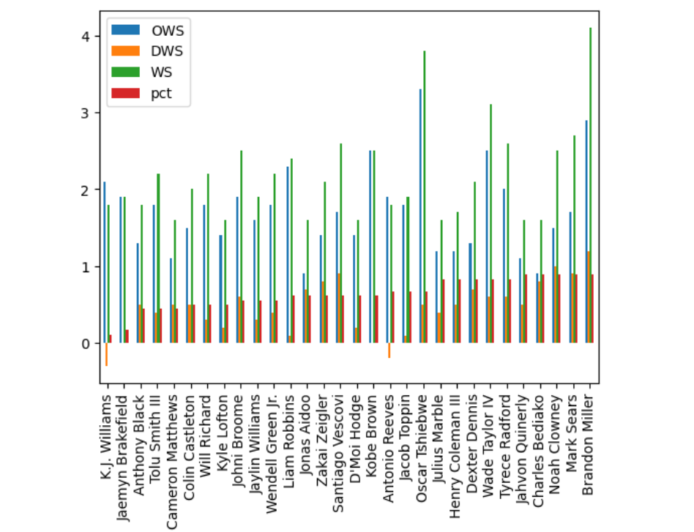
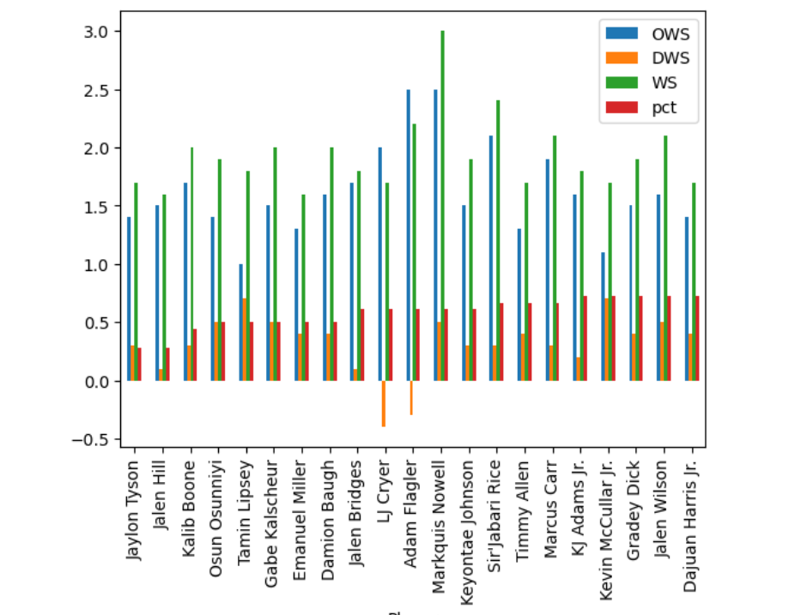
Individual players: Good players make up good teams….. …..most of the time(?)
In this study, It is important to note that only the 16-game conference schedule for each conference was used.
There was a minimum (1.5) WS used where 21 Big 12 and 25 SEC players qualified
There appears to be no connection AT ALL in the Big 12 between any of the Win share components used. (The data is sorted by win-pct – smallest to largest).
However, in the SEC, the DWS has a moderate correlation, and the WS appears to slightly coincide with the win percentage.

Slide 10
Thanks for viewing

