Slide 1
The SPH article in wikipedia
D. Duque, A. Colagrossi, and A. Souto-Iglesias

Slide 2
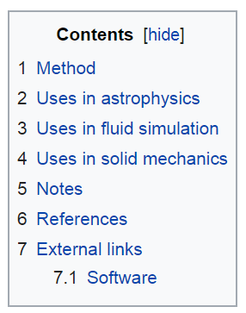
SPH
Google Scholar citation search:
(smooth OR smoothed) particle hydrodynamics ~ 220 000

Slide 3
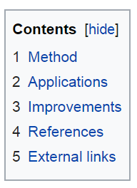
MPS
Google Scholar citations: ~ 17 000

Slide 4
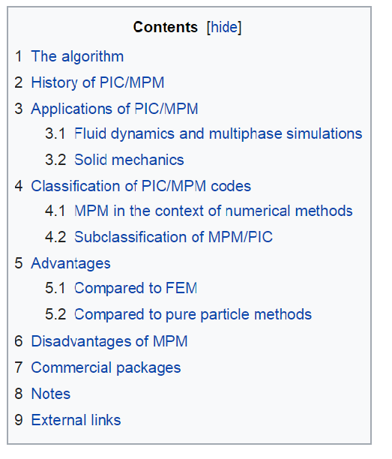
MPM
Google Scholar citations: ~ 5 470 000 !

Slide 5
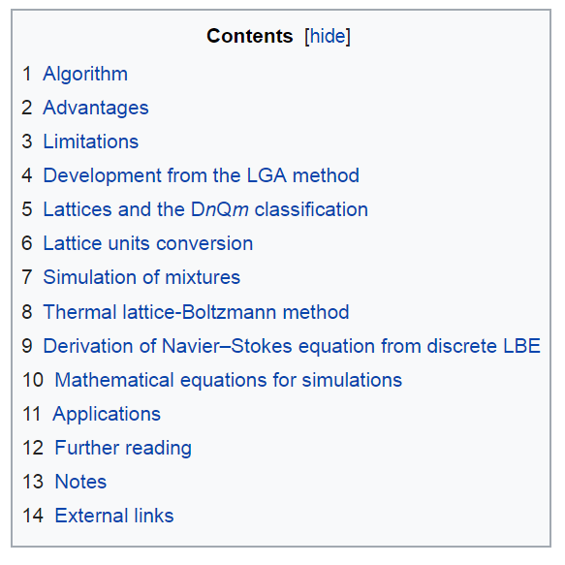
LBM
Google Scholar citations: ~ 400 000

Slide 6
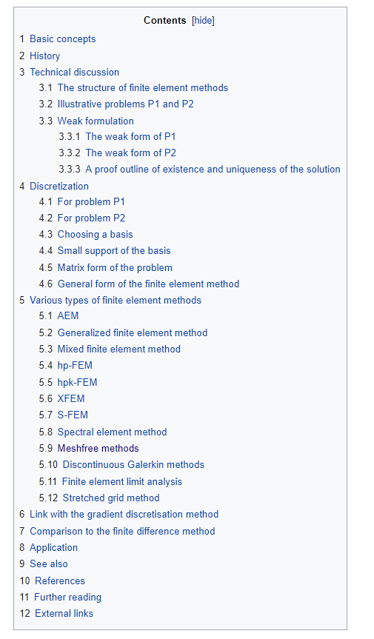
FEM
Google Scholar citations: ~ 3 350 000
pFEM: no wikipedia article !

Slide 7
Comparisons
SPH is comparable to LBM

Slide 8
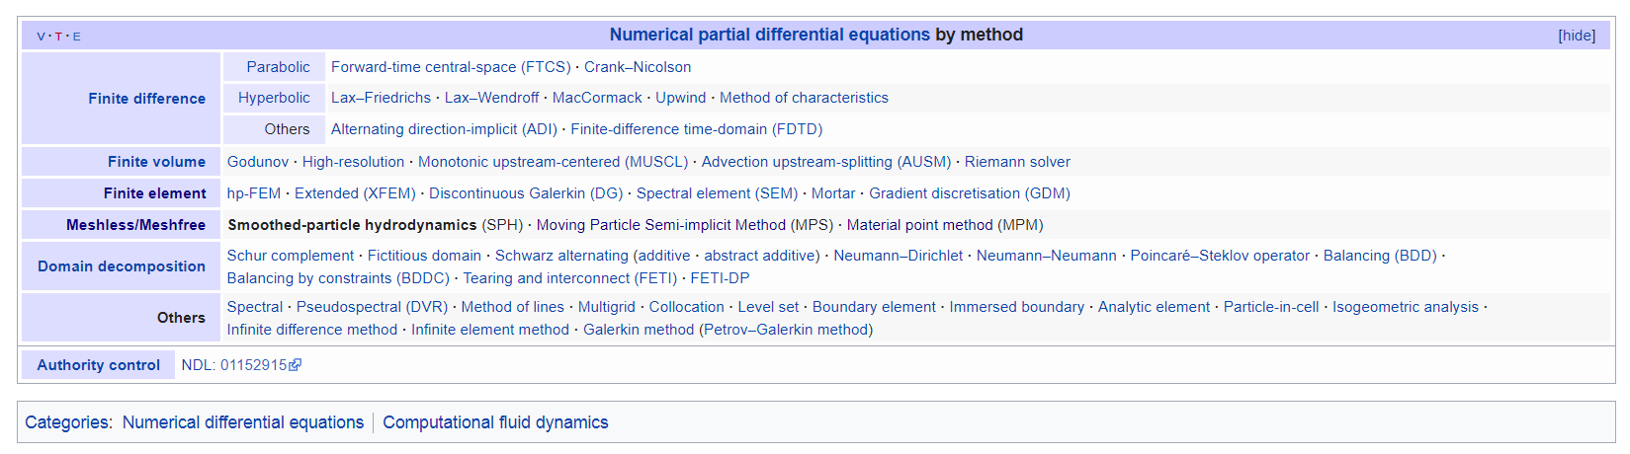
Connections: nav boxes
Navigation box, SPH✓:
LBM, for example, is very poorly connected !

Slide 9
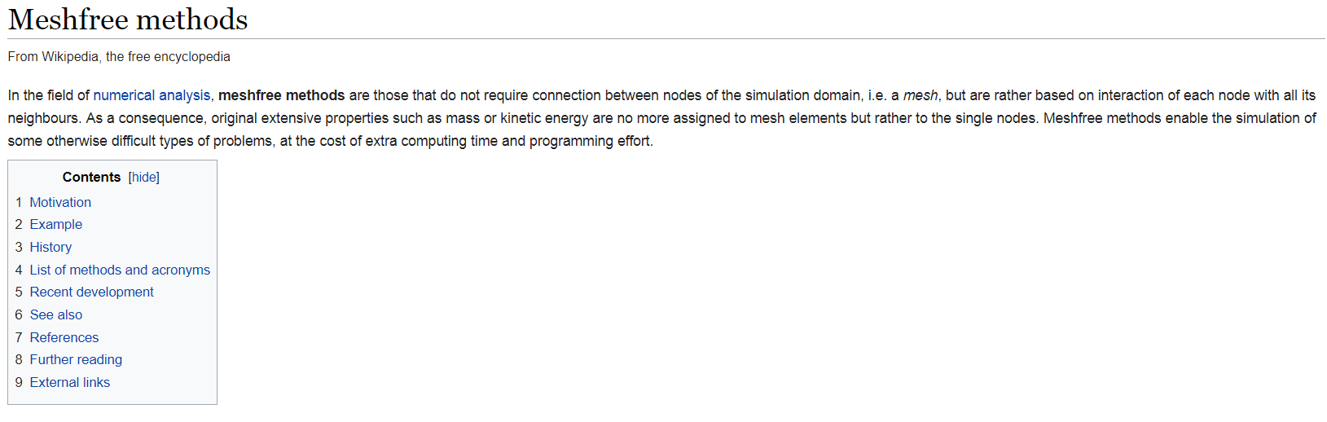
Connections: “review articles”
✓
(“MPFEM” is cited here, but the article does not exist yet, nor pFEM ...)

Slide 10
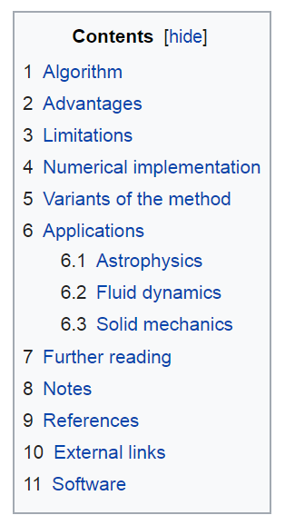
SPH, LBM-inspired TOC

Slide 11
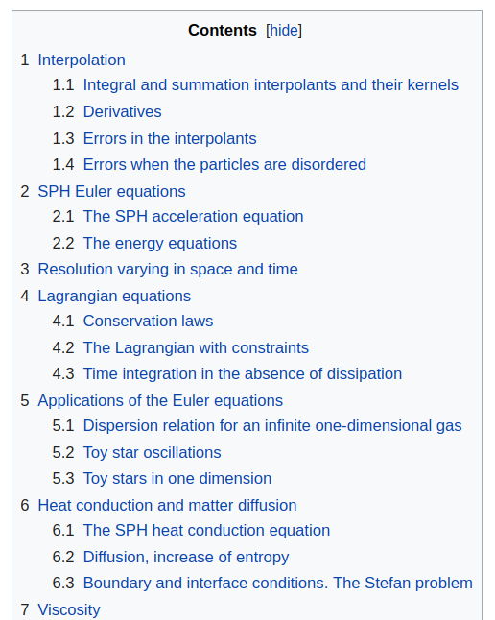
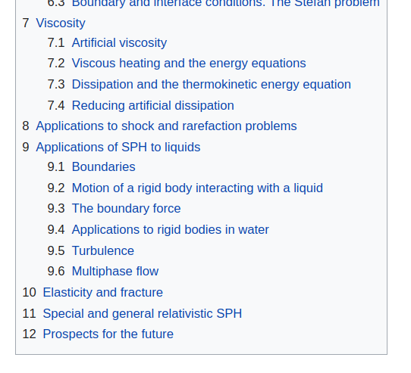
SPH, 2005 review TOC

Slide 12
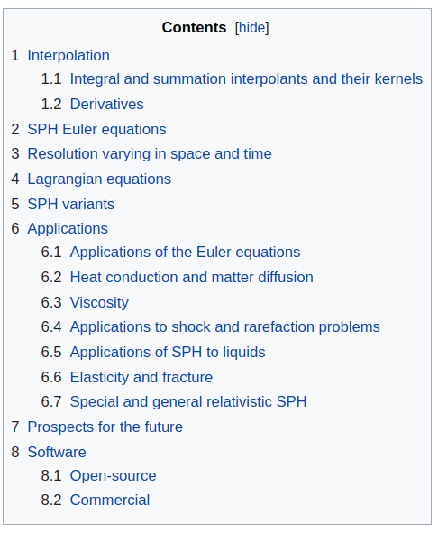
SPH, 2005++ review TOC

Slide 13
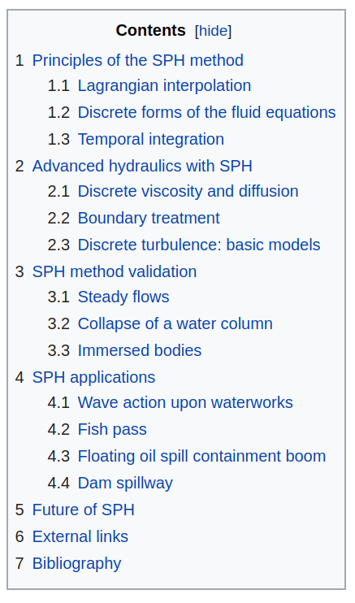
SPH, Violeau TOC

Slide 14
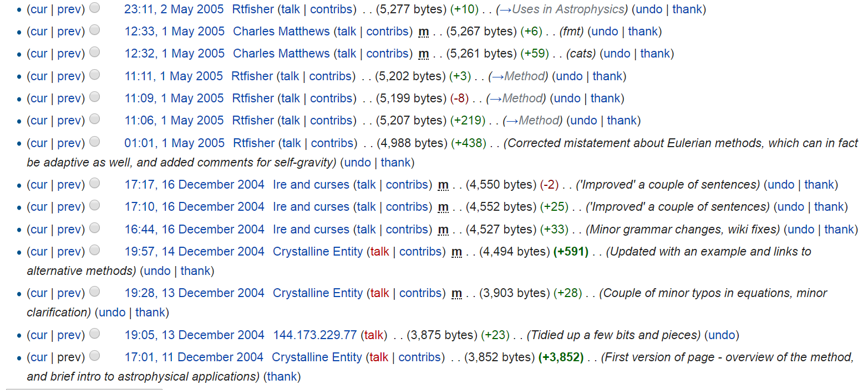
Wikipedia is open!
The inception of the SPH article
t

Slide 15
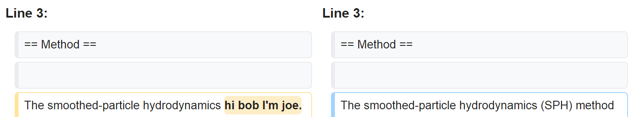
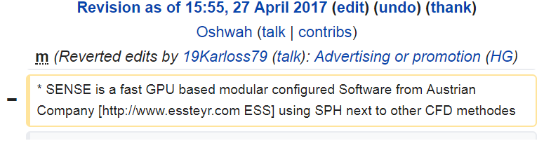
These things can happen
Vandalism
Advertising, shameless self-promotion
Rejection of “original research”
SPH article has not suffered (yet) from this, but
all claims that may be challenged must be supported by
reliable, published* sources
* somewhere else, may be online

Slide 16
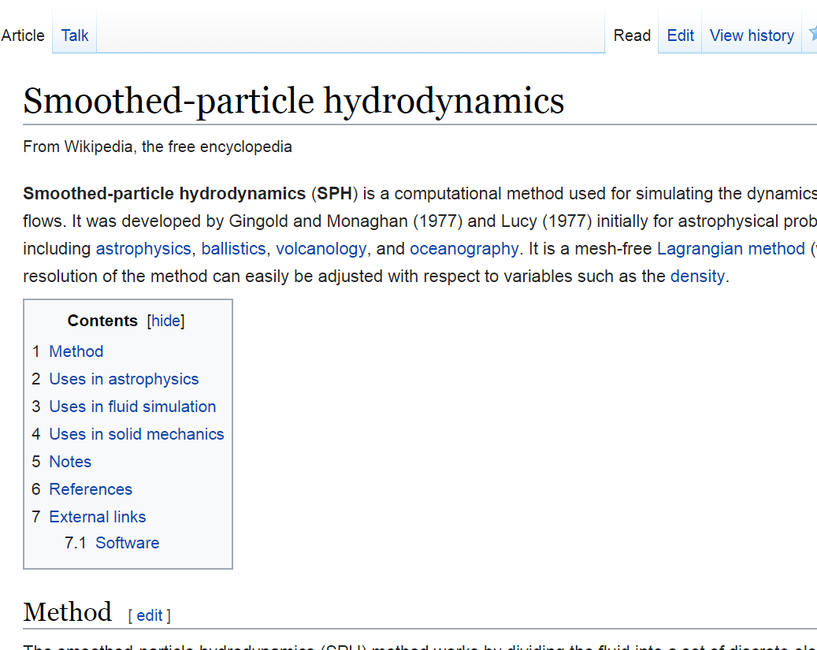
How to edit

Slide 17
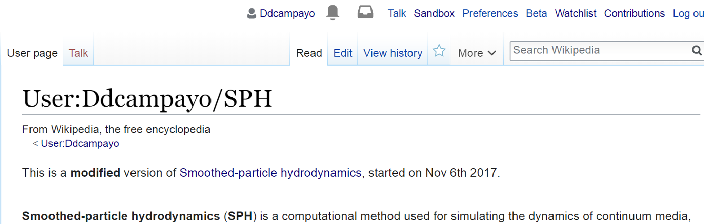
Suggested method!
First, create a personal version (sandbox concept), then modify public one

