Slide 1
DD-TEAM
Divya Nalam
Dilip Kola

Slide 2
About DD-Team
We are a team of 2 software professionals currently exploring the field of ML for different use cases. Dilip works for an IOT based start-up that helps commercial buildings optimize their energy usage. Divya works for an e-commerce company where she uses ML to enhance the catalog selection.
We are inspired about honing our skill set while working on problems that matter the most in today’s world. In India, some villages are having to relay only on Solar power for all their energy requirements due to lack of electricity supply from government. Knowing about this was sad and inspiring at the same time. This made us realize how impactful solar energy can be and we started exploring for opportunities to contribute towards this cause.
We believe that solving the issue of unpredictability associated with solar energy generation is one step towards enabling its widespread usage. Hence, we took this hackathon as an opportunity to achieve both our objectives.
Both of us have a strong software engineering background and experience in building scalable solutions. Hence, even as we innovate in solving the problem, we are able to constantly evaluate it from the point of view of making it scalable and production ready.
Notes:
Be holistic while answering the points highlighted in the slide. This slide does not hold any score weightage

Slide 3

PROOF OF METHODOLOGY
Evaluation Criteria 1

Slide 4
Proof of Methodology – Dataset
Dataset Sources
We have only used the time series and image data provided as a part of this hackathon.
We pulled in some data from the test scenarios into our training and validation sets.
Preprocessing – Weather data
We broke down 'Azimuth Angle [degrees]' into its cosine and sine components to capture the cyclic nature of angles in a continuous way.
We combined 'Peak Wind Speed @ 6ft [m/s]’ and 'Avg Wind Direction @ 6ft [deg from N]' to create a vector representation of wind-velocity. [This helps effective handling of some edge cases. For example, the wind direction is not meaningful when wind speed is near 0. This is better captured by a vector.]
Using the timestamp values, we created two sets of features to capture the relative time within a year and relative time within a day. Again to capture the cyclic nature of these two features, we broke down each of them into their cosine and sine components. (This added the following features – day_sin, day_cos, year_sin, year_cos ).
Preprocessing – Image data
We did a one-time preprocessing of all images to resize them to 40x40 pixels and saved them as a numpy array. To track the metadata associated with each image, we saved them as another numpy array in the same order as the images.
Notes:
Teams are recommended to be as much descriptive as possible and highlight the methodology clearly.
Teams are recommended to expand on this topic and use as many slides as you prefer.

Slide 5
Proof of Methodology – Dataset (contd.)
Missing Data Handling – Weather data
We identified outliers by fitting the individual features in a normal distributions and replacing all the values with absolute z-score > 3 (i.e., constituting less that 0.01% of the values) using fill forward technique.
From the training files, we removed the night time records by checking for first and last non-negative irradiance values in a day and retaining only those that come within this range - this mostly left us with data recorded between 7:30 AM to 4:30 PM each day.
For the three columns where negative values are invalid , i.e., Global Horizontal Irradiance, Cloud Coverage and Direct sNIP, we removed the negatives by fill forward technique within the records of each day.
Missing Data Handling – Image data
To reduce the impact of missing image data, we fill forward the image paths up to a maximum time range of 30 minutes. For cases where image data is missing, we look back for a maximum of 30 minutes in the past and use the latest available image. Otherwise, we consider it as a case of missing image.
We also tried to fill the missing images by looking back 2 hours but it performed poorly than using 30 minutes.
Notes:
Teams are recommended to be as much descriptive as possible and highlight the methodology clearly.
Teams are recommended to expand on this topic and use as many slides as you prefer.

Slide 6
Proof of Methodology – Dataset (contd.)
Dataset Size:
We resampled all the records at 10 minute intervals.
Total time steps of data obtained from all days in original training files = 28091
Total time steps of data obtained from all days in the original test files = 11269
Since the day-wise test data files sometimes had more than 2 hours of day, we kept aside the last 2 hours of data from each file for the final predictions and used the rest in our training and validation sets.
Total rows = 39360 (consisting of records from 366 days in training data + 300 scenario sets in test data).
Dataset Splits:
We used all the 366 days of data from the original training files as our training data and added to it the data from 40% of the scenarios sets in the original test files. The rest of scenario sets were split equally for validation and test sets.
Training records: 20198
Validation records: 1430
Test records: 1420
Existing / Pre-Existing Work
Reference for time series modelling and feature engineering on weather conditions: https://colab.research.google.com/github/tensorflow/docs/blob/master/site/en/tutorials/structured_data/time_series.ipynb#scrollTo=K9UVM5Sw9KQN
Notes:
Teams are recommended to be as much descriptive as possible and highlight the methodology clearly.
Teams are recommended to expand on this topic and use as many slides as you prefer.

Slide 7
Proof of Methodology – Model Details
Feature Set : Our feature set consists of three types of data
Time series of weather data: We use the weather data over the last 2 hours sampled at a rate of 10 minutes and aggregated using mean (12 time steps).
Image data: We use the latest available image (12th time step) in the duration of last 2 hours (after the preprocessing). If the image value is missing, we drop the entire record.
Aggregate features: We calculate the mean and standard deviation of the irradiance values over two time durations – (i) last 2 hours and (ii) from the start of the day to the current time.
Target : We use all the 12 irradiance values as the target variables.
Model - Architecture: We adopted a hierarchical architecture to accommodate the different modes of inputs.
In the first level, the time series weather data and image data are separately processed through LSTM and CNN layers respectively.
The outputs from the first level models are concatenated along with the aggregate features.
We treat the target outputs also as time series prediction. Hence, after concatenating all inputs, we use a RepeatVector layer to expand the input features for time series prediction.
At this point, we append the time information of the target time steps (in the form of day_sin, day_cos) to each of the repeated vectors.
We finally pass the above input through LSTM and Dense layers to predict the 12 output irradiance values.
Notes:
Teams are recommended to be as much descriptive as possible and highlight the methodology clearly.
Teams are recommended to expand on this topic and use as many slides as you prefer.

Slide 8
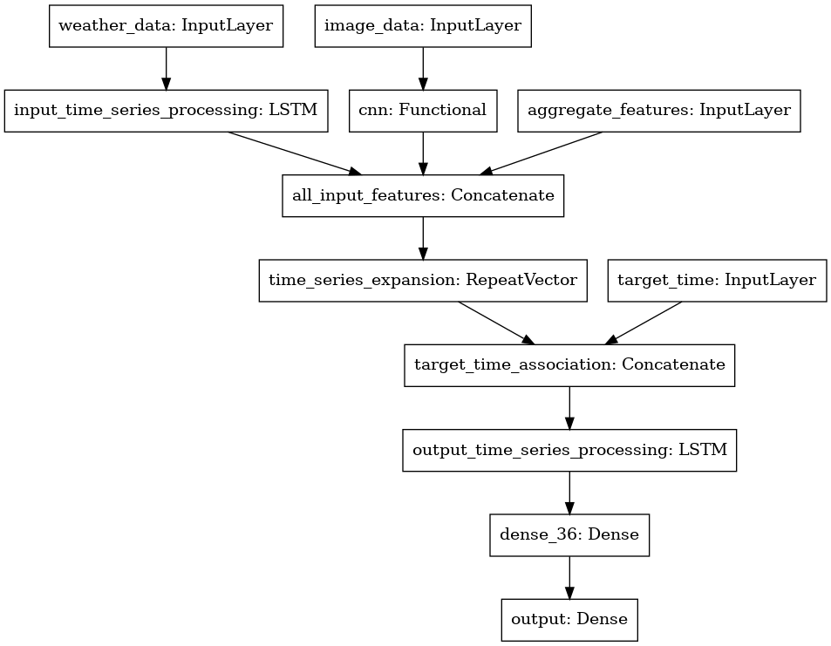
Proof of Methodology – Model Details (contd.)
Model Architecture Diagram

Slide 9
Proof of Methodology – Dataset (contd.)
Model - Training and Hyper Parameters Tuning
Data Boosting: We boosted the records where the standard deviation of the irradiance values in the 2 hour duration was high. To implement this, we applied softmax on the standard deviation values of irradiance and used it as the probability of boosting a record. We capped the boosting to 20% of the records.
probabilities = softmax(np.divide(target_std, np.max(target_std)))
boosted_indices = np.random.choice(total_records, total_records*0.2, p=probabilities)
Customized loss function: We used a weighted MAE where the weights increase exponentially over the time steps (assigning the highest weight to the last time step). To implement this we used a softwax over 12 values equally distributed in an interval of 0.0 - 0.5:
loss = loss * tf.nn.softmax(tf.linspace(0.0, 0.5, OUTPUT_STEPS))
We used ‘Adamax’ optimizer.
We configured the learning rate to reduce by a factor of 0.1 in plateau regions.
We configured early stopping with a patience of 3 time steps to stop iterating if the validation error does not decrease.
Results
Training MAE: 84.25
Validation MAE: 88.95
Held-out Testset MAE: 98.09
Prediction MAE: 89.6
Notes:
Teams are recommended to be as much descriptive as possible and highlight the methodology clearly.
Teams are recommended to expand on this topic and use as many slides as you prefer.

Slide 10
DEPLOYMENT & SCALABILITY
Evaluation Criteria 2

Slide 11
Deployment and Scalability Criteria
What computational infrastructure do you need to deploy your solution?
Our model can be deployed using any computation infrastructure similar to that provided in the hackathon. Our prediction time comes to 1.81 ms per prediction in a CPU instance and 1.25 ms per prediction in a GPU instance.
Robustness to missing data:
We have used fill-forward techniques to handle missing data.
The only scenario in which our model’s prediction fails would be if we do not find any image in the last 30 minutes. Our baseline model which works only on weather data can be used as a fallback model in such cases.
Tools/Libraries used for implementation:
Tensorflow
Scikit-learn
Notes:
Teams are recommended to be as much descriptive as possible.
Teams are recommended to expand on this topic and use as many slides as you prefer.

Slide 12
Deployment and Scalability Criteria
What steps need to be done differently to develop and deploy your solution for,
a different geographic location – Since our feature generation logic and architecture does not make any assumptions about the location, the same approach may be used to train models with location specific data.
a set of neighboring geographic locations (multiple image and weather data streams):
The simplest way of deploying models for neighboring geographic locations would be to train separate models for each pair of image and weather data streams.
However, availability of data from multiple geographically close locations will also provide an opportunity to impute missing values of one location using averages of values from immediate neighbors. To use this functionality, the preprocessing step needs to change.
Multiple streams will also give us an opportunity to train meta models that can be fine-tuned to newer locations with very small amount of training data.
What will be your IP strategy to make the product commercial?
We are considering making our code open-source on github.
Notes:
Teams are recommended to be as much descriptive as possible.
Teams are recommended to expand on this topic and use as many slides as you prefer.

Slide 13
INNOVATION
Evaluation Criteria 3

Slide 14
Innovation
Use of domain knowledge - Clustering based on seasons/climatic conditions
Upon analyzing the mean error values from our baseline model in different months, we noticed that the errors were high during the months of April to June when the irradiation values also seem to be high.
We attributed this to the possibility that these are summer months when the model finds it difficult to learn the patterns.
This led us to experiment with an approach wherein we cluster the days in the training set based on a few features like year_sin, year_cos and irradiance and build separate models for each cluster.
The challenge with this approach was that some of the clusters could be too small to perform robust training. To overcome this, we built a base model using all the training data and used the weights learnt here as the starting point for building the cluster-wise models (fine tuning).
However, we later discarded this approach as its performance was poorer than that of our proposed model.
Model related innovation
Data set boosting : This step was taken to specifically tackle the “hard to learn” patterns. We used the intuition that, even for humans, it is difficult to predict the weather on those days when the conditions change drastically over the day. Hence, we used the standard deviation of the target-value (irradiance) as a metric to decide on boosting records in the training set.
Notes:
Teams are recommended to be as much descriptive as possible and highlight the technical innovations clearly.
Teams are recommended to expand on this topic and use as many slides as you prefer.

Slide 15
Innovation (contd.)
Model related innovation
Custom Loss Function: On analyzing the error values over the 12 time steps in the target, we noticed that the error is higher for values in later time steps. This is also in-tune with usual human behavior that predictions become less accurate as we try to guess for periods much later in the future. To handle this, we used a custom loss function that penalizes the later time steps more than the earlier ones.
The overall weather conditions of a day generally help in making predictions for particular time of the day. However, adding the entire day’s weather data (upto to the current time) as separate time steps could end up confusing the model. Hence, we included day-wise aggregated features in the feature set. This helped in providing valuable input to the model without making it overfit.
The time of the day has a very high correlation with the irradiance values. Since we know the exact time of the day for which we want the predictions, we provide it as an explicit input at the time of processing output time series.
Notes:
Teams are recommended to be as much descriptive as possible and highlight the technical innovations clearly.
Teams are recommended to expand on this topic and use as many slides as you prefer.

Slide 16
Innovation (contd.)
Performance related innovation
Preprocessing image and storing them as numpy arrays brought down training time per iteration by ~100x (from ~60 minutes to ~20 seconds)
This optimization helped us to quickly experiment with multiple complex architectures and compare them.
Use of tensorflow datasets to customize generation of time series features
We had experimented with different types of time series features by varying sampling rates, strides, etc.
In this process, we discovered that creating these features as static data frames consumes more memory, contains a lot of repetitive data and was also requiring us to make multiple tweaks for each experiment.
We changed our implementation to keep just one dataframe for all weather data for the different time periods. We then created an index dataframe that contains metadata like starting time step, input steps, etc. that are processed by tensorflow datasets to create time series features per batch of execution.
This helped in reducing the memory overhead and simplified our implementation of variable length time series features sets and cluster-wise model training.
Notes:
Teams are recommended to be as much descriptive as possible and highlight the technical innovations clearly.
Teams are recommended to expand on this topic and use as many slides as you prefer.

Slide 17
APPENDIX

Slide 18
Other Architectures Experimented
We had experimented with the following different feature sets. As per the feature sets chosen, we changed the model architectures for time series, image processing and regression tasks.
Baseline Model - Only Weather data time series and aggregate features
Time series Weather data + Last Image
Variable Length Time series on Weather data
In this model, instead of using only the last 2 hours of data for each prediction, we used all the data available in that day till the current time step.
Separate Cluster Training
This model was explained in a previous slide. Here, we cluster the records based on some input features and try to train separate models for each cluster.
Proposed approach - Time Series weather, Last Image and Aggregate Features
Our proposed method out performed the methods 1, 2 and 3 significantly. The method 4 performed comparable to the proposed approach but was not better than it.
Notes:
Teams are recommended to be as much descriptive as possible and highlight the technical innovations clearly.
Teams are recommended to expand on this topic and use as many slides as you prefer.

Slide 19
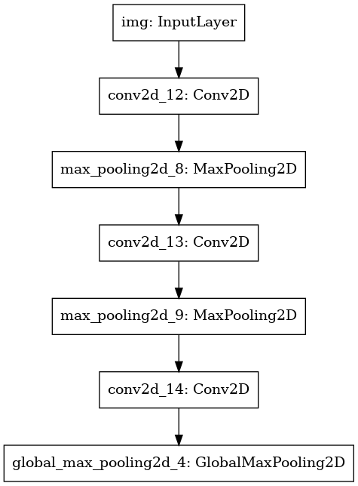
CNN Model Architecture For Image Processing
Notes:
Teams are recommended to be as much descriptive as possible and highlight the technical innovations clearly.
Teams are recommended to expand on this topic and use as many slides as you prefer.

