Slide 1
Iris Detection and Segmentation
Dat Chu, Michael Fang, Paul Hernandez Herrera, Homa Niktab, Danil Safin

Slide 2
Problem Statement
To detect and segment an iris under single pose, single lighting condition as close to real-time as possible. The video can be of different subjects, different gazes and perhaps with different backgrounds.

Slide 3
Approaches
We will use two different approaches to this problem then provide a comparison between them.
Feature-based approach
Topographic approach

Slide 4
The Feature-based Approach
Detect eye location
Segment eye using skin tone
Segment iris with histogram-based method and Hough Transform (of edge images)

Slide 5
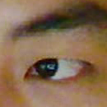
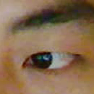
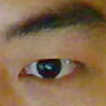






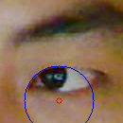
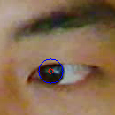
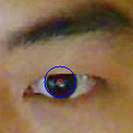
Preliminary Results (Feature-based)
Eye detection using Viola-Jones method (part of OpenCV)
Gaussian filter to remove spurious edges
Canny Edge Detection of eye region to remove most edge except those of eye-lids and iris
Hough Transform

Slide 6
Next Steps (Feature-based)
Skin-tone segmentation prior to edge detection and Hough transform using Otsu thresholding.
Stabilize Hough transform results by incorporating temporal information (e.g. Kalman filter)
Expand iris detection method to account for iris shape deformation at different gaze angles.

Slide 7
The Topographic Approach
Smooth the image using Gaussian filter
Consider the image as a 3D surface (gray intensity at (x,y) location as z)
At each (x,y) consider a squared neighborhood and fit a set of Chebyshev polynomials to retrieve the continuous function, from which the Hessian matrix can be obtained
Apply Eigenvalue decomposition and obtain the Eigenvalues, which are used to provide a terrain type for (x,y)
List all "pit" locations as eye candidates
For each pair of candidates, generate a rectangular patch around each candidate and use the terrain type labels as feature vector for SVM classification with Bhattacharyya kernel
Based on the initial detection, search for the eye location in the subsequent frames using Mutual Information

Slide 8
Advantages
No face tracker required
Detection and tracking on the topographic manifold – easier PDF estimation and faster MI calculation (12 types of topographic features vs. 256 gray levels)
Optimal match can almost always be found in “pit” pixels – more constrained search

Slide 9
Expected Results (Topographic)
<<<TBA>>>

