Slide 1
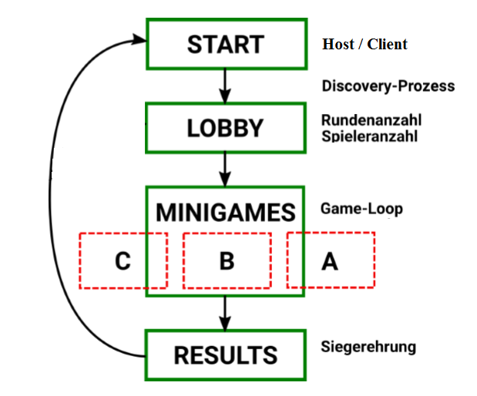
Double Up – Multiplayer Game App

