Slide 1
OpenGL shading Language (GLSL)

Slide 2
Shader
A shader is a set of software instructions, which is used to program the graphics processing unit (GPU) programmable rendering pipeline.

Slide 3
Original Rendering Pipeline

Slide 4
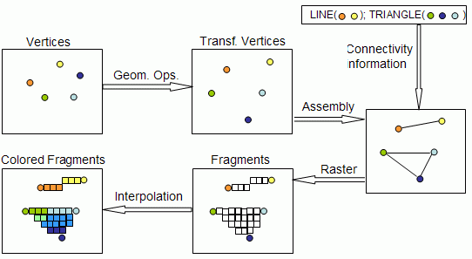
Original Rendering Pipeline

Slide 5
Vertex Shader
Vertex transformation
Normal transformation & normalization
Per-vertex lighting
Texture coordinate generation & transformation

Slide 6
Fragment (pixel) Shader
Operations on interpolated values
Texture access
Texture application
Fog
Color sum

Slide 7
Shading languages
OpenGL Shading Language (GLSL)
DirectX’s High Level Shading Language (HLSL)
Developed by Microsoft for DirectX 9.0
Use Direct3D as API
NVIDIA’s Cg (C for graphics)
ATI’s RenderMonkey

Slide 8
Comparison with GPGPU
GPGPU (General-Purpose computation on GPU)
Use GPU as massively data-parallel processor for general tasks
Not designed for shading
NVIDIA’s CUDA
Only for NVIDIA’s graphics cards
OpenCL
Across heterogeneous platforms

Slide 9
Introduction of GLSL
Data Type
Vertex Shader
Fragment Shader

Slide 10
GLSL Language Definition
Data Type Description
int Integer
float Floating-point
bool Boolean (true or false).
vec2 Vector with two floats.
vec3 Vector with three floats.
vec4 Vector with four floats.
mat2 2x2 floating-point matrix.
mat3 3x3 floating-point matrix.
mat4 4x4 floating-point matrix.

Slide 11
Vector
Vector is like a class
You can use following to access
.r .g .b .a
.x .y .z .w
.s .t .p .q
Example:
vec4 color;
color.rgb = vec3(1.0 , 1.0 , 0.0 ); color.a = 0.5
or color = vec4(1.0 , 1.0 , 0.0 , 0.5);
or color.xy = vec2(1.0 , 1.0); color.zw =vec2(0.0 , 0.5);

Slide 12
Addition data type : Texture
Sampler
sampler{1,2,3}D
sampler{1,2}DShadow
samplerCube
sampler{1,2,3}D
Texture unit to access the content of texture (texel).
sampler*DShadow
The depth texture for shadow map.
samplerCube
The cube map.

Slide 13
Addition data type
struct, array
Similar to C.
No union, enum, class

Slide 14
Qualifiers
Used to management the input and output of shaders.
attribute
Communicate frequently changing variables from the application to a vertex shader.
uniform
Communicate infrequently changing variables from the application to any shader.
varying
Communicate interpolated variables from a vertex shader to a fragment shader

Slide 15
Qualifiers
attribute
OpenGL Application
uniform
Vertex Shader
varying
Fragment Shader

Slide 16
Vertex Shader

Slide 17
Fragment Shader

Slide 18
Important !!
Vertex shader executes once per-vertex, fragment (pixel) shader executes once per-pixel
When computing lighting, all the vectors (vertex position, normal, eye, lights…etc) should be in the same coordinates system

Slide 19
Vertex Shader Code Example
varying vec3 normal, lightDir;
void main(void)
{
vec4 vertexPos = gl_ModelViewMatrix * gl_Vertex;
normal = normalize(gl_NormalMatrix * gl_Normal);
lightDir = vec3(gl_LightSource[0].position.xyz - vertexPos);
gl_Position = ftransform();
}

Slide 20
Fragment Shader Code Example
varying vec3 normal, lightDir;
void main(void)
{
vec3 N = normalize(normal);
vec3 L = normalize(lightDir);
vec4 cr = gl_FrontMaterial.diffuse;
vec4 cl = gl_LightSource[0].diffuse;
gl_FragColor = cr * cl * max(0.0, dot(N, L));
}

Slide 21
Use GLSL in OpenGL
GLEW: The OpenGL Extension Wrangler Library
http://glew.sourceforge.net/
glew.h / glew.lib
Check OpenGL 2.0 support with glewinfo.exe

Slide 22
How to Use Shader
Create shader objects
Load Source
Shader
Object
Shader Code
compiler
Attach
Shader
Program
Link and use it!
Create a program object
Application

Slide 23
How to Use Shader
Step 1 : Create shader objects
GLuint glCreateShader(GLenum shaderType);
shaderType
GL_VERTEX_SHADER
GL_FRAGMENT_SHADER
Step 2 : Load source code
void glShaderSource ( GLuint shader,
GLsizei count,
const GLchar** string, const GLint * length );
To load the source code of a shader from the array of strings.

Slide 24
How to Use Shader
Step 3 : Compile the source code
void glCompileShader(GLuint shader);
The status of the compilation can be queried by functions glGetShaderiv and glGetShaderInfoLog
Step 4 : Create program object
GLuint glCreateProgram(void);
Step 5 : Attach shader objects
void glAttachShader( GLuint program, GLuint shader);
Vertex shaders and fragment shaders can be attached with the same program object.
Notes:
glGetShaderiv — return a parameter from a shader object
glGetShaderInfoLog — Returns the information log for a shader object

Slide 25
How to Use Shader
Step 6 : Link the program object
void glLinkProgram(GLuint program);
The status of the compilation can be queried by functions glGetProgramiv and glGetProgramInfoLog
Step 7 : Use the program
void glUseProgram(GLuint program);
Tells OpenGL to use the program to replace the fixed-function pipeline.
Notes:
glGetShaderiv — return a parameter from a shader object
glGetShaderInfoLog — Returns the information log for a shader object

Slide 26
Vertex Shader Code Example
varying vec3 normal, lightDir;
void main(void)
{
vec4 vertexPos = gl_ModelViewMatrix * gl_Vertex;
normal = normalize(gl_NormalMatrix * gl_Normal);
lightDir = vec3(gl_LightSource[0].position.xyz - vertexPos);
gl_Position = ftransform();
}

Slide 27
Fragment Shader Code Example
varying vec3 normal, lightDir;
void main(void)
{
vec3 N = normalize(normal);
vec3 L = normalize(lightDir);
vec4 cr = gl_FrontMaterial.diffuse;
vec4 cl = gl_LightSource[0].diffuse;
gl_FragColor = cr * cl * max(0.0, dot(N, L));
}

Slide 28
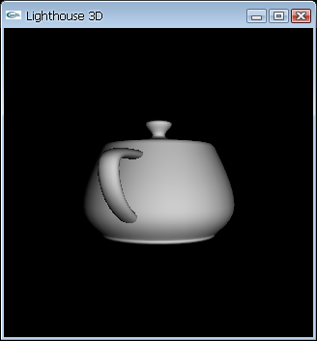
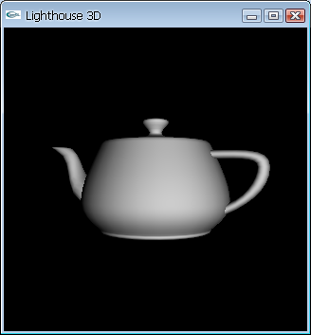
Demo

Slide 29
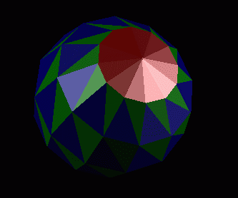
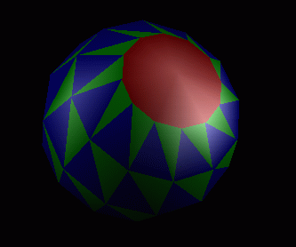
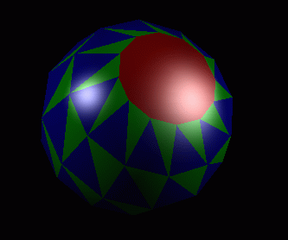
Homework #2

Slide 30
Development in R204
All computers in R204 support OpenGL and GLSL
Both the built-in and independent graphics cards
To avoid access administrators’ authority
You can put all the library and dll files you need under the same directory with the executable file.

Slide 31
Notes for skeleton code
Sometimes, visual studio may fail during the compile due to
wglGetProcAddress is used to achieve the address of openGL extension function, ex functions in glew
These addresses are declared in a header file called wingdi.h
You can comment these codes since they are unnecessary in the late system
typedef bool (*PFNWGLSWAPINTERVALFARPROC)(int);
PFNWGLSWAPINTERVALFARPROC wglSwapIntervalEXT = 0;
wglSwapIntervalEXT = (PFNWGLSWAPINTERVALFARPROC)wglGetProcAddress("wglSwapIntervalEXT");
wglSwapIntervalEXT(1);

Slide 32
Notes for skeleton code
testS.uniformLoc[0]=glGetUniformLocation(testS.prog,"lightPos[0]");
testS.uniformLoc[1]=glGetUniformLocation(testS.prog,"lightPos[1]");
testS.uniformLoc[2]=glGetUniformLocation(testS.prog,"lightPos[2]");
testS.uniformLoc[3]=glGetUniformLocation(testS.prog,"lightPos[3]");
float mat[16];
glGetFloatv(GL_MODELVIEW_MATRIX,mat);
for(int i=0;i<4;i++)
{
float lpos[4]={0};
for(int j=0;j<3;j++)
lpos[j]=lights[i].pos[0]*mat[0+j]+lights[i].pos[1]*mat[4+j]+lights[i].pos[2]*mat[8+j]+lights[i].pos[3]*mat[12+j];
glUniform4fv(testS.uniformLoc[i],4,lpos);
}

Slide 33
Notes for skeleton code
glGetUniformLocation(testS.prog,"lightPos[1]")
Get the address of "lightPos[1]“ from testS.prog
testS.prog: shader testS’s program
glUniform4fv(testS.uniformLoc[i],4,lpos)
Assign parameters from hw2.cpp to shader
Original Purpose of the partial incomplete code
Manually implement for gl_LightSource
Obtain the light position form the camera viewpoint

Slide 34
Notes for skeleton code
About the shader, the sample program has
Built the link between shader and openGL in Shader class
Created a shader object testS
Used testS to load vertex shader and fragment shader
Then, you need to
Call OpenGL functions to fulfill Flat shading and Gauraud shading
Write only one shader for Phong shading (currentShader = 3)

Slide 35
Notes for skeleton code
About lighting
The sample program has set only one light for example
You need to add 2 more lights, and place all 3 lights according to the requirements.
How to add a light?
Add a new light in hw2.cpp, and set its condition
Transfer it to the shader by gl_LightSource
(see Vertex Shader Code Example in p.26)
In the shader, sum all the lighting effect together to form the final color
About the program architecture
You can whether keep it or change it.

