Slide 1


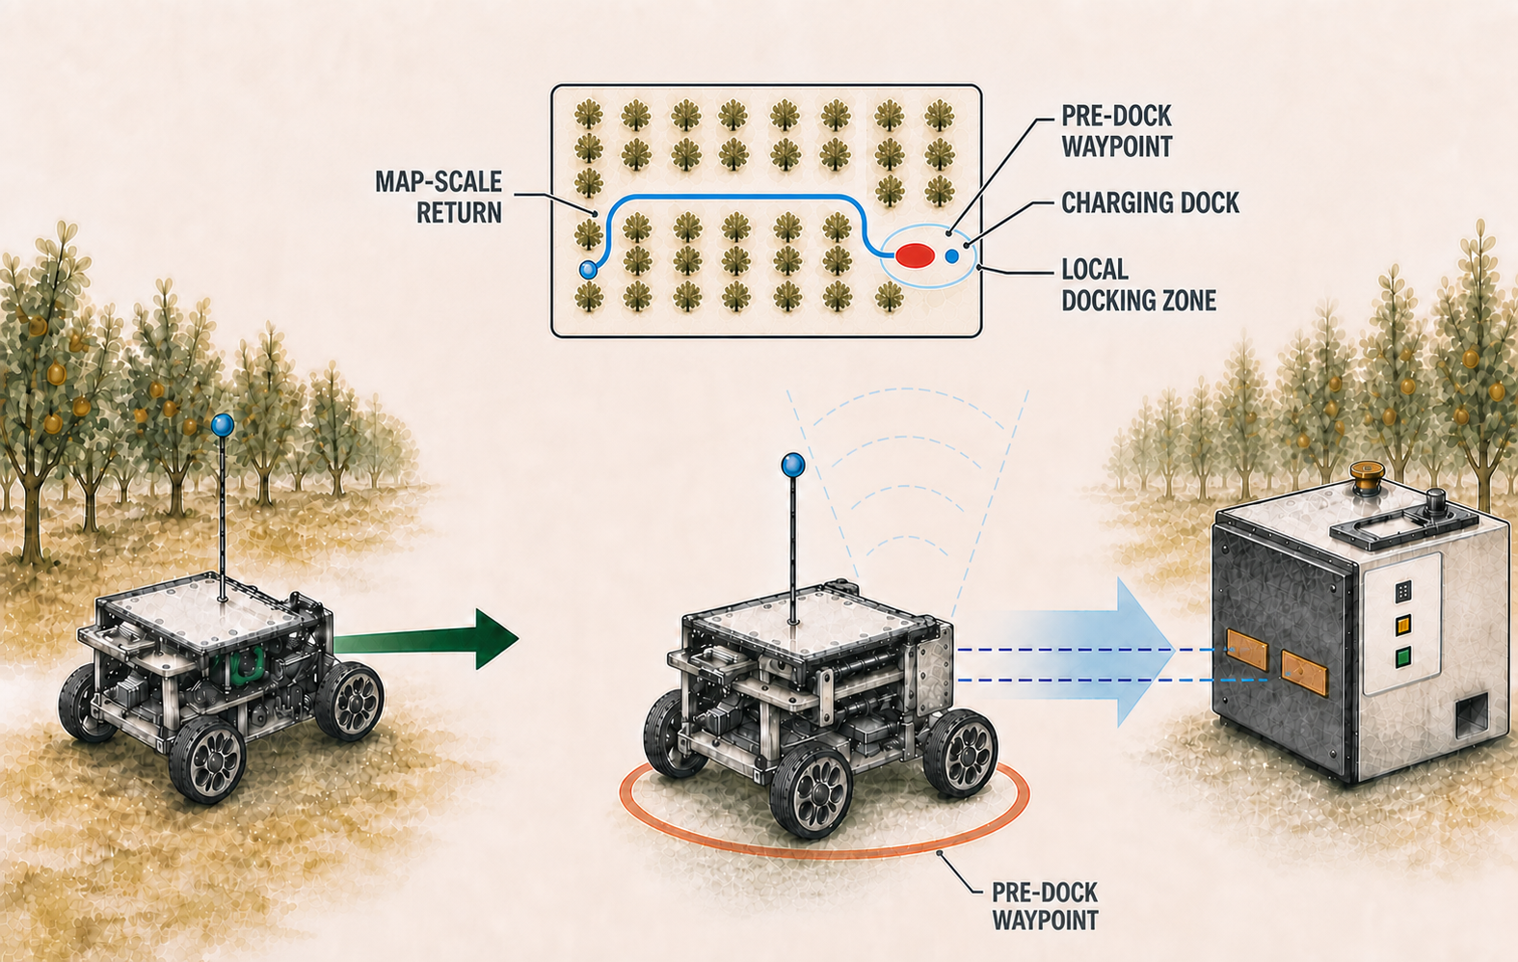
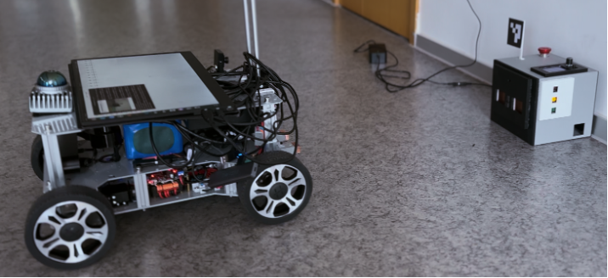
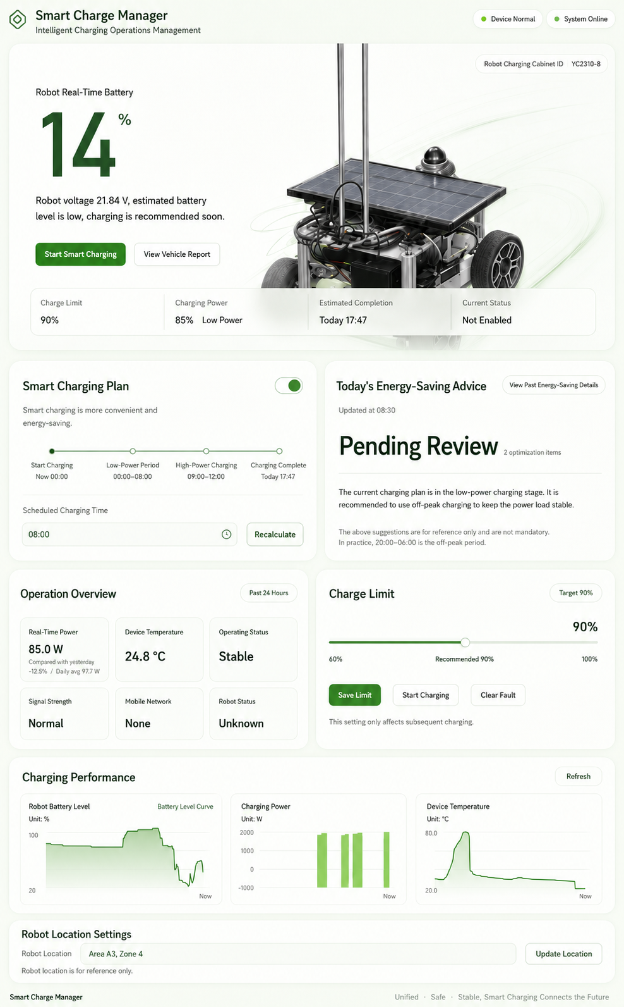
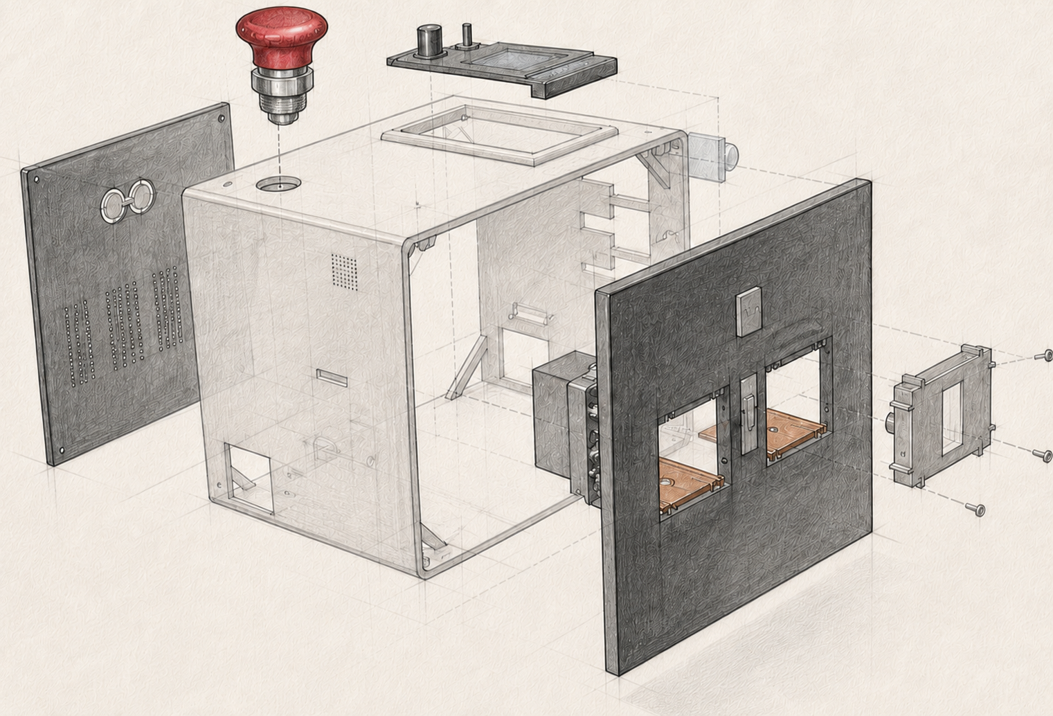

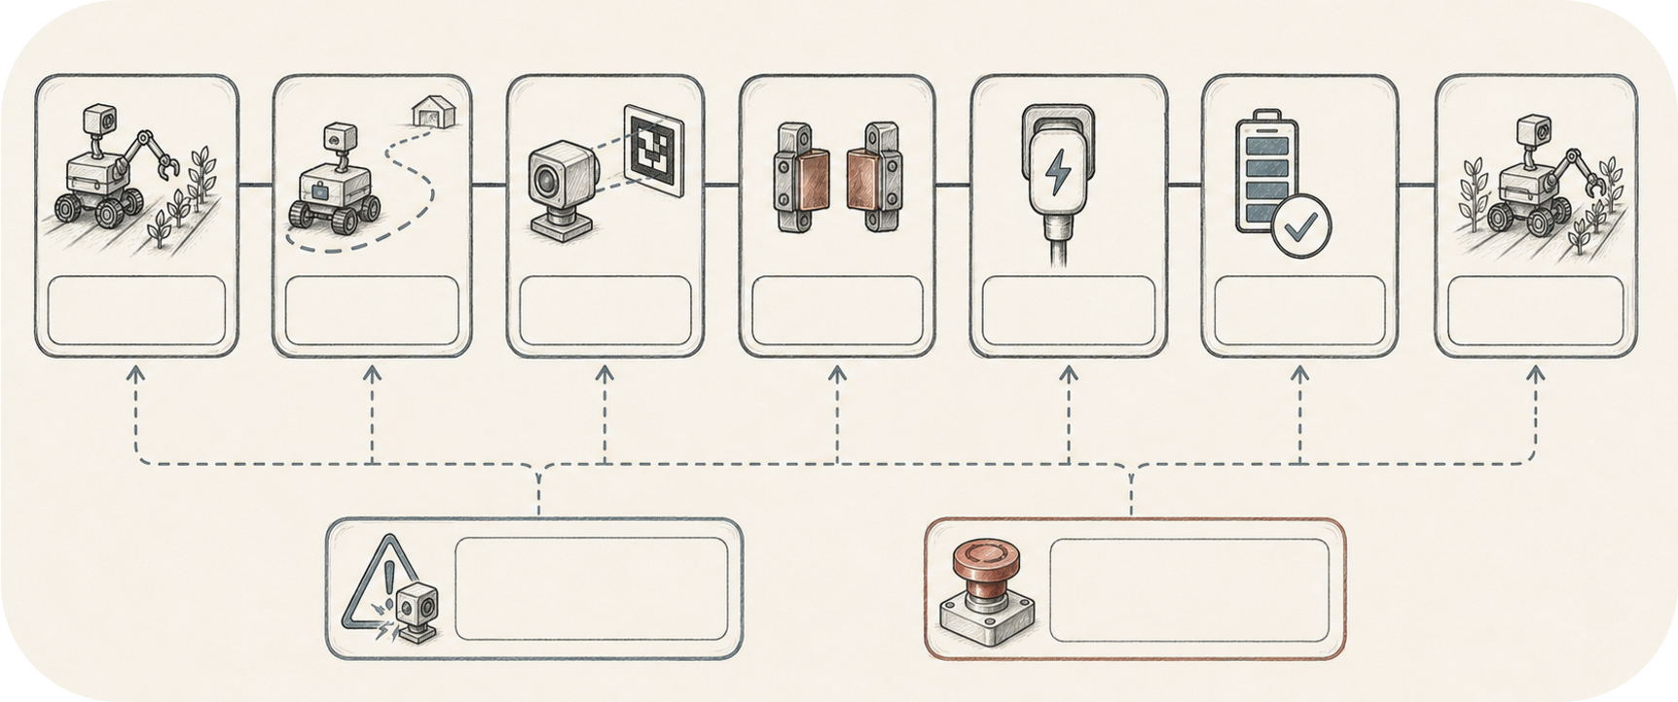
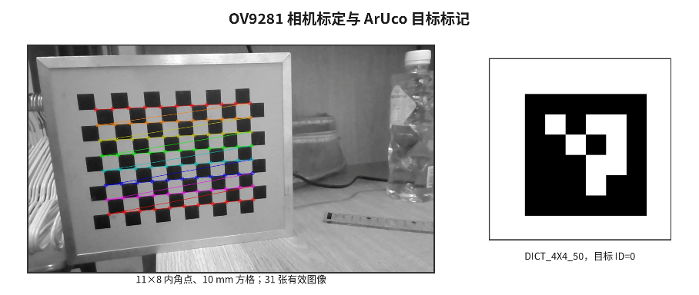
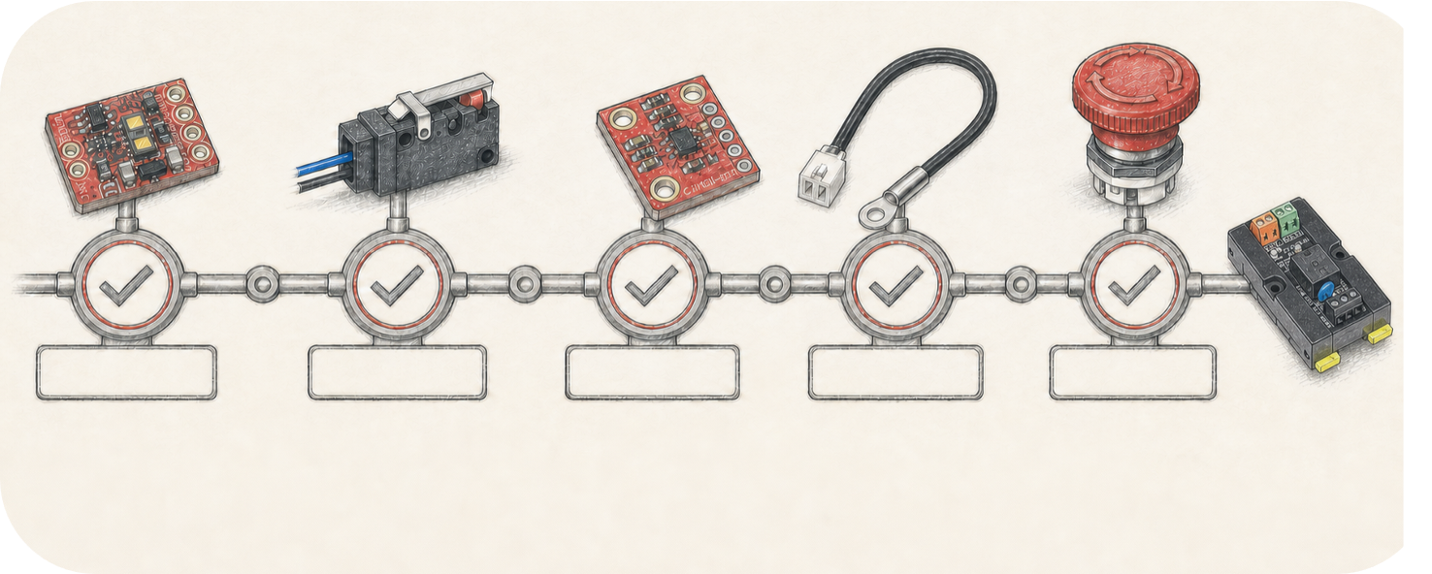
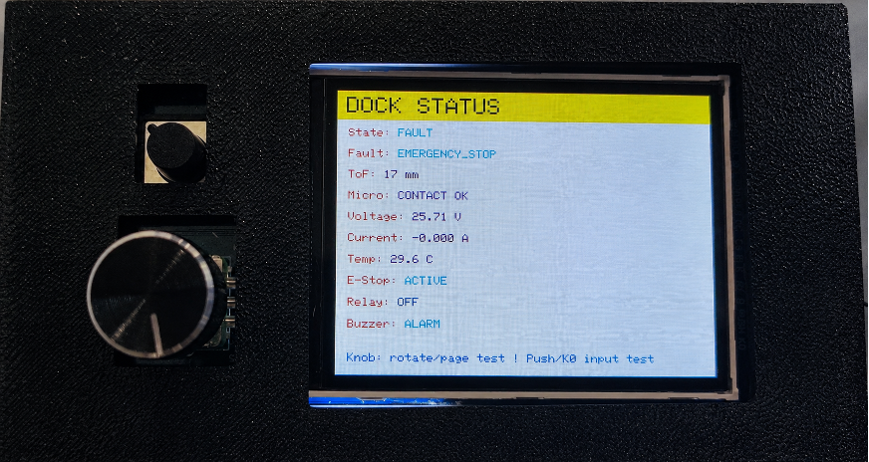
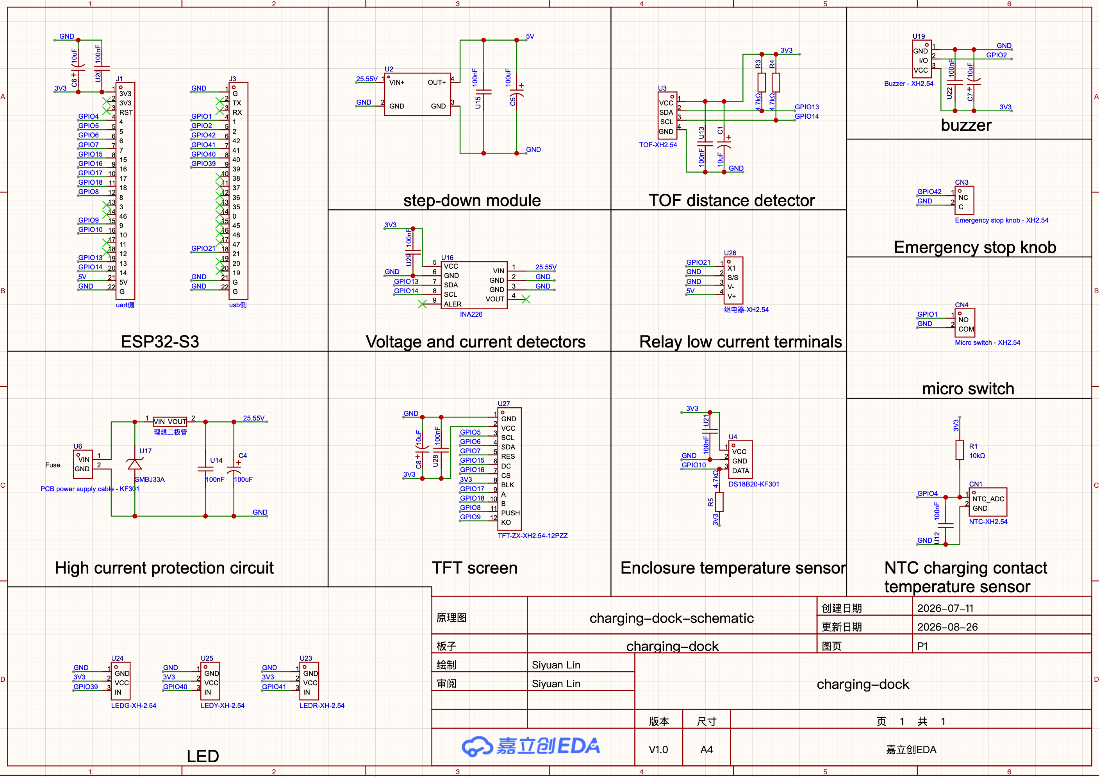
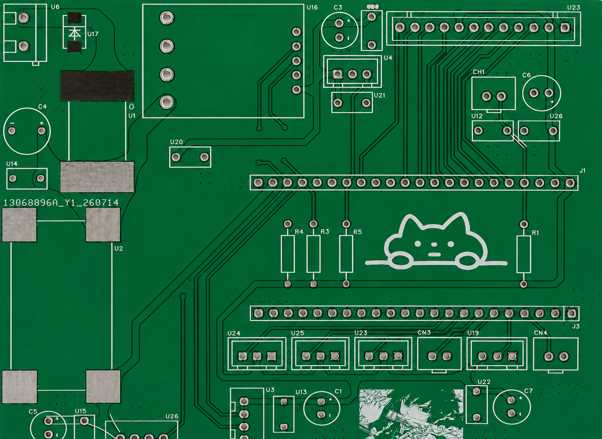
AUTONOMOUS DOCKING
SMART EV Charger
Vision-guided contact alignment and locally fail-safe power control for orchard robots
Members: Siyuan Lin, Xunuo Zhuang, Yuhan Qiu | Xi’an Jiaotong-Liverpool University
SURF Code:0639 Supervisor: Xiaohui Zhu and Yong Yue
ABSTRACT
Autonomous orchard robots cannot operate continuously if navigation, docking and charging are treated as separate demonstrations. We present an integrated ROS 2 system that interrupts field work at low battery, uses Nav2 to reach a pre-docking pose, and transfers final control to a rear camera detecting an ArUco marker. On the dock, FreeRTOS keeps Wi-Fi telemetry in a separate task while a local safety state machine verifies distance, contact, voltage/current, temperature and E-stop status before the ESP32-S3 energises the relay. Web services record state and support charge planning, while local firmware retains final safety authority. The prototype closes the loop from task execution to safe charging and recovery.
01
BACKGROUND & MOTIVATION
02
SYSTEM ARCHITECTURE
03
PROTOTYPE & EVIDENCE
Autonomous harvesting requires repeated routes and unattended energy recovery. Map-level navigation can return a vehicle near a charger, but it cannot guarantee centimetre-scale alignment of conductive contacts. A remote charging request is also not proof that the robot is physically docked or electrically safe.
RESEARCH GAP
Existing prototypes often demonstrate navigation, docking or charging in isolation. The missing capability is a verifiable, energy-aware loop that arbitrates task interruption, fine alignment, safe power delivery and recovery.
DESIGN OBJECTIVES
Physical Ackermann robot and fixed charging station in the indoor test area
1 Integrate mission, energy, docking and charging.
2 Separate coarse navigation from fine vision control.
3 Require multiple independent local safety checks.
4 Preserve Web planning without cloud authority over power.
PHYSICAL IMPLEMENTATION
The prototype combines a rear camera, conductive contacts and an energy-aware mission manager with a fixed ESP32-S3 dock. The charging station exposes local state, fault, distance, contact, electrical and thermal information for traceable testing.
REMOTE MONITORING — ADVISORY ONLY
System overview: mobile robot, visual landmark, fixed charging station and service layer
MECHANICAL INTERFACE
The dashboard displays SOC, power, contact temperature and system state. FastAPI and SQLite provide records and planning support; no Web or AI command can directly energise the relay. It can also display charging data in charts and obtain local electricity prices based on the real-time IP location to provide the most cost-effective charging recommendations.
CONTROL STACK
Elastic copper plates compensate small docking errors. An insulated centre trigger pin confirms position without carrying current, so electrical contact and mechanical detection can be adjusted independently.
VEHICLE CONTROL
ROS 2 + Nav2 → mission execution + low-battery return
VISION DOCKING
OV9281 + ArUco/PnP → near-field x / z / yaw correction
LOCAL SAFETY
ESP32-S3 + FreeRTOS → interlocks + relay authority
SERVICE LAYER
FastAPI + SQLite + Web → monitoring + charge planning
Serviceable enclosure and elastic-contact assembly
Web dashboard supplied by the project team
LOCAL AUTHORITY Network services may request; FreeRTOS alone proves safety and energises the relay.
PRIMARY QUESTION
How can a robot recover energy autonomously without allowing navigation error, network logic or a single sensor to energise an unsafe contact?
04
METHODOLOGY — FROM FIELD TASK TO SAFE RECHARGE
FIELD TASK
LOW BATTERY
RETURN
PRE-DOCK
ARUCO ALIGN
LOCAL SAFETY
CHARGE
LOG / RESUME
A battery percentage below 25% must persist for five samples before AutoChargeManager cancels active navigation goals and locks out ordinary waypoints. Nav2 sends the robot to a measured pre-docking pose; /start_docking transfers velocity authority to vision. Charging completion releases the return lock and restores the task chain. A 0.35 recovery threshold provides hysteresis against mode oscillation.
05
PRECISION ARUCO DOCKING
06
VISION CONTROLLER
OV9281 CAMERA CALIBRATION & ArUco TARGET
The rear camera detects DICT_4X4_50 marker ID 0; the black coding region is configured as 0.068 m. Calibrated intrinsics and distortion feed SOLVEPNP_IPPE_SQUARE,, while angular correction is rate-limited. with iterative PnP as fallback. Lateral offset x, range z and marker-normal yaw are low-pass filtered with hysteresis
NORMAL
TASK
LOW-BATTERY
RETURN
VISION-GUIDED
DOCKING
CONTACT &
SAFETY CHECK
RELAY-ENABLED
CHARGING
CHARGING
COMPLETE
RESUME
MISSION
11 × 8 INNER CORNERS · 10 mm SQUARES · 31 VALID IMAGES
DICT_4X4_50 · TARGET ID 0
CONTROL PARAMETERS
CUSTOM OV9281 CALIBRATION PIPELINE
Misaligned reverse speed −0.018 m/s
Centred reverse speed −0.03 m/s
Visual stop distance z ≤ 0.16 m
Bearing deadband 1.2°
Stop override /robot_charging_flag = true
FAULT
EMERGENCY STOP
We developed a dedicated OpenCV calibration program to improve
repeatability through automated corner detection, invalid-frame
rejection and reprojection-error evaluation.
Dataset 31 multi-pose images · 1280 × 720
Target 11 × 8 inner corners · 10 mm squares
RMS 0.1313 · mean reprojection error 0.014
Sensor failure
Overtemp / overcurrent
Interrupts any state
Priority power cut-off
07
FREERTOS FAIL-SAFE CONTROL
08
CIRCUIT SCHEMATIC
09
PCB LAYOUT & ROUTING
ToF RANGE
MICRO-SW.
V / I
NTC TEMP.
E-STOP
E-stop test: relay OFF and buzzer ALARM
Five independent local checks
FreeRTOS separates non-blocking network I/O from the safety-critical control path. A dedicated task uploads telemetry every 5 s and polls commands every 1.5 s with a 500 ms HTTP timeout; the local state machine continuously checks ToF, micro-switch, INA226, NTC and the normally closed E-stop. Only 600 ms of stable valid conditions permits relay ON.
STOP is latched and highest priority · relay defaults OFF · CLEAR_FAULT only after physical recovery · Web / AI cannot bypass interlocks
Control invariant: every state transition re-checks local sensors. Fault, sensor-offline, over-temperature or E-stop forces immediate relay OFF; Wi-Fi or backend loss never blocks local safety detection.
ESP32-S3, sensing, relay, display and protection interfaces
Board-level routing with separated high-current and signal paths
10
VALIDATION
11
KEY CONTRIBUTIONS
12
CONCLUSION & NEXT STEPS
• Calibration: 31 valid images; RMS 0.1313; mean reprojection error 0.014.
• Integration: one state chain links waypoint work, low-battery return, /start_docking, contact, charging and task recovery.
• Fail-safe evidence: the local display records EMERGENCY_STOP with Relay OFF and Buzzer ALARM.
• Acceptance events are separately logged at pre-dock arrival, visual stop, stable contact, relay-on and detected charging.
1 A full-cycle, energy-aware mission rather than an isolated charger demo.
2 Scale-separated control: Nav2 for coarse return; ArUco/PnP for contact alignment.
3 FreeRTOS task separation and multi-source local safety; remote services cannot bypass interlocks.
4 Traceable implementation across mechanism, sensing, firmware, circuit, PCB and Web records.
Nav2 brings the robot close; ArUco aligns the contacts; the ESP32-S3 FreeRTOS safety state machine alone authorises charging power. Current validation is indoor. Future work will quantify success rate and docking time over wider initial offsets and lighting, add outdoor dust/water protection, dual NTC and contact-resistance trends, and authenticated command auditing.
REFERENCES [1] Project technical report, 2026. [2] ROS 2 Nav2 technical documentation. [3] OpenCV ArUco, camera calibration and PnP documentation.
ACKNOWLEDGEMENT Xi’an Jiaotong-Liverpool University SURF programme and project supervisors.
Notes:
[Sources]
- SURF_poster2_FreeRTOS.pptx: original poster layout and verified technical content.
- Project-supplied vehicle and charging-dock illustrations from SURF_poster2_FreeRTOS.pptx, used as visual references for the approved architecture schematic.
[/Sources]

