Slide 1
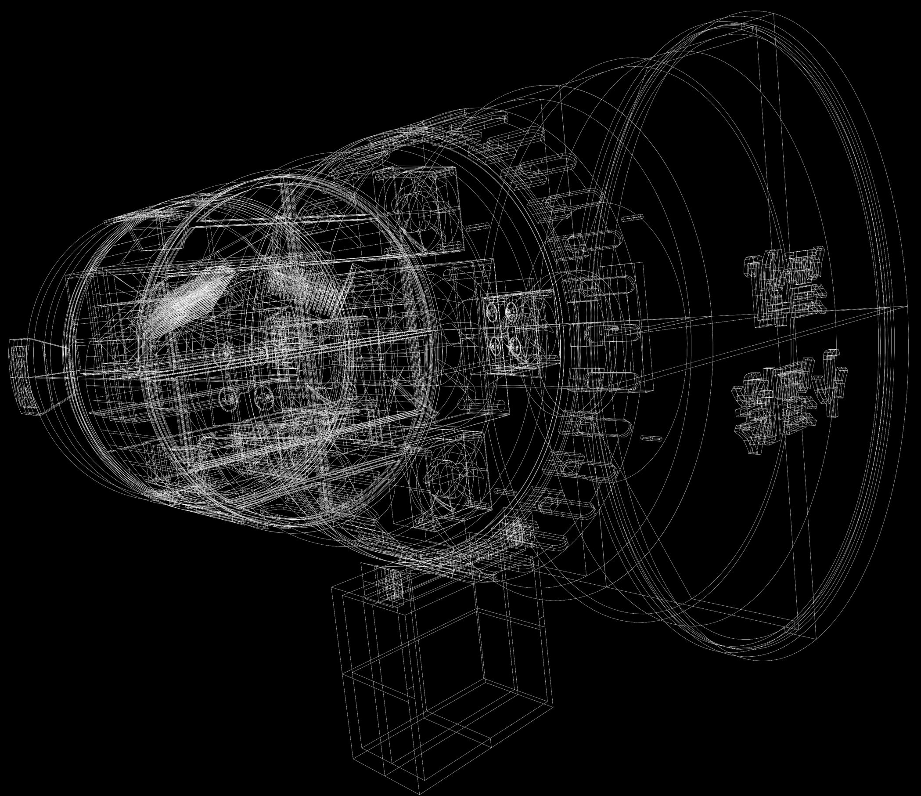
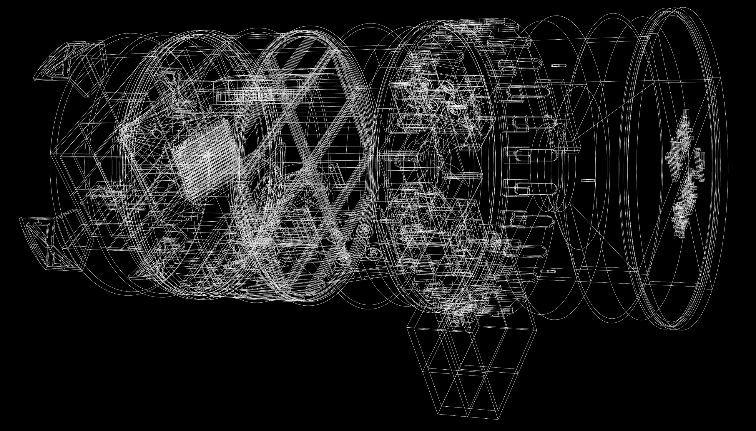
XIAOSHI
An Intelligent Household Dehumidification and Auxiliary PURIFICATION SYSTEM
Embedded Control
Connected Dashboard
Modular Hardware
Notes:
Good afternoon. Our project is Xiaoshi, an intelligent household dehumidification and air purification system. It’s designed for small rooms, such as wardrobes, bookcases, and instrument storerooms. 15s +1s 00:00-00:15

Slide 2
Background & Requirements
High humidity problems
High humidity can cause discomfort, mold growth, and damage to stored items such as clothes, books, wooden products and musical instruments.
Target Users
Users who need dry, clean storage for valuable items and prefer convenient monitoring and control of enclosed spaces.
User Need | Design Requirement
Reduce humidity | Dehumidification function
Monitor environmental status | Environmental data display
Improve air quality | Improve air quality
Easy operation | Easy operation
Fit small spaces | Fit small spaces
Notes:
We mainly focus on high humidity, which can cause many problems in daily life. Therefore, our target users are people who need dry and clean storage for valuable items and want simple monitoring and control. So our design includes dehumidification, environmental data display, air purification, easy operation, and a compact size. 23s +2s 00:15-00:38

Slide 3
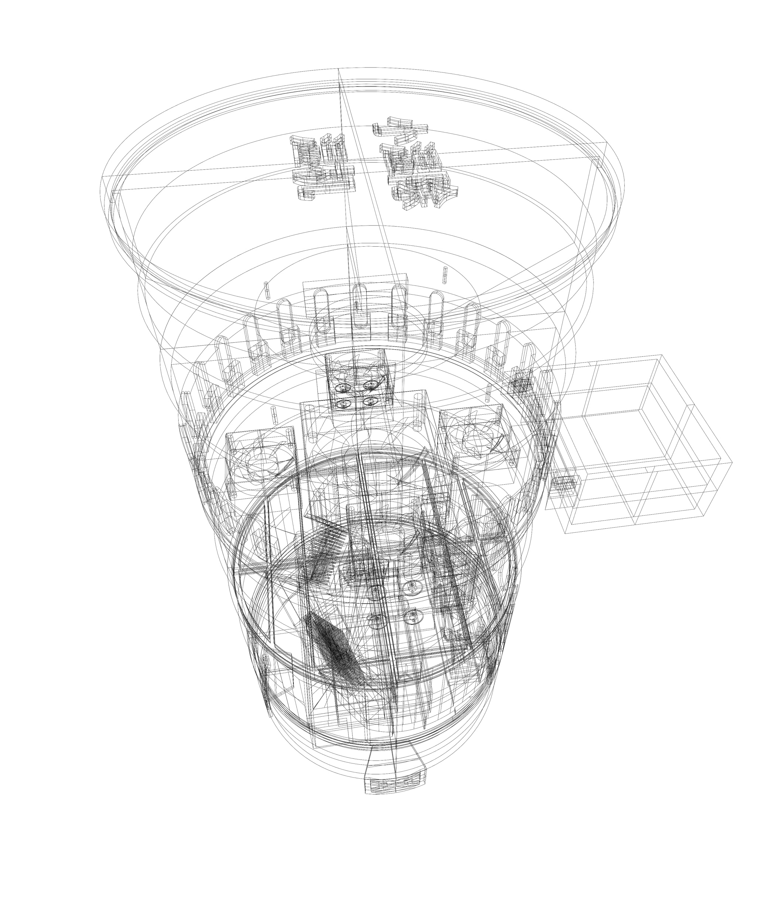
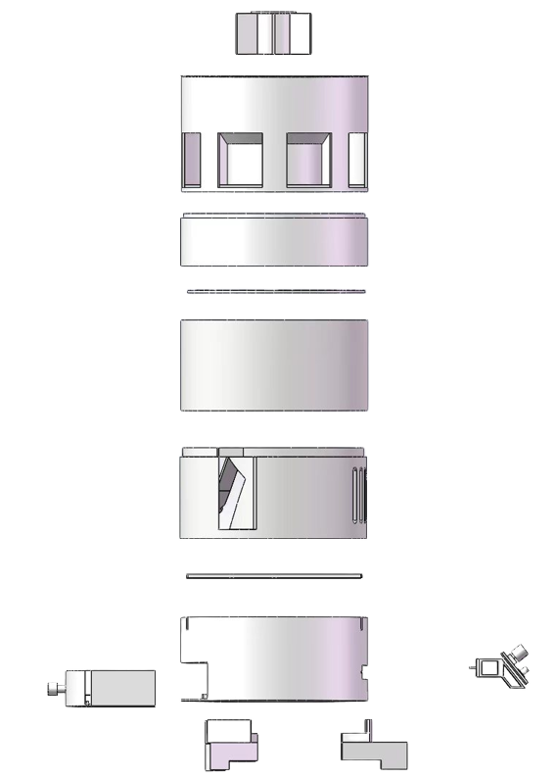
System Architecture & Design Features
Feeding area
Chemical dehumidification layer
Hardware Design Features
Fan Layer
Compact Layered Structure
For small enclosed storage spaces.
Dual Dehumidification
Silica-gel adsorption and TEC condensation.
Auxiliary UV Layer
UV/TiO₂ design; efficacy not measured.
Water and Thermal Checks
Water cutoff and temperature-limited PWM.
UV catalytic Layer
TEC Condensation Layer
Control Layer
TFT Screen With knob control
Notes:
The system has a layered structure with a silica gel dehumidification layer, a fan layer, a UV layer, a TEC condensation layer, and a control layer. This combination of physical and chemical damp absorption improves the drying effect. It also features a UV–Titanium Dioxide layer to catalyze formaldehyde into water. For safety, it can detect the full water level and TEC overheating. 28s +2s 00:38-01:07

Slide 4
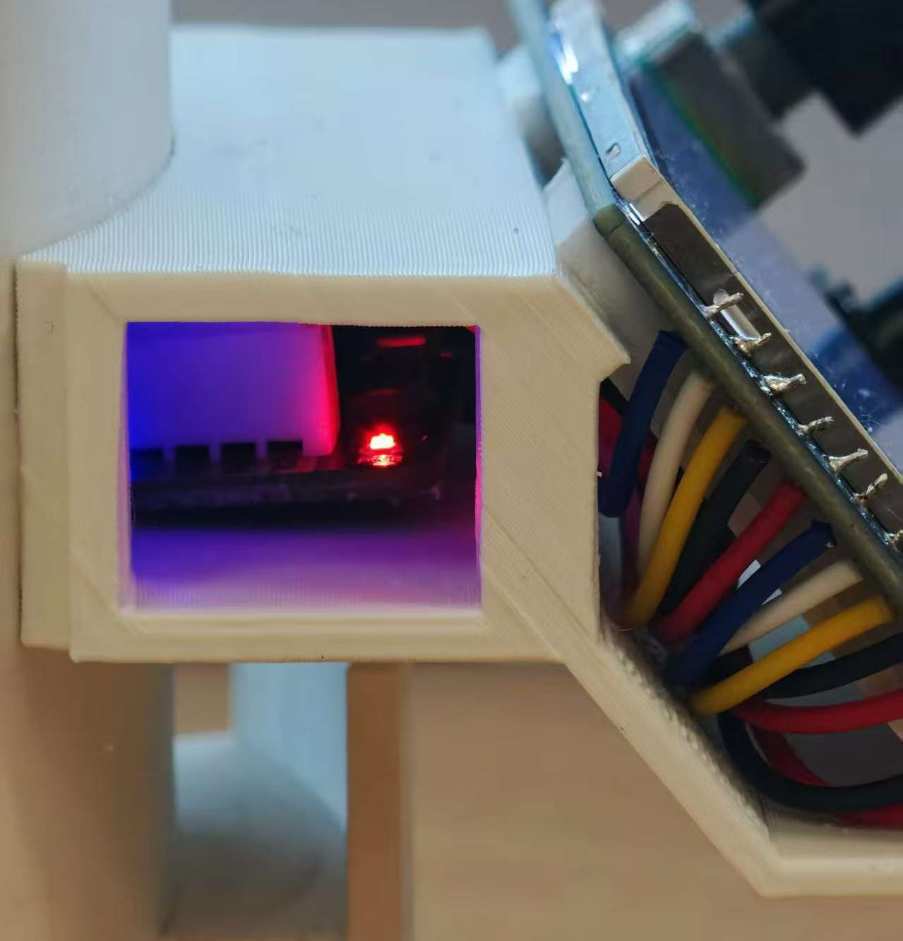
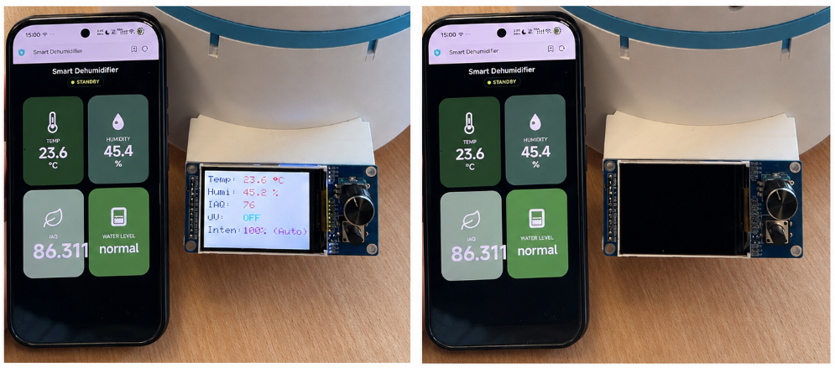

System Architecture & Design Features
User Interaction Design Features
Voice Recognition
Voice command interface.
Module configuration needs verification.
Web-Based Control
Browser status and controls.
Standby and running views.
TFT Display & Local Control
Displays device status and supports knob control.
Notes:
We designed three methods for user interaction. First, the voice recognition module supports hands-free control for common operations. Second, the ESP board provides web-based control and data display from a phone. Third, the screen and knob allow local operation and real-time status display. Here’s our video 26s+2s 01:07-01:35

Slide 5
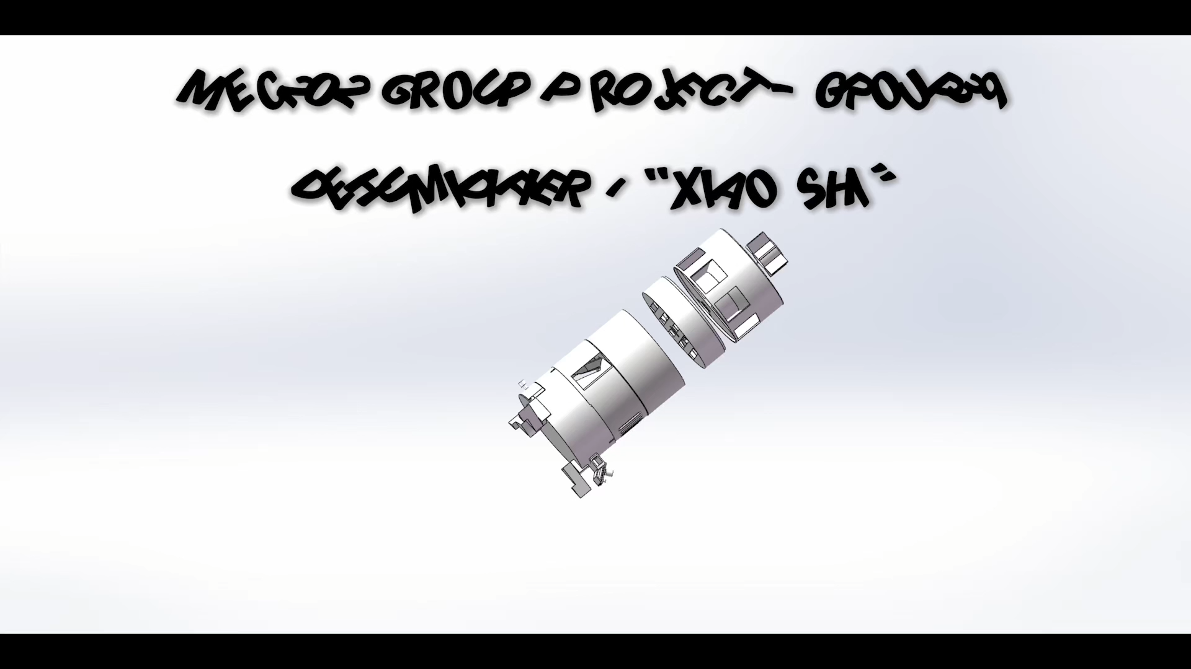
Testing Demo

Slide 6
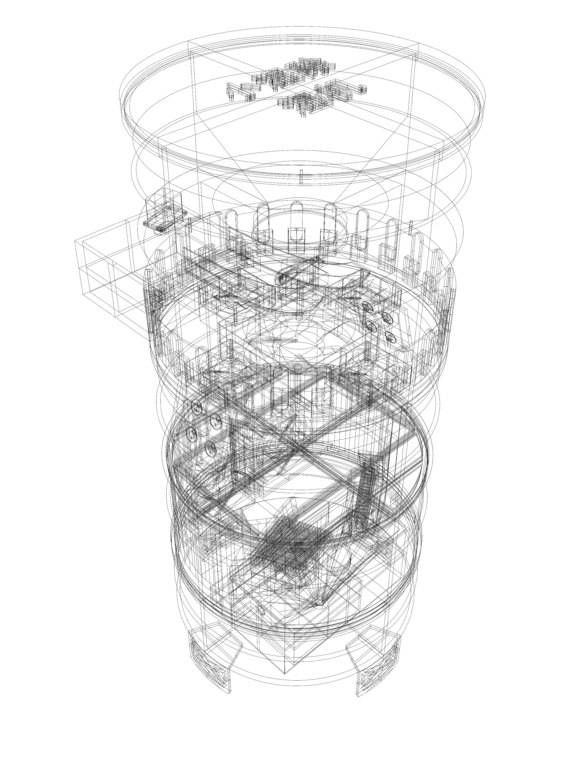
Feedback and Next Steps
Users Feedback
Control: ease of use
Protection: water-level and thermal checks
Dehumidification: enclosed-space use
Future Improvement
Improve voice recognition accuracy
Water–electricity separation
Notes:
Our product improves ease, safety, and availability of dehumidification for small spaces from feedback. In the future, we plan to improve voice recognition accuracy and strengthen water–electricity separation. Thank you. 20s +2s 04:38-05:00

