Slide 1
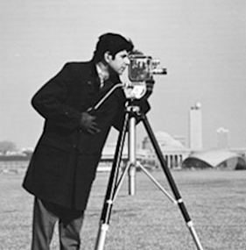
Convolution
Applying filters to your image

Slide 2
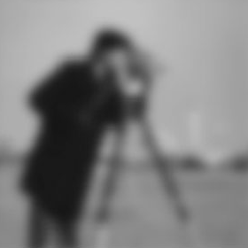
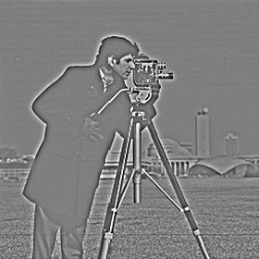
Convolution
Low pass filter
High pass filter
Low frequency info
High frequency info
Background
Colour distribution
General info
Edges
Texture
Detailed info

Slide 3



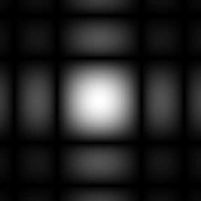
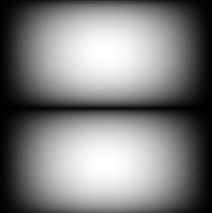



Convolution
$$Original Image$$
$$\frac{1}{9}\left(\begin{matrix}\begin{matrix}1 & 1 \\ 1 & 1\end{matrix} & \begin{matrix}1 \\ 1\end{matrix} \\ \begin{matrix}1 & 1\end{matrix} & 1\end{matrix}\right)$$
$$\frac{1}{4}\left(\begin{matrix}\begin{matrix}−1 & −2 \\ 0 & 0\end{matrix} & \begin{matrix}−1 \\ 0\end{matrix} \\ \begin{matrix}1 & 2\end{matrix} & 1\end{matrix}\right)$$

Slide 4
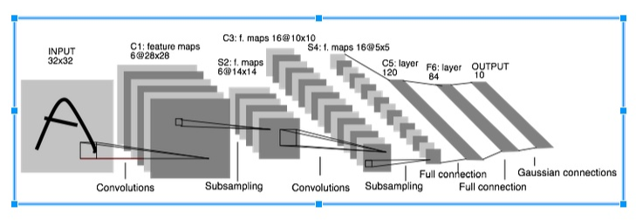
Convolution
Network structure
visualization:
3D: http://scs.ryerson.ca/~aharley/vis/conv/
2D: http://scs.ryerson.ca/~aharley/vis/conv/flat.html

Slide 5

Convolution
CNN (Convolution Neural Network)
Model building:

