Slide 1
Plan for week 1-2
Python basics
Math library – numpy
CSV file processing
Regression and MLP
OpenCV Python
Introduction to MNIST dataset
Introduction to TensorFlow
Introduction and application of MLP

Slide 2
Plan for week 2 weekend
Learn ROS

Slide 3
Plan for week 3-4
Introduction to Convolution
Introduction to image processing
Introduction to Convolutional Neural Network (CNN)
Application of CNN on MNIST
Application of CNN on Cat-Dog Classification
Application of CNN on Facial Key Points Detection
One step forward to Facial Key points Detection

Slide 4
Plan for week 5 onwards
One more step forward to Facial Key points Detection
Introduction to AI agent for game-playing. (Policy decision, Q learning)
Creating a flappy bird AI
Network optimization and speed up techniques

Slide 5
Python basics
Mostly used variable types
String process
List related operations
Conditional
Loops
Function
Class

Slide 6


Numpy
What is N-D array?
0-d: scalar
(number)
1-d: vector
(series of nums)
2-d: matrix
(row & col)

Slide 7
Numpy
3-d: tensor
(row, col, depth)

Slide 8
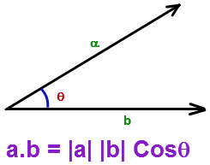
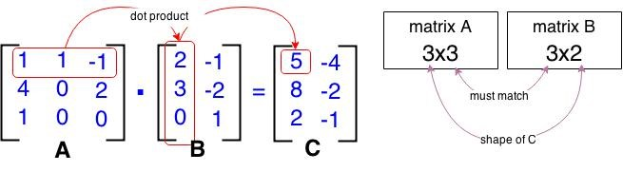
Numpy
Basic operations:
Vector:
Matrix:

Slide 9
Numpy
Other operations:
Transpose
Element-wise multiplication
Plus / minus
Practice:
Rotate (x,y) by certain degrees

Slide 10
CSV File Processing
Use pandas

Slide 11
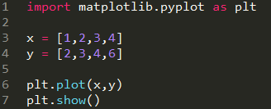
Data Visualization with pyplot

Slide 12
OpenCV Python
https://docs.opencv.org/3.0-beta/doc/py_tutorials/py_tutorials.html

Slide 13
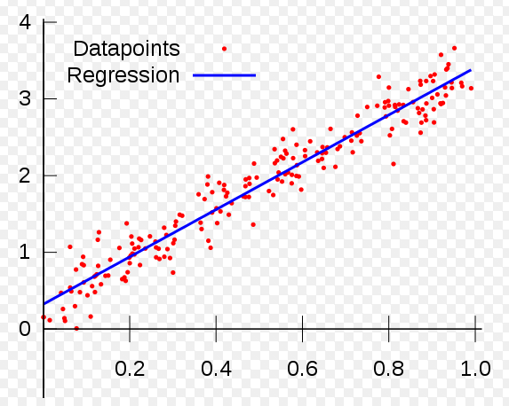
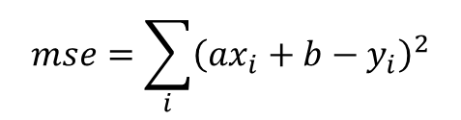
Regression
Linear Regression:
Approximate the dataset by a straight line. (y = ax+b)
The fitness of regression is evaluated by the mean_square_error.
$$mse=\sum_{i}{{\left(ax_{i}+b−y_{i}\right)}^{2}}$$

Slide 14
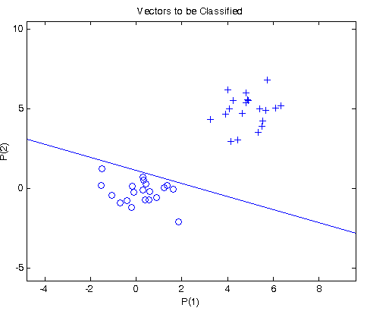
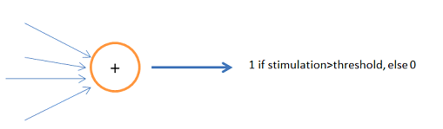
MLP

Slide 15
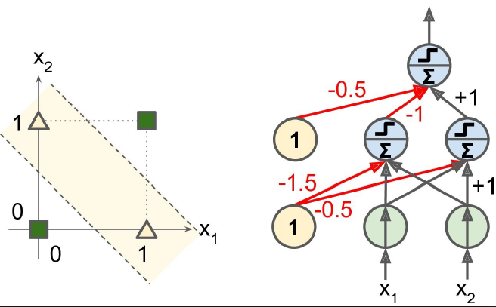
MLP

Slide 16
MLP

